Slide 1
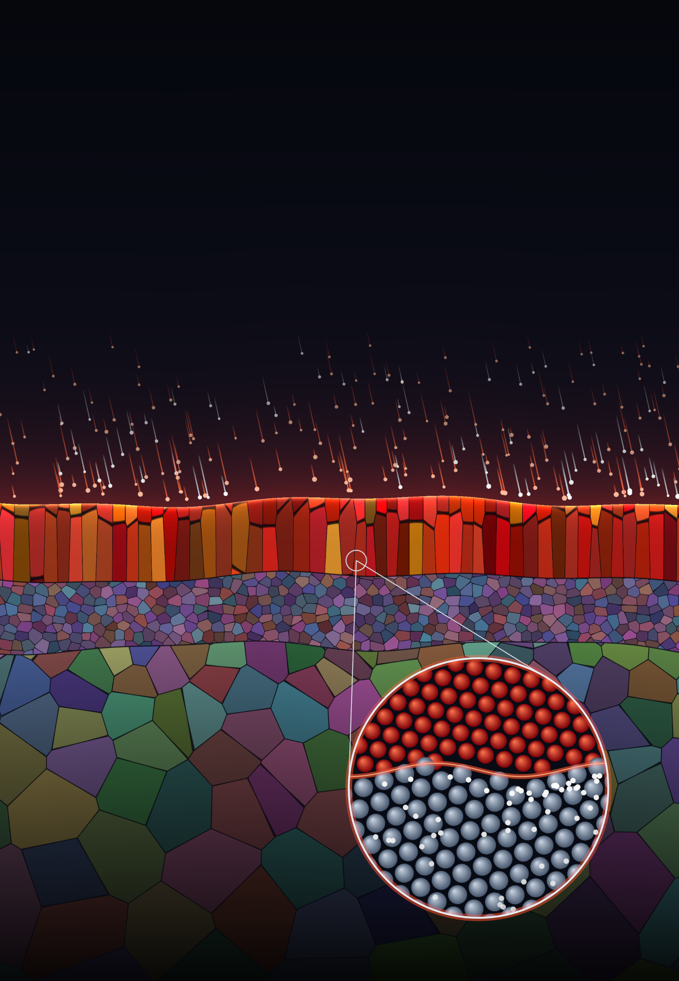

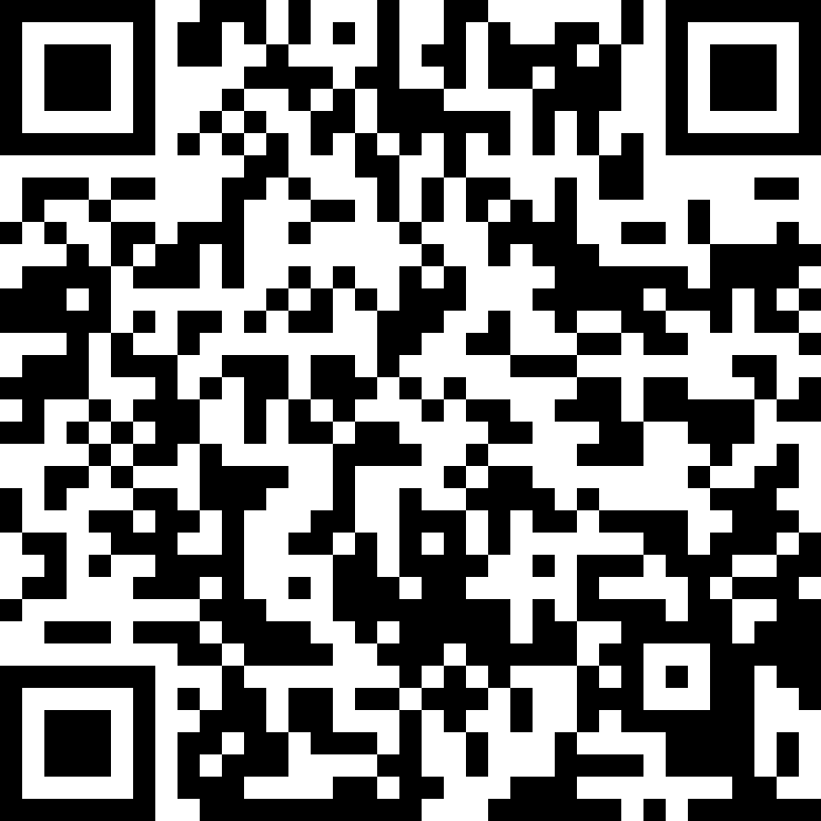
DTU Construct
Section of Materials and Surface Engineering
Find your
thesis project
Bachelor and master projects 2026–2027
21 projects, many with partners in industry and research
Most projects can be done as group work – talk to the supervisors
Not ready yet? Take a project course first – contact Karen Pantleon (kapa@dtu.dk)
Coating
Diffusion zone
Scan to browse
all projects
DTU Construct

