Slide 1
Predicting Socio-Economic Factors influencing Crime Rates in London Boroughs
Created By : Vipin Selvaraj P V
Date : 25th March 2019

Slide 2
Predicting factors influencing crime rates is valuable for London Borough Council and the people.
Borough Councils in London are trying their best efforts to bring the crime rates down
Knowing the influencing factors of crime rates could help Councils set the priorities right.
It could help Councils in the funds allocation
It could help Councils improve existing social programs and introduce new programs which would support the vulnerable community
It could help Councils improve the quality of life in the Borough.

Slide 3
Data Acquisition and Cleansing
The Socio Economic stats and crime data are taken from the following locations.
https://data.london.gov.uk
https://www.trustforlondon.org.uk/data/
https://www.ons.gov.uk
https://www.met.police.uk
https://www.gmblondon.org.uk
https://en.wikipedia.org
Coordinates data is taken from
https://foursquare.com
Please note that the data is cleansed for quality improvement as well as to convert them into percentages wherever possible.

Slide 4
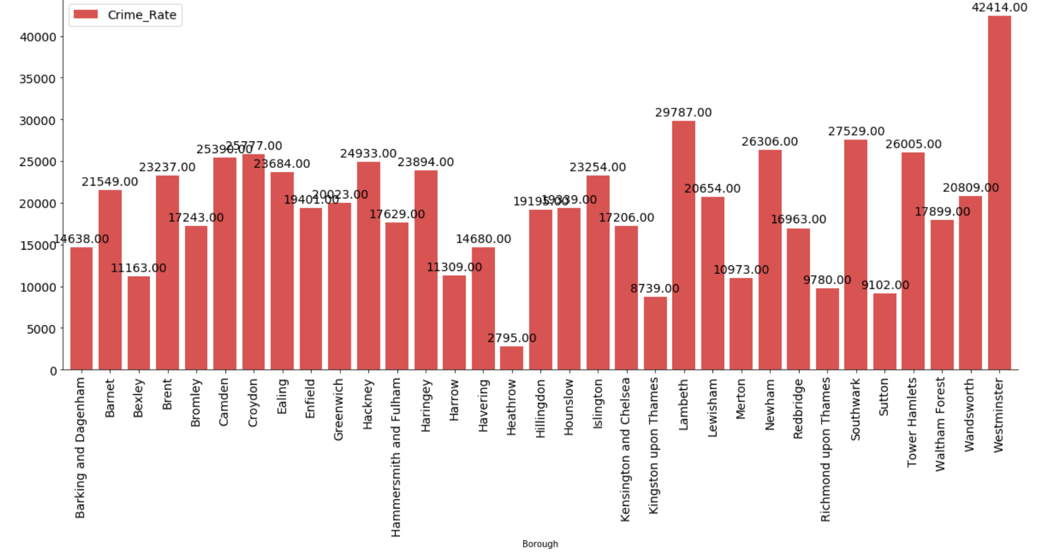
Crime Rates in London Boroughs

Slide 5
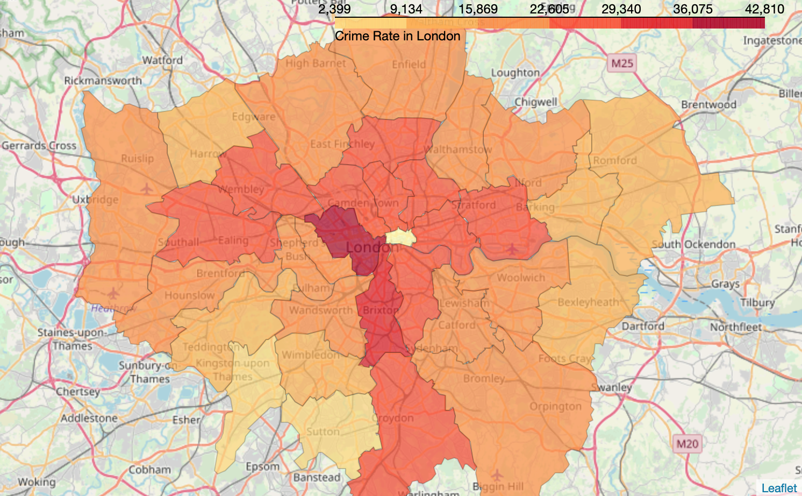
Heat map of Crime Rates in London Boroughs

Slide 6
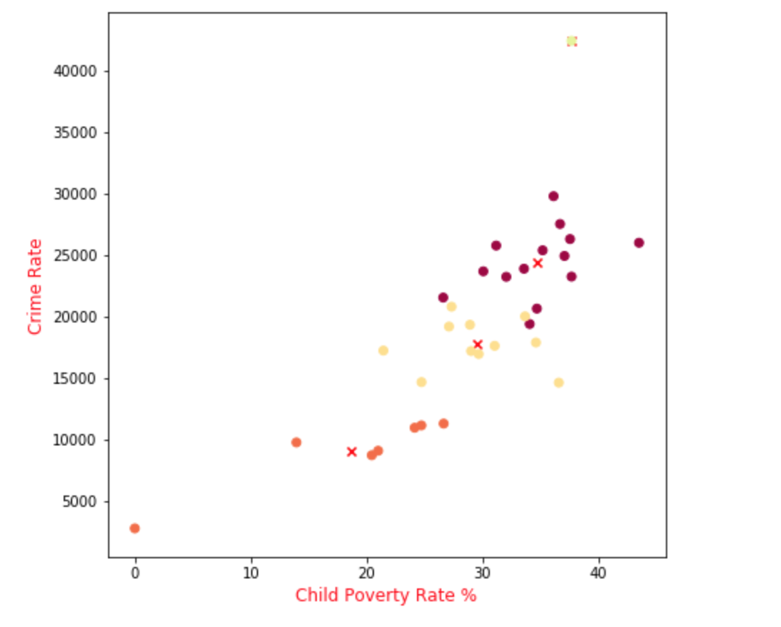
Impact of Child Poverty Percentage on Crime Rate
It is evident from the scatter plot that as Child Poverty Percentage increases Crime Rate also goes up sharply.

Slide 7
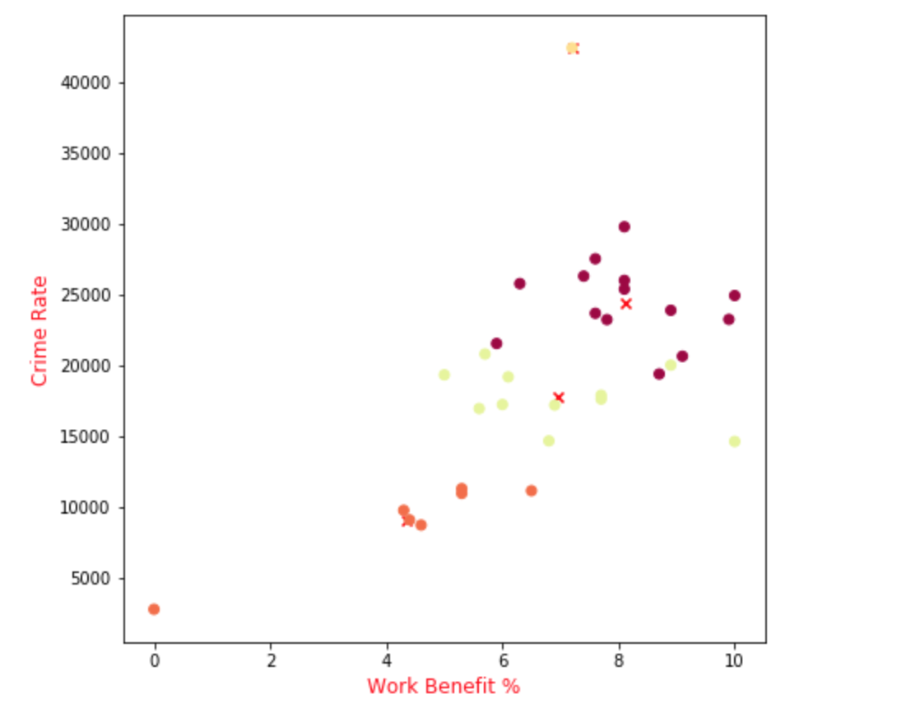
Impact of Work Benefit Percentage on Crime Rate
It is evident from the scatter plot that as Work Benefit Percentage increases Crime Rate as also goes up.

Slide 8
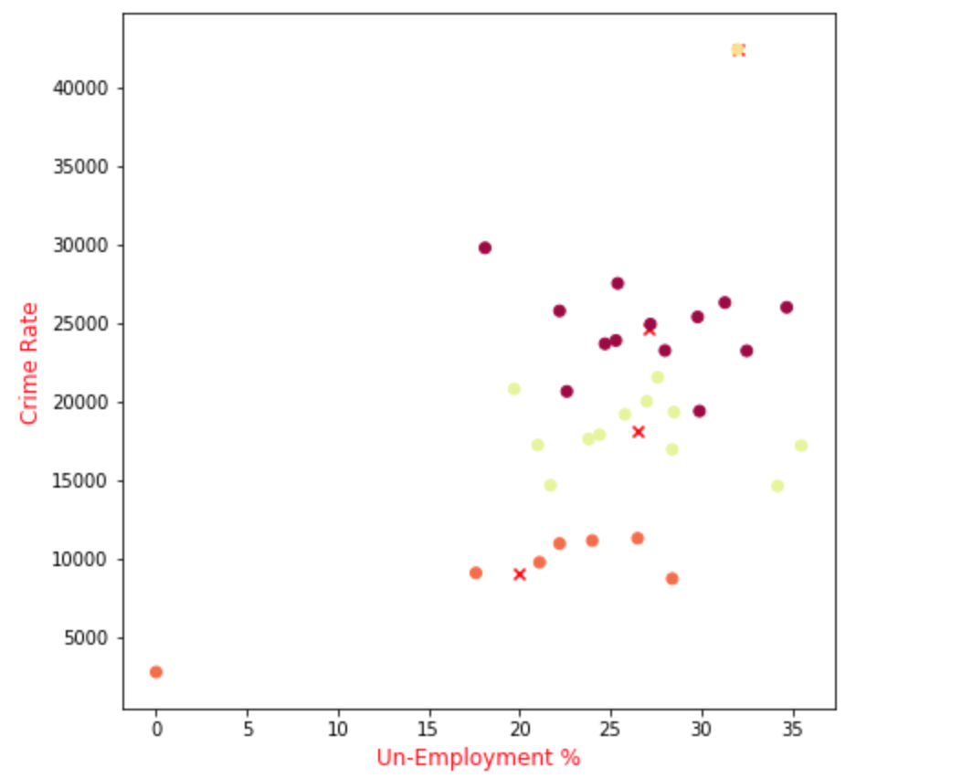
Impact of Un-employment Percentage on Crime Rate
The scatter plot shows a minimal positive increase of Crime Rate with Un-employment percentage

Slide 9
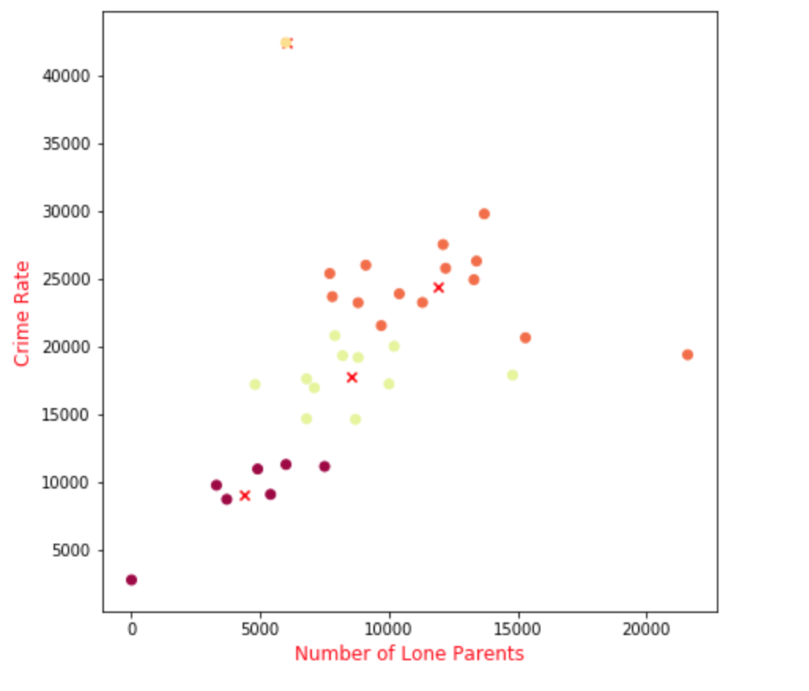
Impact of Number of Lone Parents on Crime Rate
It is evident from the scatter plot that as number of lone parents increase, there is a sharp increase in crime rates.

Slide 10
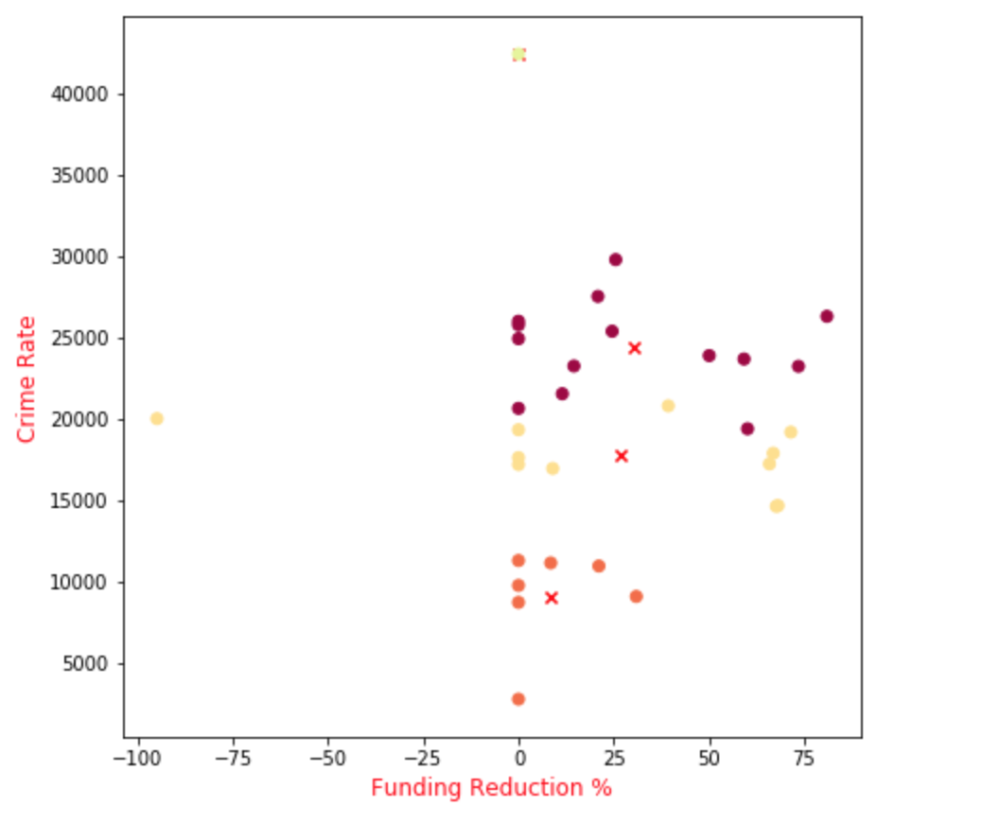
Impact of Reduction in Funds for Youth Programs on Crime Rate
The scatter plot shows that the fund reduction for the Youth Programs has very limited impact on Crime Rates.

Slide 11
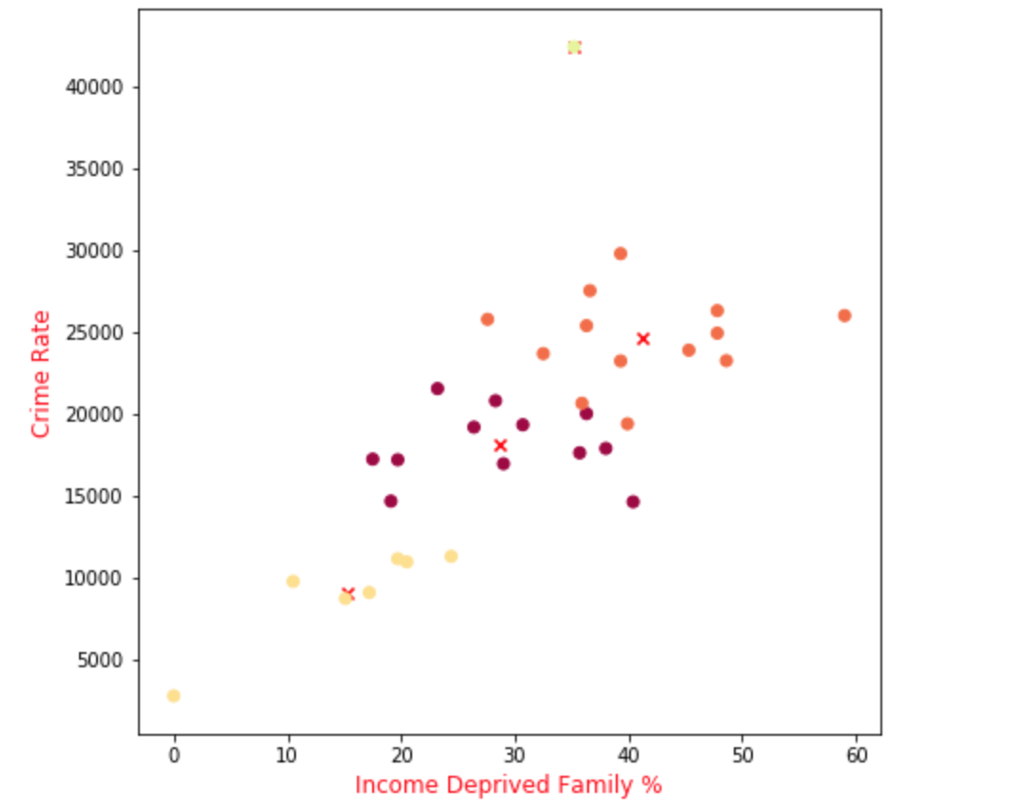
Impact of Income Deprived Family Percentage on Crime Rate
The scatter plot shows that the Percentage of the Income Deprived Families directly impacts the Crime Rates.

Slide 12
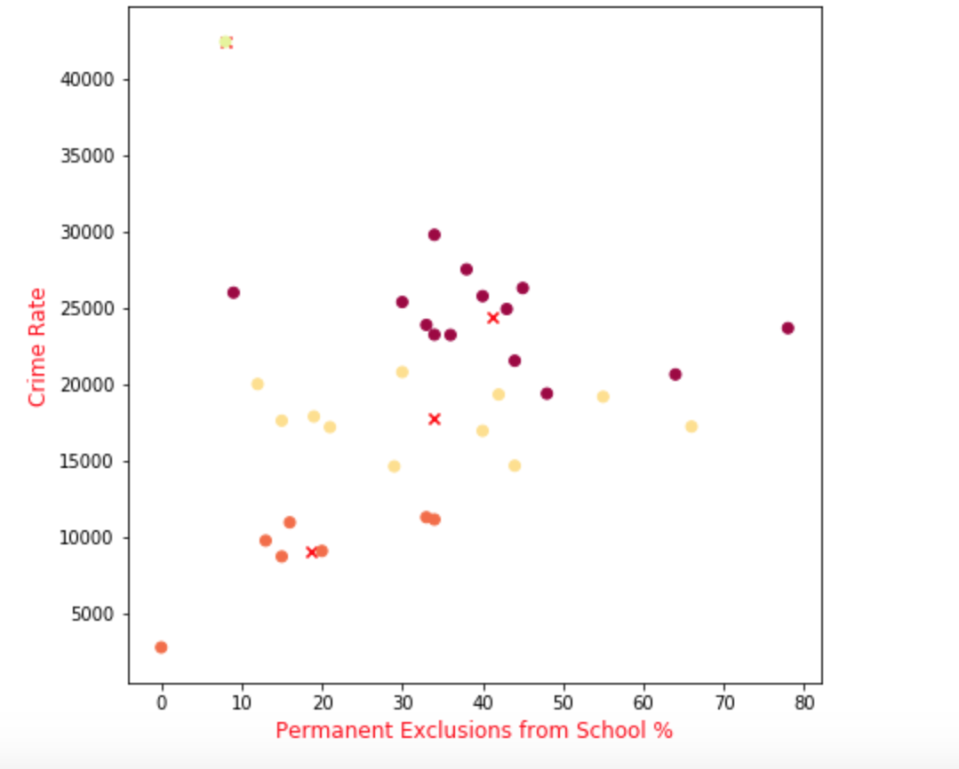
Impact of Permanent Exclusions from School on Crime Rate
The scatter plot shows varied relationship between Percentage exclusions from school and Crime Rate.

Slide 13
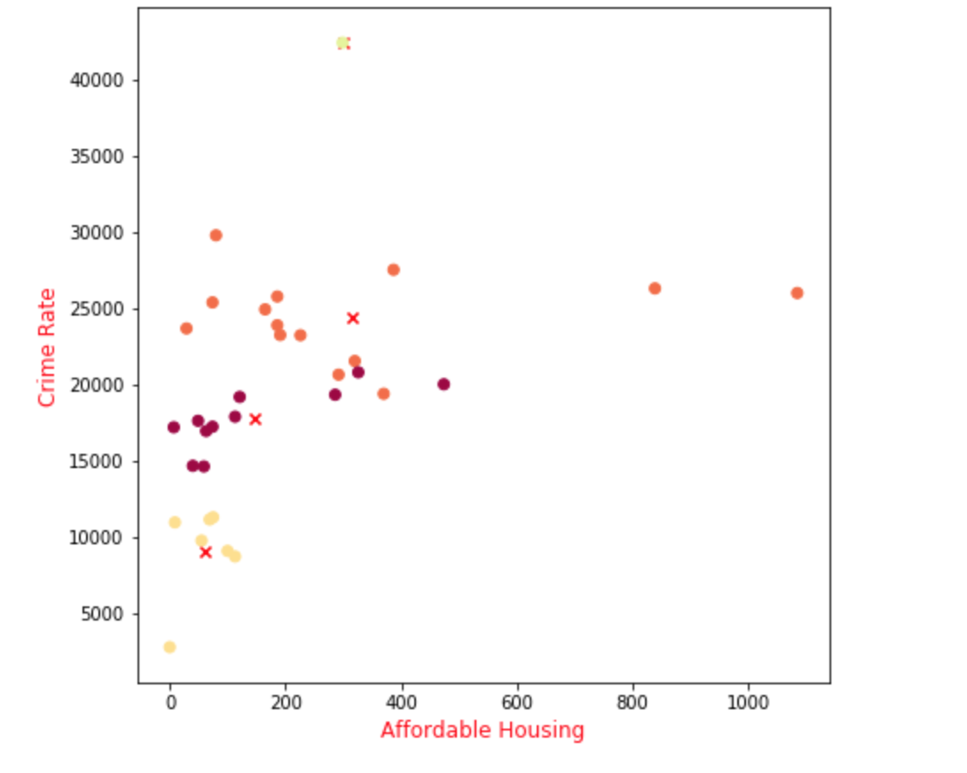
Impact of Affordable Housing on Crime Rate
The scatter plot shows varied relationship between Affordable Housing and Crime Rate.

Slide 14
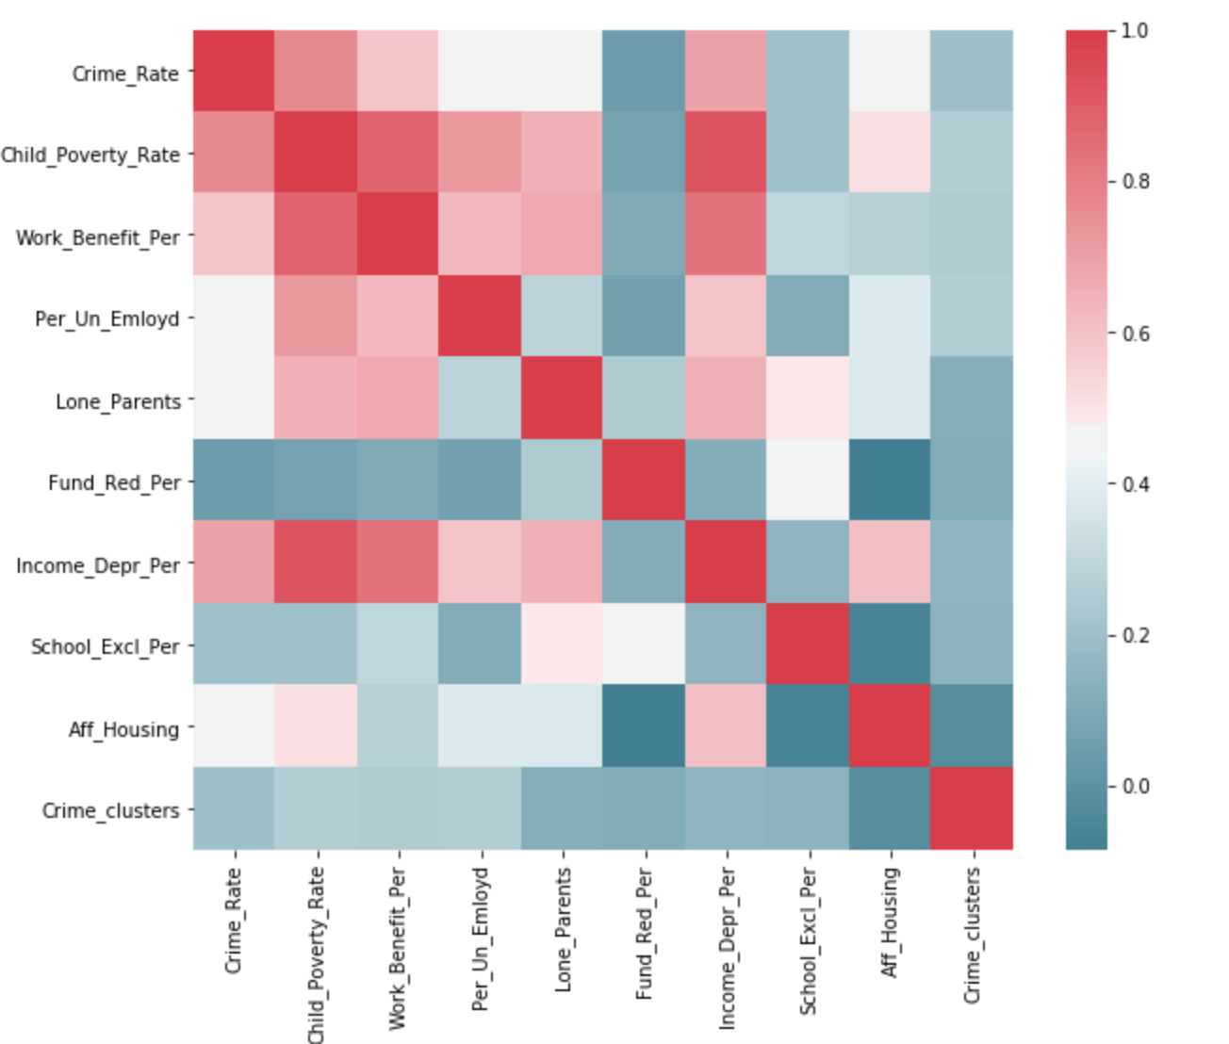
Person Correlation of Socio-Economic Factors on Crime Rate

Slide 15
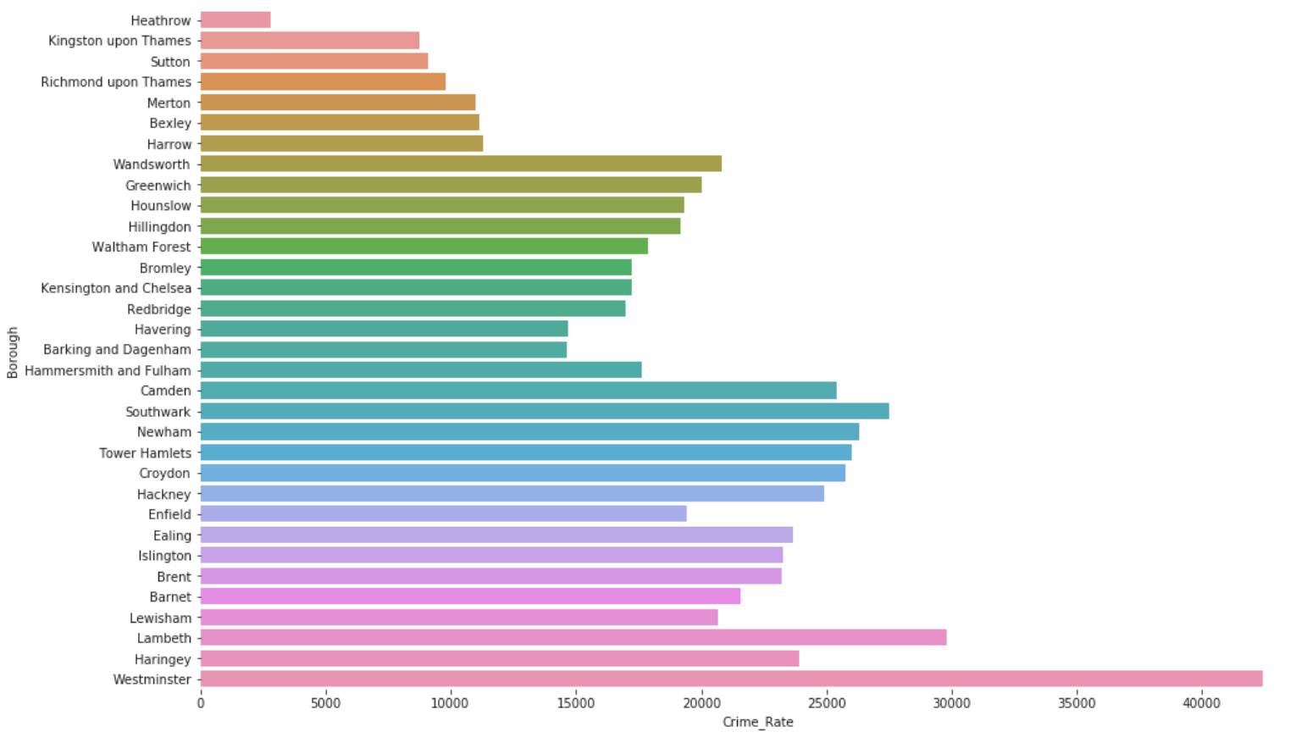
Crime Rate Clusters in London Boroughs

Slide 16
Conclusion on Crime Rate Analysis of London Boroughs
My analysis shows that there are mainly 3 categories of factors which are affecting the crime rates in London Boroughs
Impact Severity | Socio – Economic Factors
High Impact | Child Poverty Percentage Income Deprived Families Percentage Work Benefits Percentage
Medium Impact | Lone Parents Unemployment percentage Un-affordable houses
Low Impact | Youth Progrm. Fund Reduction Percentage Permanent School Exclusions

