Slide 1

PCCOE INTERNATIONAL GRAND CHALLENGE 2026
DISHADHARTI
Urban Climate Intelligence
& Decision Support Platform
AI for Climate Change
Climate Intelligence & Environmental Analytics
A BETTER DIRECTION
FOR A BETTER EARTH
Team Dishadharti
Pune, India
TEAM DISHADHARTI
1
Notes:
Event source: https://www.pccoeigc.com/
Official theme and domain source: https://www.pccoeigc.com/topics
Project source: repository README.md and supplied Dishadharti logo.

Slide 2
DISHADHARTI
PCCOE INTERNATIONAL GRAND CHALLENGE 2026
PITCH MAP
Eight slides built around the Stage I questions and the judging criteria
01
02
03
04
05
06
Problem
Objectives
Architecture
Innovation
Outcomes
Conclusion
Decision gap
Who benefits
How it works
Why it differs
What changes
Why select it
Judges assess innovation, feasibility, clarity and climate alignment
The deck connects every claim to a visible workflow, an implemented component or a stated validation need.
TEAM DISHADHARTI
2
Notes:
Required content structure source: supplied sample ppt format- Indradhanu 2026.pptx.
Judging criteria source: https://www.pccoeigc.com/timeline

Slide 3
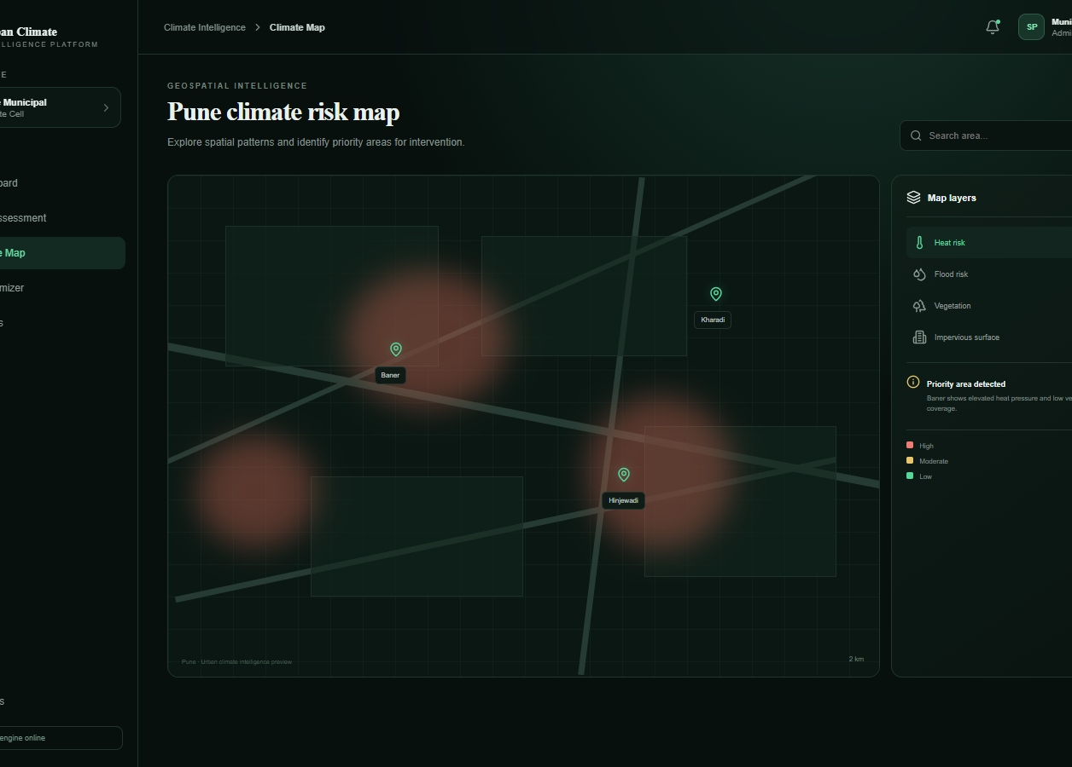
DISHADHARTI
PCCOE INTERNATIONAL GRAND CHALLENGE 2026
PROBLEM STATEMENT AND IDEA
Urban approvals review plans, yet climate consequences often remain fragmented or opaque
01
Fragmented evidence
Satellite, terrain, weather and project data live in separate tools.
02
Late intervention
Teams discover heat, runoff or carbon issues after major design choices.
03
Unverified advice
Text recommendations rarely show which input changed or whether the score improved.
THE IDEA
A pre-approval climate intelligence layer for every urban project
TEAM DISHADHARTI
3
Notes:
Problem framing source: supplied Urban Climate Intelligence R&D Framework, sections 1, 2, 8 and 11.
Competition domain source: https://www.pccoeigc.com/topics
Visual source: current repository frontend climate-map route. The displayed map is prototype UI data.

Slide 4
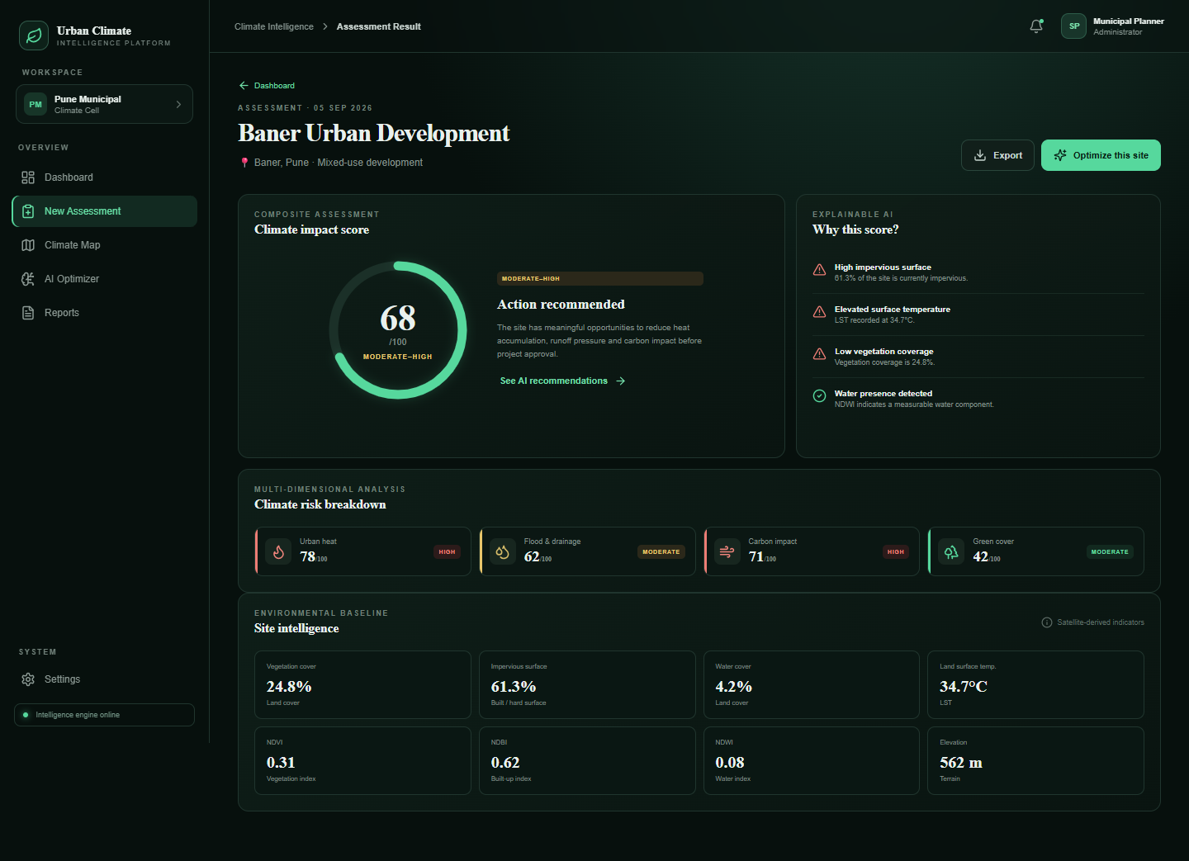
DISHADHARTI
PCCOE INTERNATIONAL GRAND CHALLENGE 2026
OBJECTIVES AND BENEFICIARIES
Four objectives define the MVP
01
Measure
Combine project inputs with land cover, LST, elevation and climate context.
02
Explain
Expose component scores, assumptions and confidence instead of a black-box result.
03
Improve
Translate risks into concrete design changes and recalculate the outcome.
04
Govern
Give each role secure access to projects, reports and review notifications.
Authorities • Planners • Consultants • Public viewers
Prototype screen uses fixture assessment data
TEAM DISHADHARTI
4
Notes:
Objective basis: supplied R&D Framework and repository backend README.md.
Role model source: backend/src/middleware/auth.js and backend/README.md.
Visual source: current repository frontend assessment-result route. Values shown are development fixture data.

Slide 5
DISHADHARTI
PCCOE INTERNATIONAL GRAND CHALLENGE 2026
PROPOSED SOLUTION AND ARCHITECTURE
One traceable path from site evidence to a revised design
PROJECT INPUT
SPATIAL + ML
4 MODULES
SCORE
GUIDANCE
REASSESS
Location
Plans + materials
GEE data
SegFormer land cover
Heat | Flood
Green | Carbon
Impact + climate
Confidence
Prioritized
recommendations
Before / after
PDF report
BACKEND FABRIC
Express 5
JWT + RBAC
PostGIS
Redis + BullMQ
S3 / Firebase
Email / SMS
API gateway
5 role profiles
Spatial records
Background jobs
Private files
In-app alerts
Formula calculations remain deterministic. The recommendation layer interprets results and proposes parameter changes.
TEAM DISHADHARTI
5
Notes:
Architecture basis: repository backend source, backend/README.md and supplied Urban Climate Intelligence R&D Framework.
The editable diagram simplifies the full MVP architecture into the judging flow.
Google Earth Engine: https://earthengine.google.com/

Slide 6
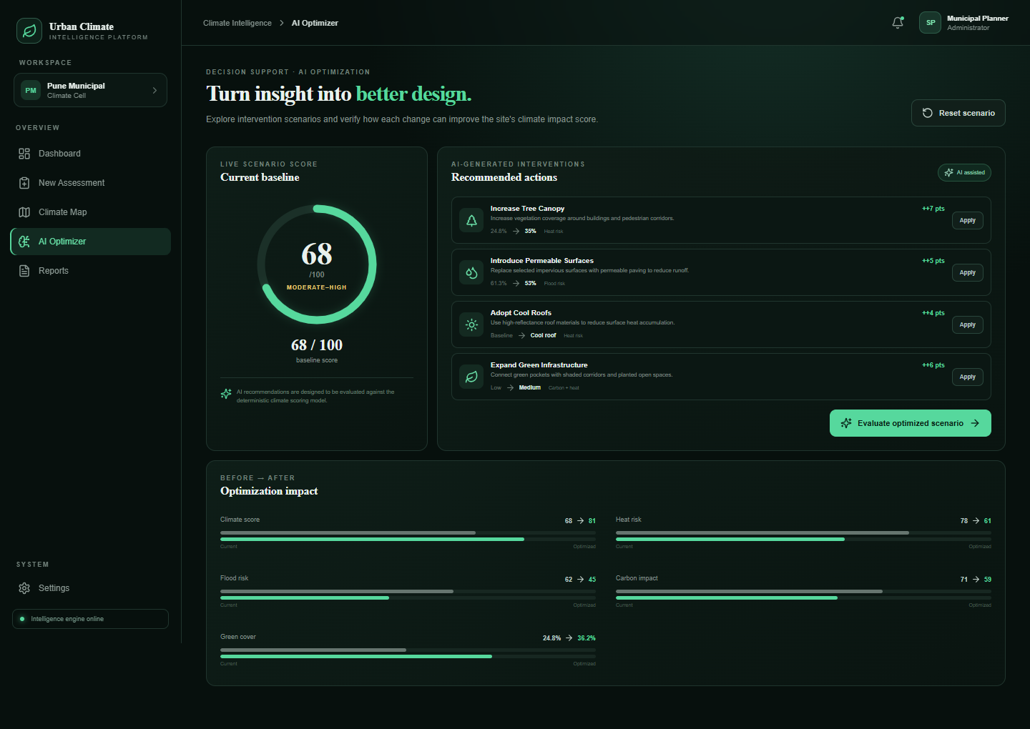
DISHADHARTI
PCCOE INTERNATIONAL GRAND CHALLENGE 2026
UNIQUE FEATURES AND INNOVATION
What makes Dishadharti different
01
Transparent scoring
Four formula modules reveal the reason behind every result.
02
Guardrailed AI
AI explains and recommends. It never invents the climate score.
03
Verified improvement
A recommendation changes inputs and triggers a genuine reassessment.
04
Confidence-aware
Missing or proxy data lowers confidence instead of creating false precision.
Prototype screen uses fixture assessment data
TEAM DISHADHARTI
6
Notes:
Innovation basis: supplied R&D Framework, especially score design, confidence, reassessment and LLM role.
Implementation basis: ml_pipeline/scorer.py, ml_pipeline/optimizer.py, backend/src/domain/scoring.js and backend/src/services/recommendationService.js.
Visual source: current repository frontend optimizer route. Displayed values are development fixture data.

Slide 7
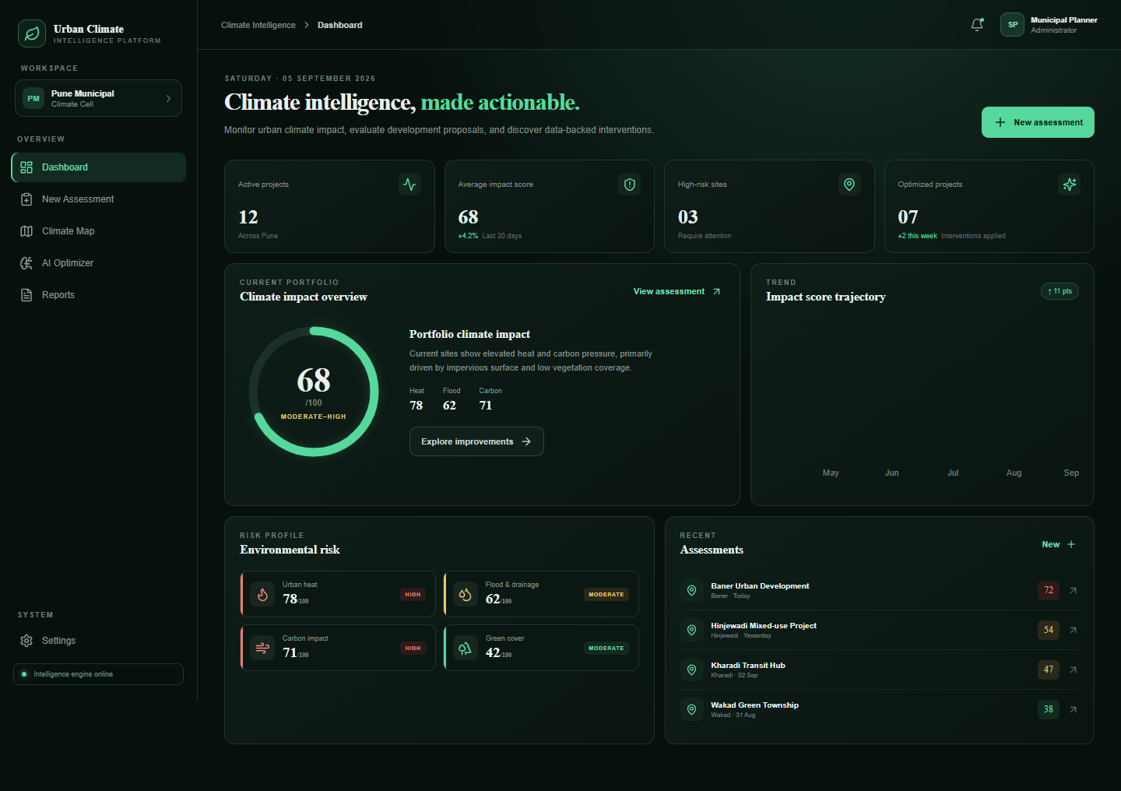
DISHADHARTI
PCCOE INTERNATIONAL GRAND CHALLENGE 2026
EXPECTED OUTCOMES AND SCALE PATH
Prototype evidence
19
5
3
API routes
automated tests
file providers
Near-term
Compare proposals before approval
Export decision-ready reports
Notify reviewers when analysis completes
Scale path
Pune pilot / multi-project portfolio / configurable regional factors
Earlier evidence enables lower-impact design choices before construction
TEAM DISHADHARTI
7
Notes:
Prototype metrics source: current backend source and tests. Route count includes the health route.
Visual source: current repository frontend dashboard route. Dashboard values are mock portfolio data, not measured deployment outcomes.
Scale path is a proposed roadmap, not a completed deployment.

Slide 8
DISHADHARTI
PCCOE INTERNATIONAL GRAND CHALLENGE 2026
WHY DISHADHARTI
MERITS SELECTION
INNOVATION
FEASIBILITY
Satellite intelligence meets deterministic scoring and guardrailed recommendations.
A working React prototype, Express backend, ML bridge and test suite already exist.
CLARITY
CLIMATE ALIGNMENT
Every score exposes components, assumptions, confidence and before-after change.
The platform supports climate risk assessment and sustainable urban development.
Ready for Stage II prototype validation
github.com/GitWithEkam/Pune-Climate-ML
TEAM DISHADHARTI
8
Notes:
Selection criteria source: https://www.pccoeigc.com/timeline
Climate domains source: https://www.pccoeigc.com/topics
Implementation evidence source: current repository README.md, backend/README.md, source code and tests.

