Slide 1

BIG
WHY

Slide 2
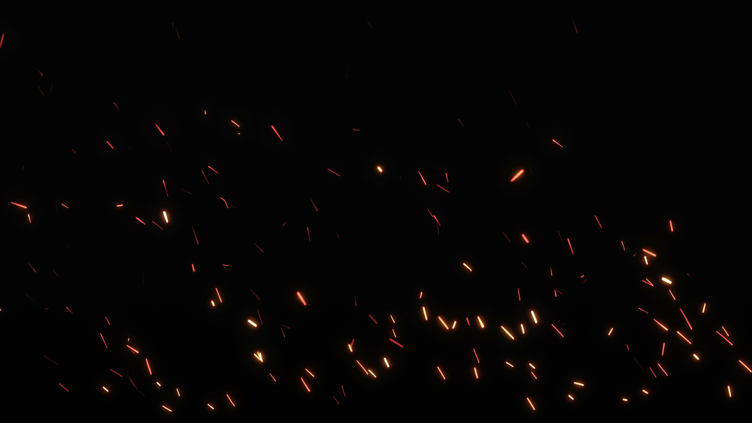


Slide 3
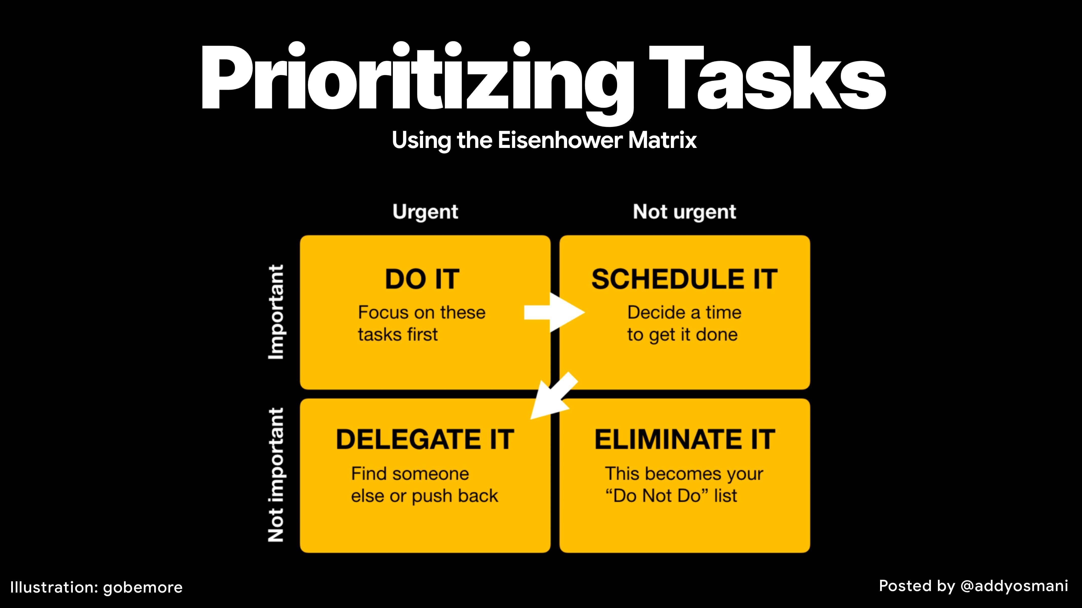

Slide 4
Effective Time Management
Pomodoro Technique
Work for 25 minutes, take a 5-minute break. Repeat!
Plan Your
Day | Week | Month | Year
ABC Method
A:More Important | B:Less Important | C:Not Important

Slide 5
Energy level & Health
Exercise regularly.
Eat a balanced diet.
Get enough sleep.

Slide 6
Motivation & Goals
Neurotransmitter in the brain.
Associated with pleasure and reward.
Influences motivation and mood.
Dopamine

Slide 7
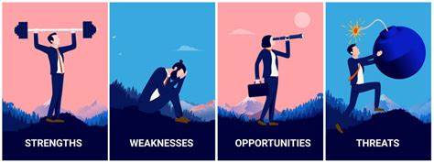
Judge Yourself
SWOT Analysis

Slide 8
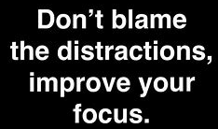
Distractions

Slide 9
D
Work Environment
etect
etach

Slide 10


