Slide 1
TELCO CUSTOMER ANALYTICS
Why Are Customers Leaving?
A Data-Driven Analysis of Customer Churn
and the Revenue at Stake
Ziad Afifi | Data Science Project

Slide 2
THE BUSINESS PROBLEM
Every Lost Customer is a Lost Revenue Stream
26.5%
1,869
$3.7M+
of customers
churned
customers
lost
estimated annual
revenue at risk
Acquiring a new customer costs 5–7× more than retaining one.
Identifying at-risk customers early is the most cost-effective retention strategy.

Slide 3
THE DATA
What We Worked With
7,043
Customer Records
Data Covers
▸ Demographics (age, gender, dependents)
21
Variables per Customer
▸ Services subscribed (internet, phone, TV)
▸ Contract & payment type
1,869
Churned Customers
▸ Monthly & total charges
0
Missing Values After Cleaning
▸ Tenure (how long they've been a customer)
▸ Churn label (Yes / No)
Source: IBM Telco Customer Churn Dataset (Kaggle)

Slide 4
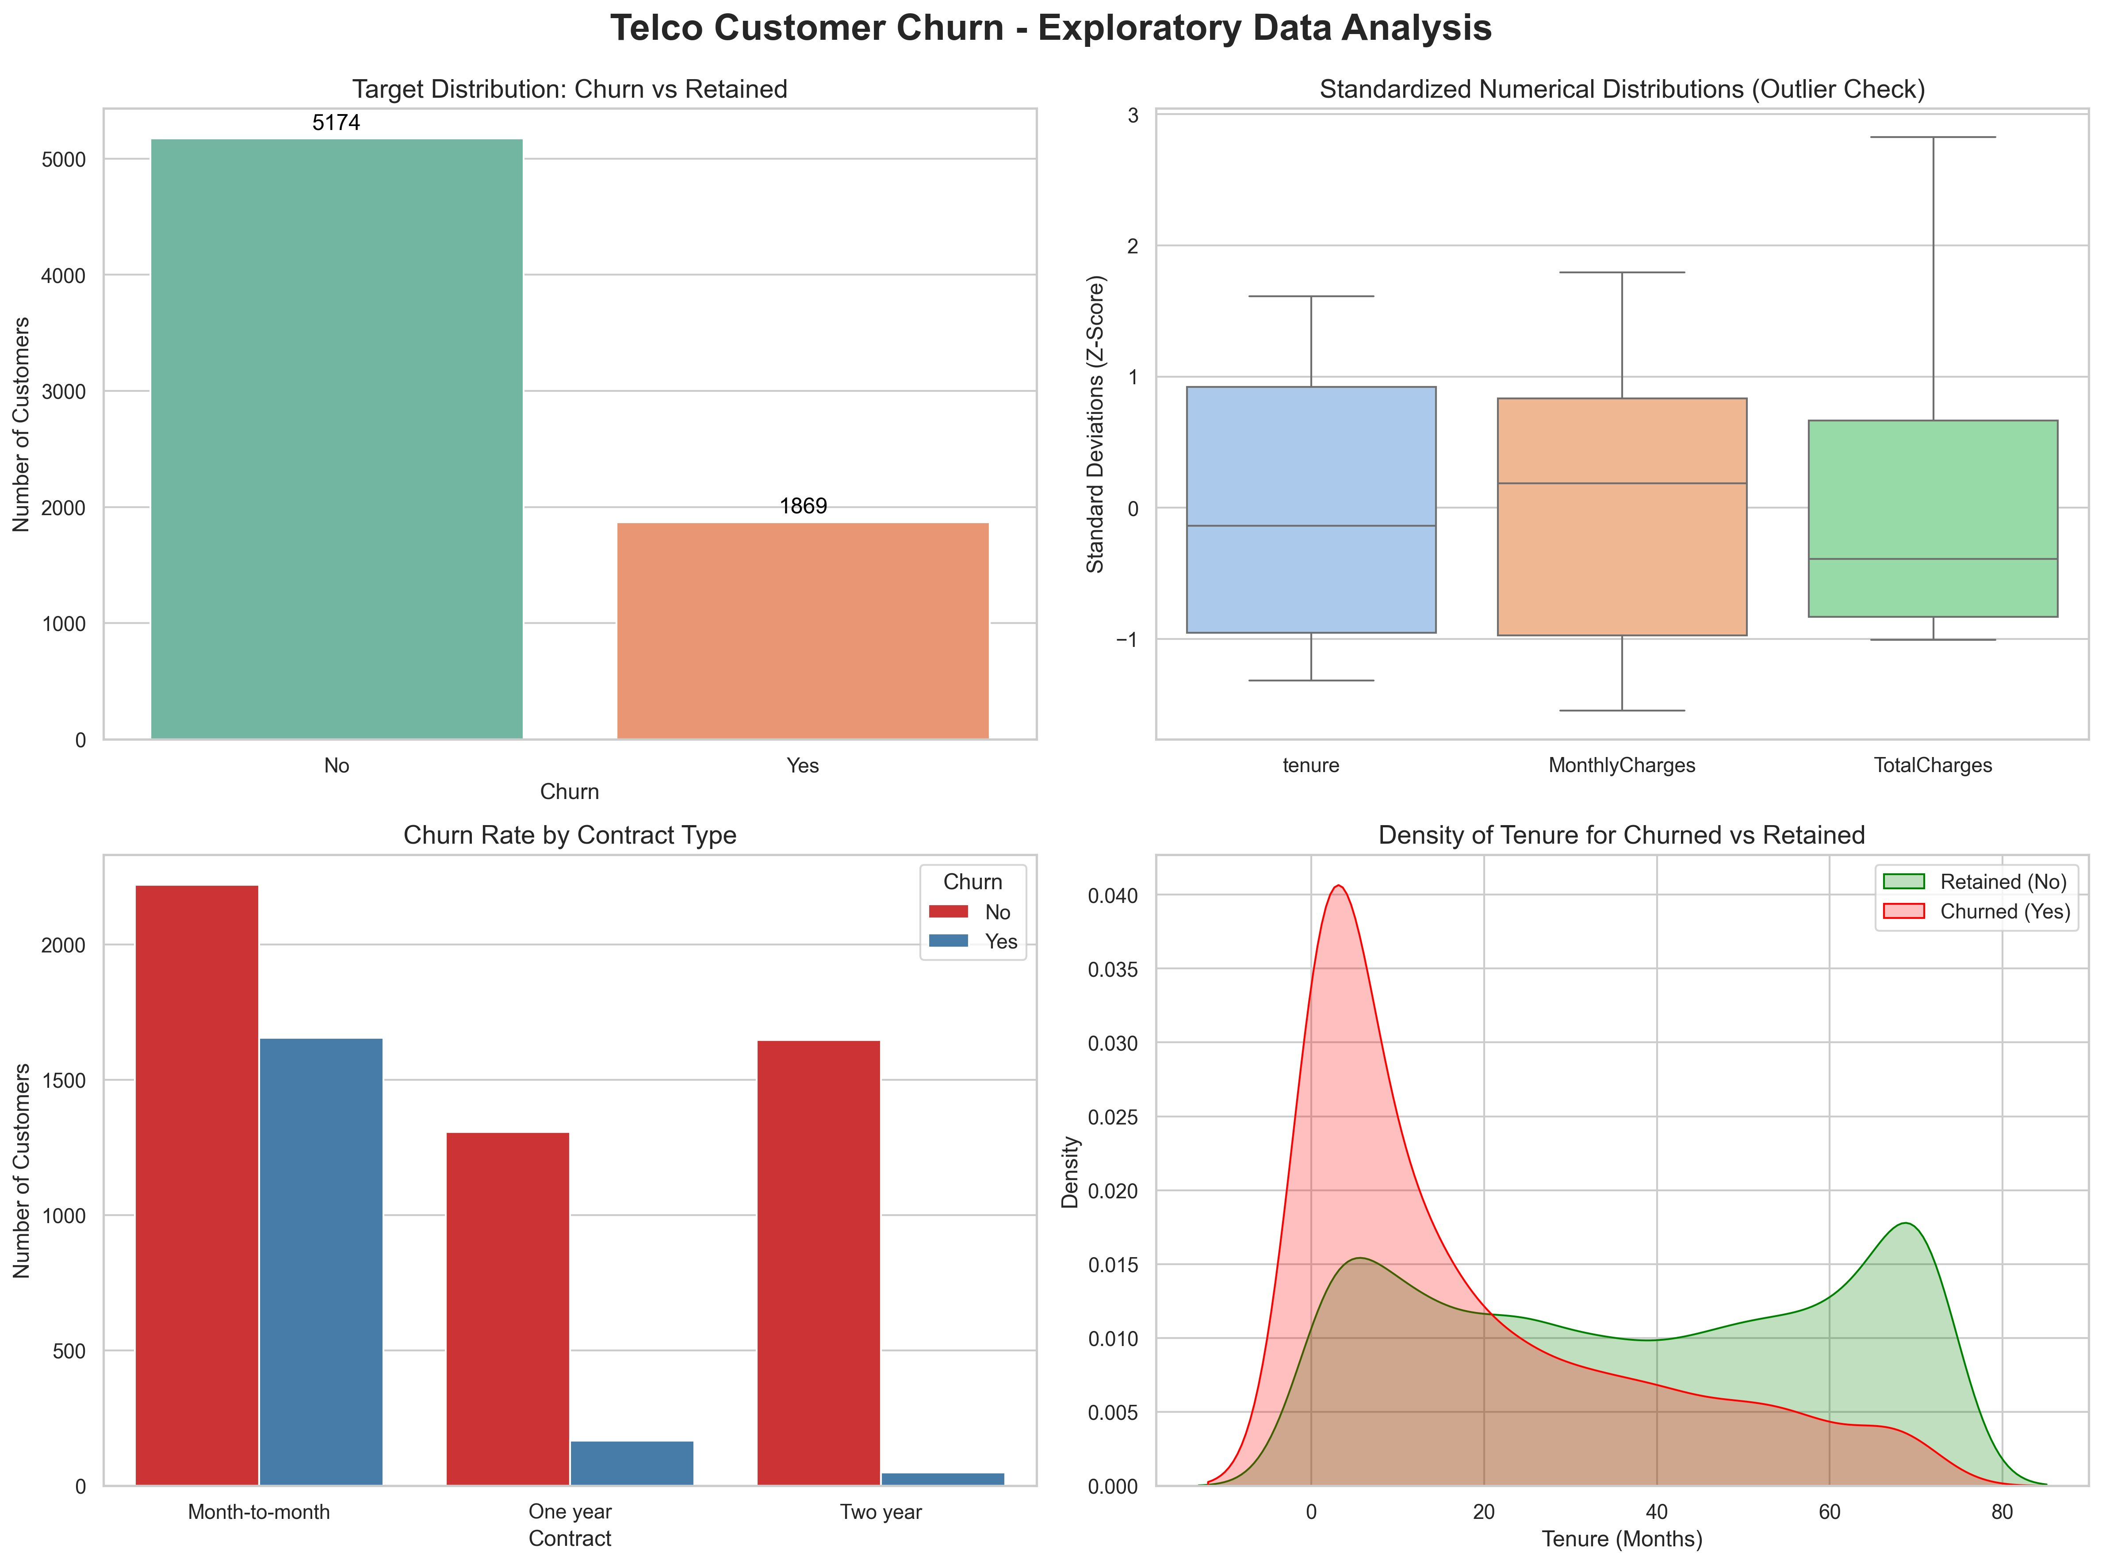
EXPLORATORY ANALYSIS
Three Patterns Stand Out Immediately
Churned customers leave faster, pay more monthly, and almost all avoid long-term contracts.

Slide 5
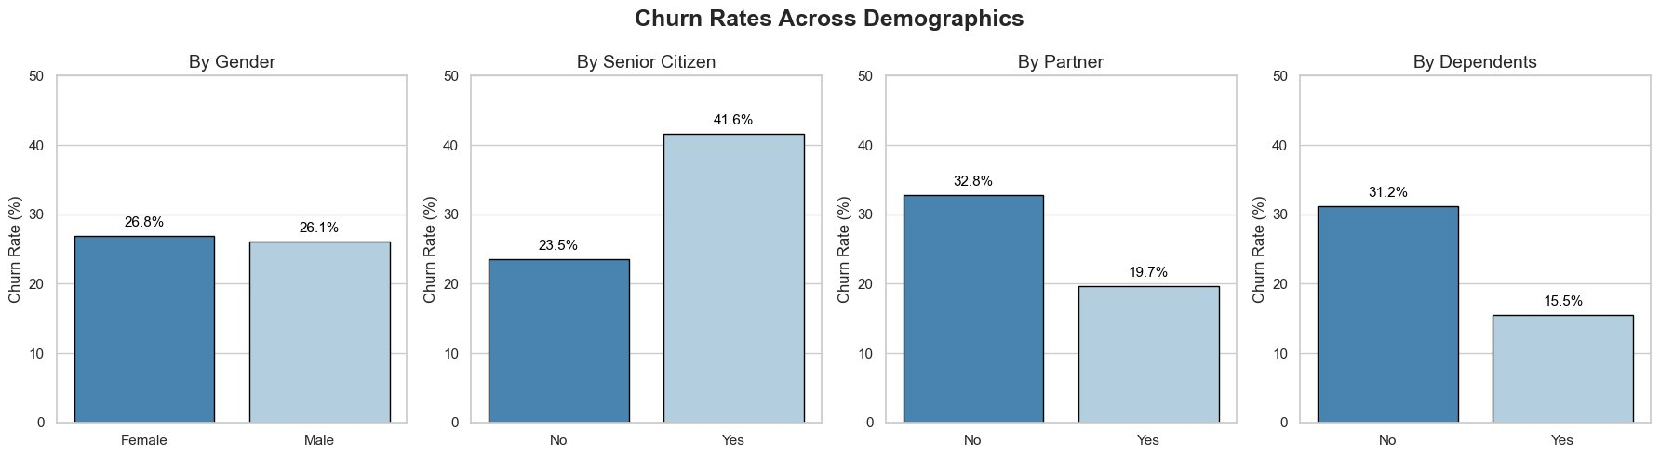
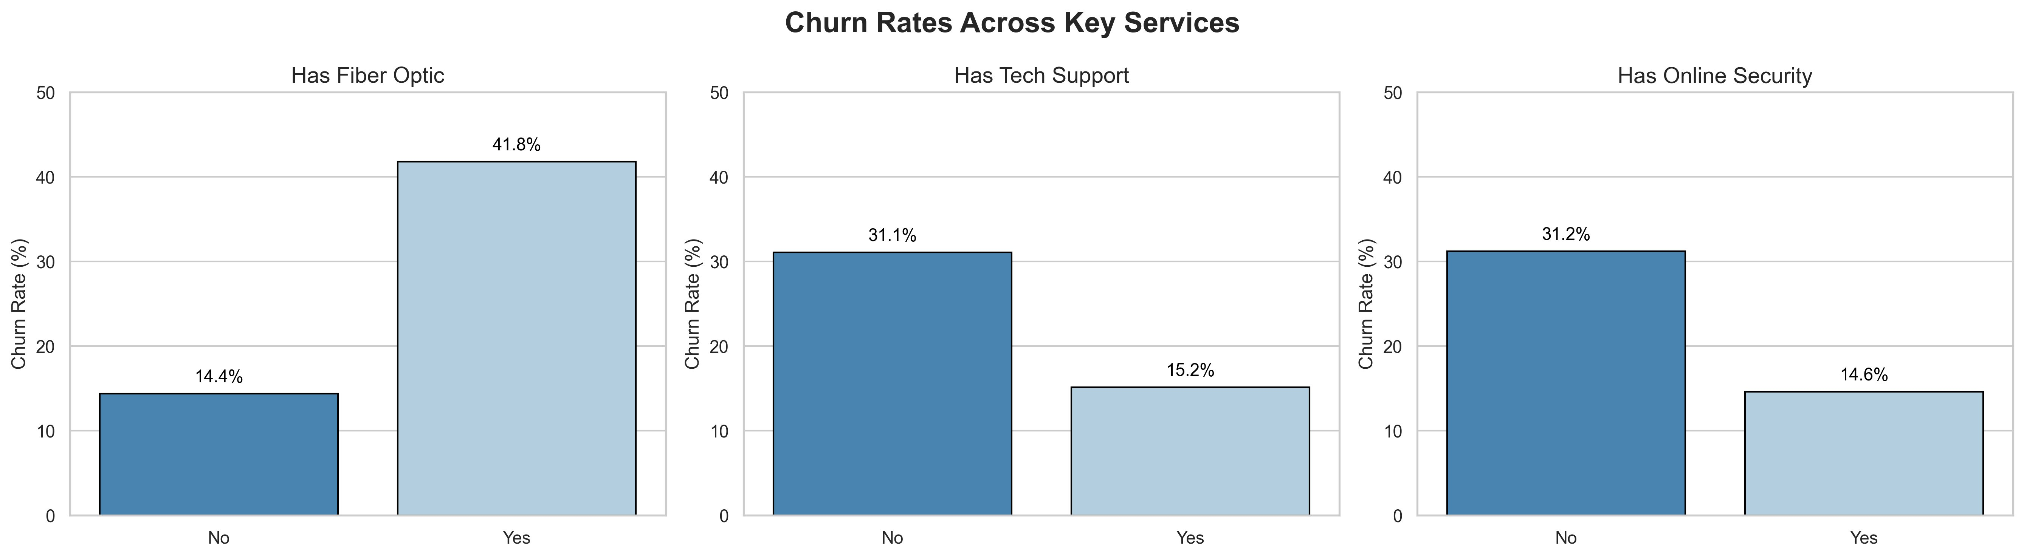
CUSTOMER PROFILE
Who Is Most Likely to Leave?
Senior citizens, solo customers, and fiber-optic users are significantly more likely to churn.

Slide 6
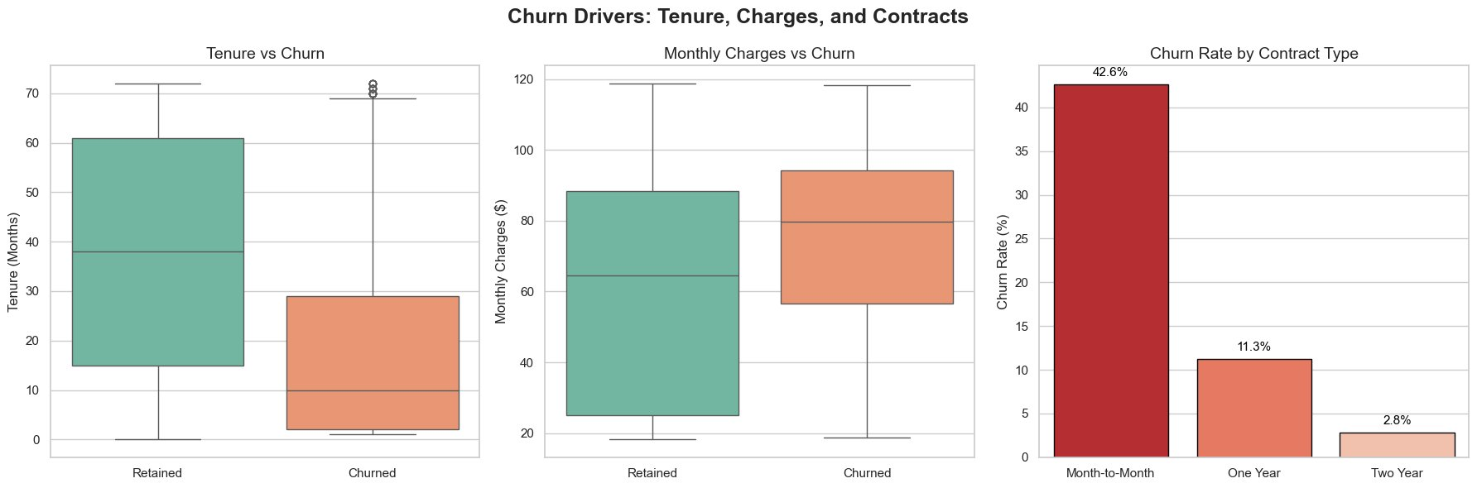
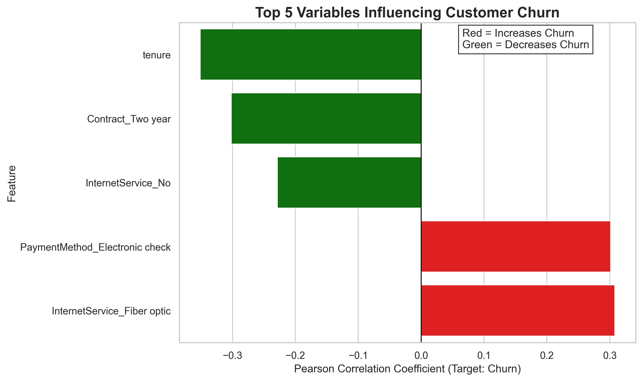
WHAT DRIVES CHURN
Contract, Charges & Tenure Tell the Story
Month-to-month contracts
First year of service
Fiber optic users
42.6% churn rate
47.4% churn rate
41.8% churn rate

Slide 7
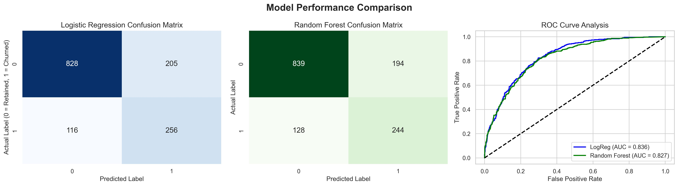
PREDICTIVE MODEL
We Built a Model to Predict Churn Before It Happens
In Plain Terms
Two models tested: Logistic Regression & Random Forest
~84% accuracy correctly identifying who will churn
AUC 0.836 vs 0.827: Logistic Regression wins — barely
Real-world meaning: out of 10 churners, the model catches ~8 of them
Model trained on 80% of data (5,634 customers) · Tested on 20% holdout (1,409 customers)

Slide 8
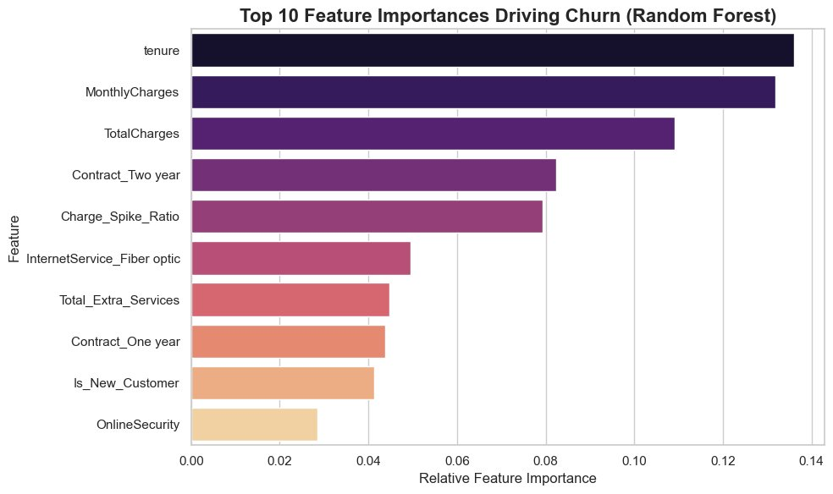
PREDICTIVE MODEL
What Does the Model Actually Look At?
#01 Tenure
How long they've been a customer — the single strongest signal
#02 Monthly Charges
Higher bills = more likely to question value and leave
#03 Contract Type
2-year contracts are the strongest loyalty lock-in signal
Source: Random Forest feature importances (relative contribution to prediction accuracy)

Slide 9
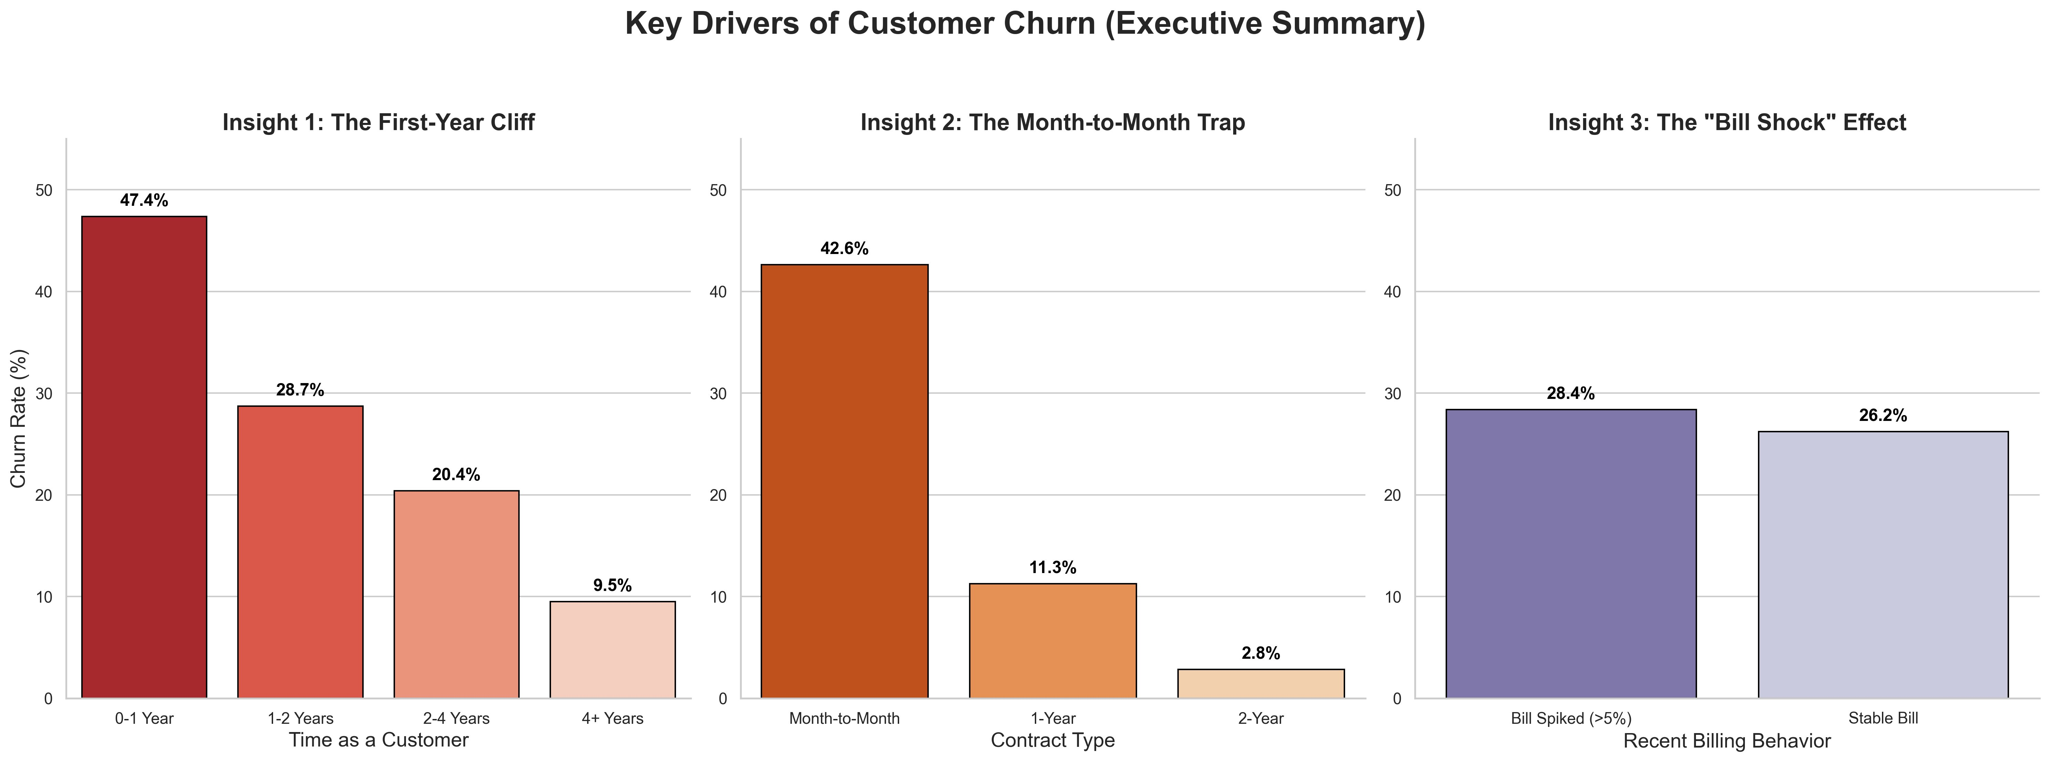
KEY INSIGHTS
Three Critical Moments That Decide Loyalty
The First-Year Cliff
Month-to-Month Trap
The Bill Shock Effect
47% of new customers churn within year 1 — critical onboarding window
Customers without a contract churn at 15× the rate of 2-year contract holders
A sudden charge spike increases churn risk by 8%

Slide 10
RISK SEGMENTATION
Not All Customers Need the Same Attention
HIGH Risk / HIGH Value
HIGH Risk / LOW Value
PRIORITY ACTION
Monitor Closely
Likely to leave AND high spenders. Target with personalized retention offers immediately.
At risk but lower revenue impact. Low-cost automated outreach recommended.
LOW Risk / HIGH Value
LOW Risk / LOW Value
Nurture & Upsell
Standard Care
Loyal high-value customers. Invest in loyalty programs to keep them engaged.
Stable and lower impact. Routine support is sufficient.

Slide 11
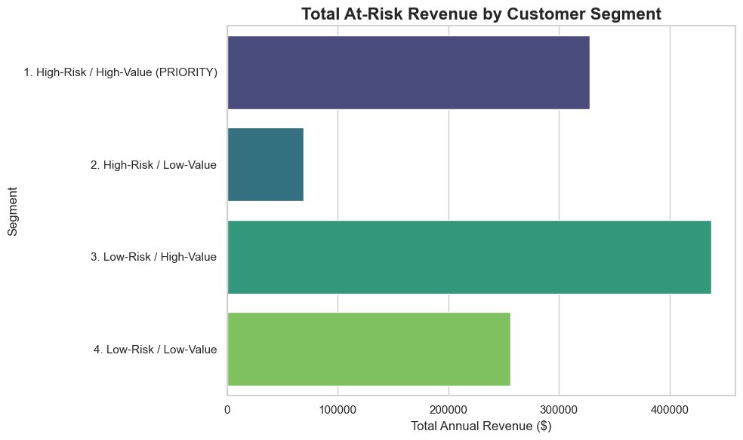
FINANCIAL IMPACT
The Revenue Picture
~$325K/yr
High-Risk / High-Value revenue at risk
~$70K/yr
High-Risk / Low-Value revenue at risk
~$1.1M+/yr
Total at-risk revenue (all segments)
💡 Retaining just 25% of high-risk customers could recover over $80K in annual revenue — at a fraction of acquisition cost.

Slide 12
RECOMMENDATIONS
Three Actions to Start With
01
Launch a First-Year Loyalty Program
New customers churn at nearly 50% in Year 1. A targeted onboarding sequence — check-in calls, discounts at month 3 and 6 — can cut this dramatically.
02
Incentivize Contract Upgrades
Month-to-month customers churn 15× more than 2-year contract holders. Offer meaningful incentives for customers to commit — discount, free services, or price lock.
03
Alert Customers to Bill Spikes
Unexpected charges trigger churn. Proactive communication before a bill spike — and offering a plan review — signals trust and reduces cancel risk.

