Slide 1

Multi‐objective optimization
using genetic algorithms
School of Mechanical Engineering
周资崴
12.16
Notes:
I will talk about the following six aspects

Slide 2
CONTENTS
1
Background
2
Mathematical model
3
Main method
4
Numerical results
5
Discussion
6
Thanks

Slide 3
1
Background
Notes:
First is background

Slide 4
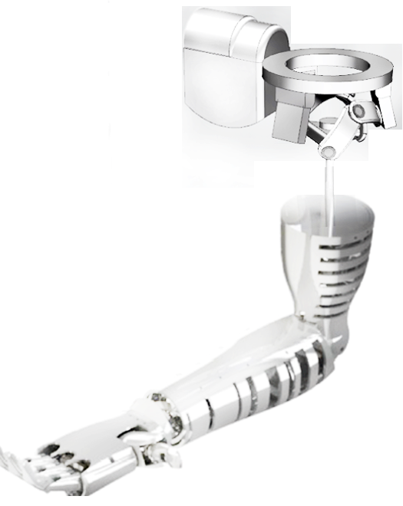
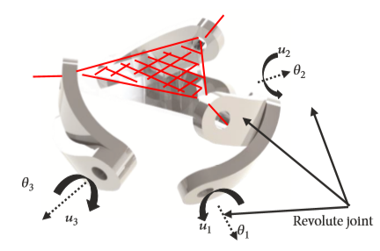
1
The shoulder joint is one of the key components of the upper limb prosthesis of the human body.
Background
A mathematical model of a three-degree-of-freedom spherical parallel mechanism was established, and 11 design parameters are to be determined.
Multi-objective optimization using genetic algorithm
Working space
Dexterity
Maximum torque
Notes:
As we all know, The shoulder joint is one of the key components of the upper limb prosthesis of the human body.
My purpose is to design the eleven parameters of a shoulder joint mechanism
And mainly consider three design objectives, they are working space, dexterity and maximum torque

Slide 5
2
Mathematical model
Notes:
The second part is to establish a mathematical model

Slide 6
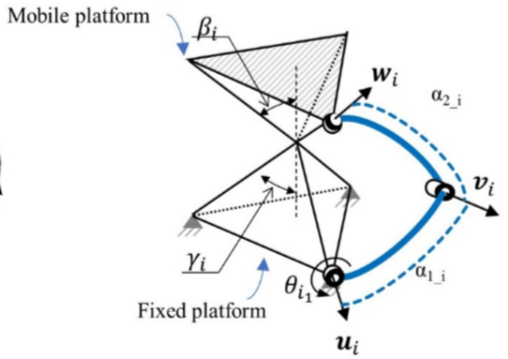
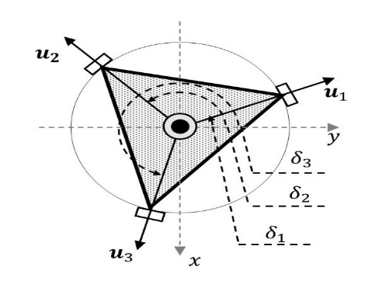
Mathematical model
2
Spherical parallel mechanism（3RRR）
Vertical view:
Mathematical model
By modeling，totally 11 different structural parameters obtained:
$$γ,β,α_{1_1},α_{1_2},α_{1_3},α_{2_1},α_{2_2},α_{2_3},δ_{1},δ_{2},δ_{3}$$
Notes:
The mechanism is mathematically modeled as follow, from this mechanism to the second picture and third picture is a vertical view(俯视图), and we obtain 11 parameters, they are design variables.

Slide 7
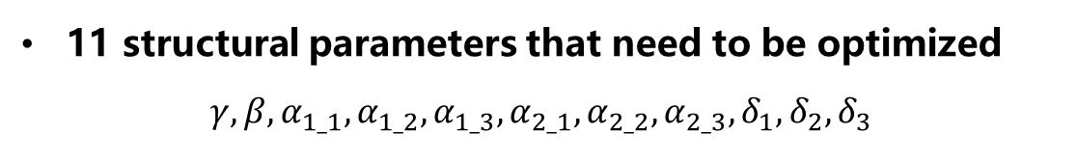
Optimization objective function
2
Three optimization goals
1. The working space is as close as possible to the range of motion of the human shoulder joint
2. High dexterity possible throughout the workspace
3. The torque of the three input shafts is as small as possible
Mathematical model
11 structural parameters that need to be optimized
$$γ,β,α_{1_1},α_{1_2},α_{1_3},α_{2_1},α_{2_2},α_{2_3},δ_{1},δ_{2},δ_{3}$$
Notes:
Then, the objective functions are to be determined.
There are three optimization goals
first, we want the working space is as close as possible to the range of motion of the human shoulder joint
Second, we want the high dexterity in the workspace
Last, we want to minimize the input torque

Slide 8
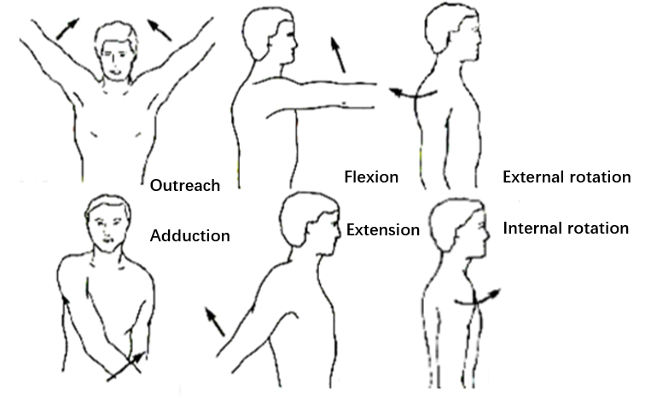
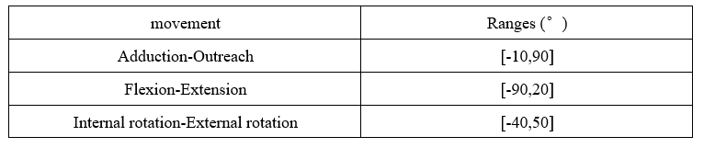
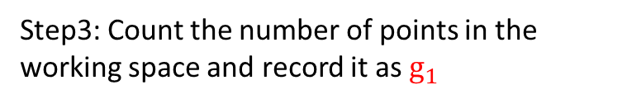
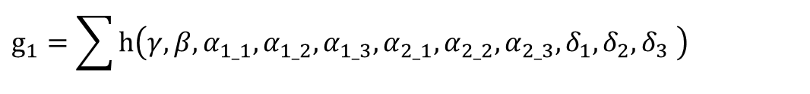
Objective 1：maximize workspace
—>maximize g1
2
Step1: Discretize the range of motion of the human shoulder joint every 10°, obtain 12x11x10=1320 points
Step2: For each discretized point, judge whether there is a solution in the work space
Mathematical model
Step3: Count the number of points in the working space and record it as $g_{1}$
$$g_{1}=\sum{h\left(γ,β,α_{1_1},α_{1_2},α_{1_3},α_{2_1},α_{2_2},α_{2_3},δ_{1},δ_{2},δ_{3} \right) }$$
$$where h=\left\{\begin{matrix}1 if there is a solution in workspace \\ 0 if where is not a solution in workspace\end{matrix}\right.$$
Notes:
Objective one, the workspace.
First of all, discretize the range of shoulder joint’s motion, as the figure on the right, and we get thirteen hundred and twenty points
Second, for each point, we need to determine whether the point is in the working space and count the number, record as g1
So g1 in mathematical expression as follow, we want to maximize workspace is equal to maximize g1.

Slide 9
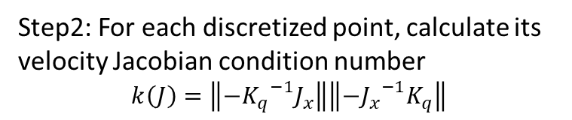
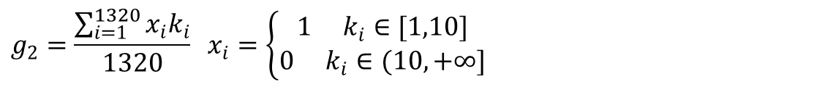
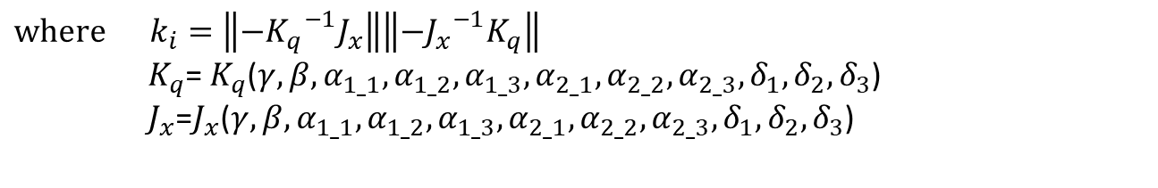
Objective 2：maximize dexterity—>maximize g2
2
Step1: Discretize the range of motion of the human shoulder joint every 10°, obtain 12x11x10=1320 points
Step2: For each discretized point, calculate its velocity Jacobian condition number
$$k\left(J\right)=\left\|−{K_{q}}^{−1}J_{x}\right\|\left\|−{J_{x}}^{−1}K_{q}\right\|$$
Mathematical model
Step3: Count the proportion of condition number in the interval of [1,10] as the dexterity evaluation $g_{2}$(The closer the condition number is to 1, the higher the dexterity)
$$g_{2}=\frac{\sum_{i=1}^{1320}{x_{i}k_{i}}}{1320} x_{i}=\left\{\begin{aligned}1 k_{i}∈[1,10] \\ 0{ k}_{i}∈(10,+∞]\end{aligned}\right.$$
$$where k_{i}=\left\|−{K_{q}}^{−1}J_{x}\right\|\left\|−{J_{x}}^{−1}K_{q}\right\|$$
$K_{q}$= $K_{q}$($γ,β,α_{1_1},α_{1_2},α_{1_3},α_{2_1},α_{2_2},α_{2_3},δ_{1},δ_{2},δ_{3}$)
$J_{x}$=$J_{x}$($γ,β,α_{1_1},α_{1_2},α_{1_3},α_{2_1},α_{2_2},α_{2_3},δ_{1},δ_{2},δ_{3}$)
Notes:
Objective two, the dexterity.
First of all, in the same way get thirteen hundred and twenty points
Second, for each point, calculate its velocity Jacobian condition number using the formula
Last, Calculate the proportion of points where condition number is between one and ten, regard as g2
So g2 in mathematical expression as follow, where ki,Kq and Jx are function of those eleven parameters.
we want to maximize dexterity is equal to maximize g2.

Slide 10
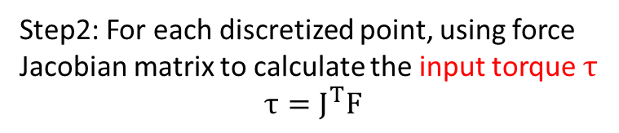

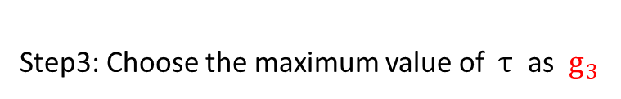
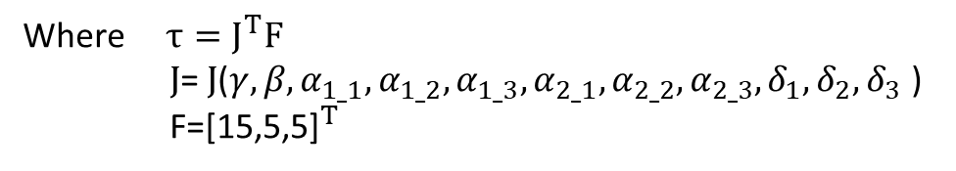
Objective 3：minimize input torque—>minimize g3
2
Step1: Discretize the range of motion of the human shoulder joint every 10°, obtain 12x11x10=1320 points
Step2: For each discretized point, using force Jacobian matrix to calculate the input torque $τ$
$$τ=J^{T}F$$
Mathematical model
The end force F is the torque produced by considering the arm weight (15N), the hand weight (5N) and the load weight (5N)
Step3: Choose the maximum value of $τ$ as $g_{3}$
$$g_{3}=max(τ)$$
Where $τ=J^{T}F$
$J$= $J$($γ,β,α_{1_1},α_{1_2},α_{1_3},α_{2_1},α_{2_2},α_{2_3},δ_{1},δ_{2},δ_{3}$)
F=${\text{[15,5,5]}}^{T}$
Notes:
Objective three, the input torque.
First of all, in the same way get thirteen hundred and twenty points
Second, for each point, calculate its input torque using the formula.
Last, regard the maximum value $τ$of as g3
So g3 in mathematical expression as follow, where $τ$ and J are function of those eleven parameters.
we want to minimize input torque is equal to minimize g3.

Slide 11

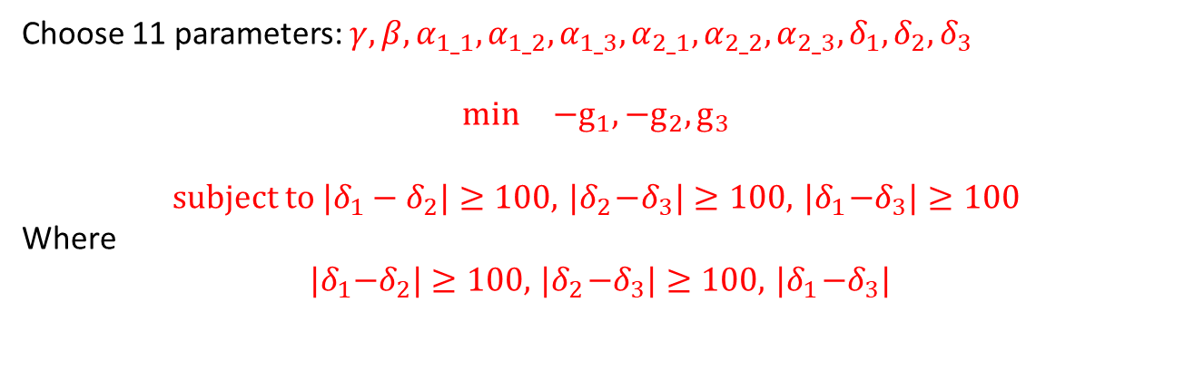

Multi-objective optimization
2
Choose 11 parameters: $γ,β,α_{1_1},α_{1_2},α_{1_3},α_{2_1},α_{2_2},α_{2_3},δ_{1},δ_{2},δ_{3}$
$$\begin{matrix}min & −g_{1},−g_{2},g_{3}\end{matrix}$$
$$subject to{ |δ}_{1}−δ_{2}|≥100,{ |δ}_{2}−δ_{3}|≥100,{ |δ}_{1}−δ_{3}|≥100$$
Where
$${ |δ}_{1}−δ_{2}|≥100,{ |δ}_{2}−δ_{3}|≥100,{ |δ}_{1}−δ_{3}|$$
Mathematical model
$are$Physical constraints:
The angle between two input shaft should be large to avoid interfere
Notes:
The overall optimization problem is defined as follow
Choose those eleven parameters to minimize –g1,-g2 and g3
These are constraints which means the angle between two input shaft.

Slide 12
3
Main method
Notes:
Third part is multi-objective optimization method

Slide 13
Multi-objective optimization: Pareto front
3
The objectives are in conflict with each other if an improvement in one objective leads to deterioration in another.
Multi-objective problems in which there is competition between objectives may have no single, unique optimal solution.
Multi-objective optimization
Pareto Solution:
In a multi-objective optimization problem,
a solution is optimal if there exists no other solution, within the feasible set,
that gives improved performance with regard to all the objectives.
Pareto front:
The set of Pareto minimizers.
Notes:
In the Multi-objective optimization, the objectives are in conflict with each other
So introduced this concept of pareto solution, which means a solution is optimal if there exists no other solution that gives improved performance with regard to all the objectives.
And the pareto front is the set of pareto minimizers.

Slide 14
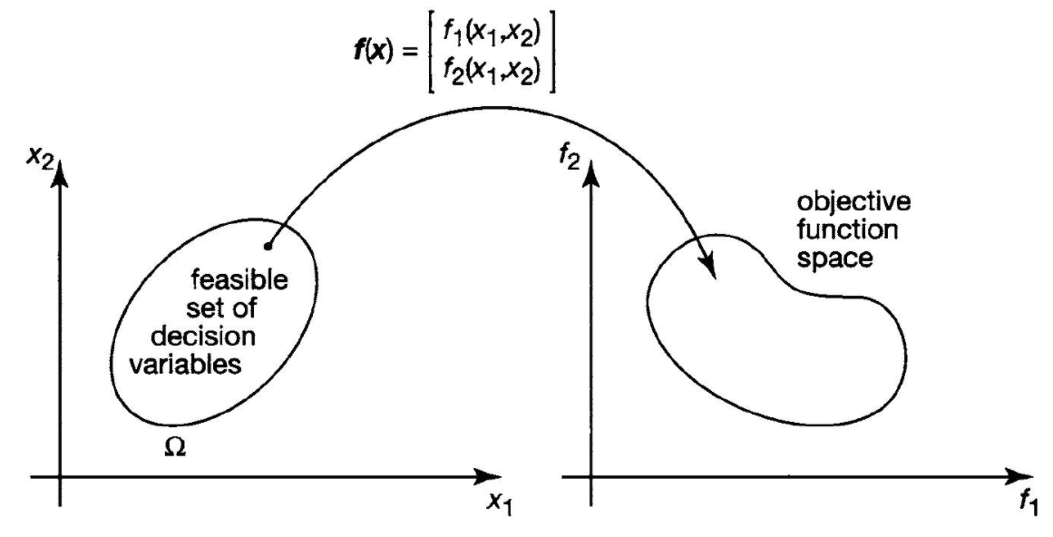
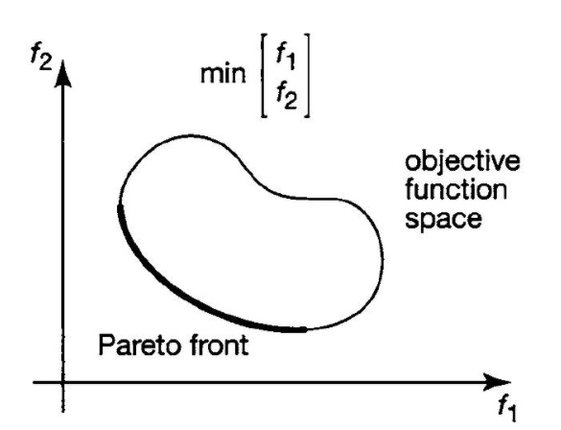
Multi-objective optimization: Pareto front
3
Two-dimensional illustration
Multi-objective optimization
Pareto front:
The set of Pareto minimizers.
Notes:
This is a two dimensional illustration
There are two variables x1,x2,
They mapped to f1 and f2
So the pareto front of min f1andf2 is this part, in contrast, the pareto front of max f1 and f2 is Upper right part.

Slide 15
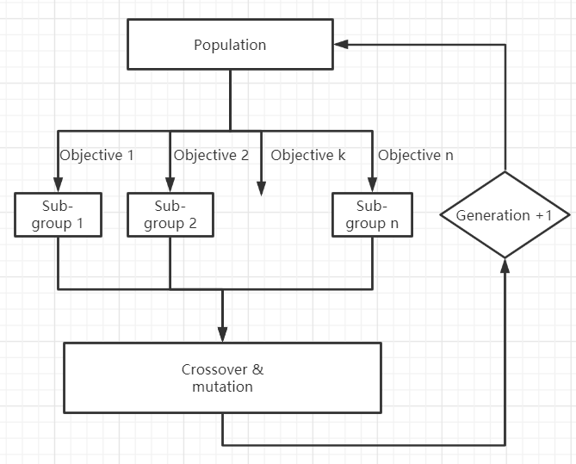
Computing the Pareto front
3
Basic idea of Genetic algorithm
Initial:
Randomly generate some points as the initial population
Do:
1.Divide the population into sub-groups.
2.Assign an objective function to each sub-group, select the points with high fitness to form a new sub-group.
3.Merge all new sub-groups into a complete group, perform crossover and mutation operation to generate the next population.
While:
not convergence or the number of generation < threshold
Final:
Obtain the Pareto front.
Multi-objective optimization
……
Notes:
Then I will show you how to compute pareto front using genetic algorithm.
As the figure on the right, initially, random generate some points as the initial population
And this part is loop,
Divide the population into sub-groups and Assign different objective function to each sub-group
Then select the points with high fitness to form complete group and do the crossover and mutation operation.
Finally, get the convergence we will get the pareto front.

Slide 16
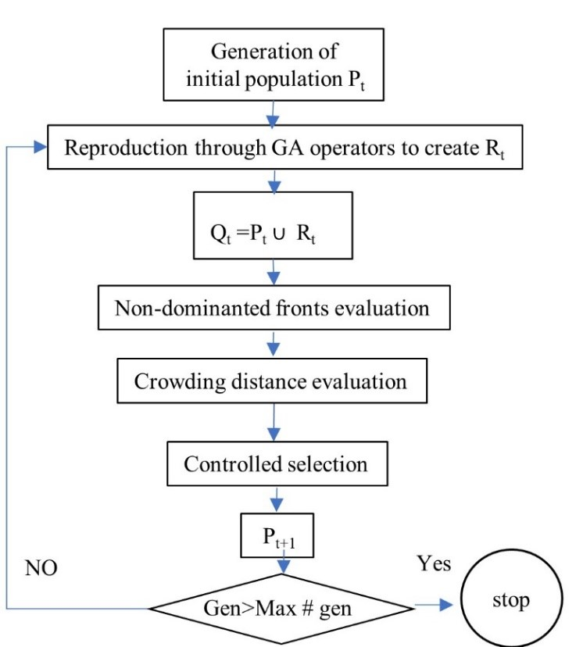
Computing the Pareto front
3
Nondominated sorting genetic algorithm II (NSGA-II)
NSGA- II is currently one of the most popular multi-objective genetic algorithms.
It reduces the complexity of non-inferior ranking genetic algorithms.
It has the advantages of fast running speed and good solution set convergence.
Multi-objective optimization
Notes:
Nondominated sorting genetic algorithm two is one of the advanced genetic algorithms. It is faster and better than traditional genetic algorithms.

Slide 17
4
Numerical results
Notes:
After using NSGA-II, obtain the numerical results.

Slide 18

Solution settings——based on NSGA-II
4
Solution settings:
1.set a random population of 100 individuals
2.a reduction rate of 0.4
3.The maximum number of iterations is 200
4.Using linear crossover and non-uniform
mutation genetic operators
5.the mutation probability is 0.5%.
Problem Description:
Choose 11 parameters $γ,β,α_{1_1},α_{1_2},α_{1_3},α_{2_1},α_{2_2},α_{2_3},δ_{1},δ_{2},δ_{3}$
$$\begin{matrix}min & −g_{1},−g_{2},g_{3}\end{matrix}$$
$$subject to h_{1}≥100,h_{2}≥100,h_{3}≥100$$
$$sign\left(\left(\vec{w_{i}}×\vec{u_{i}}\right)⋅\vec{v_{i}}\right)=const$$
Numerical results
Notes:
The solution settings and Problem Description as follow.

Slide 19
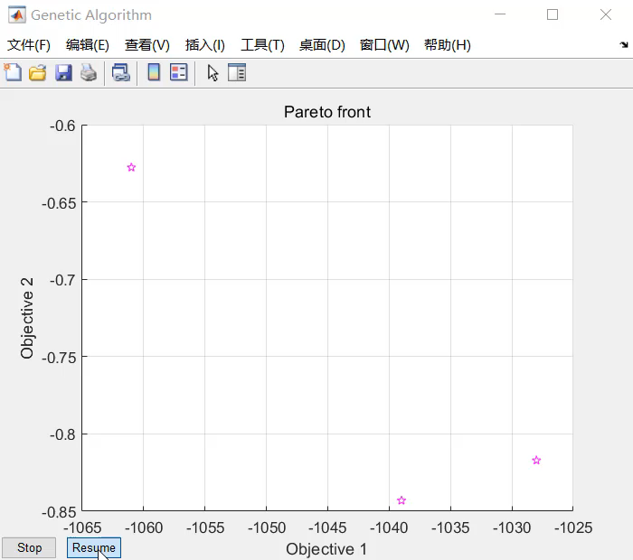
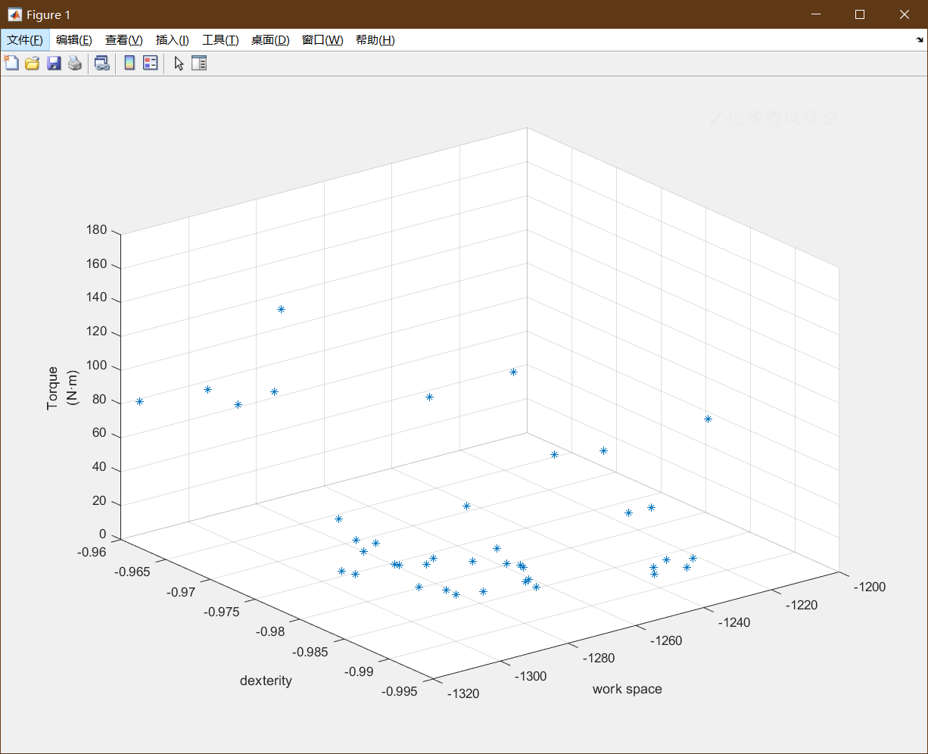
Iteration process & numerical results——based on NSGA-II
4
Iteration process:
Final numerical results:
Numerical results
Notes:
The iteration process and final numerical results as shown in figure.

Slide 20
5
Discussion

Slide 21
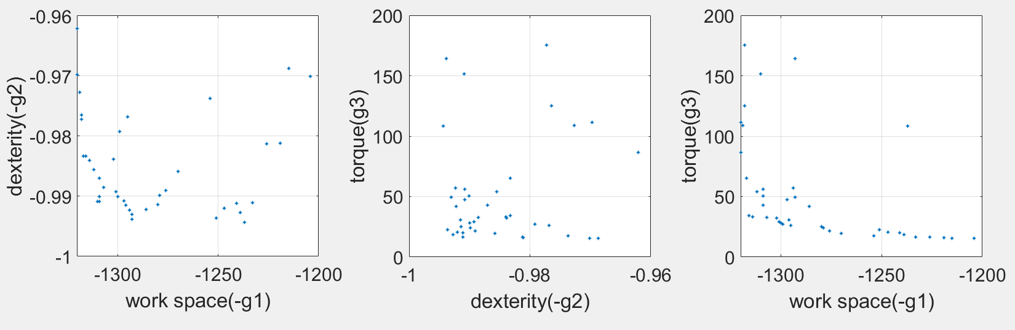
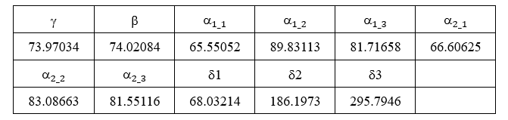
Discussion
5
Replot the 3D result into three subplots:
Discussion
Select a point corresponding to $g_{1}$=1320, $,g_{2}$=0.99, $,g_{3}$=4.5N·m, obtain the parameters
Notes:
I replot the 3D result into three subplots
The red lines are illustration of pareto front, these blue point are all pareto solutions, every point corresponding to a set of parameters.
After choosing a point g1 = 1320 , g2 = 0.99 and g3 = 4.5, obtain the eleven parameters shown in the table.

Slide 22
6
Thanks！
Ending

Slide 23
Computing the Pareto front
3
Nondominated sorting genetic algorithm II (NSGA-II)
Solution settings:
1.set a random population of 100 individuals
2.a reduction rate of 0.4
3.The maximum number of iterations is 200
4.Using linear crossover and non-uniform
mutation genetic operators
5.the mutation probability is 0.5%.
Multi-objective optimization
Notes:
Nondominated sorting genetic algorithm two is one of the most popular multi-objective genetic algorithms.

