Slide 1
zero shot emotion classification in text (analysis of results of using prompts by checking attention)
Gita Tabe Jamaat
Student ID: 237-D8905

Slide 2
Comparing results (Review)
For Isear dataset:
The cases that using prompt could lead to more improvement compared to using only emotion name (when checking the entailment of the sentence to be classified and the emotion)
When using Deberta model:
Expr_emo: “This text expresses”+ emotion
Emotion prompt: “The emotion is”+ emotion
 | Emotion name | Expr_emo | Emotion prompt
Macro averaged F1 | 0.54 | 0.61 | 0.61
accuracy | 0.57 | 0.63 | 0.62

Slide 3
Comparing results (Review)
For Tec dataset:
The case that using prompt could lead to improvement when using prompt
When using Deberta model:
Emotion prompt (“The emotion is”+main sentence)
 | Emotion name | Emotion prompt
Macro averaged F1 | 0.37 | 0.4
accuracy | 0.41 | 0.42

Slide 4
Analyzing results regarding labels when using Deberta model for Isear dataset (according to last experiment)
Emotion name
emotion | anger | disgust | fear | guilt | joy | sadness | shame
F1 score | 0.47 | 0.46 | 0.65 | 0.51 | 0.9 | 0.57 | 0.2
Expr emo (“This text expresses”+ emotion)
emotion | anger | disgust | fear | guilt | joy | sadness | shame
F1 score | 0.51 | 0.58 | 0.74 | 0.54 | 0.91 | 0.66 | 0.34
Emotion prompt (“The emotion is”+ emotion)
emotion | anger | disgust | fear | guilt | joy | sadness | shame
F1 score | 0.48 | 0.58 | 0.74 | 0.55 | 0.91 | 0.6 | 0.43
The significant improvements for labels : disgust, shame

Slide 5
Checking the attention before and after using prompt
One idea to find the reason of improvements when using prompt in some cases:
Checking the attention of the tokens regarding their relevance to the emotion (for labels which were improved) before and after using prompt.
The measured attention:
The average of attentions of the heads in the last layer of the model regarding the relevance of tokens to the emotion
So, it shows how the tokens affect the emotion to make its context clear

Slide 6
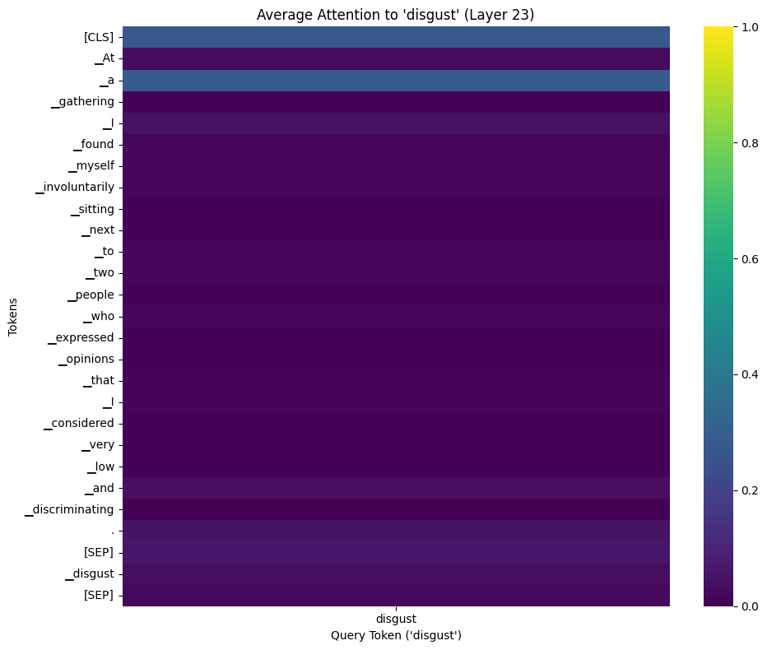
Attention visualization for a sample sentence
As a sample, when using Deberta model and only the emotion name, the attention of the tokens of the whole sentence (main sentence+emotion) regarding their relevance to the emotion is the following for a sample sentence.
The sentence: At a gathering I found myself involuntarily sitting next to two people who expressed opinions that I considered very low and discriminating.

Slide 7
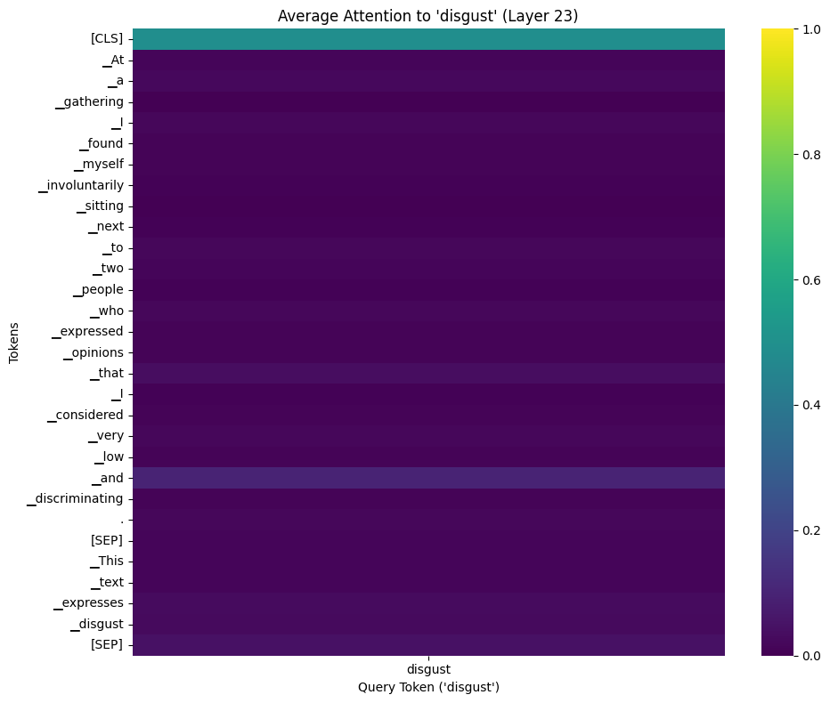
Attention visualization for the sample sentence (after using prompt)
After using prompt (adding the template, “This text expresses disgust” to the main sentence)
So, after using prompt, the average attention for the special token [CLS], was increased. It shows the relevance of the whole sentence after using prompt was increased. It indicates that using prompt can cause that the entire context of the sentence gets more relevant to the emotion disgust. So, it can give rise to true prediction.

Slide 8
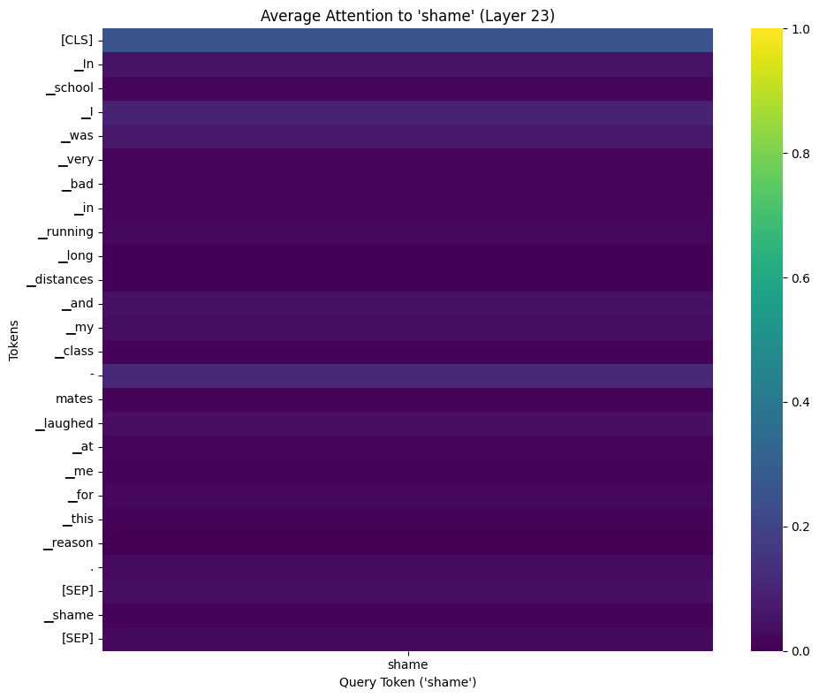
Attention visualization of another sample
Sentence: In school I was very bad in running long distances and my class-mates laughed at me for this reason.

Slide 9
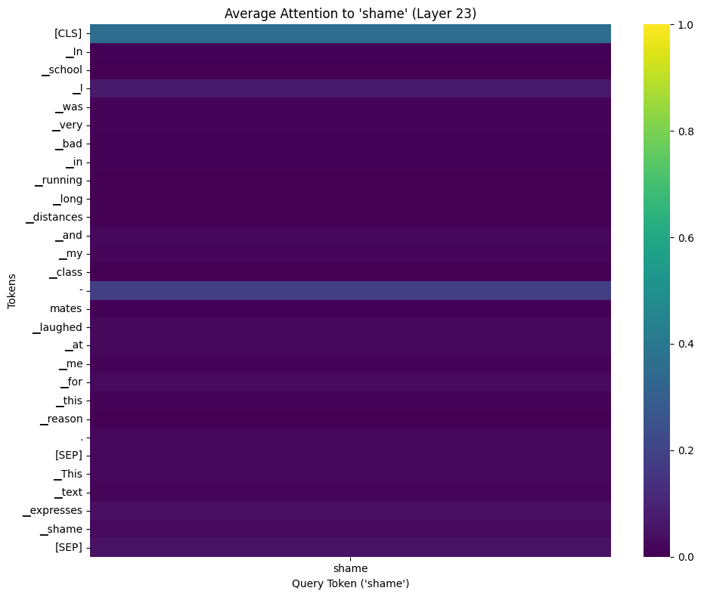
Attention visualization of the sample (after using prompt)
In this sample, the attention of the special token [CLS] was also increased.

Slide 10
Comparison of attention before and after using prompt (Isear dataset)
When using Deberta model:
Using expr prompt:
emotion | The number of data that their predictions became true after using prompt | The number of data in which [CLS] token has higher attention regarding the emotion when using prompt
disgust | 174 | 126
shame | 154 | 125
Using emotion prompt:
emotion | The number of data that their predictions became true after using prompt | The number of data in which [CLS] token has higher attention regarding the emotion when using prompt
disgust | 178 | 90
shame | 201 | 90

Slide 11
Analyzing results regarding labels when using Deberta for Tec dataset (according to last experiment)
Emotion name
emotion | anger | disgust | fear | joy | sadness | surprise
F1 score | 0.28 | 0.22 | 0.33 | 0.51 | 0.46 | 0.4
Emotion prompt (“The emotion is”+ emotion)
emotion | anger | disgust | fear | joy | sadness | surprise
F1 score | 0.37 | 0.26 | 0.45 | 0.46 | 0.45 | 0.41
The most improvements for labels fear and anger

Slide 12
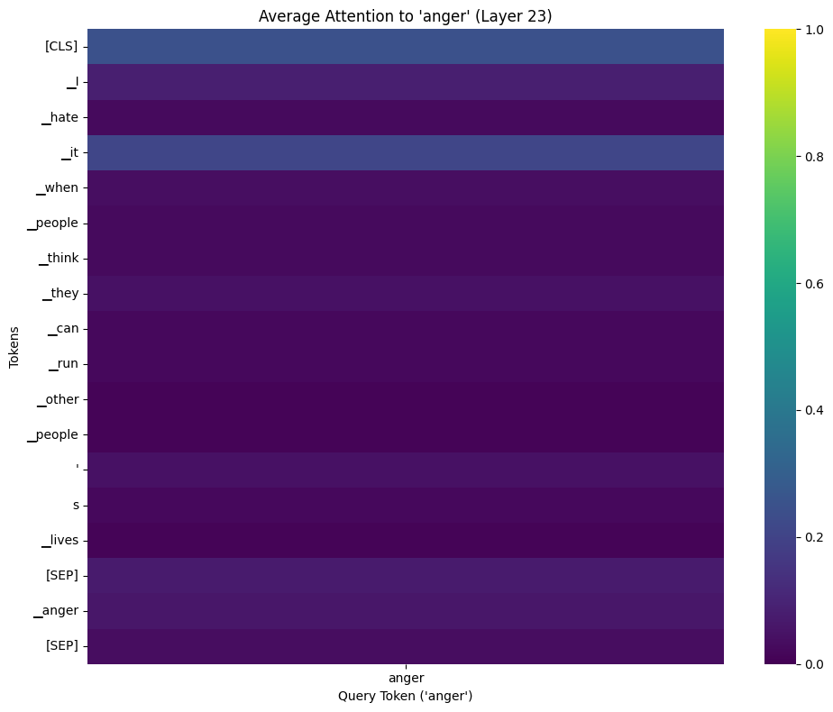
Attention visualization of one sample of Tec dataset
The sentence: I hate it when people think they can run other people's lives

Slide 13

Attention visualization of the sample (after using prompt)
the attention of the special token [CLS] was increased.

Slide 14
Comparison of attention before and after using prompt (Tec dataset)
Tec dataset: The most improvement for the emotions anger, fear.
When using Deberta model:
Using emotion prompt
emotion | The number of data that their predictions became true after using prompt | The number of data in which [CLS] token has higher attention regarding the emotion when using prompt
anger | 231 | 126
fear | 350 | 196
So adding templates can cause that the sentence gets more relevant to the emotion since the special token [CLS] can represent the entire sentence.

Slide 15
Summary of this step
In my last experiments, it was shown that using prompt can lead to improvement for some cases.
It was also shown that the improvements were for some labels more significant compared to other labels.
One idea to find the reason that I found was checking the attention of tokens regrading their relevance to the emotion before and after using prompt for the labels that their classification were more improved.
The measured attention:
The average of attentions of the heads in the last layer of the model regarding the relevance of tokens to the emotion to show how the tokens affect the emotion to make its context clear
Since Deberta model could lead to improvements when using some prompts for two dataset, I checked attention using Deberta model.

Slide 16
Summary of this step
In most samples, the attention for the special token [CLS] was increased after using prompt. Based on my findings, this special token can represent the context of the entire sentence.
So, when using Deberta model and prompt, the combination of tokens could mostly have effects to make the context of emotion clear instead of specific tokens.

