Slide 1
zero shot emotion classification in text (using prompt)
Gita Tabe Jamaat
Student ID: 237-D8905

Slide 2
Review (Data sets and models)
Datasets:
Isear dataset: 7515 data Labels: anger, disgust, fear, guilt, joy, sadness, shame
Tec dataset: 21051 data Labels: anger, disgust, fear, joy, sadness, surprise
Preprocessing datasets before doing classification:
Removing some signs such as ; , :, *, # , = , (, ), & and integers
Pre_trained NLP models:
Roberta: roberta-large-mnli,
Bart: facebook/bart-large-mnli
Deberta: microsoft/deberta-v2-xlarge-mnli

Slide 3
Review (zero shot classification)
Zero shot : Making predictions of classes that have not been seen during training
It is based on checking whether two phrases can be paraphrase of each other
So, the emotion can be considered as a text.

Slide 4
Review (Checking entailment of emotion and text)
The models return 3 scores regarding the relativeness of emotion and text (Contradiction, neutral, entailment)
Only the scores of contradiction and entailment were considered as a vector
The unnormalized scores of contradiction and entailment are converted to probabilities using softmax activation function
The emotion with highest entailment probability was considered as predicted emotion

Slide 5
Review (Zero shot classification experiment)
Isear Dataset
 | Roberta | Bart | Deberta
Accuracy | 0.51 | 0.57 | 0.57
Macro averaged F1 | 0.51 | 0.57 | 0.54
Tec Dataset
 | Roberta | Bart | Deberta
Accuracy | 0.43 | 0.41 | 0.46
Macro averaged F1 | 0.37 | 0.37 | 0.41

Slide 6
Using prompt in zero-shot classification (with more templates)
Using some templates as prompt instead of directly using emotion
Emo_name: “This text expresses”+ emotion
Expr_emo: “This person feels”+ emotion
Feels_emo: “This person expresses”+ emotion
Emotion template: “The emotion is”+ emotion
Isear dataset (deberta model):
 | Emo-name | Expr_emo | Feels_emo | Emotion
Macro-averaged F1 | 0.54 | 0.61 | 0.54 | 0.61
Accuracy | 0.57 | 0.63 | 0.55 | 0.62

Slide 7
Using prompt in zero-shot emotion classification
Isear dataset (Bart model):
 | Emo-name | Expr_emo | Feels_emo | Emotion
Macro-averaged F1 | 0.57 | 0.61 | 0.53 | 0.57
Accuracy | 0.57 | 0.61 | 0.53 | 0.57
Isear dataset (Roberta model):
 | Emo-name | Expr_emo | Feels_emo | Emotion
Macro-averaged F1 | 0.51 | 0.51 | 0.48 | 0.53
Accuracy | 0.51 | 0.51 | 0.48 | 0.52

Slide 8
Using prompt in zero-shot emotion classification
Tec dataset (deberta model)
 | Emo-name | Expr_emo | Feels_emo | Emotion
Macro-averaged F1 | 0.41 | 0.37 | 0.4 | 0.42
Accuracy | 0.46 | 0.4 | 0.4 | 0.4
Tec dataset (Bart model)
 | Emo-name | Expr_emo | Feels_emo | Emotion
Macro-averaged F1 | 0.37 | 0.36 | 0.36 | 0.4
Accuracy | 0.41 | 0.4 | 0.38 | 0.37

Slide 9
Using prompt in zero-shot emotion classification
Tec dataset (Roberta model)
 | Emo-name | Expr_emo | Feels_emo | Emotion
Macro-averaged F1 | 0.37 | 0.34 | 0.38 | 0.42
Accuracy | 0.43 | 0.37 | 0.38 | 0.38

Slide 10
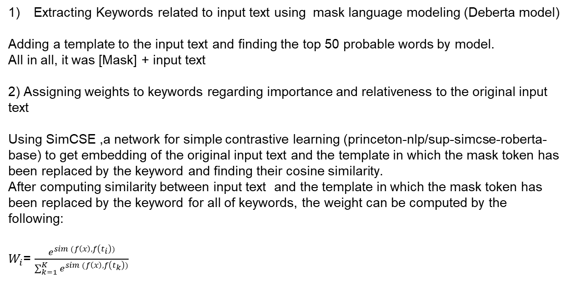
Other ideas regarding prompt based zero-shot classification
Extracting Keywords related to input text using mask language modeling (Deberta model)
Adding a template to the input text and finding the top 50 probable words by model.
All in all, it was [Mask] + input text
2) Assigning weights to keywords regarding importance and relativeness to the original input text
Using SimCSE ,a network for simple contrastive learning (princeton-nlp/sup-simcse-roberta-base) to get embedding of the original input text and the template in which the mask token has been replaced by the keyword and finding their cosine similarity.
After computing similarity between input text and the template in which the mask token has been replaced by the keyword for all of keywords, the weight can be computed by the following:
$W_{i}$= $\frac{e^{sim (f\left(x\right), f\left(t_{i}\right))}}{\sum_{k=1}^{K}{e^{sim (f\left(x\right), f\left(t_{k}\right))}}}$

Slide 11
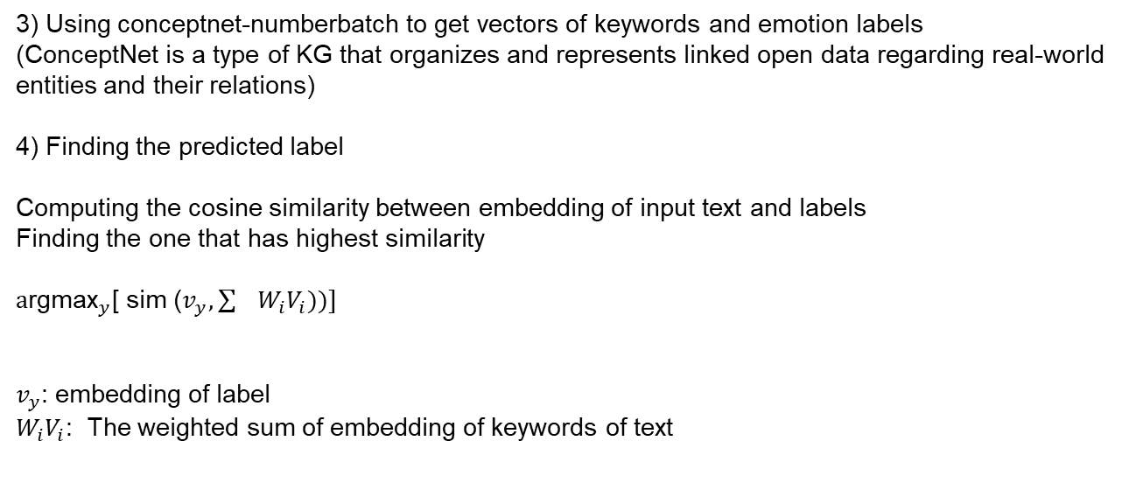
Other ideas regarding prompt based zero-shot classification
3) Using conceptnet-numberbatch to get vectors of keywords and emotion labels
(ConceptNet is a type of KG that organizes and represents linked open data regarding real-world entities and their relations)
4) Finding the predicted label
Computing the cosine similarity between embedding of input text and labels
Finding the one that has highest similarity
${\text{a}\text{rgmax}}_{y}$[ sim ($v_{y}, \sum{W_{i}V_{i})})]$
$v_{y}$: embedding of label
$W_{i}V_{i}$: The weighted sum of embedding of keywords of text

Slide 12
Another idea regarding zero-shot emotion classification using prompt
Using SimCSE , a model based on Roberta that is fine-tuned using simple contrastive learning (princeton-nlp/sup-simcse-roberta-base), to get embedding of the original input text and the template of prompt (“This text expresses”+emotion)
Computing the cosine similarity between input text and the template of prompt for each label
Selecting the label that has maximum similarity
For Isear dataset: Accuracy: %43
Macro averaged F1: %42
For TEC dataset: Accuracy: %41
Macro averaged F1: %36

