Slide 1
Prompt based zero shot emotion classification
Defense of Master thesis
Gita Tabe Jamaat
Student ID: 237-D8905
Supervisor: Professor Masayoshi Aritsugi

Slide 2
outline
Introduction
Background
Research methods
Experiments, results and analysis
Conclusion and future work

Slide 3
Introduction

Slide 4
Introduction
Recent research works on emotion classification
need predefined labels for classification.
It’s not possible to determine classes that have not been seen during training
Solution: zero shot classification
Checking the entailment of text and emotions using pre-trained model
It’s possible to use descriptions or synonyms of emotions

Slide 5
Problem statement
The recent studies have disadvantages because of training on datasets with specific labels [1].
The idea of zero shot classification can solve this problem by considering emotion as the text and doing textual emotion classification
Therefore, we can add templates at the beginning of emotions which are called prompts or use synonym of emotions by different strategies
[1] Angeliki Lazaridou, Georgiana Dinu, and Marco Baroni. 2015. "Hubness and Pollution: Delving into Cross-Space Mapping for Zero-Shot Learning". In Proceedings of the 53rd Annual Meeting of the Association for Computational Linguistics and the 7th International Joint Conference on Natural Language Processing (Volume 1: Long Papers), pages 270 280, Beijing, China. Association for Computational Linguistics.

Slide 6
Background

Slide 7
Emotion classification
Emotion classification is one of the significant works in natural language processing
It maps textual units to emotion classes
The emotion classes can be determined based on existing emotions in datasets

Slide 8
Zero shot learning
Determining classes that have not been seen during training
Therefore, it’s a kind of unsupervised method.
We can obtain a model which doesn’t need any labeled training data.
One approach for zero shot classification can be sequence pair classification

Slide 9
Natural language inference for zero shot emotion classification
It is based on checking the entailment of 2 sentences
Therefore, the emotion can be considered as a text
The emotion can be represented in different descriptions or different terms
The models can check the entailment of emotions and texts

Slide 10
Research methods

Slide 11
Proposed solution
The previous studies have shown the importance of prompt to enhance zero shot emotion classification by using pre-trained models and using prompts of emotions and synonyms of emotions [2]
These studies have limitation in showing the effects of prompts clearly and designing the guided prompts
In this work, we have analyzed the results of using prompts and use more strategies of using synonyms of emotions
Textual entailment of text and emotions
Using prompts of emotions
Using prompts of synonyms
Analyzing the results
Figure 1: The framework of proposed method
[2] Flor Miriam Plaza-del-Arco, María-Teresa Martín-Valdivia, and Roman Klinger. 2022. Natural Language Inference Prompts for Zero-shot Emotion Classification in Text across Corpora. In Proceedings of the 29th International Conference on Computational Linguistics, pages 6805–6817, Gyeongju, Republic of Korea. International Committee on Computational Linguistic

Slide 12
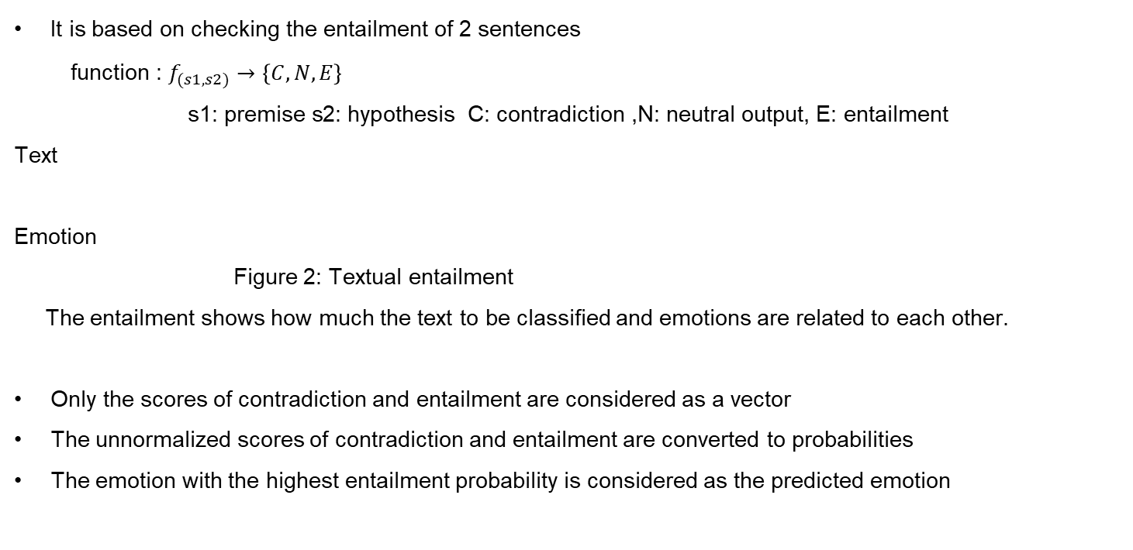
Natural language task
It is based on checking the entailment of 2 sentences
function : $f_{(s1,s2)}→\left\{C,N,E\right\}$
$$\text{s}\text{1: }\text{premise} \text{s}\text{2: }\text{hypothesis} \text{C}\text{: }\text{contradiction}\text{ ,}\text{N}\text{: }\text{neutral} \text{output}\text{, }\text{E}\text{: }\text{entailment}$$
Text
Emotion
Figure 2: Textual entailment
The entailment shows how much the text to be classified and emotions are related to each other.
Only the scores of contradiction and entailment are considered as a vector
The unnormalized scores of contradiction and entailment are converted to probabilities
The emotion with the highest entailment probability is considered as the predicted emotion
Model
Contradiction
Neutral
Entailment

Slide 13
Prompt generation
Since the emotion can be considered as text in zero-shot classification, it’s possible to add templates at the beginning of the emotions and use different descriptions of emotions which are called prompts [3].
Table 1: prompts of emotions
ID | prompt | example
emotion name | emotion name | disgust
emotion prompt | “The emotion is”+ emotion | The emotion is disgust
expr emo | “This text expresses”+ emotion | This text expresses disgust
feels emo | “This person feels”+ emotion | This person feels disgusted
[3] Wenpeng Yin, Jamaal Hay, and Dan Roth. 2019. Benchmarking Zero-shot Text Classification: Datasets, Evaluation and Entailment Approach. In Proceedings of the 2019 Conference on Empirical Methods in Natural Language Processing and the 9th International Joint Conference on Natural Language Processing (EMNLP-IJCNLP), pages 3914–3923, Hong Kong, China. Association for Computational Linguistics.

Slide 14
Using synonyms in prompts of emotions
It’s also possible to use different synonyms of emotions.
So, we can replace the synonyms of emotions in prompts and add templates at the beginning of synonyms [4].
Table 2: prompts of synonyms
ID | Prompt | example
emo-s | Emotion synonym | happy
expr-s | “This text expresses”+emotion synonym | This text expresses happiness
feels-s | “This person feels”+emotion synonym | This person feels happy
emotion-s | “The emotion is”+ emotion synonym | The emotion is happiness
[4] Bareiss Patrick; Klinger Roman; Barnes Jeremy. 2024: English Prompts are Better for NLI-based Zero-Shot Emotion Classification than Target-Language Prompts, in: WWW ’24: Companion Proceedings of the ACM on Web Conference 2024, New York,

Slide 15
Synonyms of emotions
Table 3: synonyms of emotions
emotion | synonyms
sadness | sadness, unhappiness, grief, sorrow, loneliness, depression
joy | joy, an achievement, pleasure, the awesome, happiness, the blessing
anger | anger, annoyance, rage, outrage, fury, irritation
disgust | disgust, loathing, bitterness, ugliness, repugnance, revulsion
fear | fear, horror, anxiety, terror, dread, scare
surprise | surprise, astonishment, amazement, impression, perplexity, shock
shame | shame, humiliation, embarrassment, disgrace, dishonor, discredit
guilt | guilt, culpability, responsibility, blameworthy, misconduct, regret

Slide 16
Strategies to use synonyms of emotions
Checking the entailment of different synonyms for each emotion and getting average of their entailment probabilities as the entailment probability of the emotion
Checking the entailment of different synonyms for each emotion and setting maximum of them as the entailment probability of the emotion
Combining the results of two methods by getting average of the entailment probabilities of each emotion in two results of two previous methods

Slide 17
Experiment, results and analysis

Slide 18
Datasets and Models
Datasets:
Isear dataset: 7515 data Labels: anger, disgust, fear, guilt, joy, sadness, shame
Tec dataset: 21051 data Labels: anger, disgust, fear, joy, sadness, surprise
Preprocessing datasets before doing classification:
Removing some signs such as ; , :, *, # , = , (, ), & and integers
Pre_trained Bert based models (publicly available within hugging face python library):
Deberta: microsoft/deberta-v2-xlarge-mnli
Roberta: roberta-large-mnli,
Bart: facebook/bart-large-mnli

Slide 19
Results of prompts of emotions (Isear dataset)
When using Deberta model, emotion prompt and expr emo could lead to improvement
When using Bart model, expr emo could lead to improvement.
Figure 3: The results prompts of emotions (Isear dataset)

Slide 20
Results of prompts of emotions (Tec dataset)
When using Roberta model, the emotion prompt could lead to improvement
.
Figure 4: The results of prompts of emotions(Tec dataset)

Slide 21
The results of using synonyms of emotions (the average method, Isear dataset)
The experiments of using synonyms of emotions have been done using only Deberta model.
Using average of entailment probabilities of synonyms could lead to little improvement for all prompts for the Isear dataset
Figure 5: Comparison of the results of using synonyms and using prompts of emotions (The average method, Isear dataset)

Slide 22
The results of using synonyms of emotions (the average method, Tec dataset)
Using average of entailment probabilities of synonyms couldn’t lead improvement for Tec dataset. (Using prompts of emotion names have higher performance.)
Figure 6: Comparison of the results of using synonyms and using prompts of emotions (The average method, Tec dataset)

Slide 23
The results of using synonyms of emotions( The maximum method, Isear dataset)
Using maximum of entailment probabilities of synonyms could lead to improvement just for feels_emo prompt compared to using prompt of only emotion name for the first dataset.
Figure 7: Comparison of the results of using synonyms and using prompts of emotions (The maximum method, Isear dataset)

Slide 24
The results of using synonyms of emotions (The maximum method, Tec dataset)
The prompts of emotions have better performance.
Figure 8: Comparison of the results of using synonyms and using emotion prompts (The maximum method, Tec dataset)

Slide 25
The result of combining two methods
Since emotion-s prompt had better performance compared to other prompts, the results of two previous methods for this prompt have been combined by getting average of entailment probabilities of each emotion.
Isear dataset: Macro average F1: 0.64, accuracy:0.65
Tec dataset: Macro average F1: 0.37, accuracy:0.41
it could lead to a little improvement for the first dataset

Slide 26
The effects of prompts on context of emotions
A sample sentences to compare the entailment probability of emotions with the text before and after using prompts:
Sentence: I heard part of a conversation in which one talked very low about women. (from Isear dataset)
When using prompt (adding “This text expresses” to the emotion) and Deberta model:
Before using prompt: entailment probability of the true emotion disgust: 0.66
entailment probability of the predicted emotion sadness: 0.76
After using prompt: entailment probability of the true emotion disgust: 0.83
The predicted emotion is true.

Slide 27
Comparing the prediction for some sample sentences
We can see that there are some specific tokens in the sentences that are related to the true labels. (like hurt related to anger, frustrating related to anger), but prediction by feels_emo prompt can also be reasonable
Table 4: Some sample sentences that using expr_emo could lead to improvement but feels_emo could not
True label | text | Emo name | Expr emo | Feels emo
anger | When friends try to put me down or hurt me. (Isear dataset) | fear | anger | fear
anger | It's really frustrating when your professors don't email back or show up for their office hours. (Tec dataset) | disgust | anger | fear

Slide 28
Comparing the prediction for some sample sentences
We can see that there are some tokens that are obviously related to the true emotions. (like death related to fear, cheer related to joy).
Table 5: Some sample sentences that both of expr_emo and feels_emo could lead to true prediction to them.
True label | Text | Expr emo | Feels emo
fear | Every time I imagine that someone I love or I could contact a serious illness, even death. (from Isear dataset) | fear | fear
joy | the moment when you get another follower and you cheer.(from Tec dataset) | joy | joy

Slide 29
Comparing the entailment probability for some sample sentences
The entailment probability for some sample sentences that their predictions are wrong.
When using average of entailment probabilities of synonyms
When my partner was attacked and lost three teeth. (from Isear dataset, emotion-s prompt)
True Label: anger, entailment probability: 0.84, predicted label: fear, entailment probability: 0.90
When using maximum of entailment probabilities of synonyms:
In a cottage in a large forest, I was alone for a while in the dark. (from Isear dataset, emotion-s prompt)
True label: fear, entailment probability: 0.92, predicted label: sadness, entailment probability: 0.98
These sentences have ambiguity and the entailment probabilities of true and predicted labels are close to each other.

Slide 30
The average of entailment probabilities for each emotion class (Isear dataset)
To compare the range of entailment probabilities for the cases that prediction is true and wrong, the average of entailment probabilities for each emotion class have been obtained
Table 6: The average of entailment probabilities for each emotion class (Isear dataset, when using average of entailment probabilities of synonyms, emotion-s prompt)
emotion | anger | disgust | fear | guilt | joy | sadness | shame
average (true prediction) | 0.87 | 0.9 | 0.9 | 0.86 | 0.83 | 0.88 | 0.91
average (Wrong prediction) | 0.71 | 0.62 | 0.68 | 0.75 | 0.35 | 0.6 | 0.45

Slide 31
The average of entailment probabilities for each emotion class (Tec dataset)
We can see that the range of entailment probabilities for true predictions are higher.
Table 7: The average of entailment probabilities for each emotion class (Tec dataset, when using average of entailment probabilities of synonyms, emotion-s prompt)
emotion | anger | Disgust | fear | Joy | sadness | surprise
average (true prediction) | 0.84 | 0.86 | 0.61 | 0.75 | 0.79 | 0.77
average (wrong prediction) | 0.47 | 0.52 | 0.31 | 0.23 | 0.39 | 0.57

Slide 32
Conclusion and future work

Slide 33
Conclusion
Using prompts can affect the context of emotions and sometimes lead to improvement
The synonyms of emotions have been used by different strategies, we saw that involving all of synonyms could lead to improvement
The entailment probabilities of true emotion and predicted emotion are close to each other for the sentences that have ambiguity in their content

Slide 34
Limitation and future work
Limitations
The prompts that have been used in this work were based on sample prompt types in recent studies
The texts of datasets that have been used in these experiments had different complexities and some of them had ambiguity
Future work
Designing a more guided prompt based on characteristics of datasets
If the datasets with more consistent textual features were used, the synonym adaptive methods could lead to more improvement.
Looking for a more guided synonym adaptive method

Slide 35
Thank you for listening

