Slide 1
Exercises-1 （PPT5-72 74 84）
The protocols for directly encapsulating RIP、 OSPF and BGP messages are
A. TCP、UDP、IP
B. TCP、IP、UDP
C. UDP、TCP、IP
D. UDP、IP、TCP
Notes:
D

Slide 2
Exercise-2
0010 0000 32
0010 1000 40
0011 0000 48
0011 1000 56
1. In subnet 192.168.4.0/30, the maximum number of hosts that can accept IP packets with destination address 192.168.4.3 is
A.0 B.1 C.2 D.4 主机位都是1广播地址，
2. There are four routing table entries with the same forwarding interface in a routing table, and their destination network addresses are 35.230.32.0/21, 35.230.40.0/21, 35.230.48.0/21 and 35.230.56.0/21 respectively. After aggregating the four routes, the destination network address is
A.35.230.0.0/19 B. 35.230.0.0/20
C. 35.230.32.0/19 D. 35.230.32.0/20
Notes:
1.C 32 00100 000 40 00101 000 48 00110 000 00111 000

Slide 3
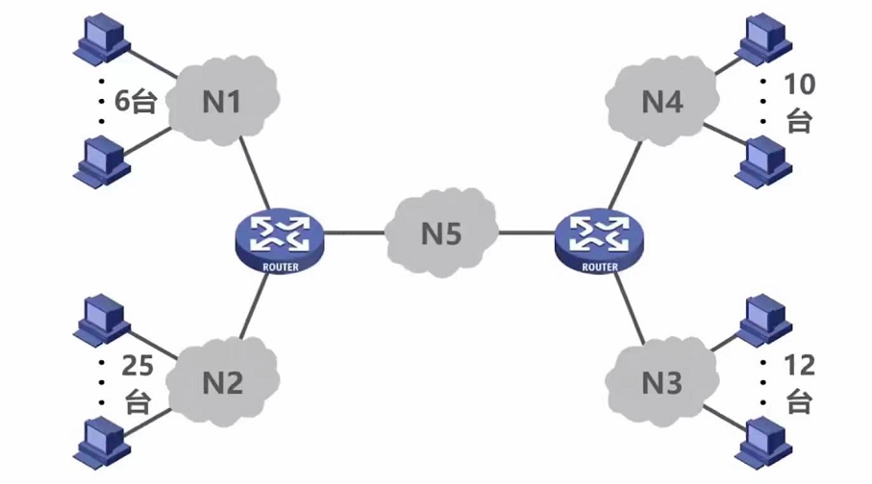
Exercises-3
Assuming that the applied IP address block is 218.75.230.0/24, please assign IP addresses to the devices in the figure below using fixed length and variable length subnet masks respectively.
00000000-00011111
0-31 分给N2 /27
00100000-00101111
32-47 分给N3 /28
00110000-00111111
48-63 分给N4 /28
01000000-01001111
64-79 分给N1 /28
01010000-01010011
80-83 分给N5 /30
84~255都没分配
00000000-00011111
0-31
00100000-00111111
32-63
01000000-01011111
64-95
01100000-01111111
96-127
10000000-10011111
128-159
10100000-10111111
160-191
11000000-11011111
192-223
11100000-11111111
193-255
Notes:
00000000-00011111
00100000-00111111 32-63
01000000-01011111
011
100
101
110
111

Slide 4
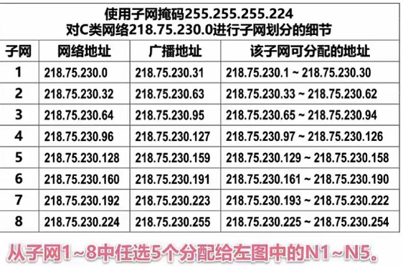
Exercises-3
Assuming that the applied IP address block is 218.75.230.0/24, please assign IP addresses to the devices in the figure below using fixed length and variable length subnet masks respectively.

Slide 5
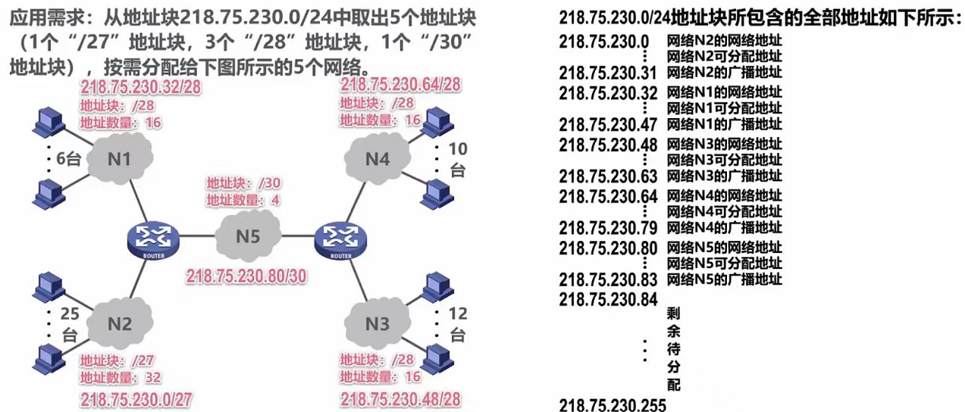
Exercises-3
Assuming that the applied IP address block is 218.75.230.0/24, please assign IP addresses to the devices in the figure below using fixed length and variable length subnet masks respectively.

Slide 6
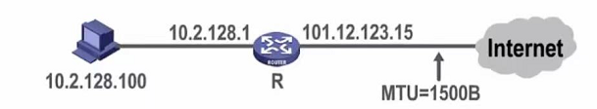
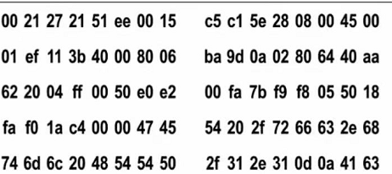
Exercises-4
Figure 1 shows the network topology, and Figure 2 shows the hex-content of the first 80 bytes of an Ethernet frame of the host for a Web request.
(1) What is the IP address of the Web server? What is the MAC address of the default gateway of this host?
(2) When the IP packet encapsulated in this frame is forwarded through router R, which fields in the IP packet need to be modified？
Fig. 1
(1)40 aa 62 20,64.170.98.32; 00-21-27-21-51-ee
(2) TTL字段，首部校验和重新计算，总长字段若大于MTU，则总长字段、标志字段、片偏移字段都需要修改
Fig. 2

