Slide 1
Concept of Verilog “Module”
In Verilog, the basic unit of hardware is called a module.
A module cannot contain definition of other modules.
A module can, however, be instantiated within another module.
Instantiation allows the creation of a hierarchy in Verilog description
Instantiation refers to replacing instanced module with its actual code.
Module module_name(list_of_ports);
input/output declarations
local net declarations
Parallel statements
endmodule
// A simple AND function
Module simpleAnd (f,x,y);
input x, y;
output f;
assign f = x& y;
endmodule
This is a behavioural description. The synthesis tool will decide how to realize f:
Using a single AND gate
Using a NAND gate followed by a NOT gate
Note : Its easier to design/implement NAND, NOT and NOR gates in CMOS technology

Slide 2
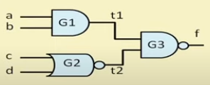
This is also behavioral description.
One possible gate level realization is shown.
T1 and t2 are intermediate lines, termed as wire data type.
Point to note:
The “assign” statement represent continuous assignment (LHS gets updated whenever RHS changes)
assign variable = expression;
LHS must be a “net” type variable, typically a “wire”
RHS can be both register and net.
The “assign” typically used for model combinational circuits.
// A 2 – level combinational circuit
Module two_level ( a, b, c, d, f);
input a, b, c, d;
output f;
wire t1, t2; // intermediated lines
assign t1 = a &b;
assign t2 = ~(c | d);
assign f = ~(t1 & t2);
endmodule

Slide 3
Data Types in Verilog
A variable in Verilog belongs to one of two data types :
1. Register
  Retains the last value assigned to it
  Often used to represent storage elements, but sometimes it can translate to combinational circuits.
2. Net
Must be continuously driven.
Cannot be used to store a value.
Used to model connections between continuous assignments and instantiations.
Represents between hardware elements.
Nets are 1 – bit values by default unless they are declared explicitly as vectors ( Default value of a net is “z” ) .
Various “Net” data types are supported for synthesis in Verilog:
  “wire” and “tri” are equivalent, when multiple drivers driving them
  “war” and “wand” inserts an OR and AND gate respectively at the connection.
  “supply0” and “supply1” model power supply connections.

Slide 4
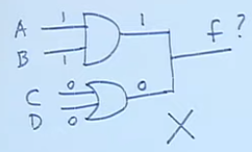
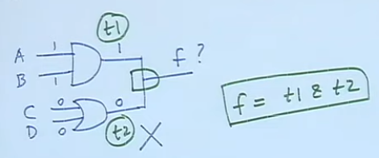
Module use_wire (A, B, C, D, f);
input A, B, C, D;
output f;
wire f; // net f declared as ‘wire’
assign f = A & B;
assign f = C | D;
endmodule
For A = B = 1, and C= D= 0,
F will be indeterminate.
Module use_wire (A, B, C, D, f);
input A, B, C, D;
output f;
wand f; // net f declared as ‘wand’
assign f = A & B;
assign f = C | D;
endmodule
Here, function realized will be
f = (A & B ) & (C | D)
Module using_supply_wire(A, B, C, D, f);
input A, B, C, D;
output f;
supply0 gnd; supply1 vdd;
nand G1 (t1, vdd, A, B);
xor G2 (t2, C, gnd);
and G3 (f, t1,t2);
endmodule
Supply0 and supply1 have the greatest signal strength

Slide 5
Data Values and Signal Strengths
Verilog supports 4 value levels and 8 strength levels to model the functionality of real hardware.
Levels are typically used to resolve conflicts between signal drivers of different strengths in real circuits.
Value Level | Represents
0 | Logic 0 state
1 | Logic 1 state
X | Unknown logic states
z | High impedance state
Strength | Type
Supply | Driving
Strong | Driving
Pull | Driving
Large | Storage
Weak | Driving
Medium | Storage
Small | Storage
high | High impedance
Note : Unconnected nets are set to “z” and register variables set to “x”

