Slide 1
agenda
Introduction 1
JVM 2
JDK 3
JRE 4

Slide 2
What is JVM
A specification where working of Java Virtual Machine is specified. But implementation provider is independent to choose the algorithm. Its implementation has been provided by Oracle and other companies.
An implementation Its implementation is known as JRE (Java Runtime Environment).
Runtime Instance Whenever you write java command on the command prompt to run the java class, an instance of JVM is created.

Slide 3
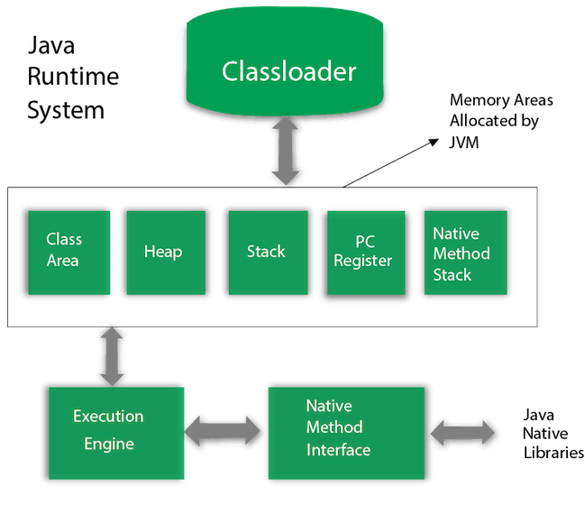
JVM Architecture

Slide 4
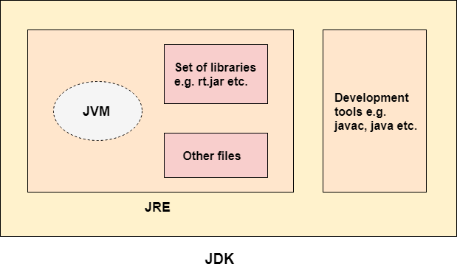
What is Jdk
JDK is an acronym for Java Development Kit. The Java Development Kit (JDK) is a software development environment which is used to develop Java applications and applets. It physically exists. It contains JRE + development tools.

Slide 5
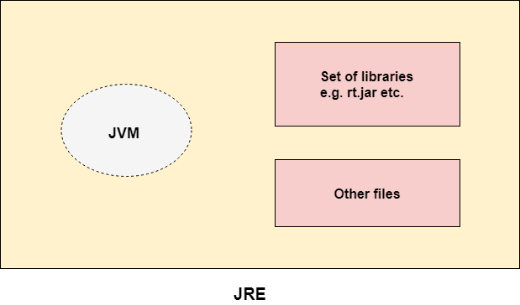
What is JRE
JRE is an acronym for Java Runtime Environment. It is also written as Java RTE. The Java Runtime Environment is a set of software tools which are used for developing Java applications. It is used to provide the runtime environment. It is the implementation of JVM. It physically exists. It contains a set of libraries + other files that JVM uses at runtime.

Slide 6
THANK YOU

