Slide 1
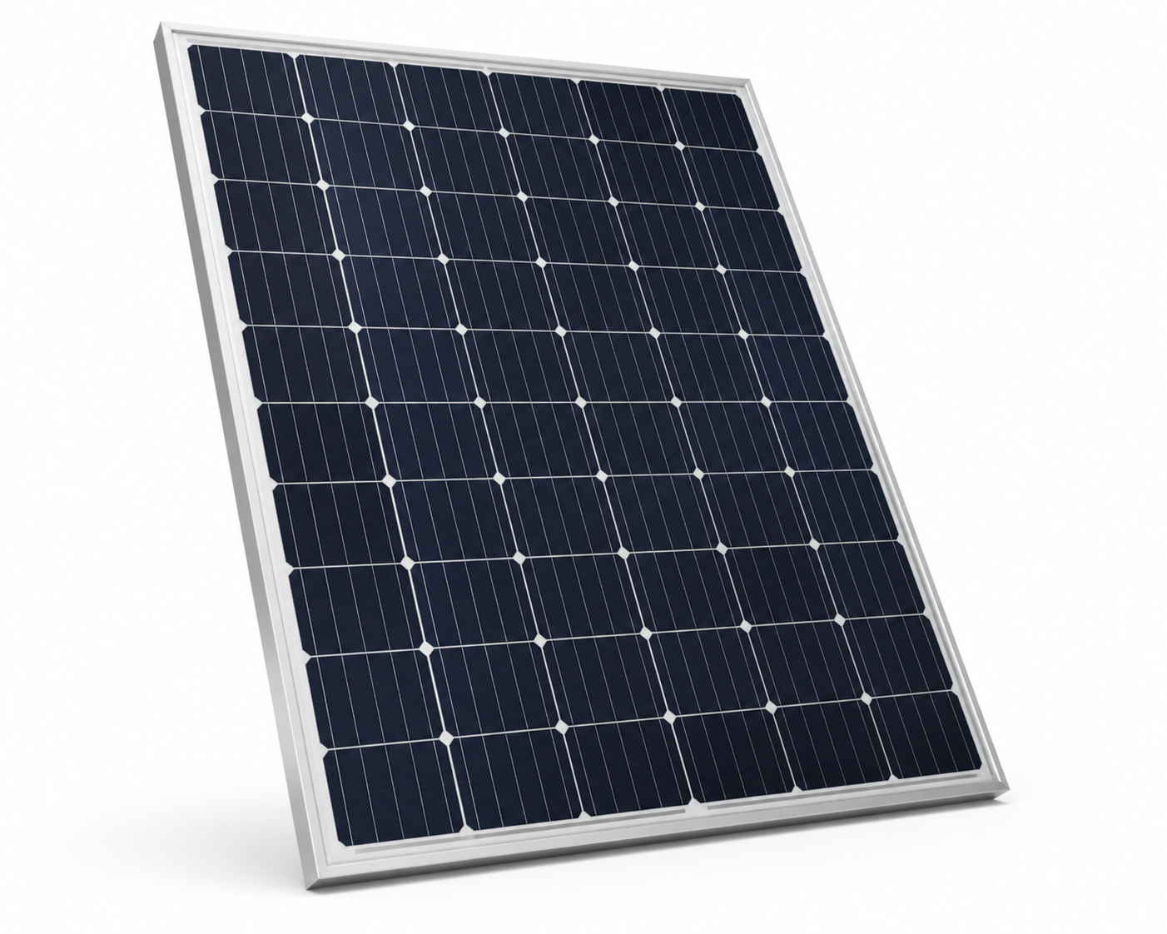
PV Panel DPP Workshop
15 minutes to build, calculate, and export one mock Digital Product Passport
1
2
3
4
0-2 min
2-10 min
10-13 min
13-15 min
Product setup
Inventory
Results
Export
Confirm PV panel, Belgium as assembly location, and reference flow.
Add the simplified material rows. The Chinese PV cell DPP is already loaded.
Check total impact, linked DPP impact, and own assembly rows.
Download the DPP package and note missing or proxy information.
Keep this interpretation visible
CN = preloaded upstream cell DPP. BE = panel assembly rows. CN-to-BE transport can be documented as an optional logistics row; it is calculated only when transport factors are available.
Output: one exported PV panel DPP package with participant-entered rows, linked cell DPP, assumptions, and GWP100 results.

