Slide 1

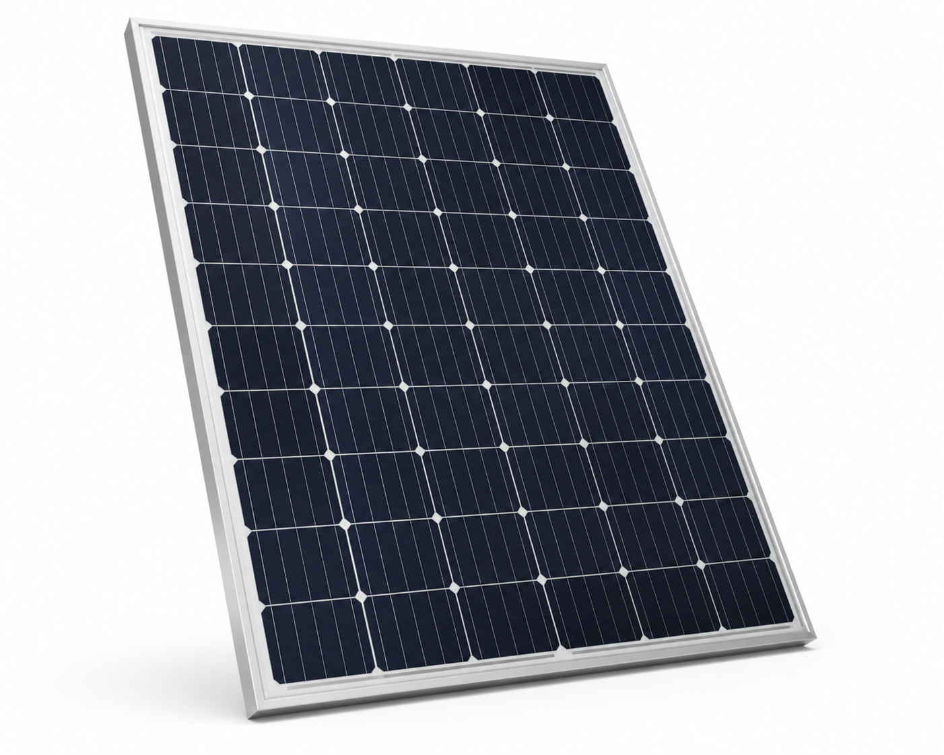
PV Panel DPP Workshop
CE-RISE
15 minutes to build, calculate, and export one mock Digital Product Passport
1
2
3
4
0-2 min
2-10 min
10-13 min
13-15 min
Product setup
Inventory
Results
Export
PV panel, Belgium assembly, reference flow.
Add material rows. Cell DPP is preloaded.
Check total, linked DPP, and own rows.
Download the DPP package and notes.
Keep this interpretation visible
CN = preloaded upstream cell DPP. BE = panel assembly rows. CN-to-BE transport can be documented as an optional logistics row; calculate it only when transport factors are available.
Output: one exported PV panel DPP package with participant rows, linked cell DPP, assumptions, and GWP100 results.

