Slide 1

Mount bind volumes
Romain Pasquier

Slide 2
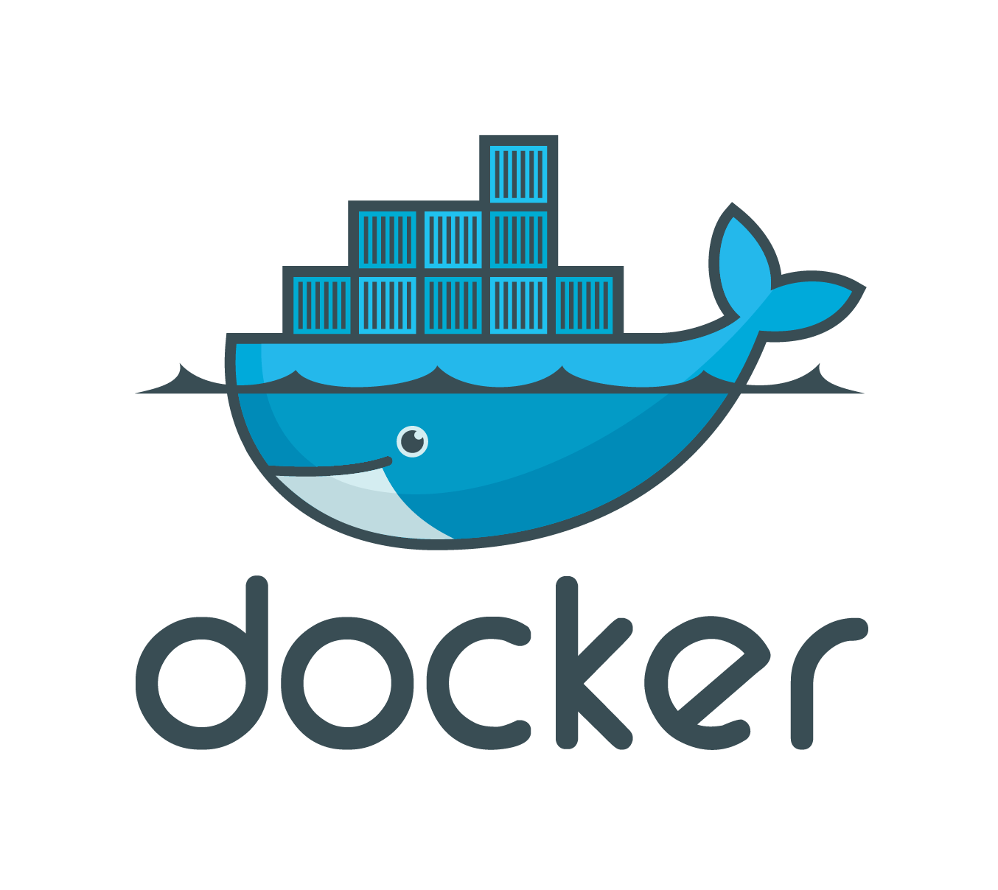
Introduction
When a Docker container is destroyed, creating a new container of the existing Docker image make it without making any changes to the original container. Therefore, you’ll lose data any time you destroy one container and create a new one.
To avoid losing data, Docker provides volumes and bind mounts, two mechanisms for persisting data in your Docker container. In this courses, we’ll examine volumes and bind mounts before looking at some examples and use cases for each.

Slide 3
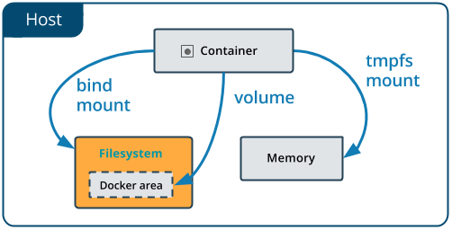
Bind Mounts
Bind mounts will mount a file or directory on to your container from your host machine, which you can then reference via its absolute path.
To use bind mounts, the file or directory does not need to exist on your Docker host already. If it doesn’t exist, it will be created on demand. Bind mounts rely on the host machine’s filesystem having a specific directory structure available. You must explicitly create a path to the file or folder to place the storage.
Another important piece of information about bind mounts is that they give access to sensitive files. According to the Docker docs, you can change the host filesystem through processes running in a container. This includes creating, modifying, and deleting system files and directories, which can have pretty severe security implications. It could even impact non-Docker processes.

Slide 4
Docker volumes
Volumes are a great mechanism for adding a data persisting layer in your Docker containers, especially for a situation where you need to persist data after shutting down your containers.
Docker volumes are completely handled by Docker itself and therefore independent of both your directory structure and the OS of the host machine. When you use a volume, a new directory is created within Docker’s storage directory on the host machine, and Docker manages that directory’s contents.

Slide 5
Benefit of using volumes
In Docker volumes, storage is not coupled to the lifecycle of the container, but instead exists outside of it. This has many benefits. For one, you can kill your container as many times as you want and still have your data persisted. It’s also easy to reuse storage in multiple containers; for example, one container writes to the storage while another reads from it.
Since volumes are not tied to any container, you can easily attach them to multiple running containers at the same time. You’ll also find that volumes don’t increase the size of the Docker container using them. Lastly, you can use the Docker CLI to manage volumes, for example, retrieving the list of volumes or removing unused volumes.

Slide 6

Use cases
When deciding when to use volumes or bind mounts, there are a few important factors to consider. If you want your storage or persisting layer to be fully managed by Docker and accessed only through Docker containers and the Docker CLI, you should choose to use volumes.
However, if you need full control of the storage and plan on allowing other processes besides Docker to access or modify the storage layer, then bind mounts is the right tool for the job.

Slide 7
Comparaison
According to the Docker documentation, using volumes is the easiest way to begin persisting data in your Docker container. Overall, bind mounts are more limited in comparison.
This insight comes as no surprised based on what we’ve seen so far. A good rule of thumb is that if you’re ever in doubt of what route to take to persist data in your Docker containers, use volumes.
One of the key differentiators of a bind mount is that a bind mount can be accessed and modified by processes outside Docker. As previously mentioned, this can be a benefit when you want to integrate Docker with other processes, but it could also cause a headache if you’re concerned with security.

Slide 8
Conclusion
Thanks for watching !

