Slide 1

Chapter Two
Introduction HTML

Slide 2
HTML
Hypertext Markup Language
is the standard markup language used to create web pages.
HTML describes the structure of a website semantically along with cues for presentation. The purpose of HTML is to add meaning and structure to the content.
its a markup language, rather than a programming language
HTML documents consist of a tree of elements and text.
Each element is denoted in the source by a start tag,
such as "<body>", and an end tag, such as "</body>".
Web browsers can read HTML files and render them into visible or audible web pages.

Slide 3
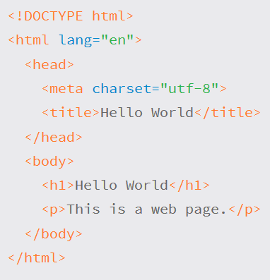
Anatomy of HTML document
The <!DOCTYPE html> declaration defines this document to be HTML.
The <html> element is the root element of an HTML page
The lang attribute defines the language of the document
The <meta> element contains meta information about the document
The charset attribute defines the character set used in the document
The <title> element specifies a title for the document
The <body> element contains the visible page content
The <h1> element defines a large heading
The <p> element defines a paragraph

Slide 4
Anatomy …
<!DOCTYPE html>
<html></html>: The <html> element.
This element wraps all the content on the entire page, and is sometimes known as the root element.
<head></head>: The <head> element.
This element acts as a container for all the stuff you want to include on the HTML page that isn't the content you are showing to your page's viewers.
This includes things like keywords and a page description that you want to appear in search results, CSS to style our content, character set declarations, and more.
<meta charset="utf-8">: This element sets the character set your document should use to UTF-8, which includes most characters from the vast majority of human written languages.
<title></title>: The <title> element.
This sets the title of your page, which is the title that appears in the browser tab the page is loaded in
<body></body>: The <body> element.
This contains all the content that you want to show to web users when they visit your page, whether that's text, images, videos, games, playable audio tracks, or whatever else.

Slide 5
HTML Anatomy ...
Stylesheet (CSS)
<head>
...
<link href=“styles.css” rel=“stylesheet”>
<head>
Javascript
<head>
...
<script src=“jscript.js”></script>
<head>

Slide 6
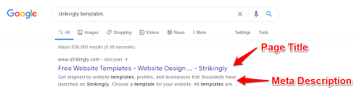
Meta Element ...
The <meta> element lives inside the <head> element and contains information about that web page.
It is not visible to users It is not visible to users but fulfills a number of purposes such as telling search engines about your page(used for SEO(Search engine Optimization)), who created it, and whether or not it is time sensitive, its description.
Used for several purpose
Putting keyword for the page that helps easier for searching
<meta name=“keyword”, content=“ IR, Information retrieval “>
To refresh the page within a fixed time interval
<meta http-equiv=“refresh” content = “5; Url=http://www.bbc.com”>
To specify character encoding schema
<meta charset=“utf-8”>

Slide 7
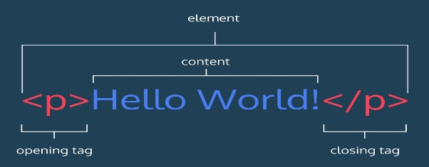
HTML Anatomy ...
Elements
Elements define the structure and content of objects within a page.
Enclosed inside angel brackets < and > : E.g. <a> , <p>, <div>, <span>, <strong>, <h1>…
meta information is placed in the head element
content information is placed in the body element
Tags
The use of less-than and greater-than angle brackets surrounding an element creates what is known as a tag.
Tags most commonly occur in pairs of opening and closing tags.
Content of the elements always falls between the opening (e.g. <p>)and closing (e.g. </p>) tag: E.g. <p> …content here…</p>
Tags have to be nested such that elements are all completely within each other, without overlapping:

Slide 8
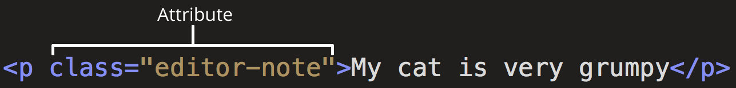
Tag, Attribute and Value
Tag
Void element: <input> <hr> <br>
Non void element:
<a>Link</a>
Attribute and Value
Attributes
Attributes are properties used to provide additional information about an element.
The most common attributes include id, class, src, herf
Attributes are defined within the opening tag, after an element’s name.

Slide 9
Tag, Attribute and Value
Generally attributes include a name and a value.
The format for these attributes consists of the attribute name followed by an equals sign and then a quoted attribute value.
E.g.
<a href="demo.html"> simple </a>
<input name=“email” value=“who@where.com”>
Atrribute: name, value
Value: email, who@where.com

Slide 10
Classifying HTML elements
top-level elements: html, head and body
head elements: placed inside the head
Title, style, link, meta, base, script
Wouldn’t display on the page
block-level elements: flow elements that behave like paragraphs
occupy 100% of available width
stacked vertically with preceding and subsequent block elements
article, h1-h6, header, footer, section, p, figure, canvas,
pre, div, ul, ol, dl, table, form, video

Slide 11
Classifying HTML elements
inline elements
phrasing elements that behave like words
flow horizontally
usually placed inside block elements
a (anchor), audio, br, code, img, em, nav, samp
span, strong, sub, sup, time, var

Slide 12
Syntax of HTML
All tags begin with < and end with >
tag name is given immediately following opening <
unrecognized tags and attributes are ignored
attributes are given following the tag name:
<tag attribute1=“value” attribute2=“value” ...>
‘ can be used instead of “
forgetting to close a quote can result in a blank page
It’s good practice to keep HTML markup lowercase.
values are case sensitive (used to).

Slide 13
Syntax of HTML
elements without closing tags are of the form <img />
ending / is optional for HTML5, needed for XHTML documents
elements must be well-formed: no bad nesting
<p>Stuff <strong></p></strong>
attributes can be in any order.
white space is allowed
between tag name and attributes
around the = sign
within attribute value (but should be avoided)

Slide 14
Standard HTML Tags
Heading
<h1>, <h2>, .... <h6>
Table
<table>, <tr>, <th>, <td>, <tbody>, <thead>
Paragraph
<p>
List
<ol>, <ul>, <li>
Image
<img>
Horizontal Line
<hr>
Form
<form>
Form Component
<input>, <select>, <textarea>
Link/Anchor
<a>
Layer Box
<div>
Formatting
<strong>, <em>, <sub>
Line Break
<br>

Slide 15
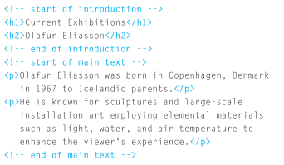
HTML Comments
If you want to add a comment to your code that will not be visible in the user's browser, you can add the text between these characters:
<!-- comment goes here -->
Comments are used to indicate where sections of the page start or end, and to pass on notes to help anyone who is looking at the code understand it.

Slide 16
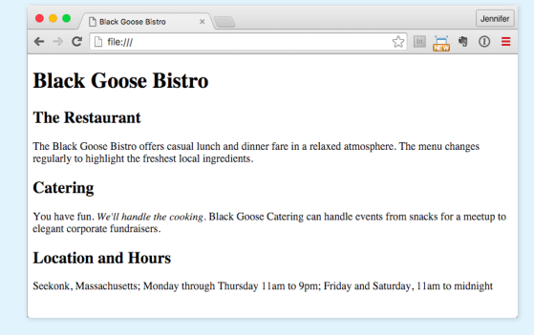
Example
Try to design web page.

Slide 17
Text Formatting
One of the components on webpage is elements used to mark up text.
A semantically marked-up document ensures your content is available and accessible in the widest range of browsing environments. i.e. ,desktop computers, mobile devices and assistive screen readers.
Search engine programs indexing programs can also correctly parse the content and make decisions about the relative importance of elements on the page.

Slide 18
Paragraph
<p> </p>
E.g. <p> Serif typefaces have small slabs at the ends of letter strokes. In general, serif fonts can make large amounts of text easier to read.</p>
Visual browsers nearly always display paragraphs on new lines with a bit of space between them by default.
Paragraphs may contain text, images, and other inline elements (called phrasing content), but they may not contain headings, lists, sectioning elements, or any elements that typically display as blocks by default.

Slide 19
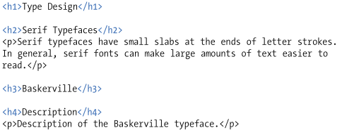
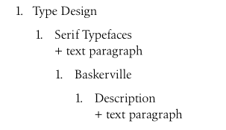
Heading
There are actually six levels of headings, from h1 to h6.
When you add headings to content, the browser uses them to create a document outline for the page.
The example below shows the markup for four heading levels and the corresponding document outline.

Slide 20
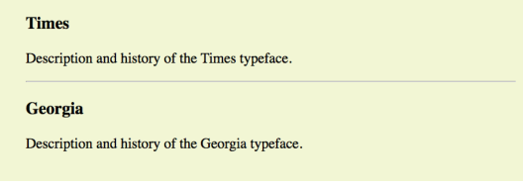
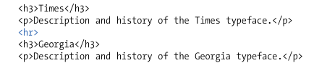
Thematic Breaks (Horizontal rule)
<hr>
To indicate one topic has completed and another one is beginning, “paragraph level thematic break” can be used with the hr element.
The element adds a logical divider between sections of a page or paragraphs.
Is an empty element.
E.g. The example below shows the usage of hr element.
N.B. Don’t use <br> interchangeably with <hr>. Br elements must be used only for line breaks that are actually part of the content, as in poems or address it should not be used for separating thematic groups in paragraph

Slide 21
Grouping Content
According to HTML5 spec there are elements that are considered “grouping content” like blockquote(long quotations), pre(preformatted text), and figure and figcaption(figures). Additional grouping contents are p,hr, list elements, main, div elements etc ..
This elements typically displayed as block elements.
Long Quotations: if the document contains a long quotation, a testimonial, or a section of copy from another source, mark the content using blockquote element.
It is recommended that content within blockquote elements be contained in other elements, such as paragraphs, headings, or lists, as shown in the example:

Slide 22
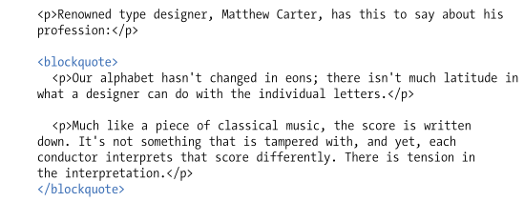
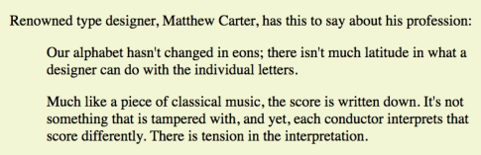
Cont’d[blockquote]
There is also an inline element q for short quotation in the flow of text. In this case the browser simply puts a quotation around the content inside the tag.

Slide 23
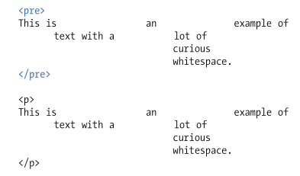
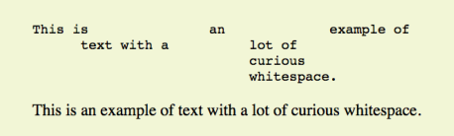
Cont’d[Grouping Content]
Preformatted Text: The browsers ignore whitespaces such as line returns and character spaces in the source document. But in some types of information white space is semantically significant like code examples or certain poems .
For content in which whitespace is semantically significant, use the preformatted text (pre) element.
It is a unique element in that it is displayed exactly as it is typed—including all the carriage returns and multiple character spaces.

Slide 24

Inline elements
Semantic meaning can be provided to phrases within the chunks by using what the HTML5
specification calls text-level semantic elements (inline elements).
displayed in the flow of text by default and do not cause any line breaks.
Emphasized text: <em> it is used to indicate which part of a sentence should be stressed or emphasized.
Emphasized text (em) elements nearly always display in italics by default. [it can be changed using stylesheet]
The placement of em elements affects how a sentence’s meaning is interpreted.
E.g.

Slide 25
Cont’d [em]
N.B Screen readers may use a different tone of voice to convey stressed content, which is why you should use an em element only when it makes sense semantically, not just to achieve italic text.
Important text: The strong element indicates that a word or phrase is important, serious,
or urgent.
the strong element identifies the portion of instructions that requires extra attention.
The strong element doesn’t change the meaning of the sentence; it merely draws attention to the important parts.

Slide 26
Cont’d [strong]
Visual browsers typically display strong text elements in bold text by default.
N.B Screen readers may use a distinct tone of voice for important content, so mark text as strong only when it makes sense semantically, not just to make text bold.
Presentational Inline elements
These elements provide typesetting guidelines to enclosed text.
However, if a type style change is all our intention, using a style sheet rule is the appropriate solution.
The next table shows these elements and the alternative style sheet alternatives.

Slide 27
Element | description | CSS Property
b | Keywords, product names, and other phrases that need to stand out from surrounding text without conveying added meaning. | font-weight: bold
i | Indicates text that is in a different voice or mood than the surrounding text, such as a phrase from another language, a technical term, or a thought. | font-style: italic
s | Indicates text that is no longer accurate or relevant (but that should not be deleted). | text-decoration: line-through
u | There are a few instances when underlining has semantic significance. N.B underlined text is easily confused with a link and should generally be avoided except for a few niche cases. | text-decoration: underline
small | Indicates an addendum or side note to the main text. | font-size: 70%

Slide 28

Additional Inline Elements
Abbreviations and acronyms: abbr element provides useful information for search engines, screen readers, and other devices by marking up acronyms and abbreviations.
Abbreviations are shortened versions of a word ending in a period (“Conn.” for “Connecticut,” for example).
Acronyms are abbreviations formed by the first letters of the words in a phrase (such as NASA or USA).
The title attribute provides the long version of the shortened term, as shown in below.

Slide 29


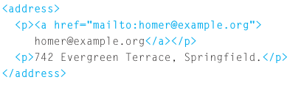

Cont’d [Additional inline elements]
Element | Purpose | Example
cite | used to identify a reference to another document, such as a book, magazine, article title, and so on. Citations are typically rendered in italic text by default.
dfn | The first time you explain some new terminology in a document, it is known as the defining instance of it.
address | it contains contact details for the author of the page. It can contain a physical address, but it does not have to. For example, it may also contain a phone number or email address.
Subscript & superscript | The subscript (sub) and superscript (sup) elements cause the selected text to display in a smaller size, positioned slightly below (sub) or above (sup) the baseline.

Slide 30
Generic Elements (DIV and SPAN)
The div element indicates a division of content, it is known as generic block-level element, and span indicates a word or phrase for which no text-level element currently exists, it is known as generic inline elements.
The generic elements are given meaning and context with the id and class attributes.
The div and span elements have no inherent presentation qualities of their own, but we can use style sheets to format them however we like.
Divide it up with a div
The div element is used to create a logical grouping of content or elements on the page. It indicates that they belong together in a conceptual unit or should be treated as a unit by CSS or JavaScript.

Slide 31
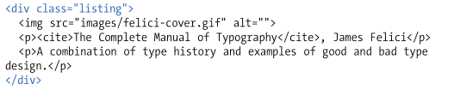

Cont’d
In other words, we can give context to the elements in the grouping.
The below example show the usage of div element. Here the div element is used as a container to group an image and two paragraph.
div also used to break a page into sections for layout purposes. In this example, a heading and several paragraphs are enclosed in a div and identified as the “news” division:

Slide 32
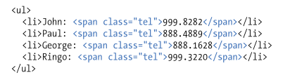
Define a Phrase with span
A span offers the same benefits as the div element, except it is used for phrase elements and does not introduce line breaks.
Because spans are inline elements, they may contain only text and other inline elements (in other words, you cannot put headings, lists, content-grouping elements, and so on, in a span)
For example, There is no telephone element, but we can use a span to give meaning to telephone numbers. In this example each telephone number is marked up as a span and classified as “tel”.

Slide 33
List
HTML provides elements for marking up three types of list:
All list elements (the list themselves and the items that go in them) are displayed as block elements by default.
Unordered lists
( Collections of items that appears in no particular order).
Ordered lists
( lists in which the sequence of the items is important).
Description lists
( lists that consist of name and value pairs, including but not limited to terms and definitions).

Slide 34
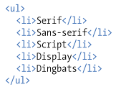
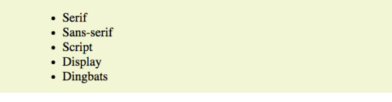
Unordered List (<ul> .. </ul>)
By default, unordered lists display with a bullet before each list item, but can be changed that with a style sheet.
To identify an unordered list, mark it up as a ul element. The opening <ul> tag goes before the first list item, and the closing tag </ul> goes after the last item. Then to mark up each item in the list as a list item (li), enclose it in opening and closing li tags, as shown in this example.
N.B. The only thing that is permitted within an unordered list is one or more list items. You can’t put other elements in there, and there may not be any untagged text.

Slide 35
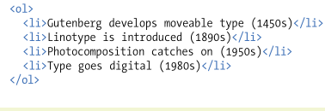
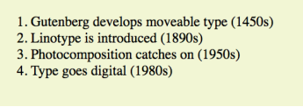
Ordered List (<ol> .. </ol>)
Ordered lists are for items that occur in a particular order, such as step-by-step instructions or driving directions.
They work just like the unordered list but they are defined with the ol element. Instead of bullets, the browser automatically inserts numbers before ordered list items.
If we want a numbered list to start at a number other than 1, we can use the start attribute in the ol element to specify another starting number. <ol start=“10”>
You can use the list-style-type style sheet property to change the bullets and numbers for lists

Slide 36
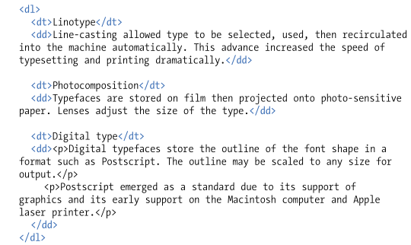
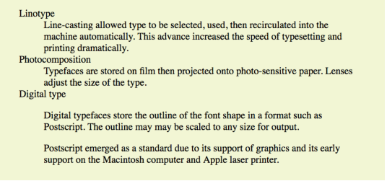
Description List (<dl> .. </dl>)
Description lists are used for any type of name/value pairs, such as terms and their definitions, questions and answers, or other types of terms and their associated information.
The whole description list is marked up as a dl element. The content of a dl is some number of dt elements indicating the names, and dd elements for their respective values.

Slide 37
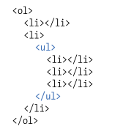
Cont’d (lists)
Any list can be nested within another list, it is just to be placed within a list item. This example show the structure of an ordered list nested in the second item of an ordered list.
When you nest an unordered list within another unordered list, the browser automatically changes the bullet style for the second-level list.

Slide 38
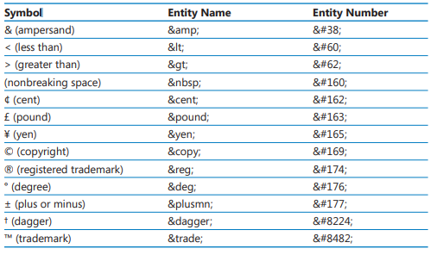
Inserting Special Characters (<dl> .. </dl>)
In HTML special characters are referred to as entities , and they are created by using codes beginning with an ampersand (&), followed by entity name or an entity number.
For example &nbsp; or &#160 both render as a non-breaking space.

Slide 39
Link (<a> … </a>)
The web is based on hyperlinks. Each webpage contains active links to other pages, which in turn link to even more webpages.
Your activate a hyperlink by clicking a designated bit of text or a graphic that, depending on the link takes to a different location on the page.
opens a different webpage,
Start an email-message,
downloads a file,
lets you view a movie or listen to a sound clip etc.
The <a> tag, which is used to create various types of hyperlinks. It is known as anchor element (hypertext link).
It starts with the <a> tag, and then uses href attribute which provides the URL or the path to the destination.

Slide 40
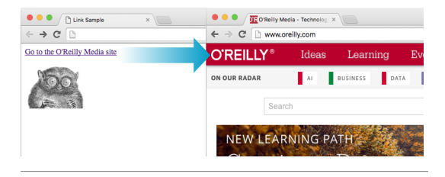
Cont’d[Link]
Nearly all graphical browsers display linked text as blue and underlined by default.
Visited links generally display in purple opens a different webpage.
Example
<a href="http://www.oreilly.com">Go to the O'Reilly Media site</a>

Slide 41
Cont’d[Link]
href Attribute: provides the address of the page or resource (its URL) to the browser.
The URL must always appear in quotation marks.
In most case the URL points to HTML documents, but can point to other web resources, such as images, audio and video files.
There are two ways to specify the URL:
Absolute URLs
Relative URLs
Absolute URLs: provide the full URL for the document, including the protocol (http:// or https://), the domain name, and the path name as necessary. we need to use an absolute URL when pointing to a document out on the web (i.e., not on our own server): This is known as external link.

Slide 42
Cont’d[Link]
Relative URLs: describe the pathname to a file relative to the current document.
can be used when we are linking to another document on our own site (i.e., on the same server)
It doesn’t require the protocol or domain name—just the pathname:
A relative pathname describes how to get to the linked document starting from the location of the current document.
In order to see the how relative URL works we use the following site structure.

Slide 43
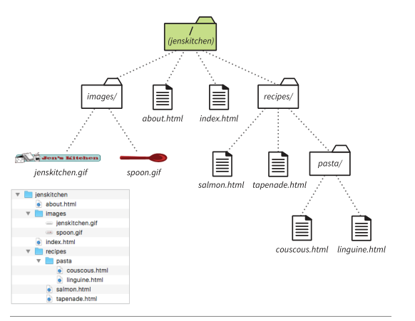
How Relative URL works (three scenarios)
Linking within a Directory
E.g. how to make a link from index.html to about.html
Soln = provide only the name of the file (its file name).
From index.html
<a href=“about.html”> About the site … </a>
Linking to a Lower Directory
E.g. how to make a link from index.html to a file in the
Recipes directory called salmon.html
Soln = The pathname in the URL tells the browser to
look in the current directory for a directory called
recipes, and then look for the file salmon.html
From index.html
<a href=“recipes/salmon.html”> Garlic Salmon </a>

Slide 44
How Relative URL works (cont’d)
Linking to a higher Directory
E.g. how to make a link from salmon.html to back to
home page (index.html)
Soln = use dot-dot-slash (../), it is like telling “back up one
directory level up”
<a href=“../index.html”> [Back to home page] … </a>
How to link from linguine.html back to index.html??

Slide 45

Linking to a Specific Point in a Page
Providing shortcuts to some part of information can be very useful.
E.g. providing shortcuts to information at the bottom of a long scrolling page or for getting back to the top of a page with just one click or tap. This is known as linking to a document fragment.
Linking to a particular location within a page is a two-part process. First, identify the destination, and then make a link to it. To create a destination, use the id attribute to give the target element. This id attribute in this case acts like fragment identifier.
The following example shows the step. In the glossary page the author wants users to able to link directly to the “H” heading. So the first step will be identifying the heading as follows.

Slide 46
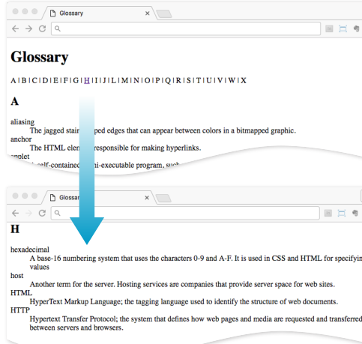
Cont’d
The second step will be linking to the destination, At the top of the page link is created to point “startH” fragment. To indicate that the destination is fragment (#) octothorpe, hash, pound, or number symbol, before the fragment name.

Slide 47
Cont’d
Linking to Fragment in Another document
Link can be created to points to a fragment in another document.
The step is to add the fragment name to the end of the URL (absolute or relative).
Example
To make a link to the “H” heading of the glossary page from another document in same directory, the URL would look like this:
To make a link to specific destinations in pages on other sites by putting the fragment identifier at the end of an absolute URL.

Slide 48
Cont’d
Setting a target window
By default, a hyperlink opens the referenced page in the same browser window. That means the new page replaces the previous page in your browser. Usually this is fine, but in some cases you might want to open in a new window.
To direct the hyperlink to open a page in a new window, add the attribute target=“_blank” to the <a> tag.
N.B Before deciding whether to start a link in a new window, consider carefully the benefits outweigh the potential drawbacks.

Slide 49
Cont’d
Hyperlinking to an E-mail Address
You can create e-mail hyperlinks, for example that start the user’s default e-mail program, create a new message and enter the recipient’s address.
<a href="mailto:support@adatum.com">Contact Us</a>
Contact <a href="mailto:support@adatum.com">support@adatum.com </a>
< a href="mailto:support@adatum.com?subject=Comment">Contact Us </a>
<a href="mailto:support@adatum.com" title="Please contact us with questions or comments"> support@adatum.com </a>
Hyperlinking to Telephone
Telephone links are the ones that you tap to call a number on phone-capable devices.
The syntax uses the tel: protocol.

Slide 50
Image (<img>)
Images appear on web pages in two ways: embedded in the inline content or as background images.
You can’t put just any image on a web page; it needs to be in one of the web-supported formats.
For images made up of grid of colored pixels PNG, JPEG or GIF file formats is used.
For vector images, such as the kind of icons and illustrations created by Adobe illustrator SVG format is used.
The <img> element is used to add an inline image. It tells the browser “Place an image here”. Images stay in flow of text, aligned with the baseline of the text, and do not cause any line breaks. (HTML5 call this a phrasing element).

Slide 51
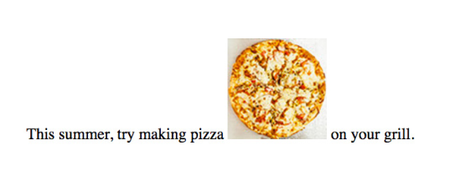
Cont’d
E.g.
When the browser sees the img element, it makes a request to the server and retrieves the image file before displaying it on the page.
The src and alt attributes shows in the examples are required. The src(source) attribute provides the location of the image file(its URL). The alt attribute provides alternative text that displays if the image is not available or for those who are not able to see it.
The img element is an empty and inline element.
The img element is what’s known as a replaced element because it is replaced by an external file when the page is displayed.

Slide 52
Cont’d
If an image does not add anything meaningful to the text content of the page, it is recommended that you leave the value of the alt attribute empty (null).
Width and Height: attributes indicates the dimensions of the image in number of pixels. Browsers use the specified dimensions to hold the right amount of space in the layout while the images are loading rather than reconstructing the page each time a new image arrives.
we can be use image as a link. <a href=“” > <img src=“” alt=“”> </a>
N.B These attributes have less useful in the age of modern web development. It is better to use responsive image techniques.
Reading Assignment (Responsive Image Markup)

Slide 53
Cont’d
Image Map: You have seen how image can be used as a hyperlink, but sometimes you might want different areas of the image to hyperlink to different locations. For example, suppose you have a map of the United States, and you want the user to be able to click individual states to view a page containing information specific to different location. In this case we must use image map.
The <map> tag in HTML defines image mapping in HTML. The map is overlaid on the image. An image map is clickable link area. The <area> tag is used along with the <map> tag to generate a clickable link area(define the clickable area). Image map combine two different components:
A map of defined linked area
An image
Syntax
<img src=“” usemap=“#map_name”>
<map name=“map_name”>
<area href=“link” coords=“coordinates of selected shape” shape=“circle/rect/poly”>
</map>

Slide 54
Table
Html tables were created when we need to arrange data into rows and columns.
Used to organize schedules, product comparisons, statistics, inventory or other types of information.
The data can be any sort of information including numbers, text elements, and even images and multimedia objects.
The intersections of rows and column which form cells. Each cell is a distinct area, into which you can place text, graphics, or even other tables.

Slide 55
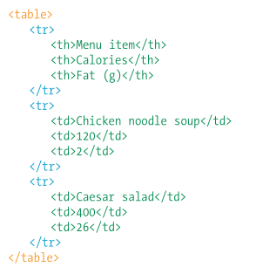
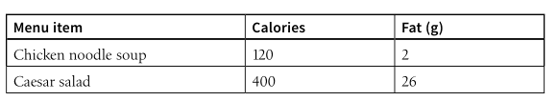
Creating and Formatting Table
The <table> tag creates an HTML table. Within that tag, you include one or more <tr> tags, which define the table’s rows, and within each <tr> tag, you define one or more <td> tags, which define the cells. One of cells can be <th> tag, which define table headers. <th> element is like the <td> element but its purpose is to represent the heading for either a column or rows. <th> element helps scrren readers and improves the ablity for search engines to index the page.

Slide 56
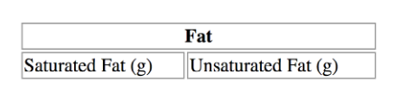
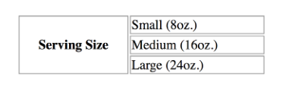
Spanning Cells
Streching of a cell to cover several rows or column.
Allows to create complex table structure.
rowspan and colspan is used to span cells and applied in the th or td elements.
To merge a cell into adjacent cells to its right, use the colspan attribute and specify the number of columns to be spanned, like this:
<th colspan=“2"> Fat </th>
To merge a cell into adjacent cells below it, use the rowspan attribute and specify the number of rows to be spanned, as shown in the following:
<th rowspan=“3"> Serving Size </th>

Slide 57
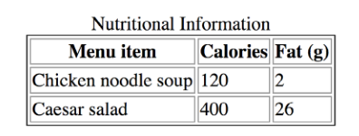
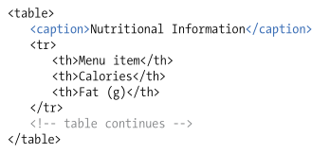
Table Accessibility
Html Specification Provides measures to improve the experience and make the content understandable.
Describing Table Content
<caption> element is used to give table a title or description about the content or provide hints on how it is structured.
Captions are usually displayed next to the table (generally above it).

Slide 58
Cont’d [Table Accessibility]
Connecting cells and header
The scope and headers attributes allow authors to explicitly associate headers and their respective content.
The scope attribute associates a table header with the row, column, group of rows or column group by using values row, col, rowgroup or colgroup respectively.
The scope attribute tells the browser and screen reader that everything under the column is related to the header at the top and everything to the right of the row header is related to that header.
The headers attribute is usually used when data cells are associated with more than one row or one column header.

Slide 59
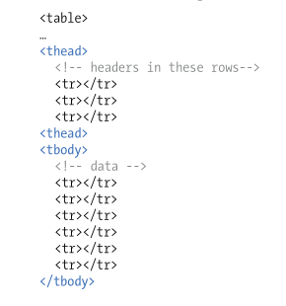
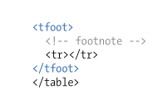
Long Tables
Tables in real world can be complex in this case conceptual table grouping provides additional semantic structure .
Tables can have a group of rows and columns.
Row Group Elements: we can describe rows or groups of rows as belonging to a header, footer, or the body of a table by using the thead, tfoot, and tbody elements, respectively.

Slide 60
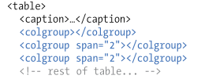
Long Tables
Column Group elements: columns are implied by the number of cells (td or th) in each row. Columns can be semantically grouped (and assign id and class attribute) using colgroup element.
Column groups are identified at the start of the table just after caption (if there is available).
The no of columns a colgroup represent is specified with span attribute.

