Slide 1



OPENEVOLVE-TUNED L2 CACHE PREFETCH ROUTING
Route the next epoch
Mixture of Prefetchers
Use recent usefulness counters to choose MLOP, SPP+PPF, both, or the off action.
Tune a small policy
OpenEvolve changes budget, score weights, accuracy floor, and tie margin.
A compact router chooses between MLOP and SPP+PPF after each epoch, then OpenEvolve tunes the policy dictionary.
Claim the right result size
MoP-V2 reaches 1.066x on 13 training-split validation traces and 1.003x on heldout.
Final claim size: strong 13-trace training-split validation result, modest heldout generalization over disabled prefetching.
CMU 15-740 class project. Disabled prefetching is the 1.000x reference throughout.

Slide 2
What we built on Athena
The project adds a router layer and a small policy-search loop above existing Athena L2C prefetchers.
ROUTER NAMES
EVIDENCE LAYER
MoP-V1
Manual one-epoch probe router. It probes both experts, then routes to the higher-scoring expert.
Epoch-level counters record issued and useful prefetches.
OpenEvolve edits a small literal policy dictionary.
MoP-V2
OpenEvolve-tuned router. It keeps the same public role and tunes budget, scoring, and tie behavior.
Generated candidate records preserve valid scored rows and fail-closed rows.
Experts
MLOP and SPP+PPF are the two Athena L2-cache prefetchers used by this router.
Report tables and figures rebuild from simulator summaries.

Slide 3
Trace protocol and comparators
All performance numbers use disabled prefetching as 1.000x. Best expert is a per-trace reference.
FIXED SETUP
COMPARISON LADDER
Cache
Athena L2C
Disabled
Universal 1.000x baseline.
Expert pair
MLOP + SPP+PPF
Best expert
max(MLOP, SPP+PPF) per trace, then geomeaned. It is colored dark blue in the result plots.
Official split
24 traces total: 17 training, 7 heldout
Final validation
13 available training traces, 500K warmup, 1M simulation
Worse expert
Minimum practical check for whether routing clears the weaker constituent prefetcher.
Heldout
7 frozen traces, 20M warmup, 50M simulation
Epoch
500K retired instructions
Simple routers
WinnerTakeAll, OneShotFit, and Athena MAB appear as small baselines.

Slide 4
OpenEvolve changed a small policy dictionary
The search could tune router settings and numeric policy weights while the trace split and simulator stayed fixed.
SELECTED MOP-V2 POLICY
SELECTION SCORE
Budget
9,216 prefetches per 500K-instruction epoch, about 18.4 per 1K retired instructions
Weighted score combines closeness to best expert, IPC over disabled prefetching, margin over the worse expert, tail-loss penalty, and off-action penalty.
Probe
One initial dual-expert probe epoch
Guardrails
Accuracy floor 30 and 3% close-score tie margin
Weights
Accuracy 1.0, coverage 0.55, traffic 1.0
Candidate programs received failure scores for simulator failures, unknown policy keys, helper/import code, and missing evolve markers.
Ledger
Rows
All candidates
374
Valid scored
306
Fail-closed
68

Slide 5
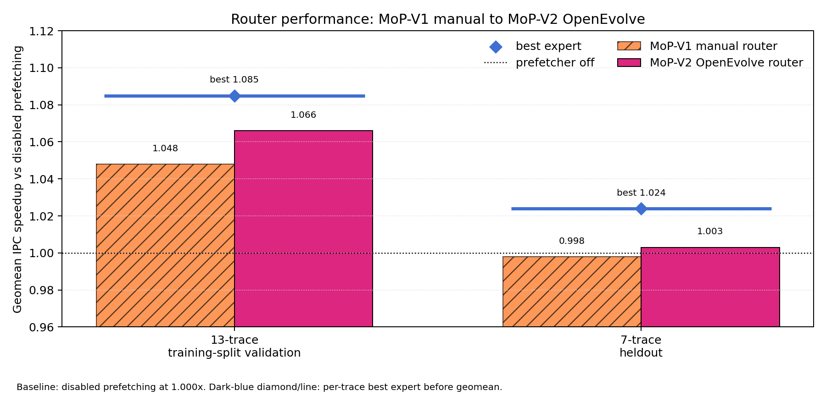
Training-split validation is the main win
Disabled prefetching is 1.000x. Dark blue is best expert, orange is MoP-V1, and pink is MoP-V2.
Caption: The 13-trace validation bars show the main gain from MoP-V1 to MoP-V2. The 7-trace heldout bars show the smaller post-selection result. Prefetcher off is black at 1.000x and best expert is dark blue.

Slide 6
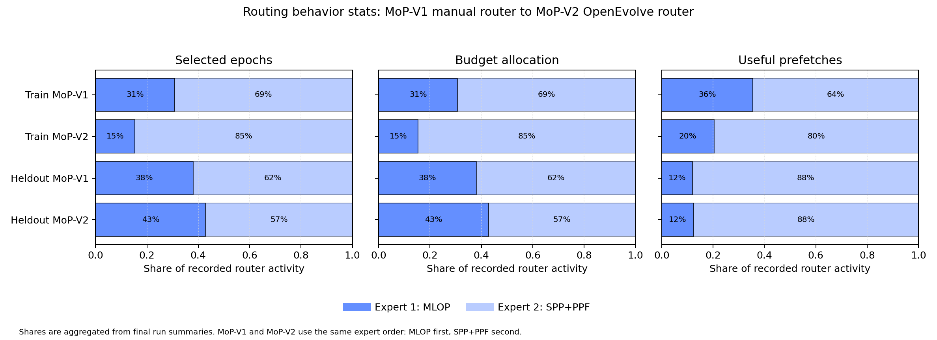
The numeric result is stronger on training than heldout
Training-split validation carries the quantitative weight. Heldout supports a modest generalization claim.
Surface
MoP-V1
MoP-V2
Best expert
13-trace speedup
1.048x
1.066x
1.085x
13-trace % best
96.5%
98.3%
100.0%
Beats worse expert
9/13
11/13
Below 95% best
3/13
2/13
7-heldout speedup
0.998x
1.003x
1.024x
7-heldout % best
97.6%
97.9%
100.0%
The IPC movement is cycle movement under a fixed retired-instruction window: MoP-V2 has instruction-count ratio 1.000x on both final runs, with cycle-count ratio 0.938x on training-split validation and 0.997x on heldout.
Caption: The routing-behavior plot uses final run summaries to show selected-epoch share, budget share, and useful-prefetch share for MoP-V1 and MoP-V2.

Slide 7
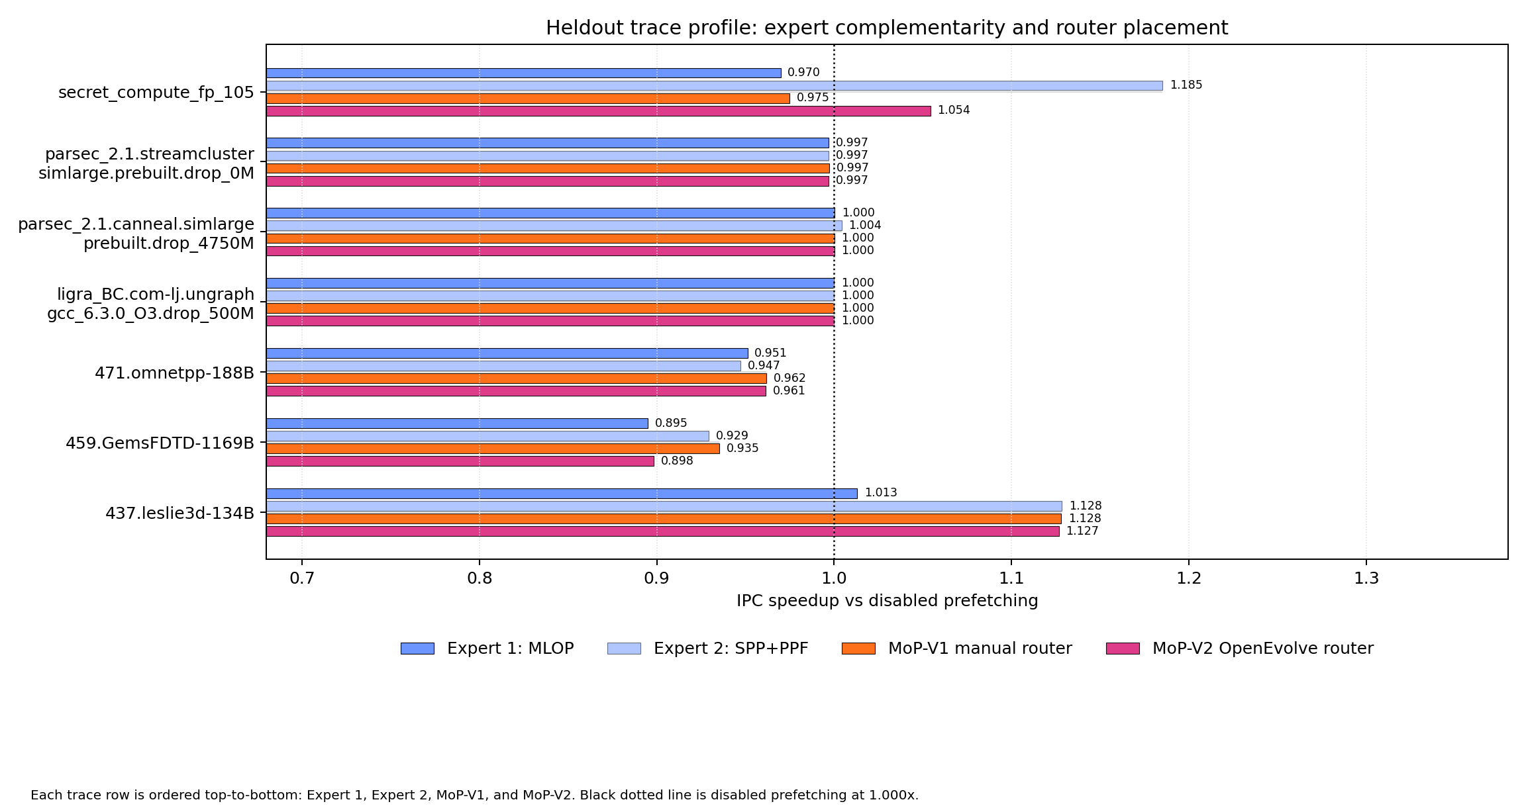
Heldout behavior is trace-specific
Within each heldout trace the profile order is Expert 1, Expert 2, MoP-V1, MoP-V2. The 1.000x line is disabled prefetching.
Caption: The single experts share one blue hue with different opacity, MoP-V1 is orange, MoP-V2 is pink, and the black vertical line is disabled prefetching at 1.000x.

Slide 8
The expert pair gives routing something real to choose
MLOP and SPP+PPF have different strengths across traces, so the router has a meaningful selection problem.
1.024x
SPP+PPF heldout geomean over disabled prefetching
0.974x
MLOP heldout geomean over disabled prefetching
The best-expert reference is computed per trace, then geomeaned. It is a reference curve for routing quality.
Caption: The heldout trace profile shows where MLOP, SPP+PPF, MoP-V1, and MoP-V2 land relative to disabled prefetching at 1.000x.

Slide 9
MoP-V2 clears the simple router baselines
WinnerTakeAll and OneShotFit are intentionally small baselines for the same expert pair.
WinnerTakeAll
Picks the expert with the stronger previous-epoch usefulness score.
OneShotFit
Probes the experts once, then keeps the better early winner.
Athena MAB
Athena's multi-armed-bandit router baseline for the same expert pair.
13-trace method
Speedup
% best
MoP-V2
1.066x
98.3%
WinnerTakeAll
1.025x
94.3%
OneShotFit
1.027x
94.3%
Athena MAB
1.021x
94.2%
Caption: MoP-V2 improves over MoP-V1 on the 13-trace validation set, while the heldout effect is smaller and shown after policy selection.

Slide 10
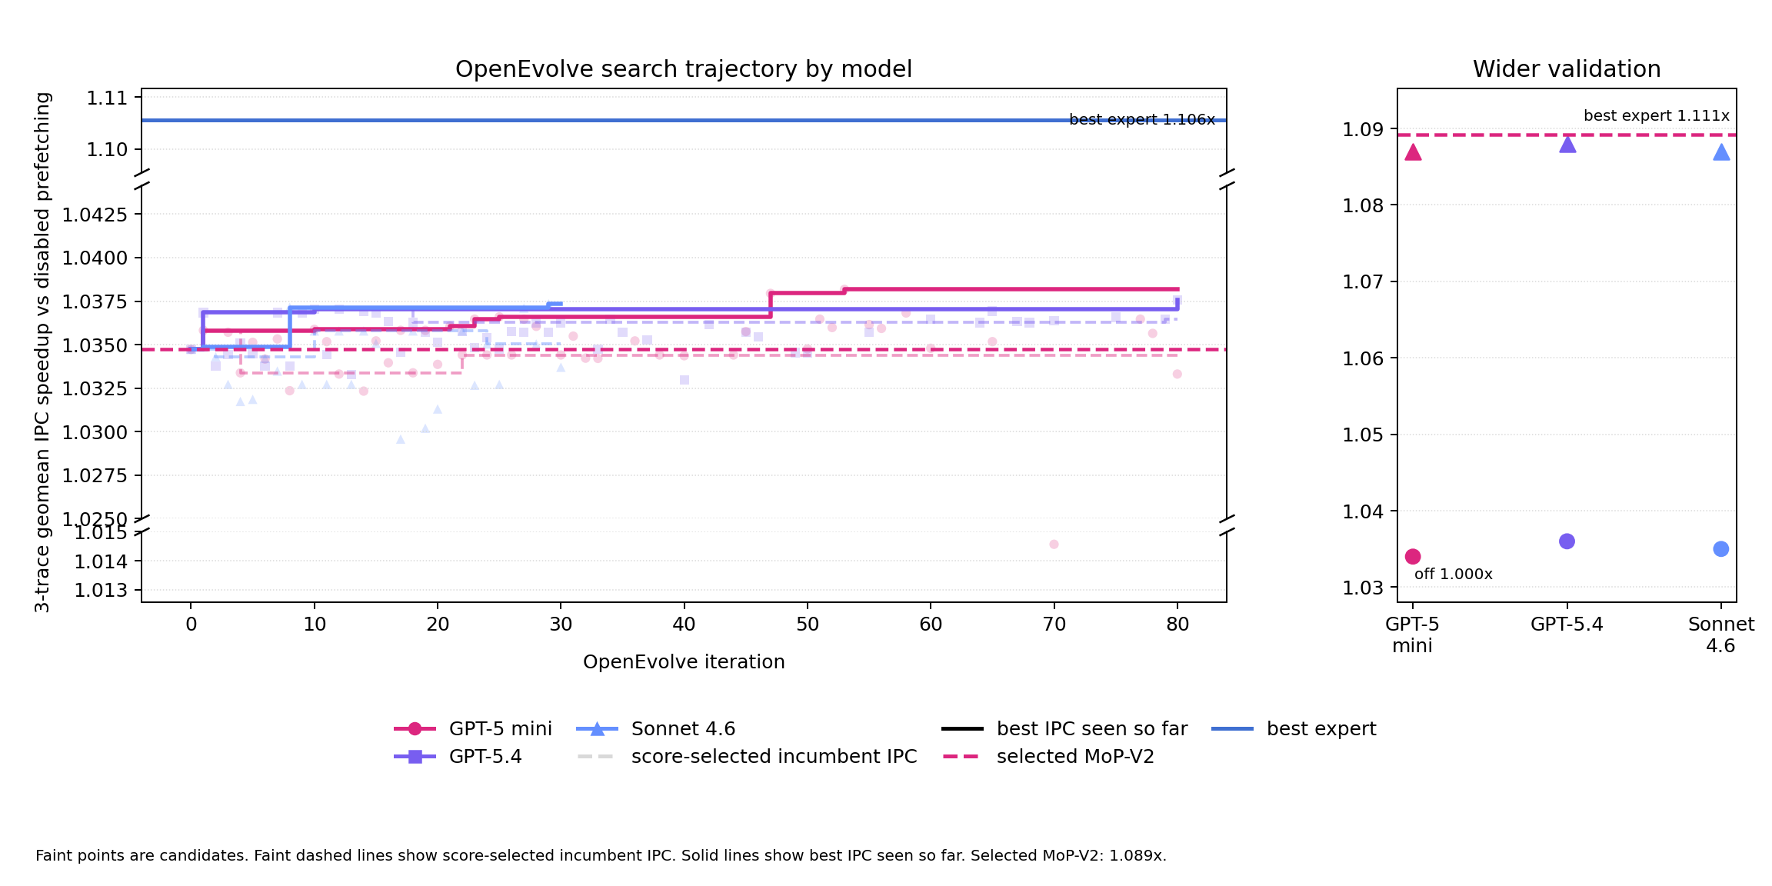
OpenEvolve found close candidates across models
Quick-evaluation winners were similar, then wider validation and 13-trace confirmation selected MoP-V2.
Model
Iter
Wide val
GPT-5 mini
80
1.087x
GPT-5.4
80
1.088x
Sonnet 4.6
30
1.087x
The selected policy reached 1.089x on the same 10-trace wider-validation set, then 1.066x on the 13-trace training-split validation set.
Caption: Faint points are quick-evaluation candidates. Dashed lines track the score-selected incumbent IPC, while solid lines track best IPC seen so far.

Slide 11
Routing behavior remained interpretable
MoP-V2 still acts like a compact epoch router, with observable action choices and budget behavior.
The router can choose MLOP, SPP+PPF, both, or the off action after each epoch.
The selected budget and score weights shape these choices without changing simulator internals.
This keeps the final method inside a compact, auditable policy dictionary.
The report keeps raw implementation keys in writing_logistics.md so the main story can use public names.
Caption: Final routing behavior stays interpretable: the plot shows how MoP-V1 and MoP-V2 allocate selected epochs, budget, and useful prefetches across the two experts.

Slide 12
Claim and limitations
The final report makes a measured claim: strong training-split validation, small heldout lift, and transparent limits.
CLAIMS
LIMITS AND REPRODUCTION
MoP-V2 improves over MoP-V1 on the 13-trace training-split validation set.
Seven heldout traces make the heldout result a sanity check with visible per-trace variation.
MoP-V2 reaches 1.003x over disabled prefetching on seven heldout traces.
secret_compute_fp_105 remains the largest heldout loss relative to best expert.
Best expert remains a separate reference, with MoP-V2 reaching 97.9% of it on heldout.
Malformed or out-of-contract OpenEvolve candidates stay in the candidate record with failure scores.
Instruction count stays fixed within simulator-rounding error.
Reproduction paths, naming map, and generated-file list live in the writing logistics note.

