Slide 1
Mixture-of-Prefetchers
1.0662x
13-trace training validation vs disabled prefetching
A small L2-cache router that improves IPC over disabled prefetching and tracks an oracle best-prefetcher cap
1.0033x
7-trace heldout vs disabled prefetching
CMU 15-740 class project, OpenEvolve training-validation report

Slide 2
What we added to Athena
Athena is the simulator substrate. Our work is the router, sandboxed search, ledgers, and report pipeline.
Athena substrate
Our router layer
Our evidence layer
ChampSim-derived simulator
MoP-V1.2 manual router
17 train traces, 7 heldout traces
Existing L2C prefetchers
MoP-V1.3 sticky router
OpenEvolve candidate ledger
AthenaMAB comparator
Epoch counters and budget controls
Generated tables and figures

Slide 3
Protocol: disabled prefetching is 1x
Expert pair: MLOP + SPP+PPF
Performance baseline: disabled prefetching
Cache level: L2C
Oracle cap: max(MLOP, SPP+PPF) per trace
Search: 10 training traces
Minimum check: beat the worse prefetcher
Training validation: 13 traces
Simple routers: WinnerTakeAll, OneShotFit, AthenaMAB
Heldout: 7 traces after policy selection
Quick evaluation used 3 training traces. Wider validation used 10 training traces. Heldout runs after policy selection.

Slide 4
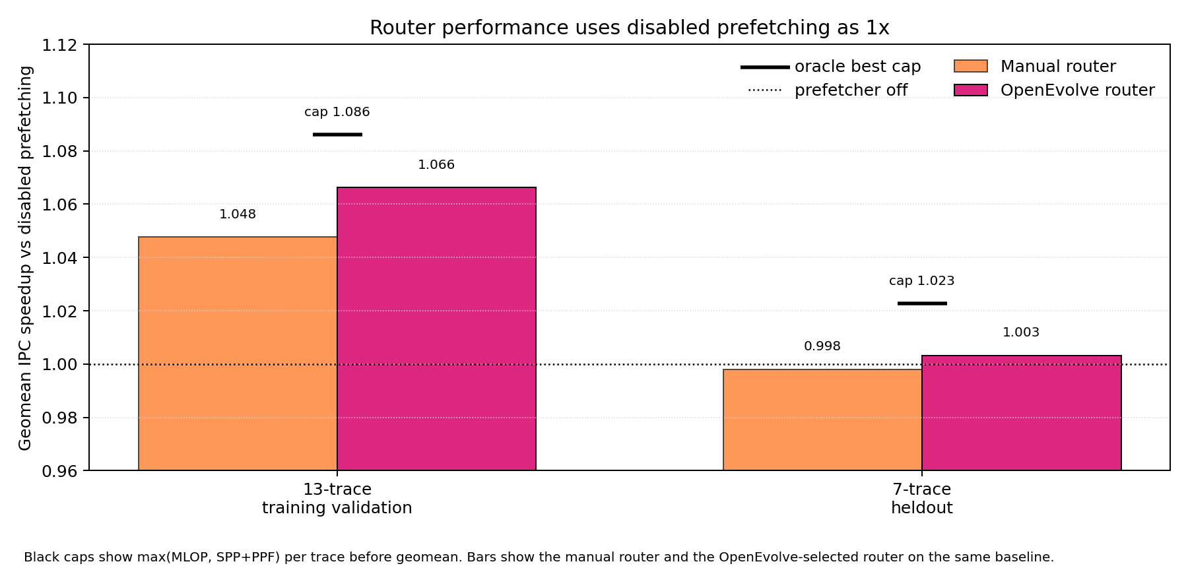
OpenEvolve improved the router
Bars use disabled prefetching as 1x. Black caps show the per-trace oracle best prefetcher.

Slide 5
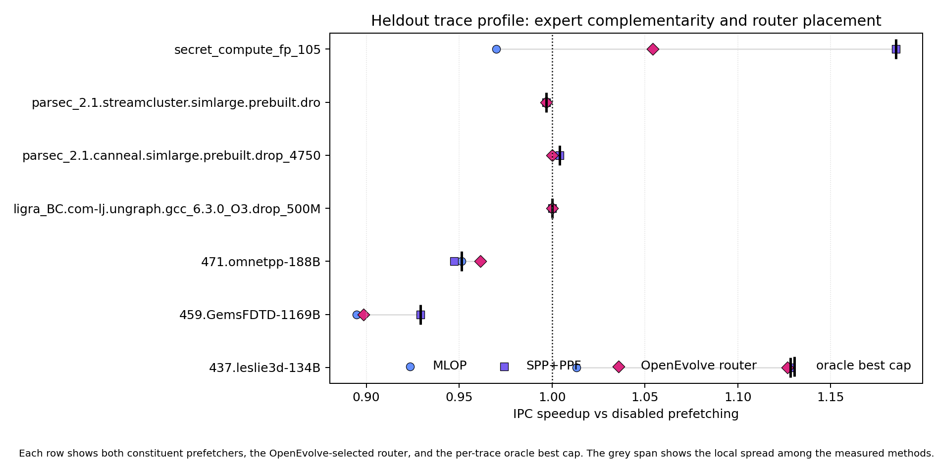
Heldout shows a modest geomean lift
Each trace uses disabled prefetching as 1x, with the oracle cap marked separately.

Slide 6
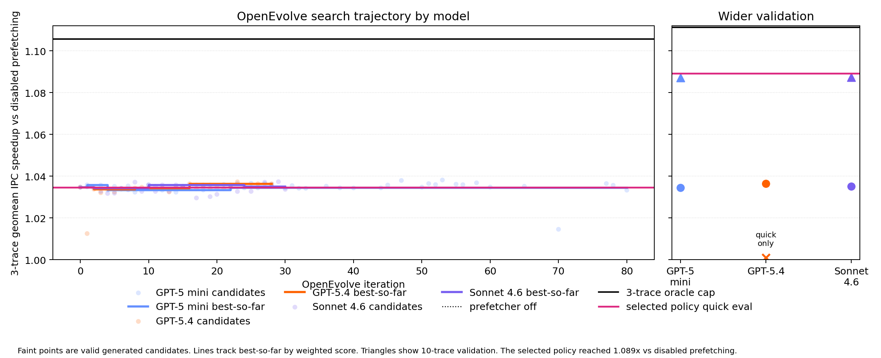
OpenEvolve search trajectory
Faint points are valid generated candidates. Lines show best-so-far by weighted score.

Slide 7
The evaluator made search auditable
Candidate programs changed a literal policy dictionary.
Allowed outputs
Recorded failures
Router choice
Simulator failures
Budget split knobs
Unknown policy keys
Sticky margin
Helper/import code
Score weights
Missing evolve markers
Ledger: 290 candidates, 225 valid scored rows, 65 fail-closed rows. Malformed or crashed candidates receive combined_score = -10.0.

Slide 8
Defensible claims
Primary claim: OpenEvolve improves IPC speedup over disabled prefetching on 13 training-validation traces.
Heldout claim: the selected router reaches 1.0033x over disabled prefetching on seven heldout traces.
Instruction-count ratios stay at 0.999999462x on training validation and 1.000000009x on heldout.
The oracle best prefetcher remains a cap, which keeps the claim sized correctly.
Reproduction paths and naming details live in report/writing_logistics.md.

