Slide 1
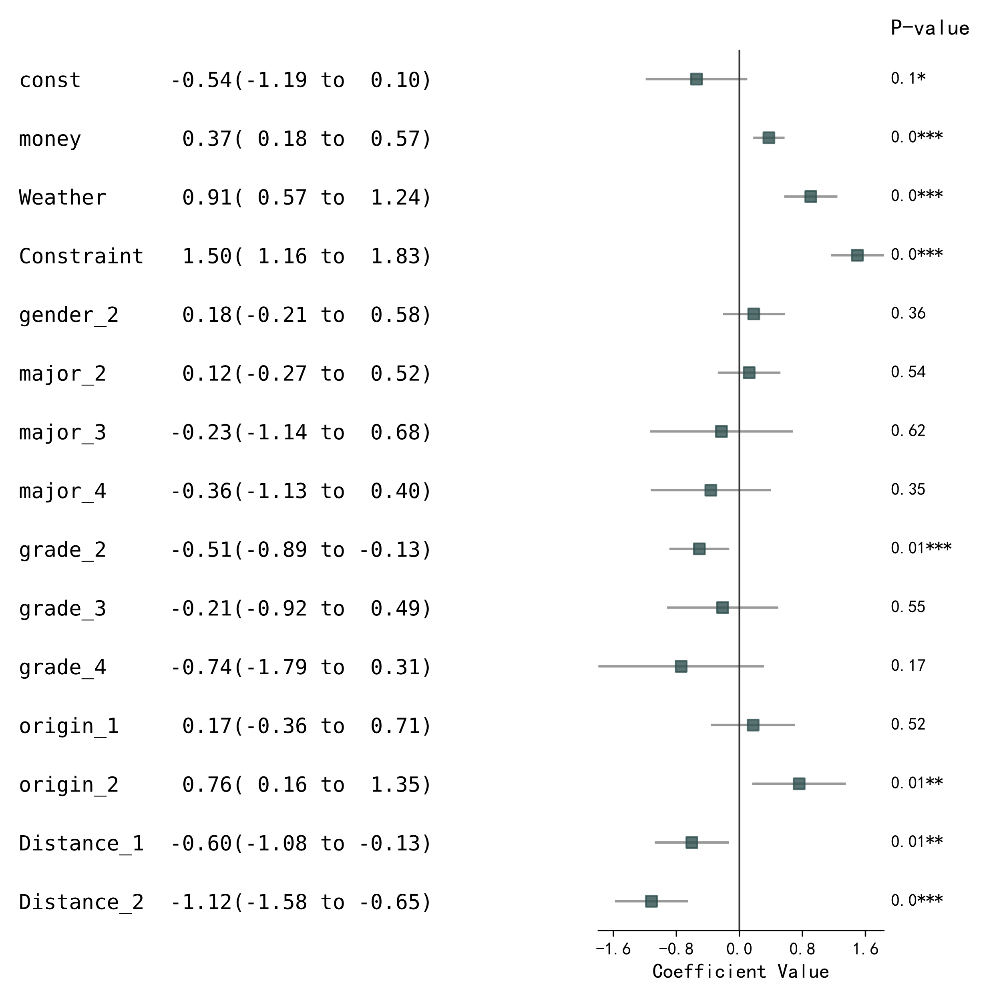
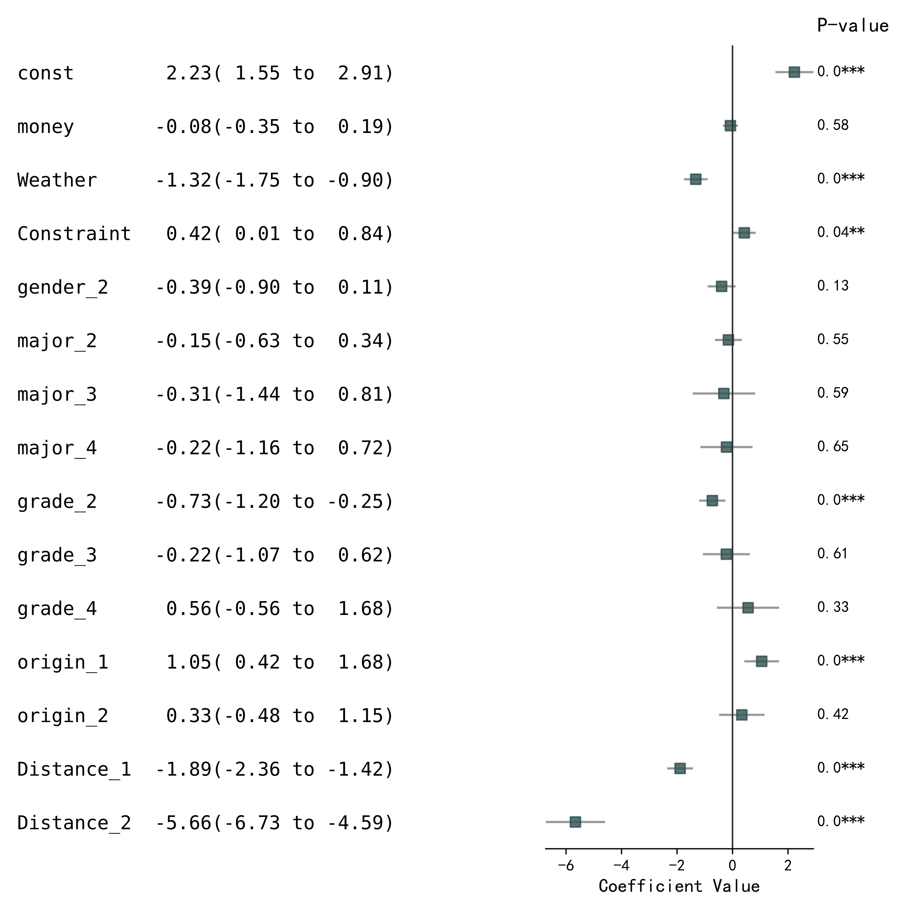
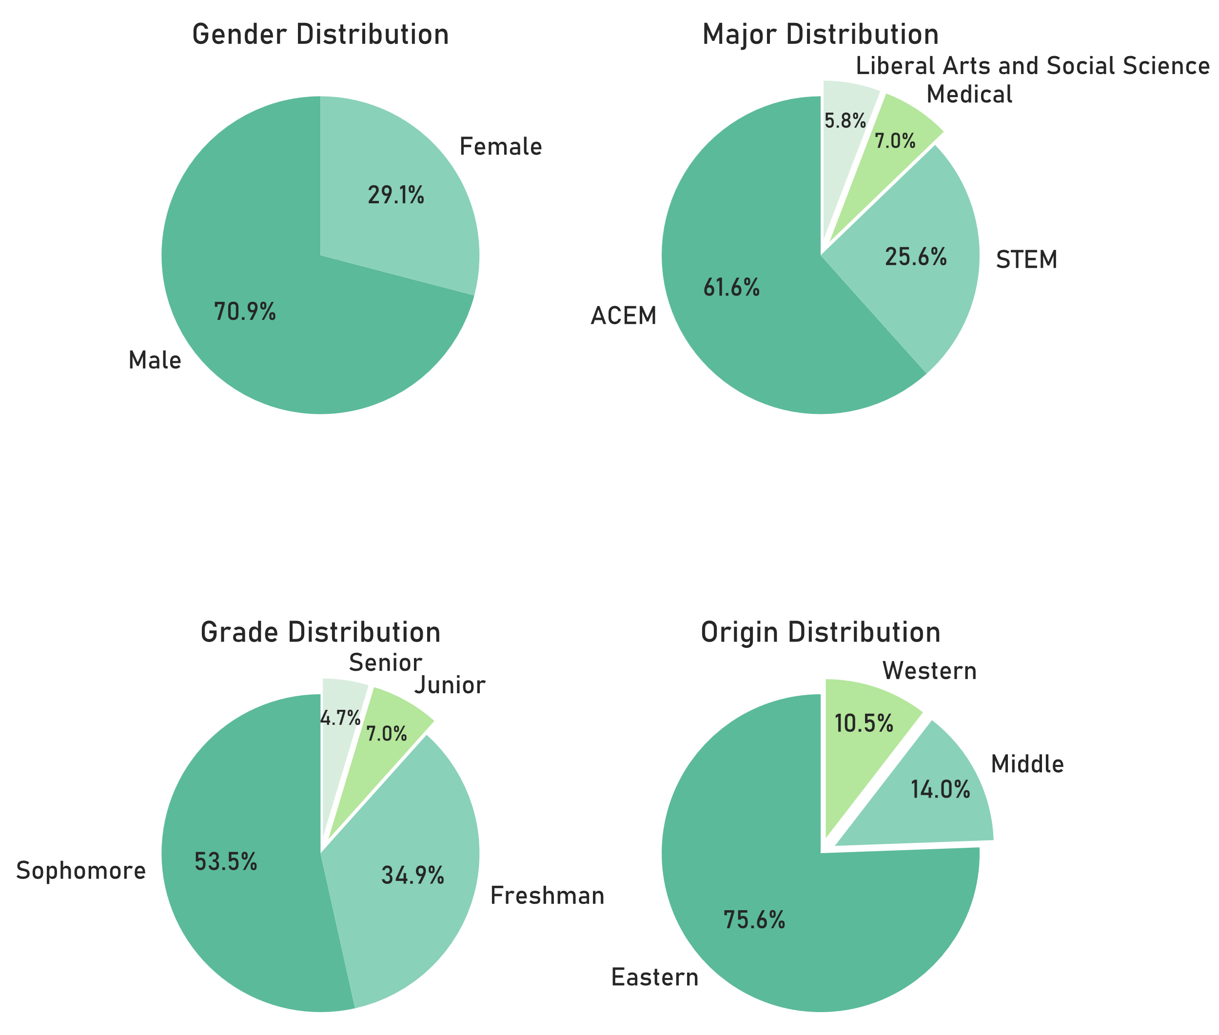
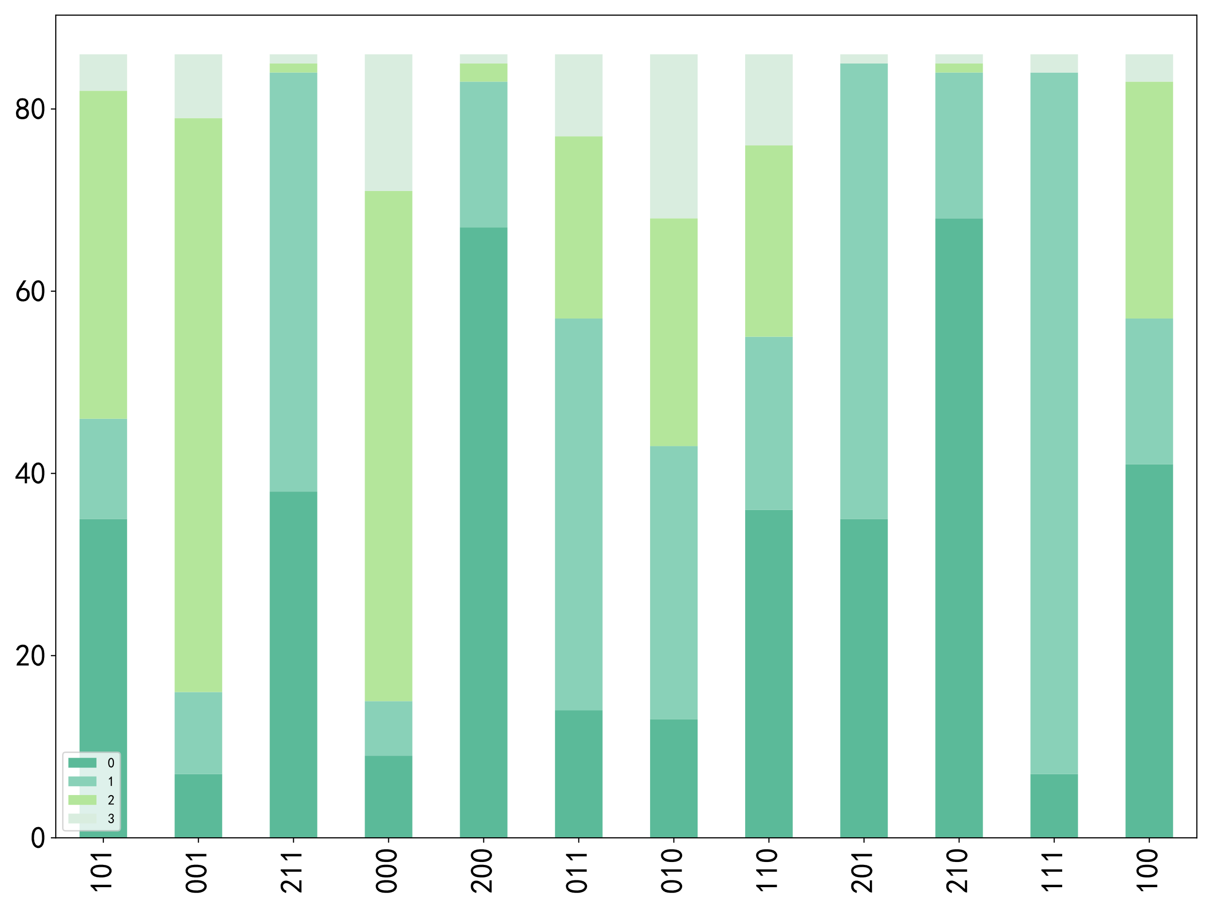
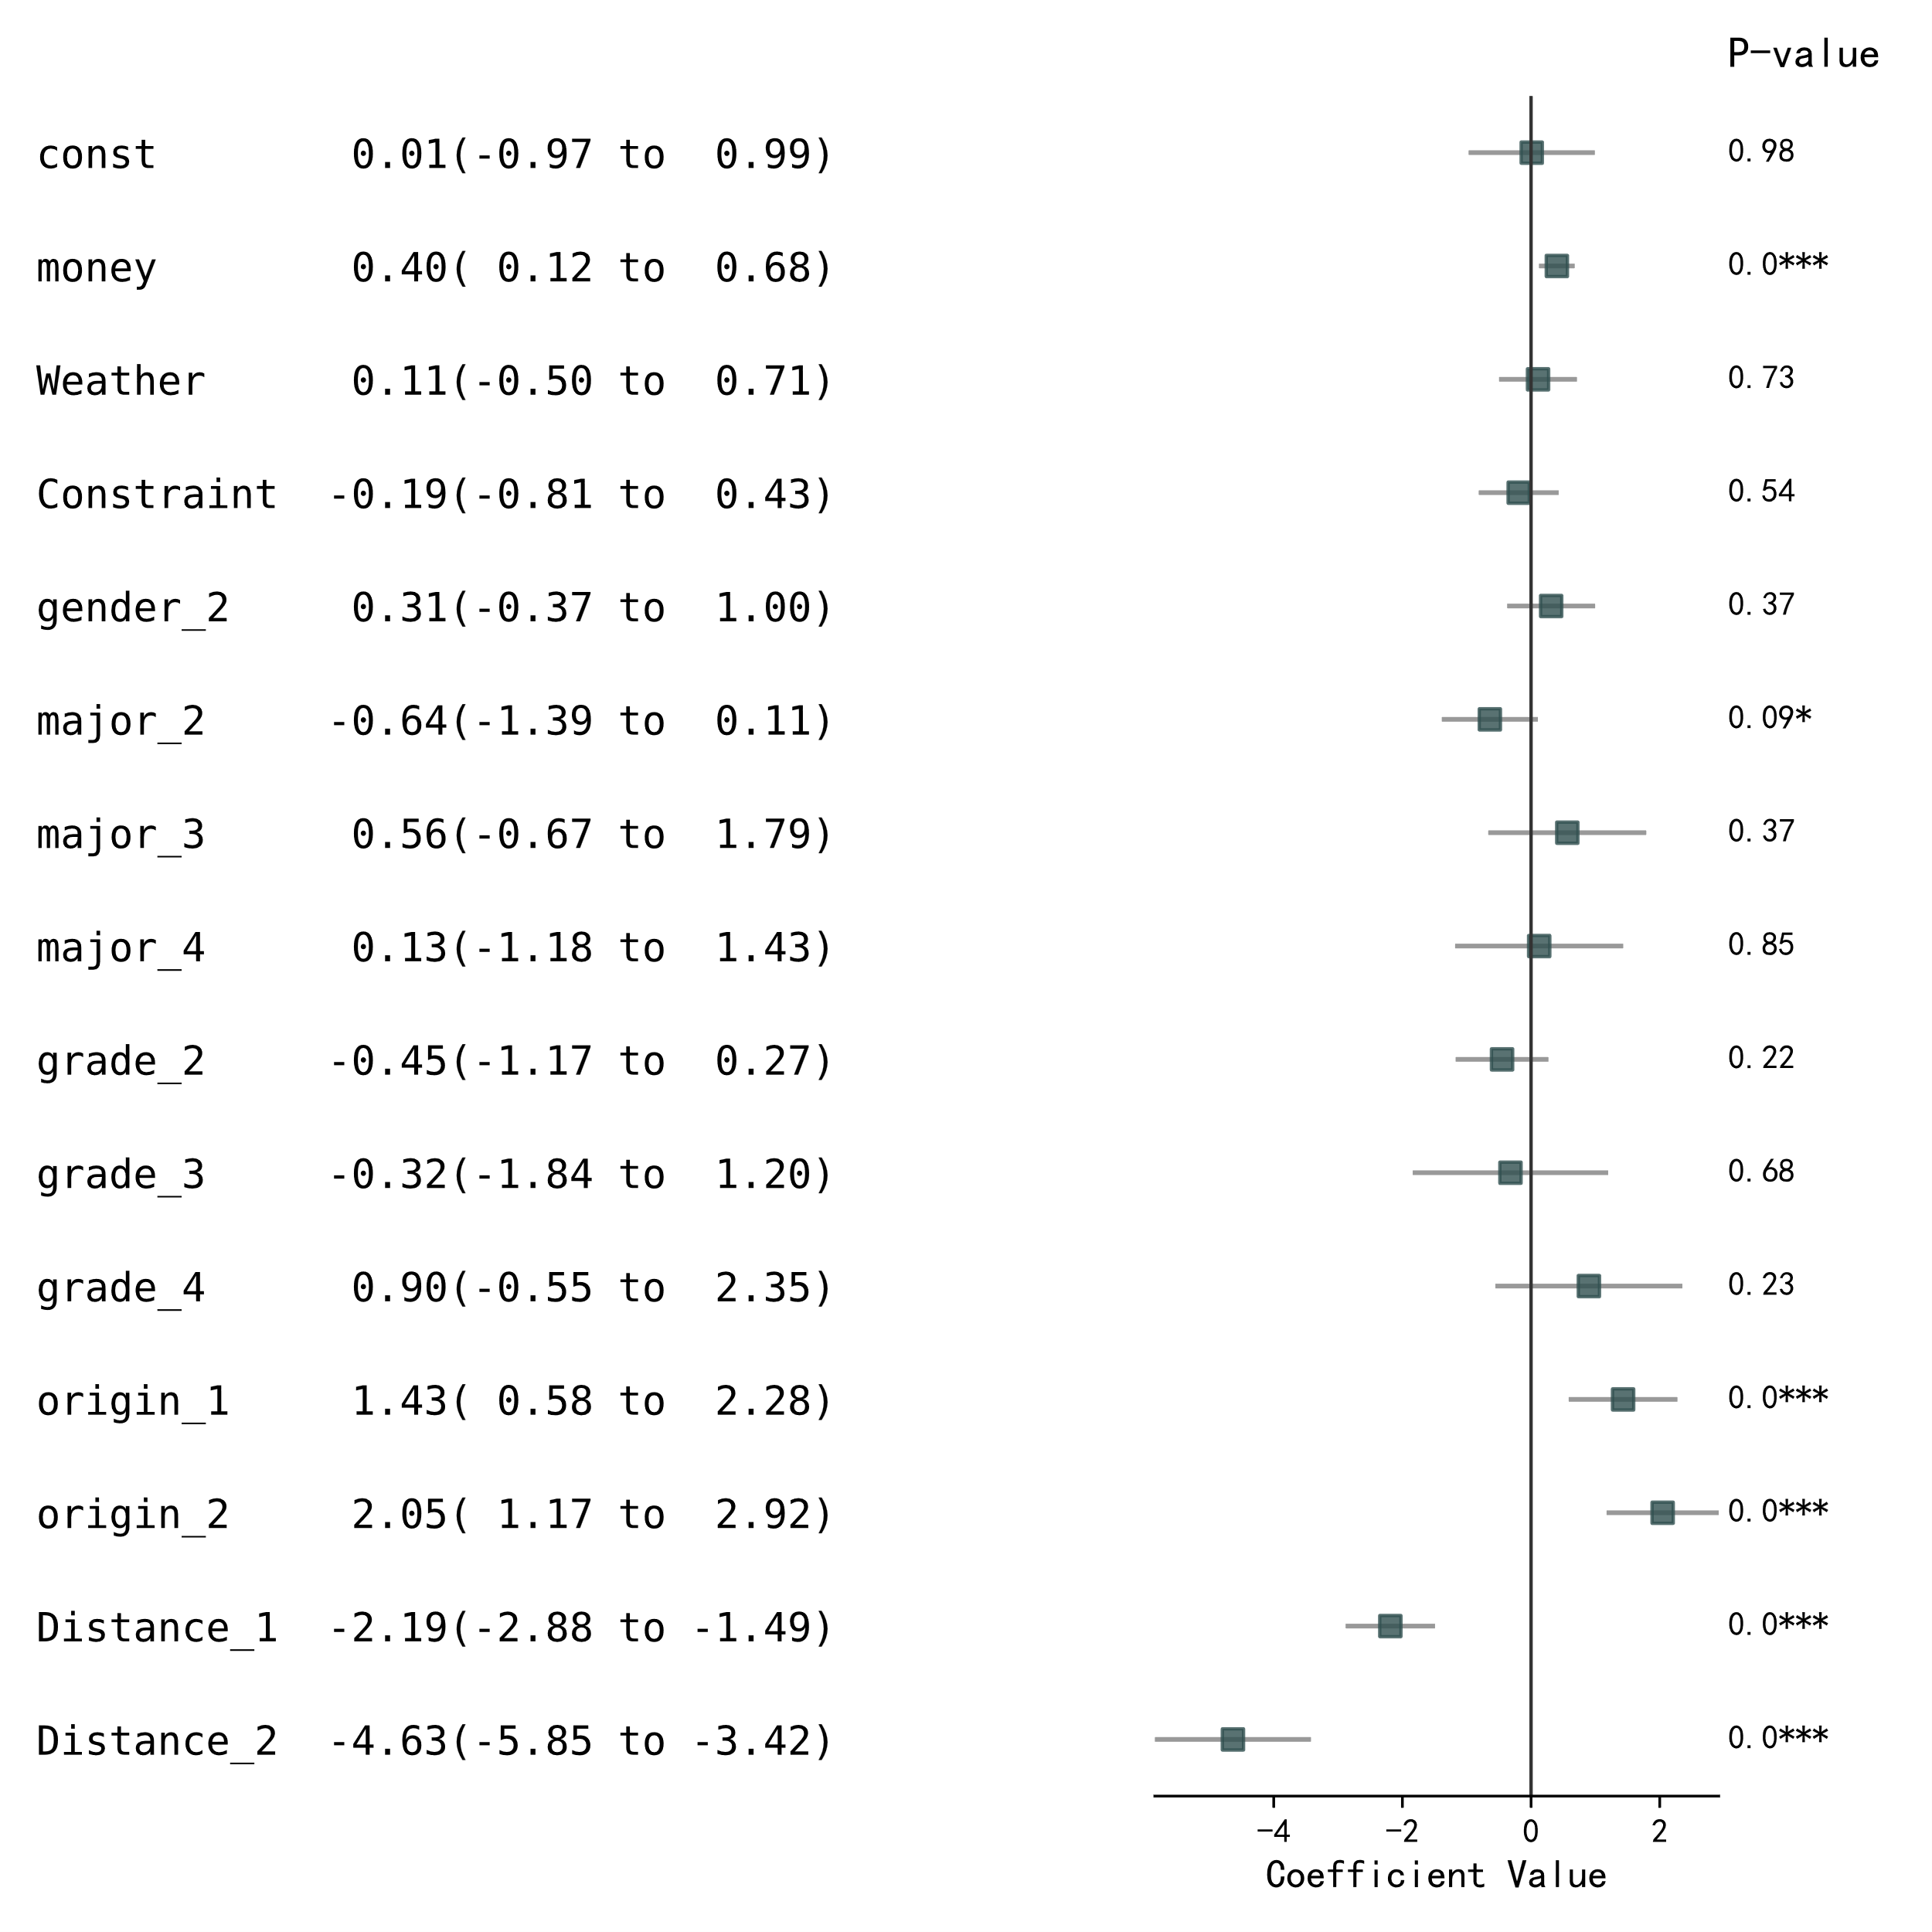
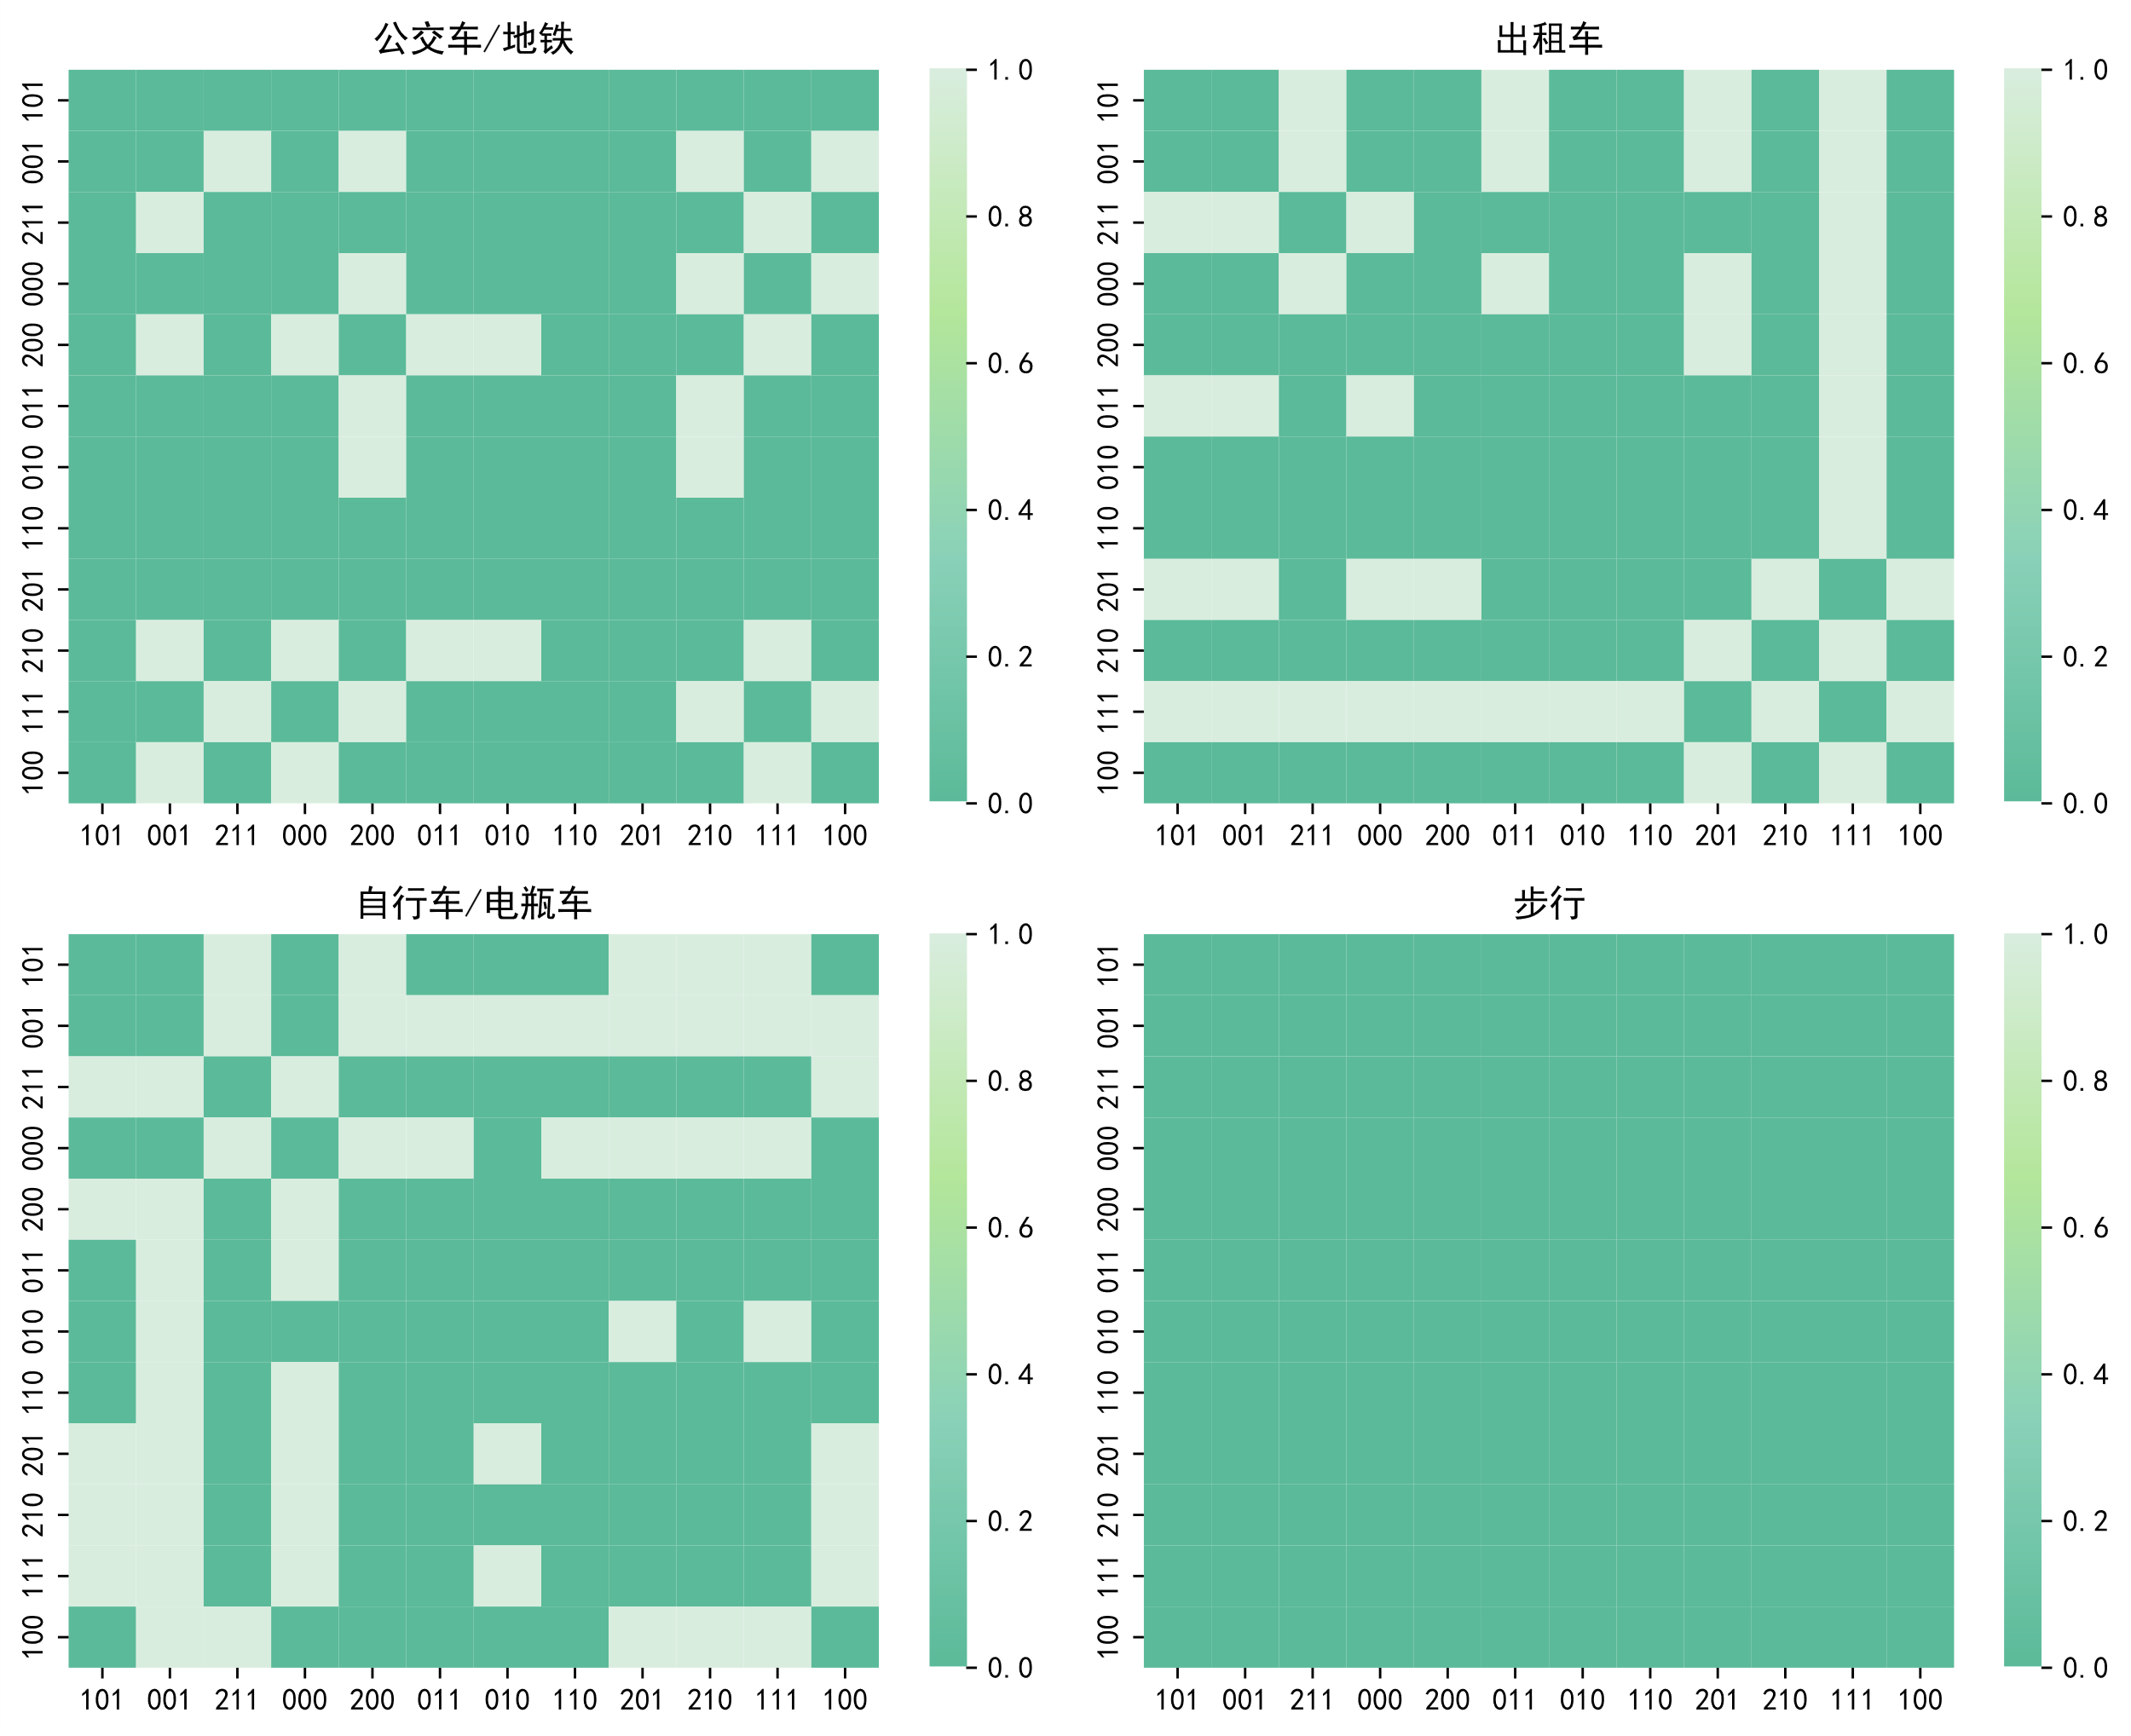
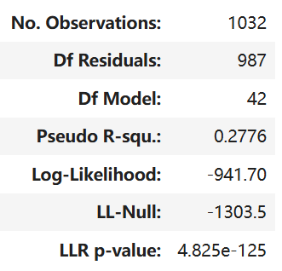
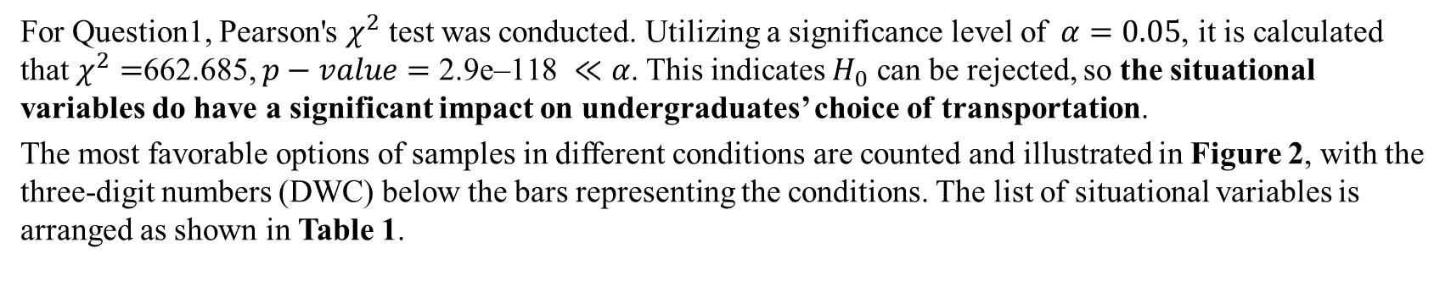
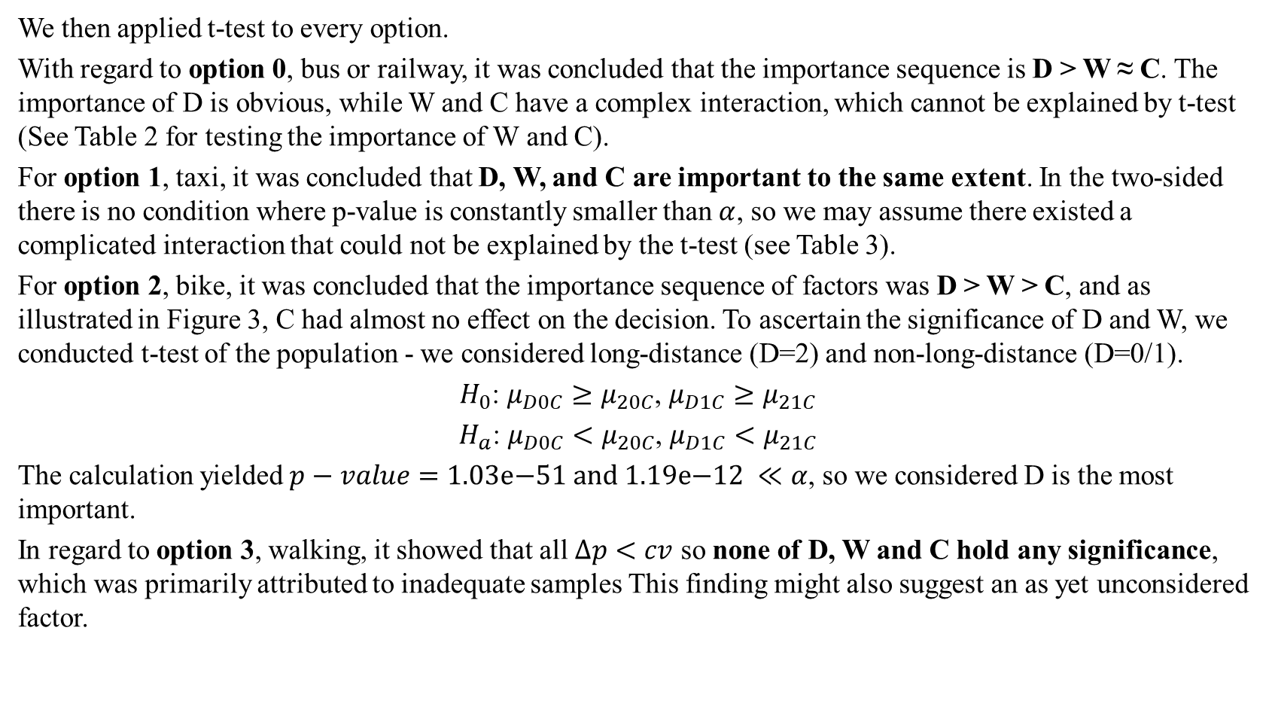
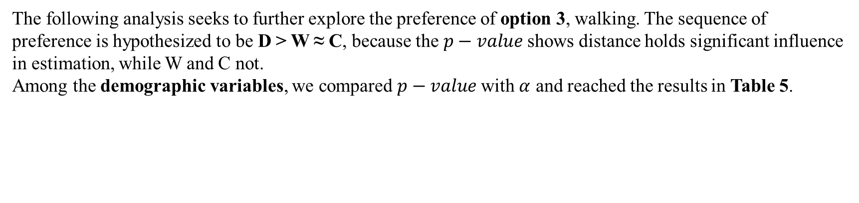
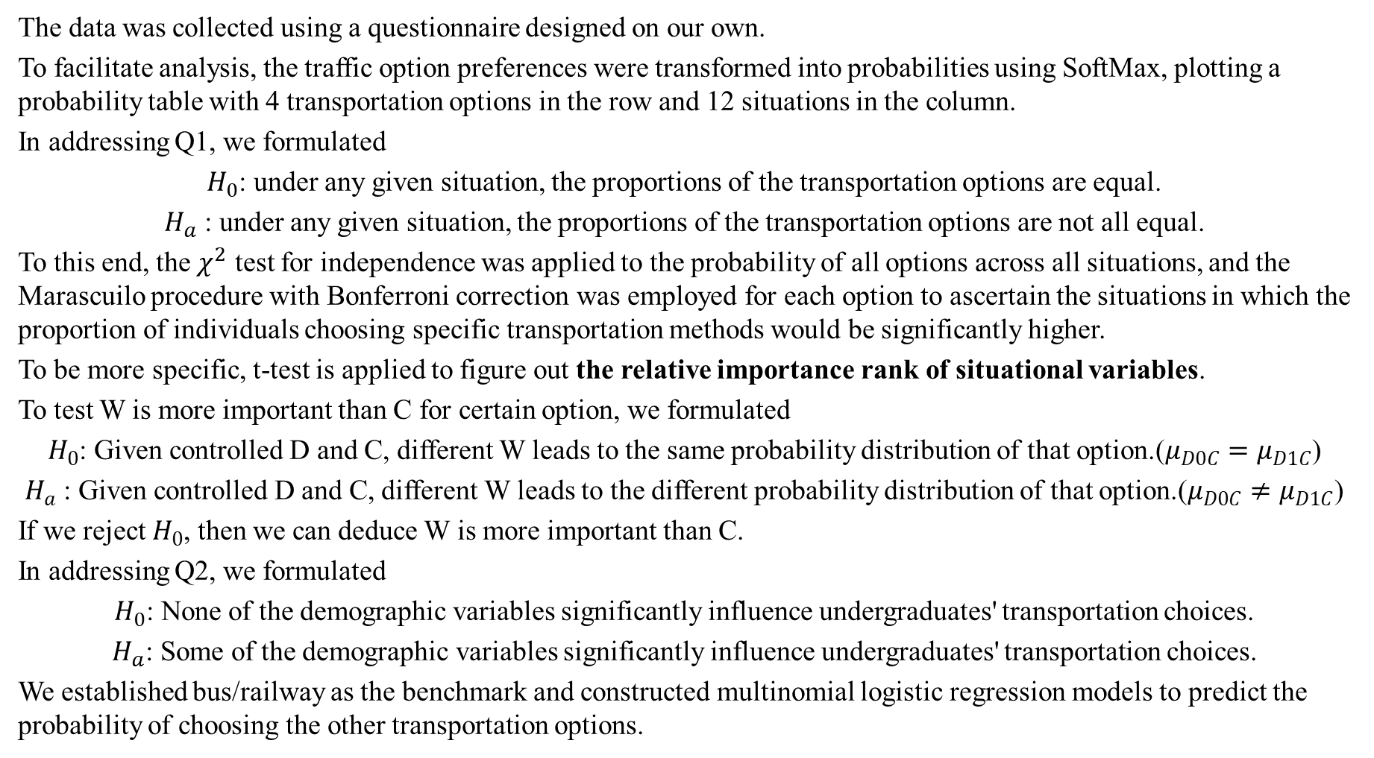
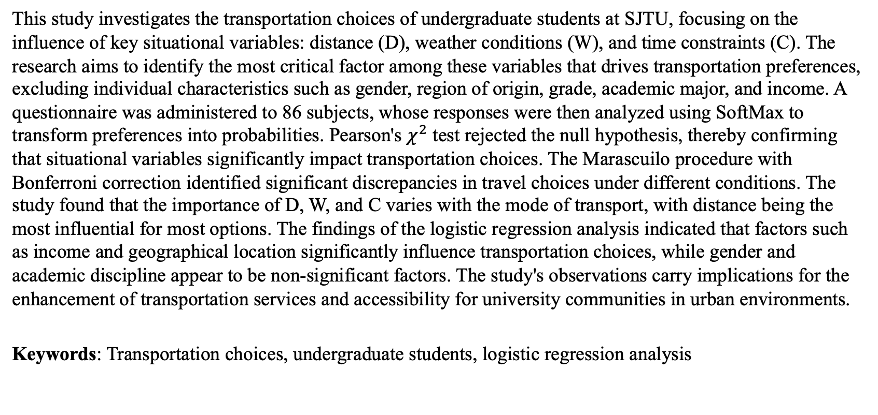
‘Jiao Tong’ Preference of Jiao Tong Undergraduates 施奕涵、吴泽楠、方真、高纵、亢予凡
Abstract
Results
We then applied t-test to every option.
With regard to option 0, bus or railway, it was concluded that the importance sequence is D > W ≈ C. The importance of D is obvious, while W and C have a complex interaction, which cannot be explained by t-test (See Table 2 for testing the importance of W and C).
For option 1, taxi, it was concluded that D, W, and C are important to the same extent. In the two-sided there is no condition where p-value is constantly smaller than $α$, so we may assume there existed a complicated interaction that could not be explained by the t-test (see Table 3).
For option 2, bike, it was concluded that the importance sequence of factors was D > W > C, and as illustrated in Figure 3, C had almost no effect on the decision. To ascertain the significance of D and W, we conducted t-test of the population - we considered long-distance (D=2) and non-long-distance (D=0/1).
$H_{0}$: $μ_{D0C}≥μ_{20C}$, $μ_{D1C}≥μ_{21C}$
$H_{a}$: $μ_{D0C}<μ_{20C}$, $μ_{D1C}<μ_{21C}$
The calculation yielded $p−value=\text{1.03}\text{e}\text{−51 }\text{and}\text{ 1.19}\text{e}\text{−12} ≪α$, so we considered D is the most important.
In regard to option 3, walking, it showed that all $Δp<cv$ so none of D, W and C hold any significance, which was primarily attributed to inadequate samples This finding might also suggest an as yet unconsidered factor.
Option 1
Option 2
This study investigates the transportation choices of undergraduate students at SJTU, focusing on the influence of key situational variables: distance (D), weather conditions (W), and time constraints (C). The research aims to identify the most critical factor among these variables that drives transportation preferences, excluding individual characteristics such as gender, region of origin, grade, academic major, and income. A questionnaire was administered to 86 subjects, whose responses were then analyzed using SoftMax to transform preferences into probabilities. Pearson's $χ^{2}$ test rejected the null hypothesis, thereby confirming that situational variables significantly impact transportation choices. The Marascuilo procedure with Bonferroni correction identified significant discrepancies in travel choices under different conditions. The study found that the importance of D, W, and C varies with the mode of transport, with distance being the most influential for most options. The findings of the logistic regression analysis indicated that factors such as income and geographical location significantly influence transportation choices, while gender and academic discipline appear to be non-significant factors. The study's observations carry implications for the enhancement of transportation services and accessibility for university communities in urban environments.
Keywords: Transportation choices, undergraduate students, logistic regression analysis
A total of 86 samples were collected, and no instances of outliers were identified. The proportion of gender, major, grade, and region of origin is illustrated in Figure 1.
Table 1
Variables | Description
Distance (D) | 0/1/2 - short/medium/long-distance
Weather (W) | 0 for sunny, 1 for rainy.
Time Constraint (C) | 0 for time-abundant, 1 for time-constrained
Option 3
Objectives
Table 2
Table 3
The present study has been designed to investigate the transportation choices made by undergraduate students at SJTU when travelling to different parts of Shanghai, with a particular focus on the factors that influence these decisions. The primary research questions guiding this study are as follows:
To what extent do key situational variables – namely, the distance of the trip, weather conditions, and time constraints – affect travel decisions? Furthermore, the study sought to identify the single most critical factor among these situational variables that predominantly drive transportation preferences. It is important to note that in this question we will not consider individual characteristics of the students.
Whether demographic variables such as gender, origin, major, and income play a significant role in shaping these decisions.
Hopefully, the study will develop a predictive model to estimate the choice of SJTU undergraduates given all the situational variables researched in the study. The investigation of these questions will not only illuminate the practical difficulties faced by university students in balancing cost, time, and convenience, but will also have implications for improving transportation services and accessibility for university communities in Shanghai and similar urban contexts worldwide.
 | D 0 | D 1 | D 2
W 0 for C | 0.30 | 0.01 | 0.28
W 1 for C | 0.16 | 4.04e-11 | 0.98
C 0 for W | 0.01 | 0.53 | 0.61
C 1 for W | 1.31e-9 | 4.83e-37 | 0.64
 | D 0 | D 1 | D 2
W 0 | 5.95e-5 | 0.76 | 0.67
W 1 | 8.68e-9 | 4.65e-38 | 0.98
C 0 | 0.41 | 0.22 | 4.93e-6
C 1 | 0.01 | 1.61e-27 | 7.20e-8
Figure 1
Figure 2
Q1
For Question1, Pearson's $χ^{2}$ test was conducted. Utilizing a significance level of$α=0.05$, it is calculated that $χ^{2}=$662.685, $p−value=\text{2.9}\text{e}\text{–118} ≪α$. This indicates $H_{0}$ can be rejected, so the situational variables do have a significant impact on undergraduates’ choice of transportation.
The most favorable options of samples in different conditions are counted and illustrated in Figure 2, with the three-digit numbers (DWC) below the bars representing the conditions. The list of situational variables is arranged as shown in Table 1.
Q2
With regard to Question 2, the results of the logistic regression is listed in Table 4.
Utilizing the regression of bus and railway services as a benchmark, the regression coefficients of the remaining three traffic options, along with their 95% confidence intervals and t-test p-values, are illustrated in Figure 4.
Conclusion
In the subsequent stage of the analysis, the Marascuilo procedure with Bonferroni correction was employed to ascertain the pairs of conditions that exhibit a significant discrepancy in travel choices (see Figure 3).
Methods
For bus/railway, D is the most important. W and C have a complex interaction.
For taxi, D, W and C are equally important and might have a complex interaction.
For bike/e-bike, D is the most important, W is the second and C is almost irrelevant.
For walking, D is the most important, which needs further research due to insufficient data or an unexpected variable.
Neither Gender nor Major significantly influenced these decisions.
Whether one is second-year in Grade were found to be influential.
Income was identified as crucial in choices between taxis and walking.
Origin was also key in the estimation of all transportation choices.
Table 4
The data was collected using a questionnaire designed on our own.
To facilitate analysis, the traffic option preferences were transformed into probabilities using SoftMax, plotting a probability table with 4 transportation options in the row and 12 situations in the column.
In addressing Q1, we formulated
$H_{0}$: under any given situation, the proportions of the transportation options are equal.
$H_{a}$ : under any given situation, the proportions of the transportation options are not all equal.
To this end, the $χ^{2}$ test for independence was applied to the probability of all options across all situations, and the Marascuilo procedure with Bonferroni correction was employed for each option to ascertain the situations in which the proportion of individuals choosing specific transportation methods would be significantly higher.
To be more specific, t-test is applied to figure out the relative importance rank of situational variables.
To test W is more important than C for certain option, we formulated
$H_{0}$: Given controlled D and C, different W leads to the same probability distribution of that option.($μ_{D0C}=μ_{D1C}$)
$H_{a}$ : Given controlled D and C, different W leads to the different probability distribution of that option.($μ_{D0C}≠μ_{D1C}$)
If we reject $H_{0}$, then we can deduce W is more important than C.
In addressing Q2, we formulated
$H_{0}$: None of the demographic variables significantly influence undergraduates' transportation choices.
$H_{a}$: Some of the demographic variables significantly influence undergraduates' transportation choices.
We established bus/railway as the benchmark and constructed multinomial logistic regression models to predict the probability of choosing the other transportation options.
The following analysis seeks to further explore the preference of option 3, walking. The sequence of preference is hypothesized to be D > W ≈ C, because the $p−value$shows distance holds significant influence in estimation, while W and C not.
Among the demographic variables, we compared $p−value$with $α$ and reached the results in Table 5.
Table 5
Variables | Influence level (to option)
Gender | No
Major | No
Grade (Sophomore) | Great to all
Income | Great to option 1 and 3
Origin | Great to all
References
[1] Statistics for Business and Economics, 13e, by Anderson, Sweeney, Williams, Camm, and Cochran (2018)
[2] https://en.wikipedia.org/wiki/Multinomial_logistic_regression
Figure 3

