Slide 1
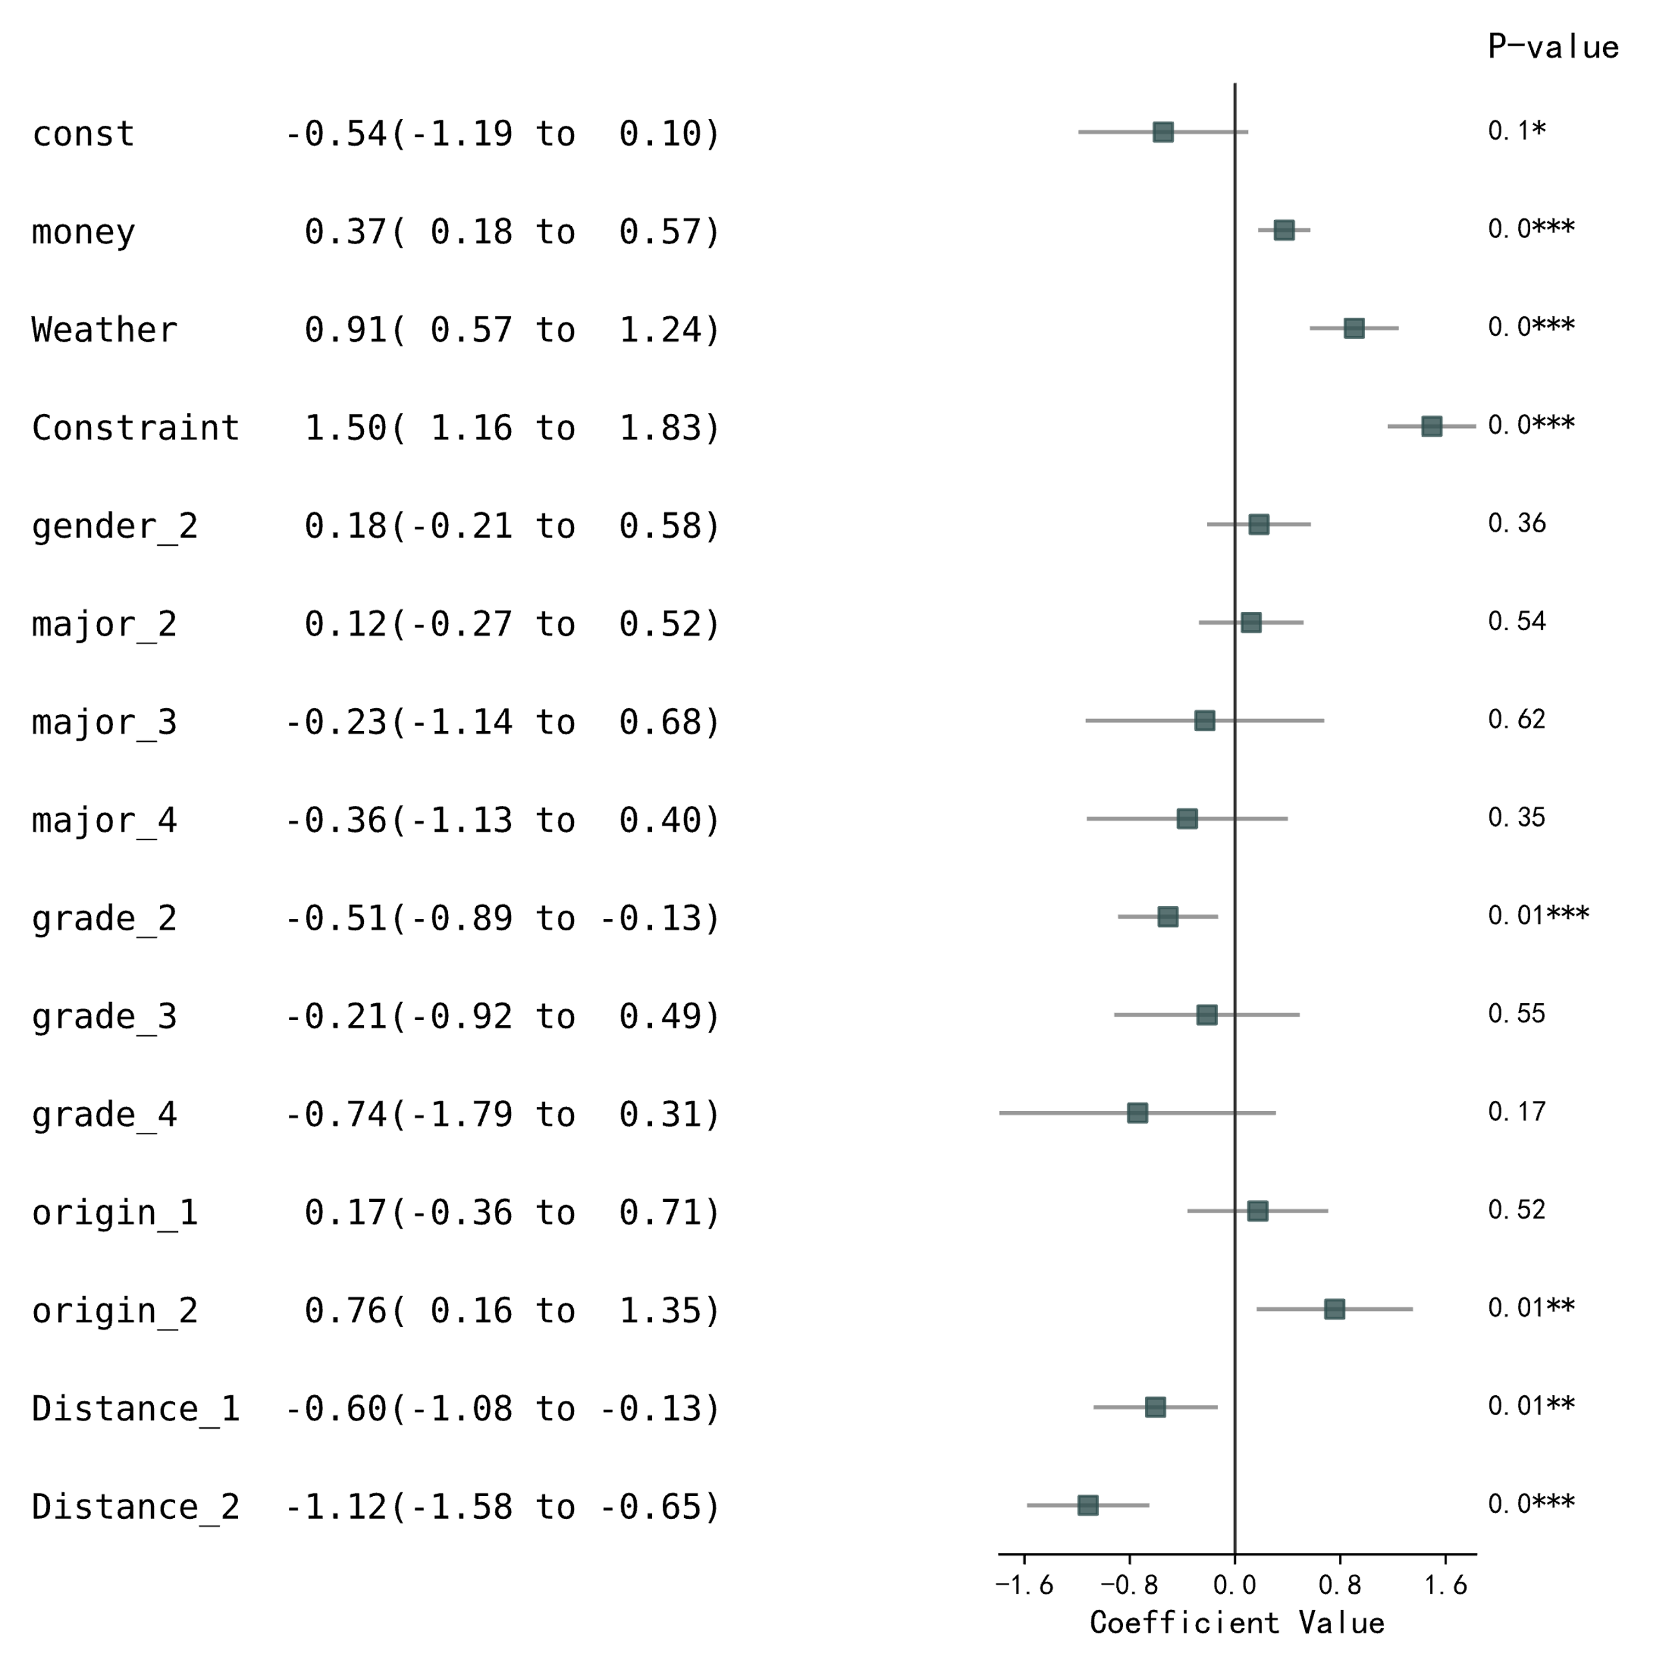
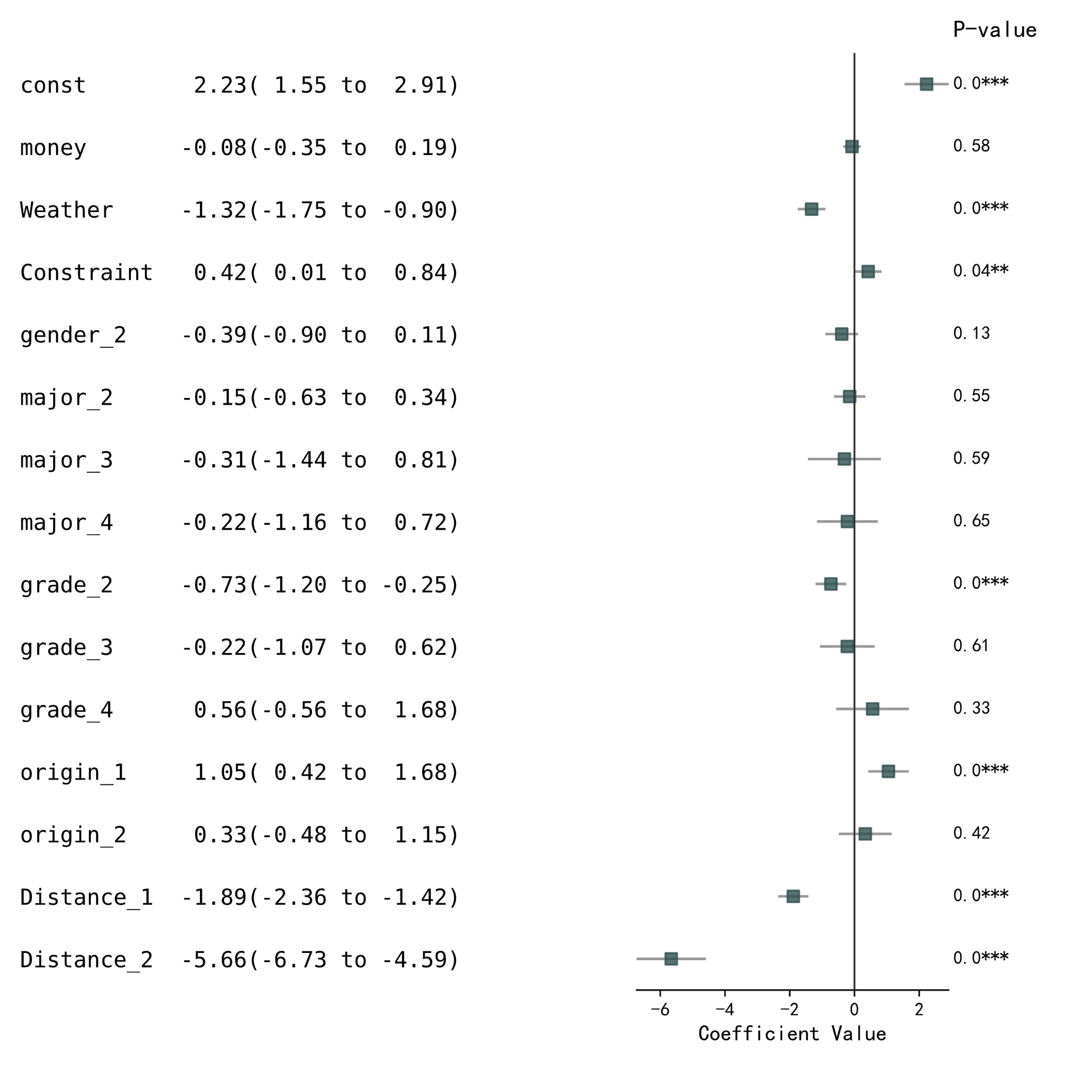
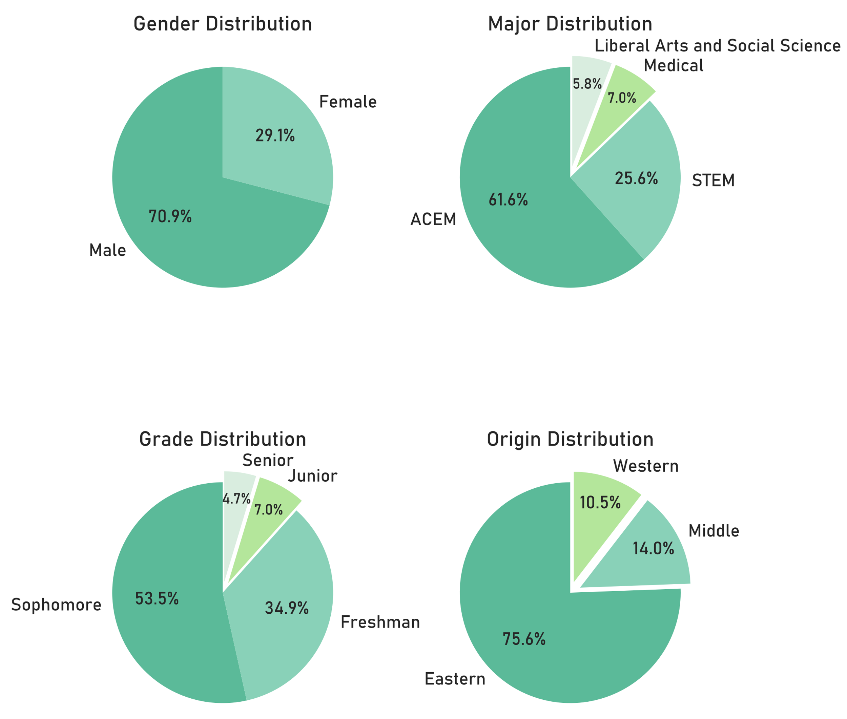
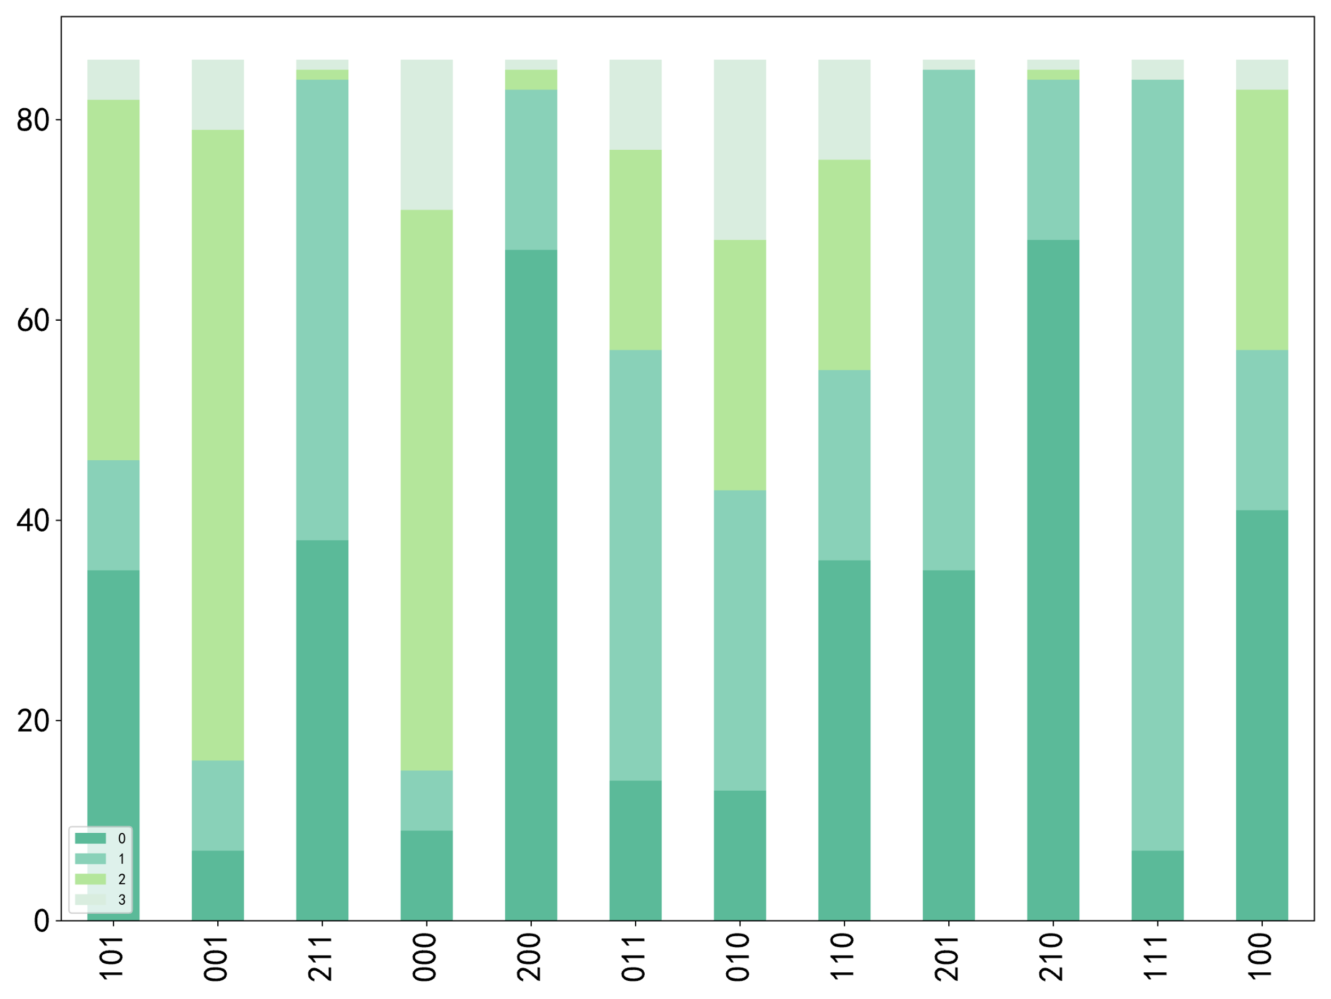
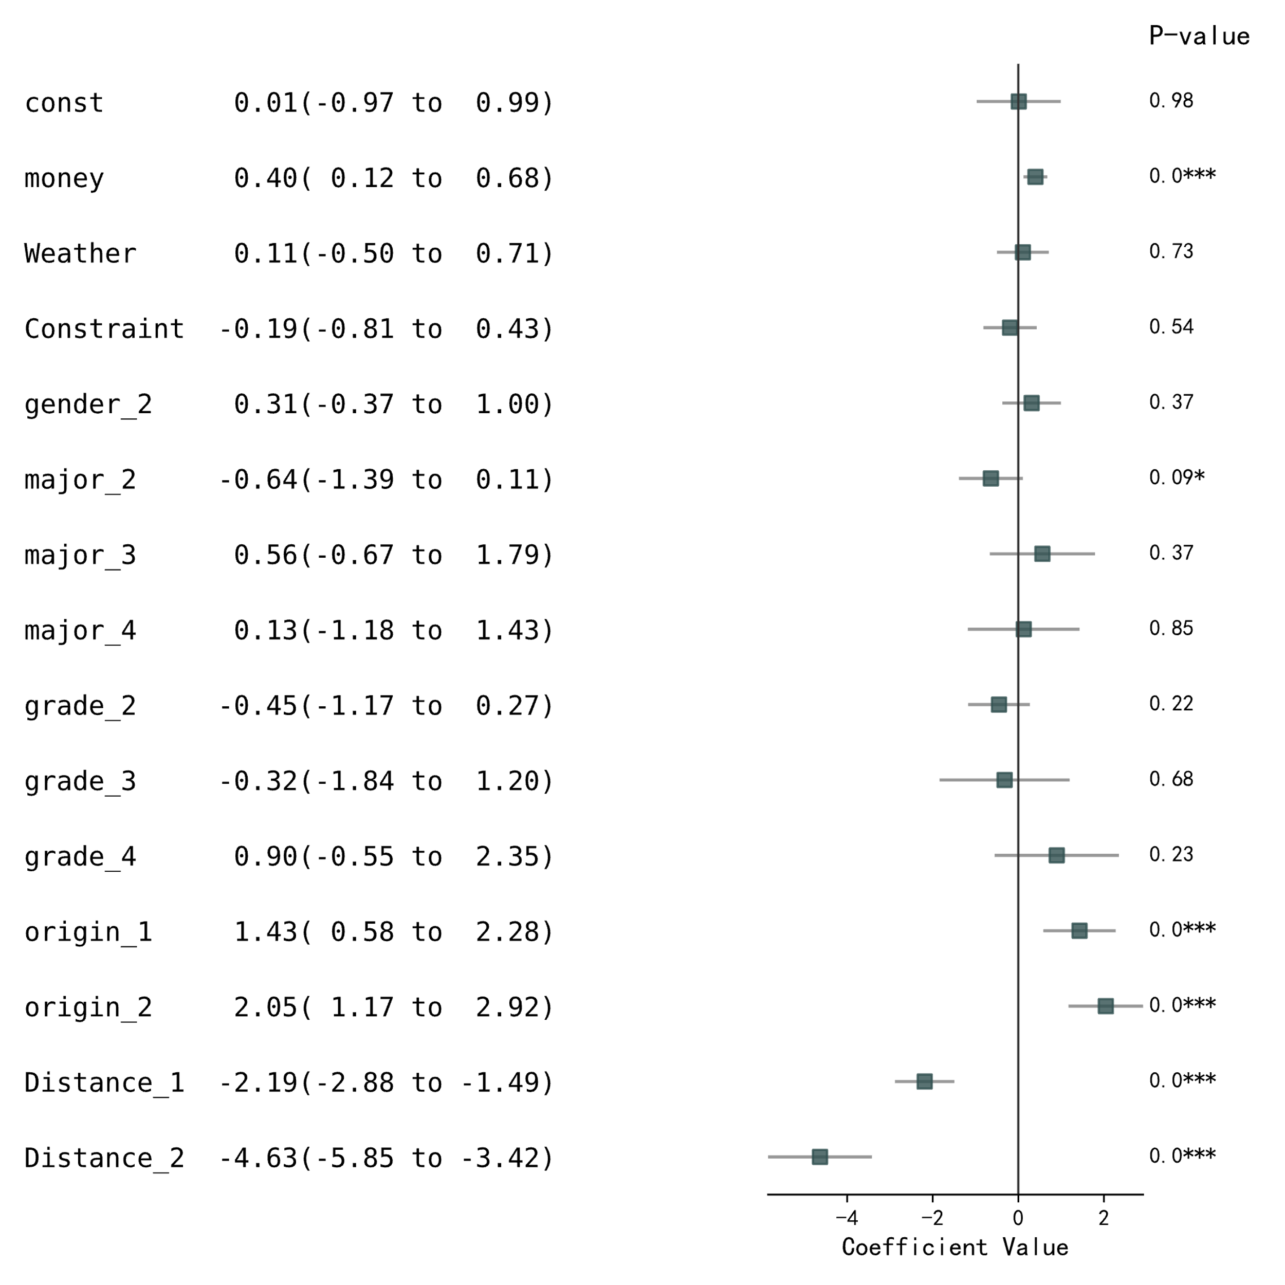
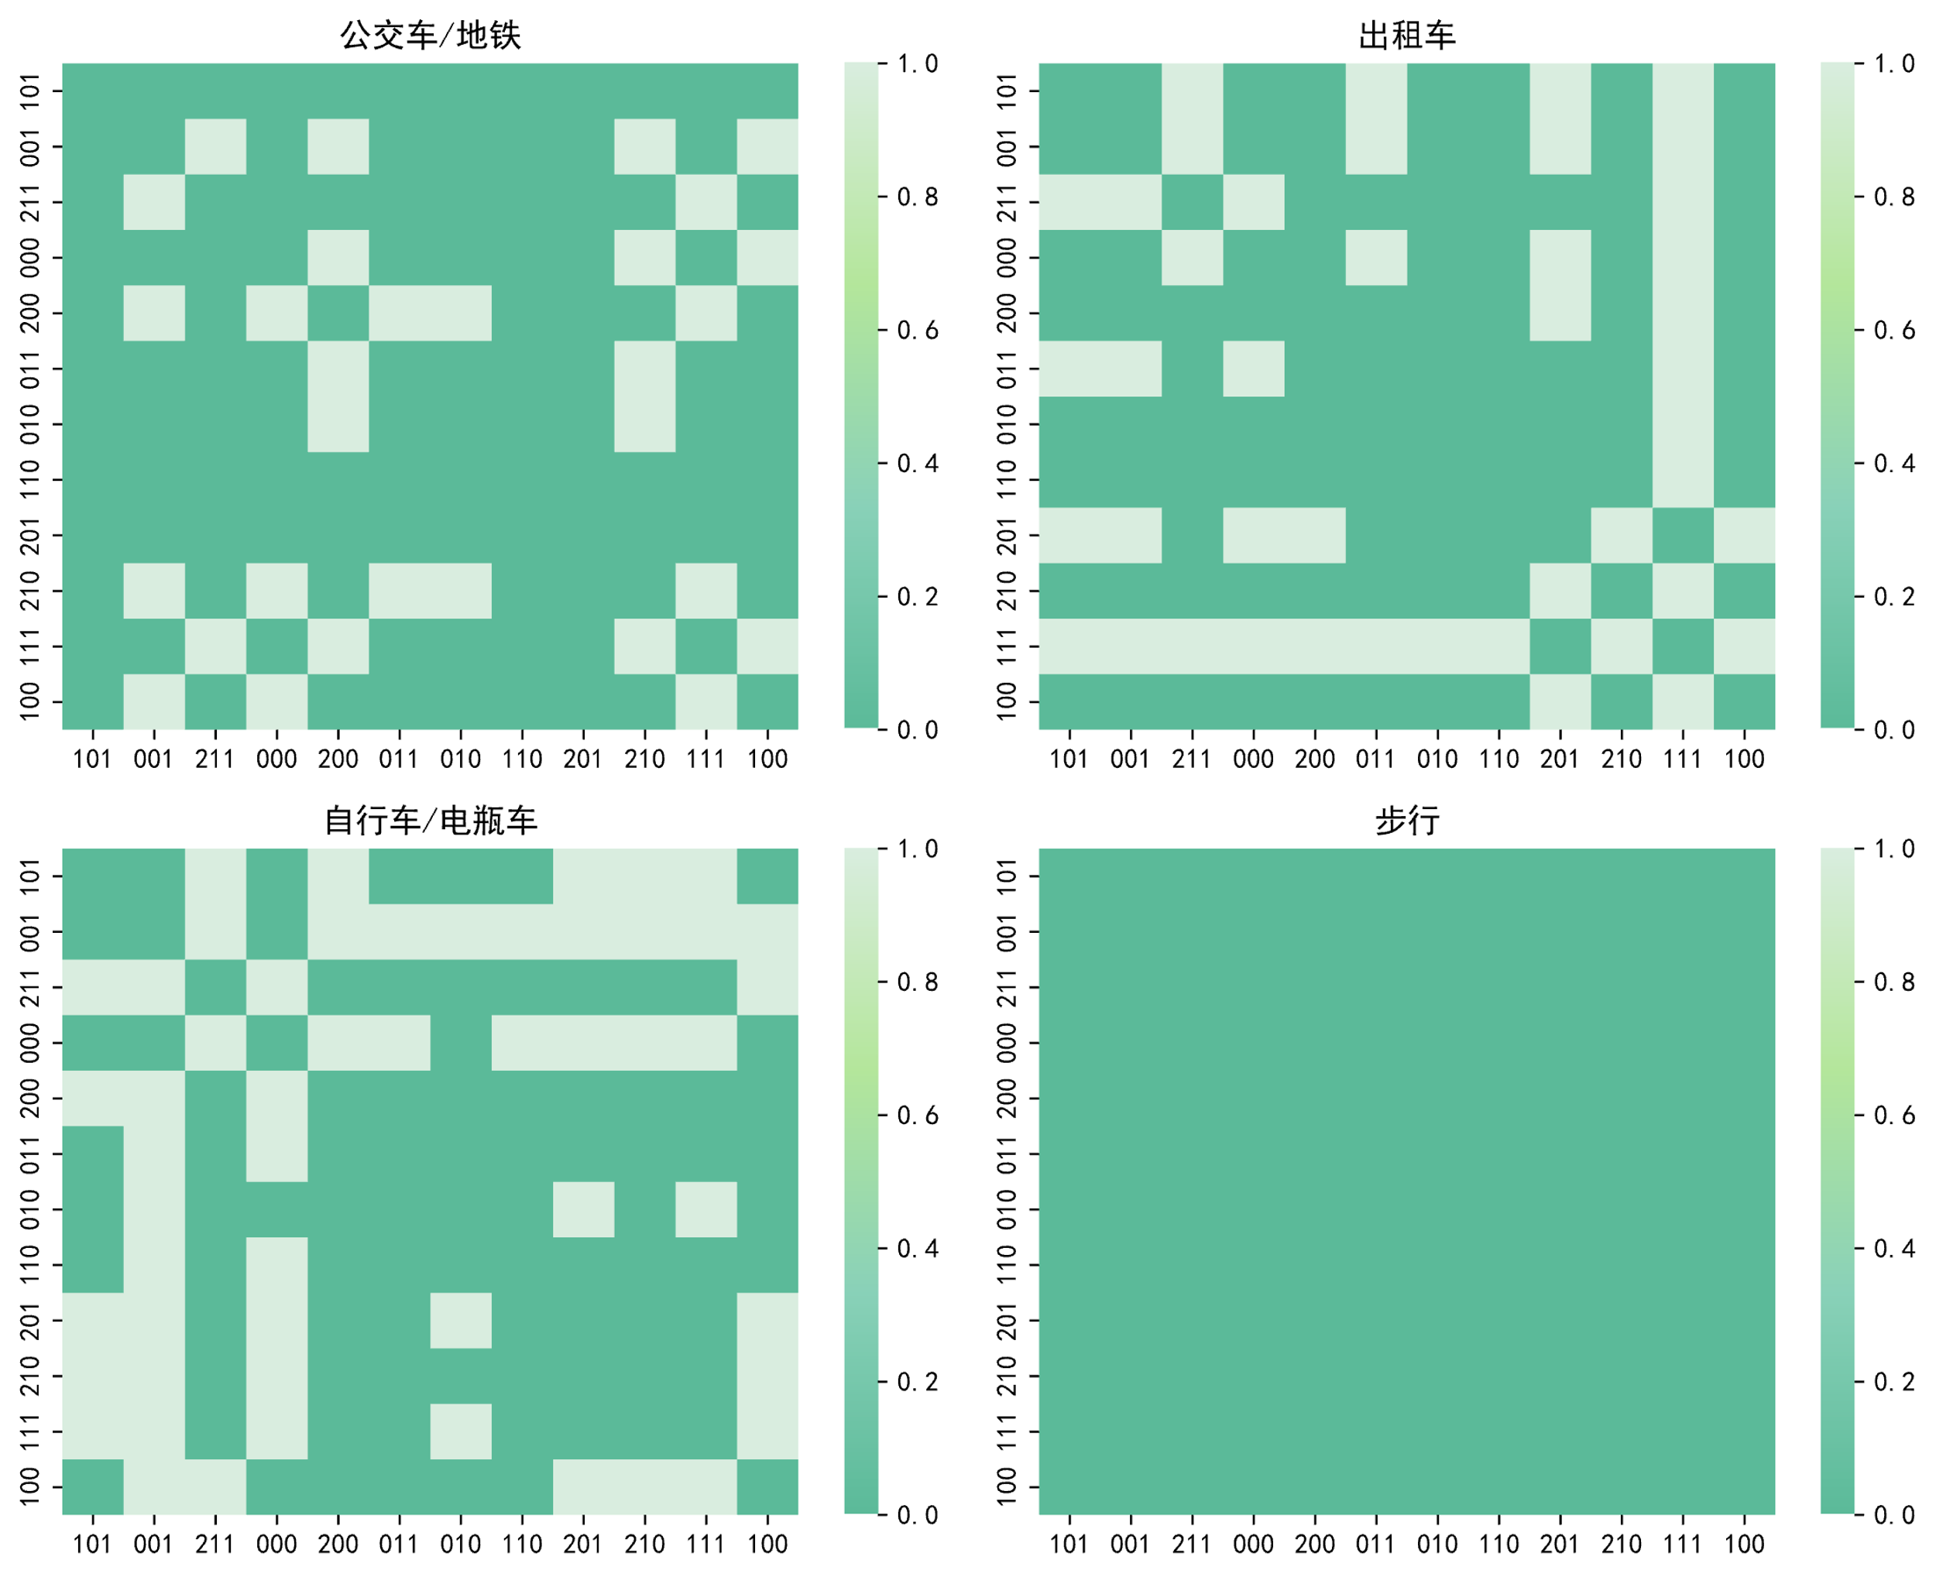
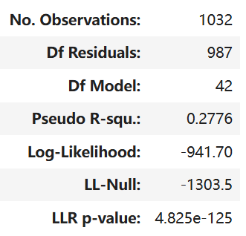
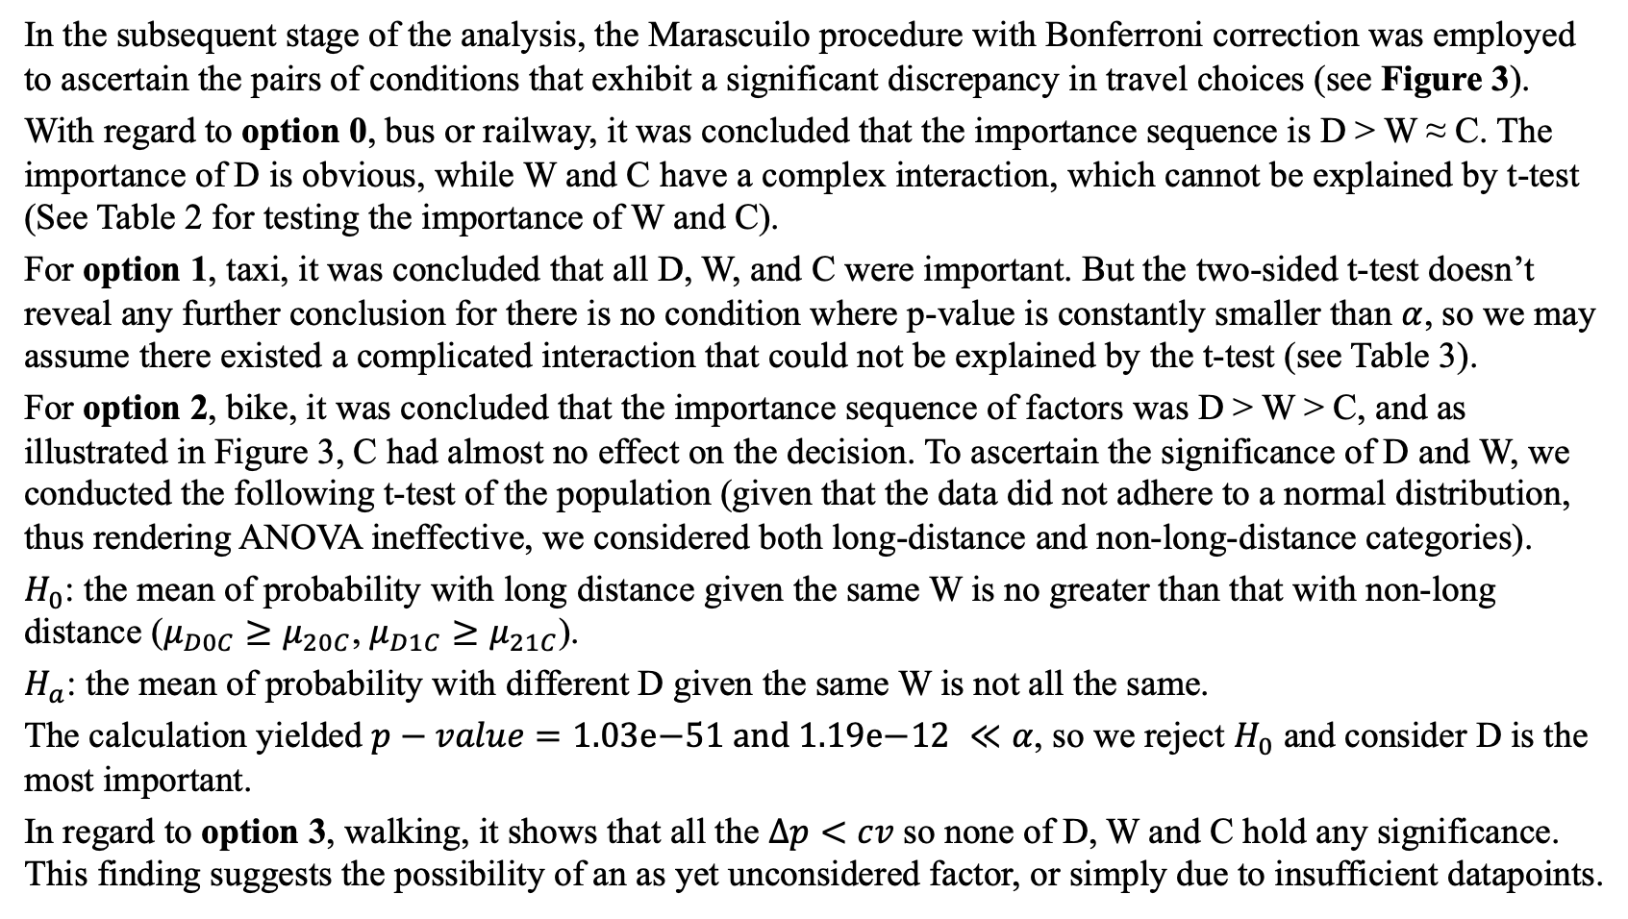
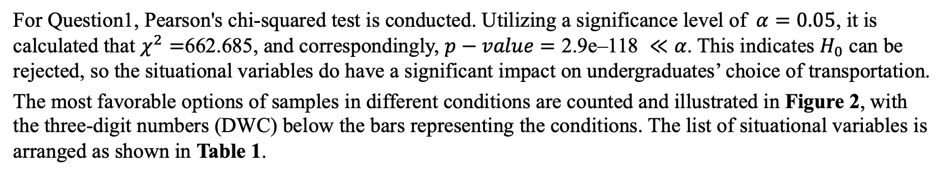
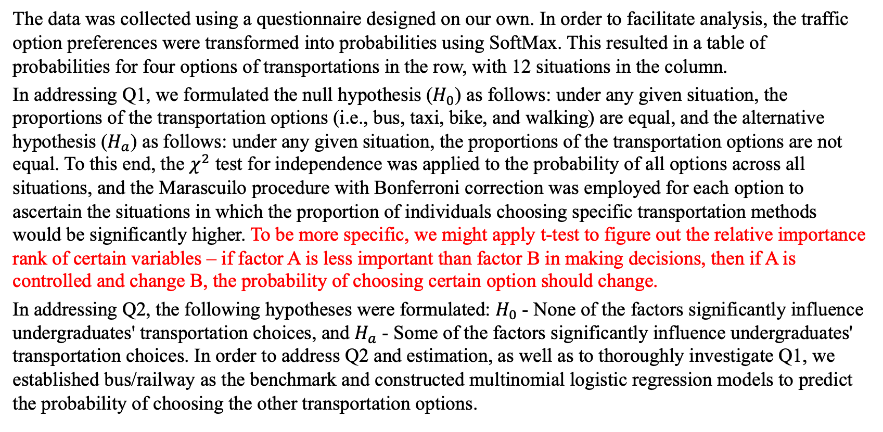
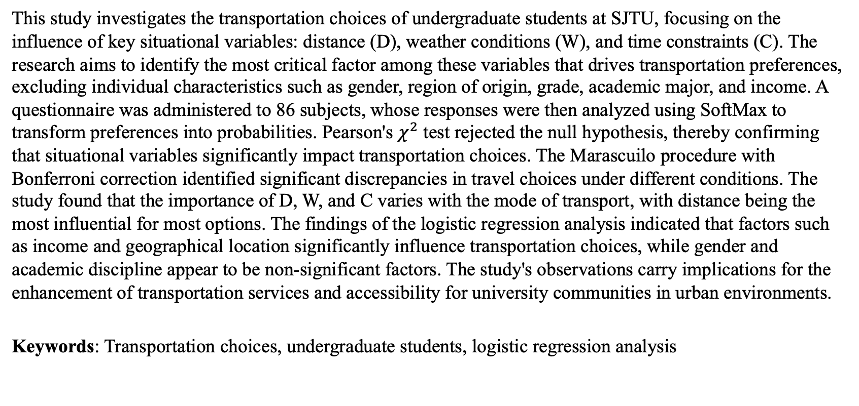
‘Jiao Tong’ Preference of Jiao Tong Undergraduates 施奕涵、吴泽楠、方真、高纵、亢予凡
Abstract
Results
In the subsequent stage of the analysis, the Marascuilo procedure with Bonferroni correction was employed to ascertain the pairs of conditions that exhibit a significant discrepancy in travel choices (see Figure 3).
With regard to option 0, bus or railway, it was concluded that the importance sequence is D > W ≈ C. The importance of D is obvious, while W and C have a complex interaction, which cannot be explained by t-test (See Table 2 for testing the importance of W and C).
For option 1, taxi, it was concluded that all D, W, and C were important. But the two-sided t-test doesn’t reveal any further conclusion for there is no condition where p-value is constantly smaller than $α$, so we may assume there existed a complicated interaction that could not be explained by the t-test (see Table 3).
For option 2, bike, it was concluded that the importance sequence of factors was D > W > C, and as illustrated in Figure 3, C had almost no effect on the decision. To ascertain the significance of D and W, we conducted the following t-test of the population (given that the data did not adhere to a normal distribution, thus rendering ANOVA ineffective, we considered both long-distance and non-long-distance categories).
$H_{0}$: the mean of probability with long distance given the same W is no greater than that with non-long distance ($μ_{D0C}≥μ_{20C}$, $μ_{D1C}≥μ_{21C}$).
$H_{a}$: the mean of probability with different D given the same W is not all the same.
The calculation yielded $p−value=\text{1.03}\text{e}\text{−51 }\text{and}\text{ 1.19}\text{e}\text{−12} ≪α$, so we reject $H_{0}$ and consider D is the most important.
In regard to option 3, walking, it shows that all the $Δp<cv$ so none of D, W and C hold any significance. This finding suggests the possibility of an as yet unconsidered factor, or simply due to insufficient datapoints.
Option 1
Option 2
This study investigates the transportation choices of undergraduate students at SJTU, focusing on the influence of key situational variables: distance (D), weather conditions (W), and time constraints (C). The research aims to identify the most critical factor among these variables that drives transportation preferences, excluding individual characteristics such as gender, region of origin, grade, academic major, and income. A questionnaire was administered to 86 subjects, whose responses were then analyzed using SoftMax to transform preferences into probabilities. Pearson's $χ^{2}$ test rejected the null hypothesis, thereby confirming that situational variables significantly impact transportation choices. The Marascuilo procedure with Bonferroni correction identified significant discrepancies in travel choices under different conditions. The study found that the importance of D, W, and C varies with the mode of transport, with distance being the most influential for most options. The findings of the logistic regression analysis indicated that factors such as income and geographical location significantly influence transportation choices, while gender and academic discipline appear to be non-significant factors. The study's observations carry implications for the enhancement of transportation services and accessibility for university communities in urban environments.
Keywords: Transportation choices, undergraduate students, logistic regression analysis
A total of 86 samples were collected, and no instances of outliers were identified. The proportion of gender, major, grade, and region of origin is illustrated in Figure 1.
Table 1
Variables | Description
Distance (D) | 0/1/2 - short/medium/long-distance
Weather (W) | 0 for sunny, 1 for rainy.
Time Constraint (C) | 0 for time-abundant, 1 for time-constrained
Option 3
Objectives
The present study has been designed to investigate the transportation choices made by undergraduate students at SJTU when travelling to different parts of Shanghai, with a particular focus on the factors that influence these decisions. The primary research questions guiding this study are as follows:
To what extent do key situational variables – namely, the distance of the trip, weather conditions, and time constraints – affect travel decisions? Furthermore, the study sought to identify the single most critical factor among these situational variables that predominantly drive transportation preferences. It is important to note that in this question we will not consider individual characteristics of the students.
Whether demographic variables such as gender, region of origin, academic major, and income play a significant role in shaping these decisions.
Hopefully, the study will develop a predictive model to estimate the choice of SJTU undergraduates given all the situational variables researched in the study. The investigation of these questions will not only illuminate the practical difficulties faced by university students in balancing cost, time, and convenience, but will also have implications for improving transportation services and accessibility for university communities in Shanghai and similar urban contexts worldwide.
Table 2
Table 3
Figure 1
Figure 2
 | D 0 | D 1 | D 2
W 0 for C | 0.30 | 0.01 | 0.28
W 1 for C | 0.16 | 4.04e-11 | 0.98
C 0 for W | 0.01 | 0.53 | 0.61
C 1 for W | 1.31e-9 | 4.83e-37 | 0.64
 | D 0 | D 1 | D 2
W 0 | 5.95e-5 | 0.76 | 0.67
W 1 | 8.68e-9 | 4.65e-38 | 0.98
C 0 | 0.41 | 0.22 | 4.93e-6
C 1 | 0.01 | 1.61e-27 | 7.20e-8
For Question1, Pearson's chi-squared test is conducted. Utilizing a significance level of$α=0.05$, it is calculated that $χ^{2}=$662.685, and correspondingly, $p−value=\text{2.9}\text{e}\text{–118} ≪α$. This indicates $H_{0}$ can be rejected, so the situational variables do have a significant impact on undergraduates’ choice of transportation.
The most favorable options of samples in different conditions are counted and illustrated in Figure 2, with the three-digit numbers (DWC) below the bars representing the conditions. The list of situational variables is arranged as shown in Table 1.
Q1
Q2
Conclusion
In the subsequent stage of the analysis, the Marascuilo procedure with Bonferroni correction was employed to ascertain the pairs of conditions that exhibit a significant discrepancy in travel choices (see Figure 3).
With regard to Question 2, the results of the logistic regression is listed in Table 4.
Utilizing the regression of bus and railway services as a benchmark, the regression coefficients of the remaining three traffic options, along with their 95% confidence intervals and t-test p-values, are illustrated in Figure 4.
For public transportation, distance emerged as the most significant factor, followed by a complex interplay between weather and time constraints that the t-test could not fully elucidate. In the case of taxis, all three variables were deemed crucial, with intricate interactions that exceeded the explanatory capacity of the t-test. In the case of cycling, distance emerged as the predominant consideration, while weather exhibited a negligible impact on the decision-making process. Conversely, for walking, none of the situational variables were found to be significant, hinting at the presence of an unexplored factor that influences students' aversion to walking, possibly related to personal preferences or cultural factors.
Logistic regression analysis was utilized to elucidate the influence of individual characteristics on transportation choices. The analysis revealed that neither gender nor academic major significantly influenced these decisions. However, the transportation choices of second-year undergraduates were found to be influential, likely due to their larger representation in the sample. Income level was identified as a factor in the choice between taxis and walking, with the former being a more expensive option and the latter being cost-effective. It is important to note that the region of origin was a significant factor in the estimation of all transportation choices, suggesting cultural or habitual influences on travel behavior.
Methods
Table 4
The data was collected using a questionnaire designed on our own. In order to facilitate analysis, the traffic option preferences were transformed into probabilities using SoftMax. This resulted in a table of probabilities for four options of transportations in the row, with 12 situations in the column.
In addressing Q1, we formulated the null hypothesis ($H_{0}$) as follows: under any given situation, the proportions of the transportation options (i.e., bus, taxi, bike, and walking) are equal, and the alternative hypothesis ($H_{a}$) as follows: under any given situation, the proportions of the transportation options are not equal. To this end, the $χ^{2}$ test for independence was applied to the probability of all options across all situations, and the Marascuilo procedure with Bonferroni correction was employed for each option to ascertain the situations in which the proportion of individuals choosing specific transportation methods would be significantly higher. To be more specific, we might apply t-test to figure out the relative importance rank of certain variables – if factor A is less important than factor B in making decisions, then if A is controlled and change B, the probability of choosing certain option should change.
In addressing Q2, the following hypotheses were formulated: $H_{0}$- None of the factors significantly influence undergraduates' transportation choices, and $H_{a}$- Some of the factors significantly influence undergraduates' transportation choices. In order to address Q2 and estimation, as well as to thoroughly investigate Q1, we established bus/railway as the benchmark and constructed multinomial logistic regression models to predict the probability of choosing the other transportation options.
The following analysis seeks to further explore the propensity for walking. The sequence of preference is hypothesized to be D > W ≈ C, on the grounds that distance is deemed a significant factor in estimating probability of pedestrian travel, with W and C deemed to be insignificantly relevant.
Among the fixed variables, we find that gender and major have no significant effect in choice, while whether an undergraduate is in their second year contributes to estimating the transportation choice. Income plays a role in estimating one's choice of taxi or walking, which is understandable in that the former is relatively expensive and the latter is much cheaper. Lastly, the region of origin is quite important in estimating all of the choices.
References
[1] Statistics for Business and Economics, 13e, by Anderson, Sweeney, Williams, Camm, and Cochran (2018)
[2] https://en.wikipedia.org/wiki/Multinomial_logistic_regression
Figure 3

