Slide 1
Proposal for CS181 project
Team: 熊章智 杨天倪 冯令康

Slide 2
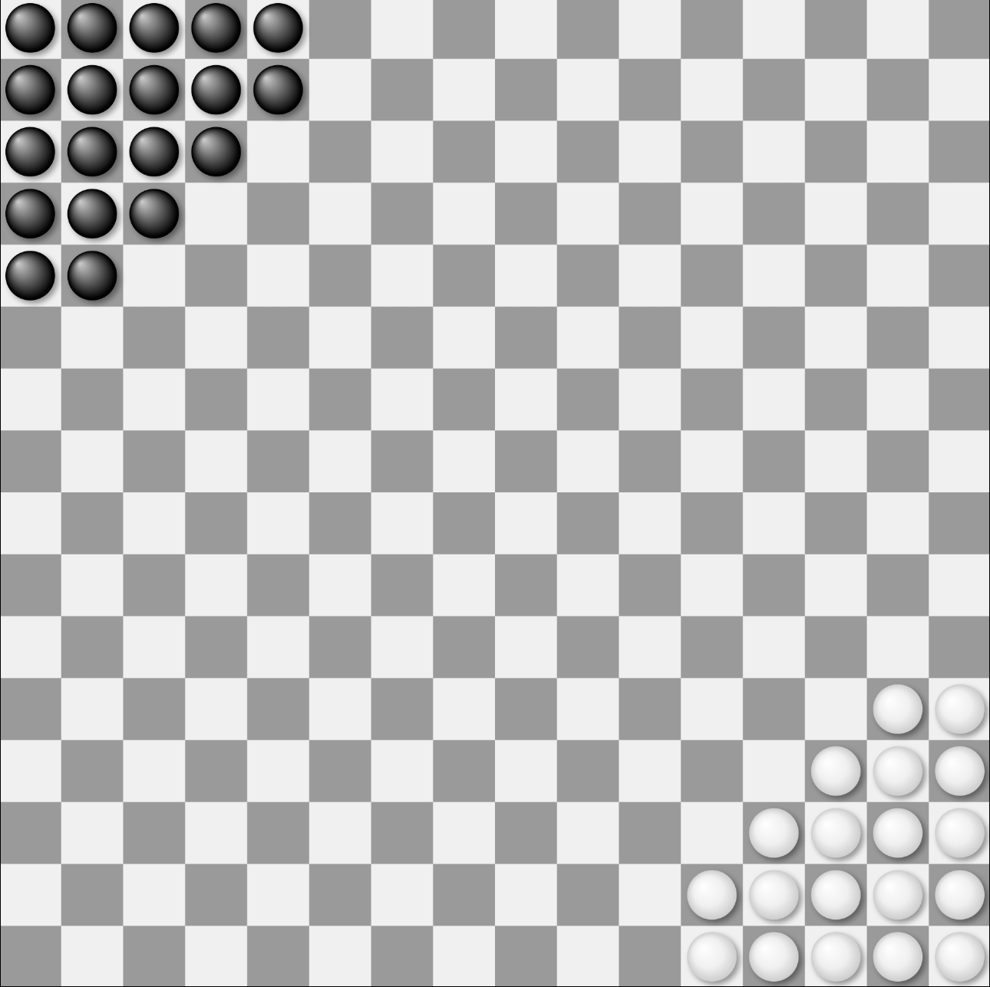
Game——Halma
Halma(正方跳棋) is a strategy board game invented in 1883 or 1884 by George Howard Monks, an American thoracic surgeon at Harvard Medical School. The gameboard is checkered and divided into 16×16 squares. Pieces may be small checkers or counters, or wooden or plastic cones or men resembling small chess pawns. Piece colors are typically black and white for two-player games, and various colors or other distinction in games for four players.
Source: https://en.wikipedia.org/wiki/Halma

Slide 3
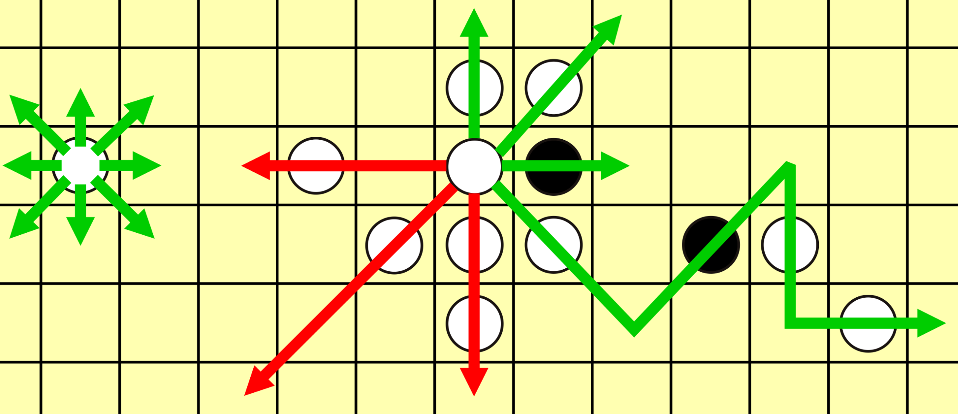
Halma Rule
Main Rule: Similar to 中国跳棋. The board length can be 8, 10, or 16. Two players, and the goal is to move all your pawns to the diagonal corner.
One pawn can move to eight directions for one step (if no pawn in this directions), or start jumping using other pawns till it can’t jump at all.
Image Source: https://en.wikipedia.org/wiki/Halma#/media/File:Halma_game_2.svg

Slide 4
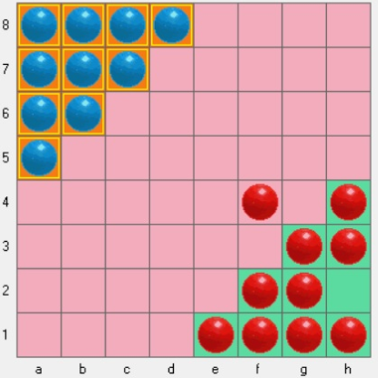
Problem Formulation
Basic Settings:
8*8 grids, 20 pawns (10 per side)
Goal for one player: Move all your pawns
to the diagonal corner regions.
Problem: Design a agent with win rate as
high as possible!
Image Source:
https://hwiegman.home.xs4all.nl/hhalma.html

Slide 5
Solution: Implement Agents
Search (DFS, BFS, Greedy, Heuristics, etc)
Adversial Search (Minimax, α-β pruning, MCTS)
Reinforcement Learning (Q-learning)

Slide 6
Related Work
Though being a niche games, there are still few works& repo from others on this.
Basic game implementation
Game GUI
Almost all agents deployed are simply (vanilla) minimax
Very few agents design outside of minimax!

Slide 7
Novelty
Here are some prbable novel technical contribution we propose:
More agents available
More game settings available and we can further discuss the impact of changes in game settings.
Innovation on game rules (e.g., jump in a row can earn more points and victory is worth large amount of points, we can even set total step limitation and the player with higher score wins, etc) and discuss the potential policy change due to the game rules innovation.
Neural network approach for approximate Q-learning

Slide 8
Comparative experiments
horizontal one:
Under one rule or game setting, two different or identical agents can fight against each other and we can collect the win rate.
verticle one:
Under different rule or game setting, for the same agent, are there any notable changes in policy? Or any interesting phenomena?
Also we may compete with other researchers’agents on halma (if there are)

Slide 9
Expected Outcome & Contribution
The performance of different agents are waited to tested and validated.
Our expected contribution is to implement as many agents we learned in CS181 as possible, and further implement our probable novel technical points.

Slide 10
Thank you!

