Slide 1
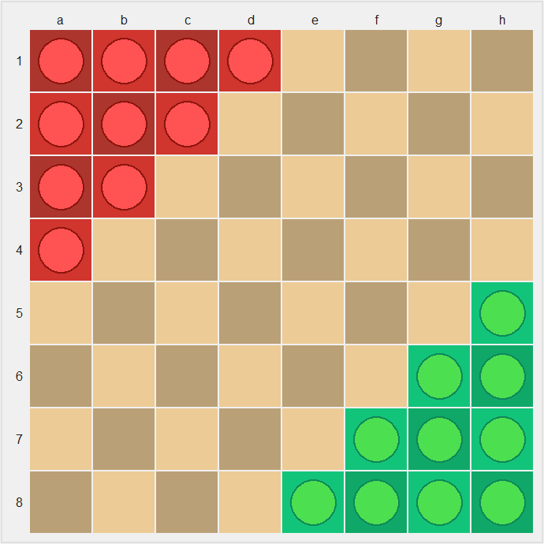
Halma
CS181 Final Project
熊章智，杨天倪，冯令康

Slide 2
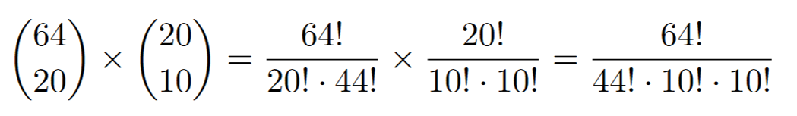
Setting
8*8 grids
20 pawns in total (10 per side)
Around 10²⁸ States!

Slide 3
Implement methods
Human Player
Random
Greedy
Minimax (alpha-beta pruning); Minimax Local Search
MCTS
(Conventional) Approximate Q-learning
Neural Approximate Q-learning

Slide 4
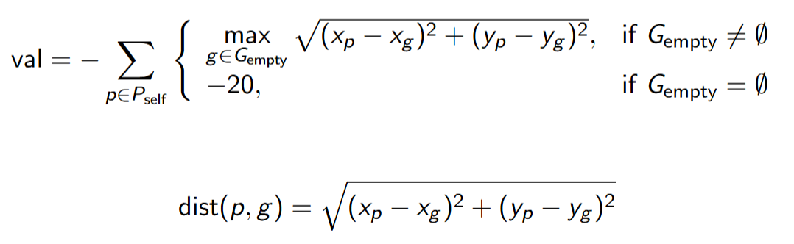
State Evaluation
Calculate the Euclidean distance from the pawn to every empty or non-player-occupied position in the player's goal area.
If there are available goal positions, add the maximum of these distances to a running total (val).
If there are no available goal positions for that pawn, subtract 20 from the total as a penalty.
After evaluating all pawns: Multiply the total score by -1, so that a smaller distance (i.e., pawns closer to the goal) results in a higher evaluation score.

Slide 5
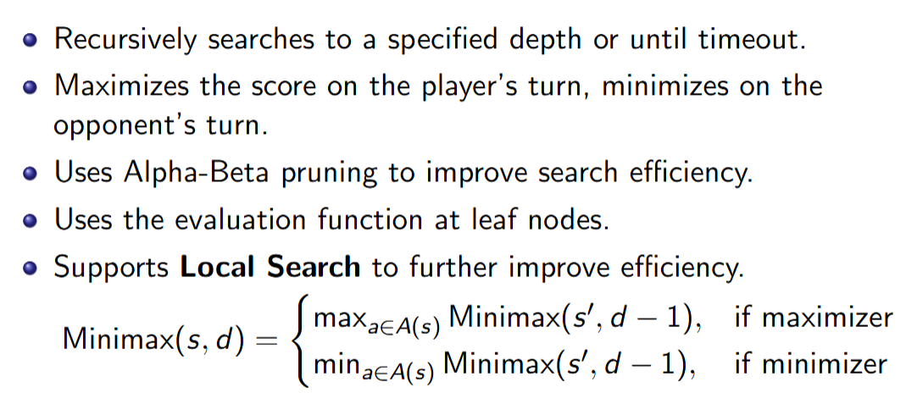
Basic Methods
Random & Greedy
Minimax with alpha-beta pruning:

Slide 6
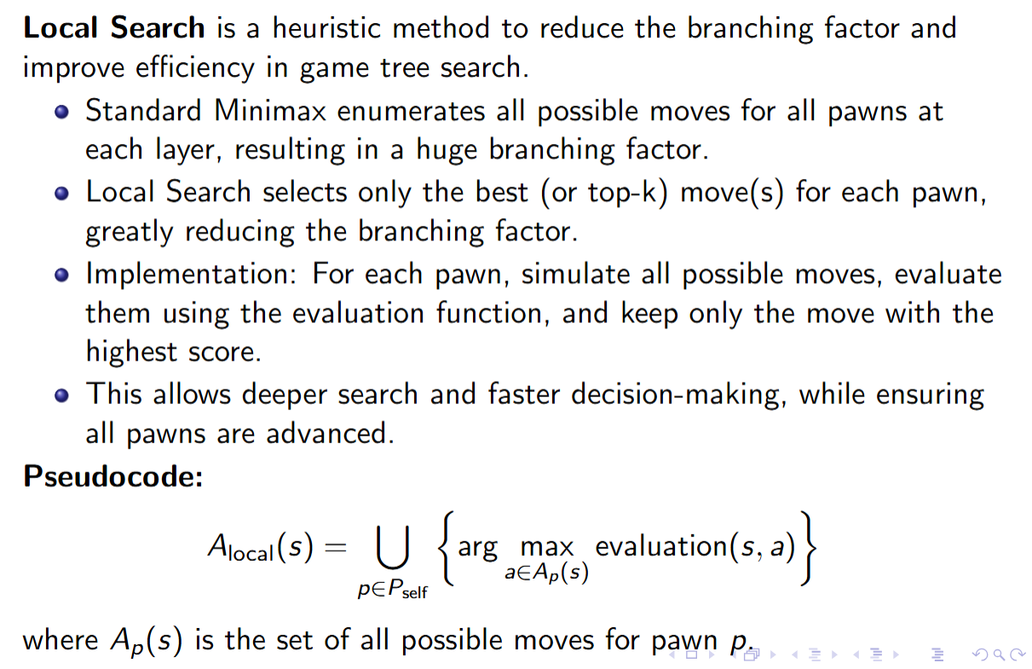
Minimax with Local Search Skill

Slide 7
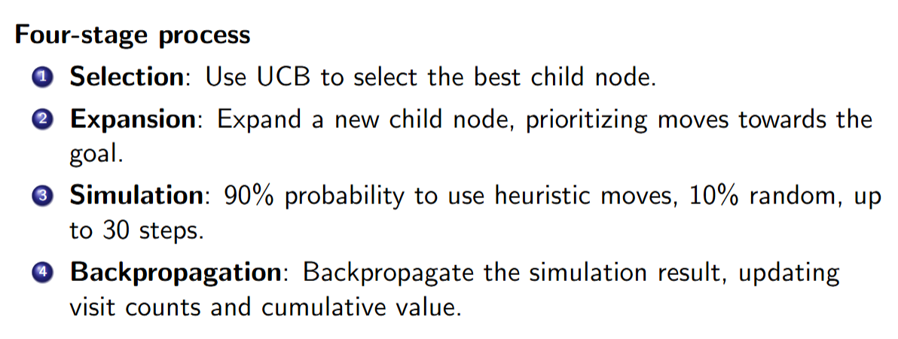
MCTS

Slide 8
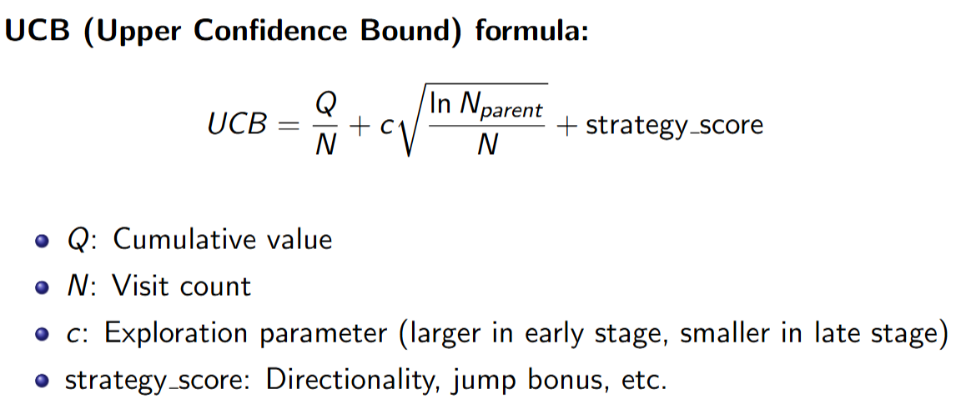
MCTS

Slide 9
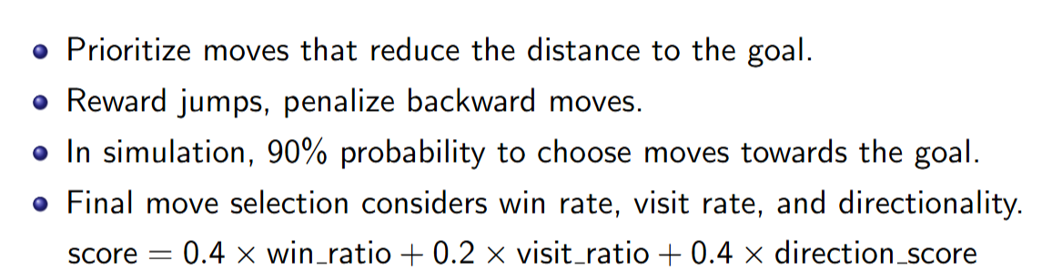

Slide 10
Q-learning
Unfortunately, we failed to train a Q-learning agent...
First of all, (s, a) pairs are numerous. The file containing trained parameters after 200 episodes is 21GB!
Secondly, it is hard to train. We tried letting Q-learning to fight against random/minimax/Q-learning agents, but failed.

Slide 11
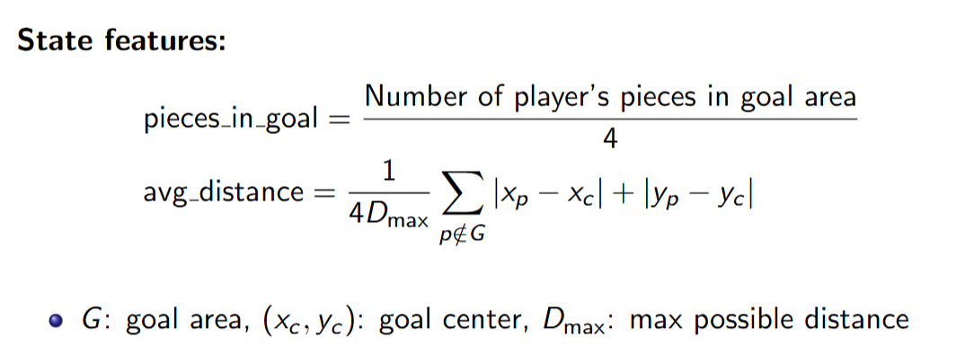
Approximate Q-learning

Slide 12
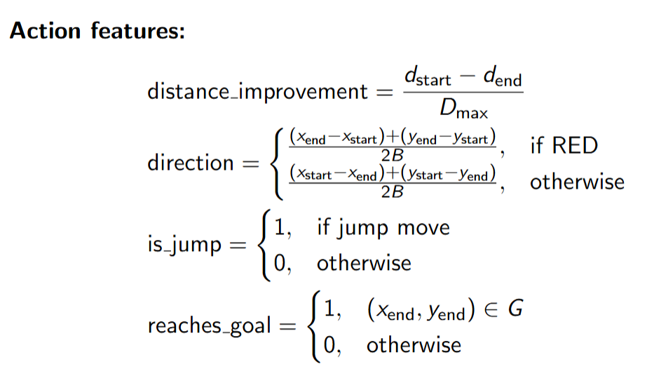
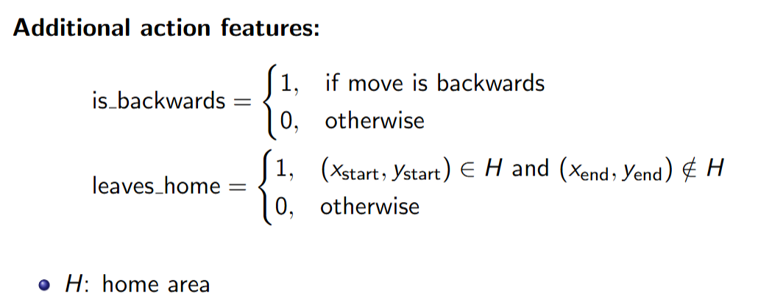

Slide 13
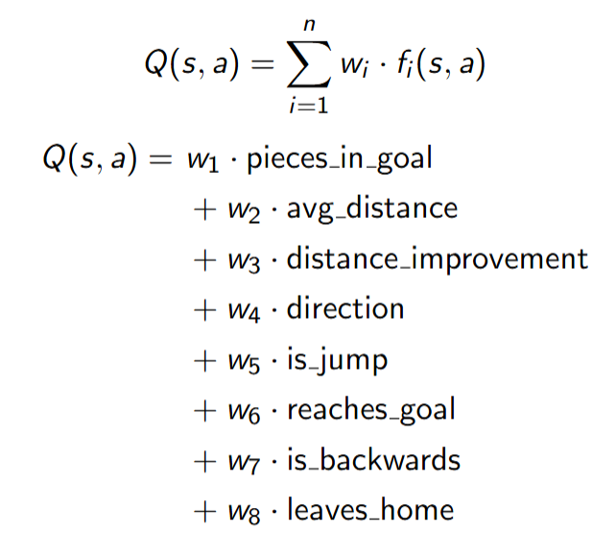

Slide 14
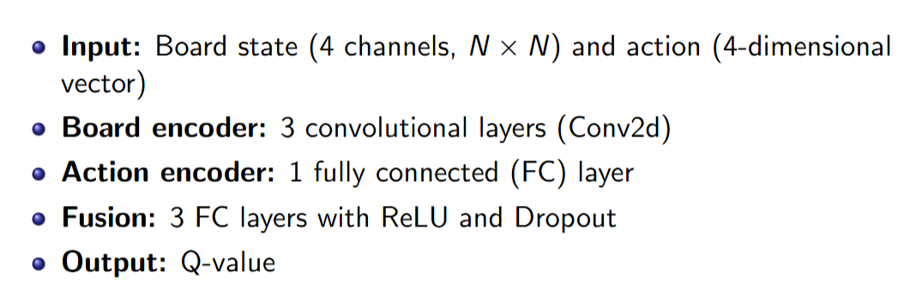
Neural Approximate Q-learning: Network Architecture

Slide 15
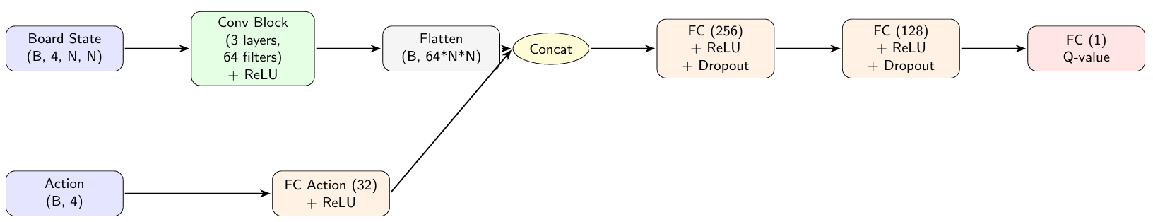
Diagram

Slide 16
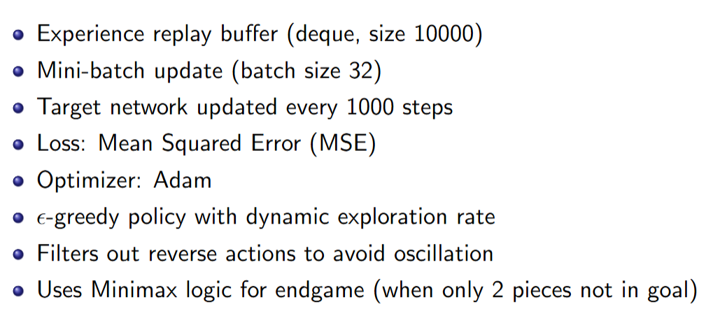
Training Detail

Slide 17
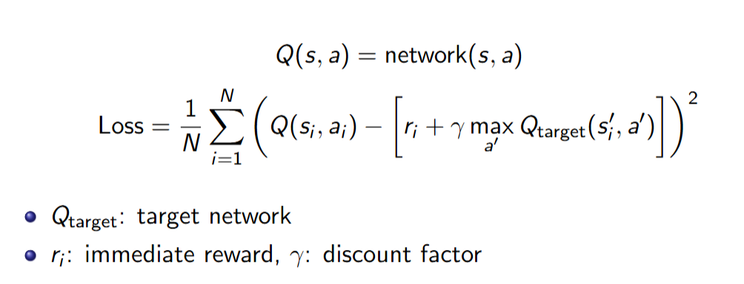

Slide 18
Thank You!

