Slide 1











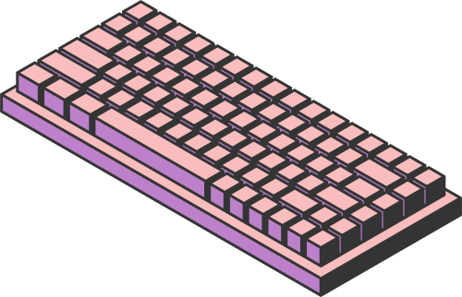


CS182
MOLECULES
PROPERTY CLASSIFICATION
FEATURING MULTI-MODALITY
Team members: Zhangzhi Xiong Tianni Yang Yixuan Chen

Slide 2
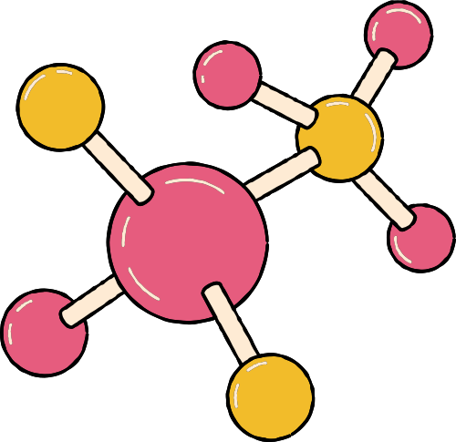
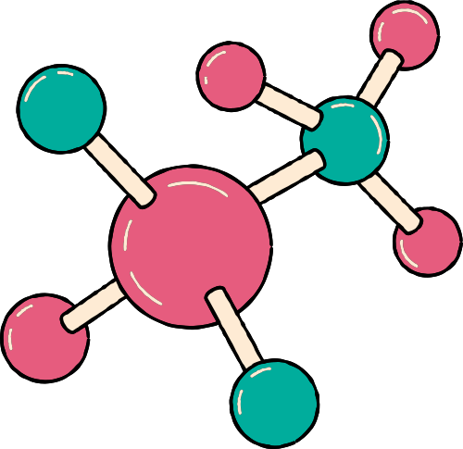
01. INTRODUCTION
OUTLINE
02. METHODS
03. EXPERIMENTS

Slide 3

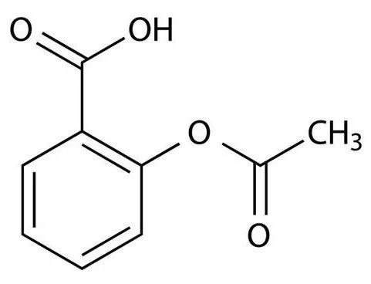


01. INTRODUCTION
Output:
Toxic?
Soluble?
...
Example: Aspirin

Slide 4
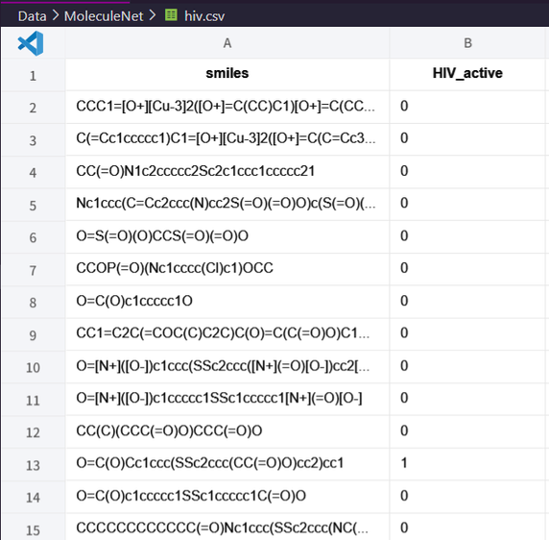
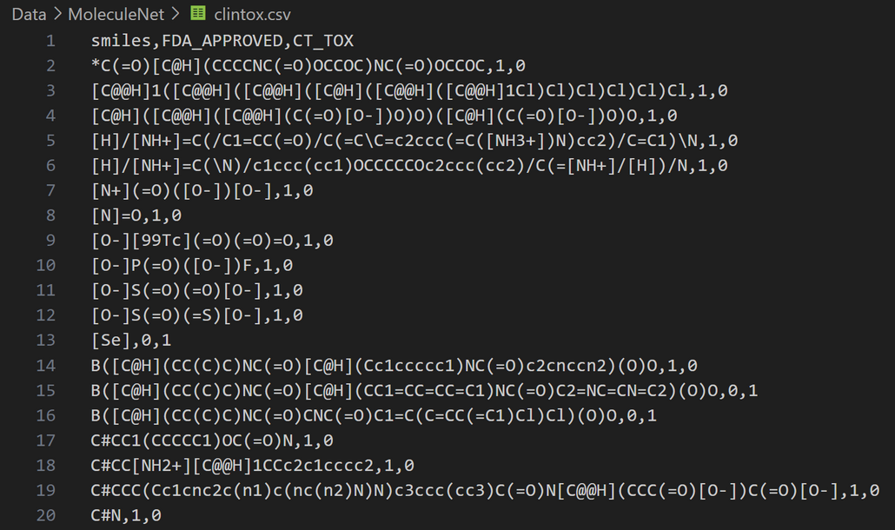
DATASET
In our research, we choose a subset of datasets which are suitable for classification:
BACE: β-secretase enzyme
HIV: HIV activeness
Tox21: multiple properties
BBBP: Blood-Brain Barrier Penetration
Clintox: drugs failed clinical trials for toxicity
SIDER: multiple side effects
Moleculenet

Slide 5


RELATED WORK
Feature Engineering Model (Leveraging Different Fingerprint Feature):
Random Forest; XGBoost; AttentiveFP...
Graph Based Model:
Graph Convolution Model; Weave Model; Direct Acyclic Graph Model;...
Few Feature Mixture Model: FP-GNN
Multi-Modality Engineering!

Slide 6
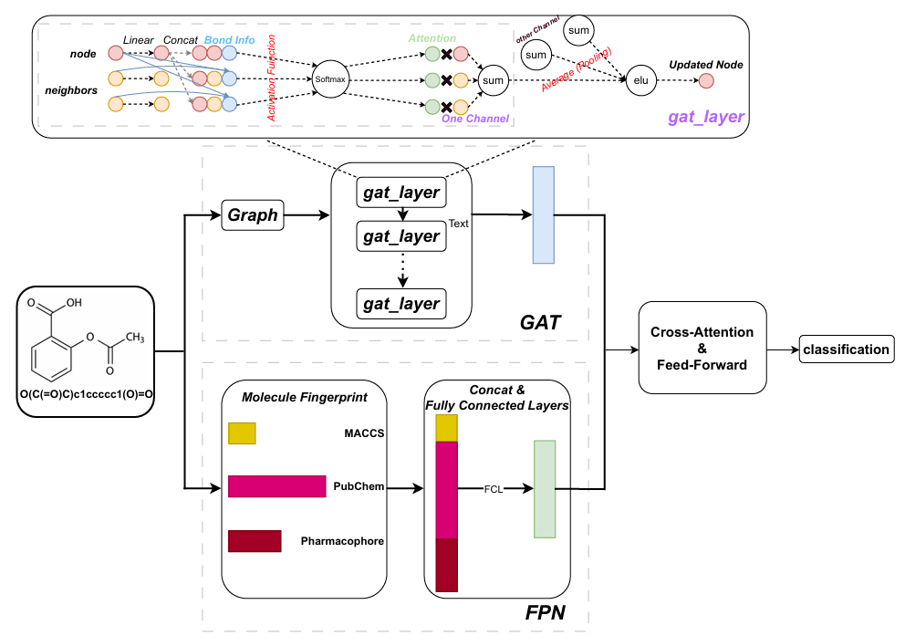
02. METHODS
PIPELINE

Slide 7
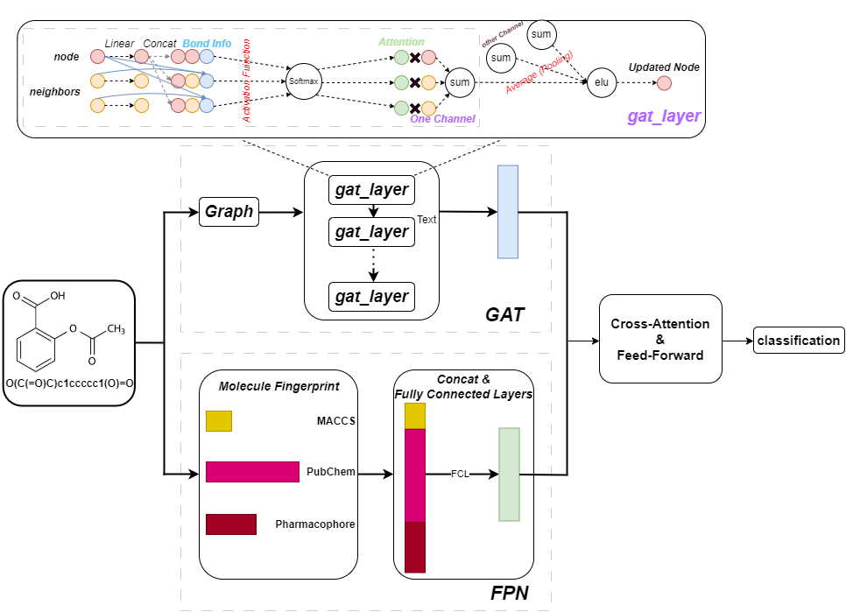
02. METHODS
PIPELINE
Graphical Information
Graph features:
Atom Features:
atom_symbol
degree
...
Adjacency Matrix
Bond Features:
Single
Double
Triple
Aromatic
None

Slide 8

PIPELINE
Tried GraphSAGE to replace graph attention, but poor in performance
Cross-Attention
To Connect Features:
Previous methods:
Naive concatenation
Out method:
Cross-Attention
Self-Attention
Tried Self-Attention on the fingerprints in FPN.
Did not work.

Slide 9
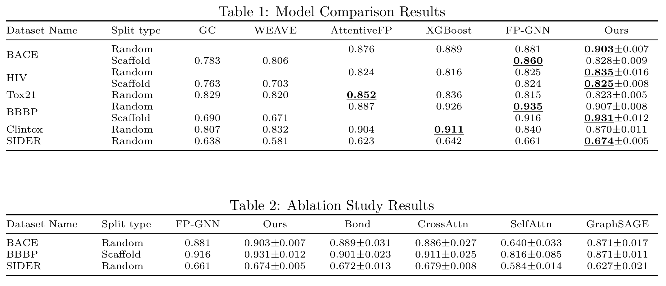
03. EXPERIMENTS

Slide 10
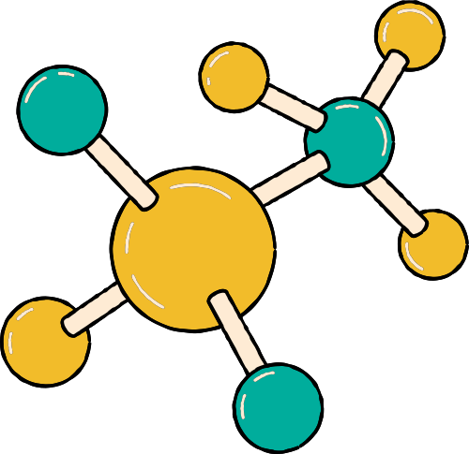



THANK YOU

