Slide 1
Data Ingestion Pipeline
From SQL Server to ADLS and Back To SQL Server As Transformed Data
Presented by: Shivam Gupta
Date:04/10/2024

Slide 2
Data Ingestion Pipeline Overview
Flow of raw CSV data from SQL Server to ADLS
Transformation via Databricks
Conversion to CSV and loading back into SQL Server

Slide 3
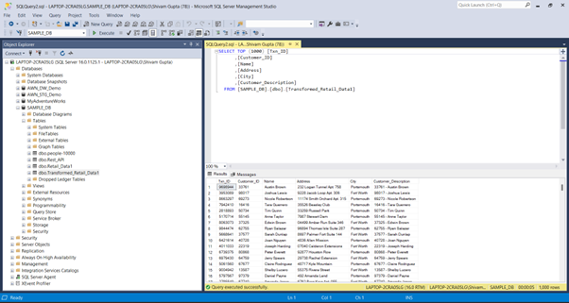
Step 1: Raw CSV Data Extraction
Raw CSV data is extracted from the SQL Server database. [Data source: SQL Server- SAMPLE_DB]
Data is prepared for loading into Azure ADLS Gen2[Data Staging source: ADLS GEN2-shivamstorage39]

Slide 4
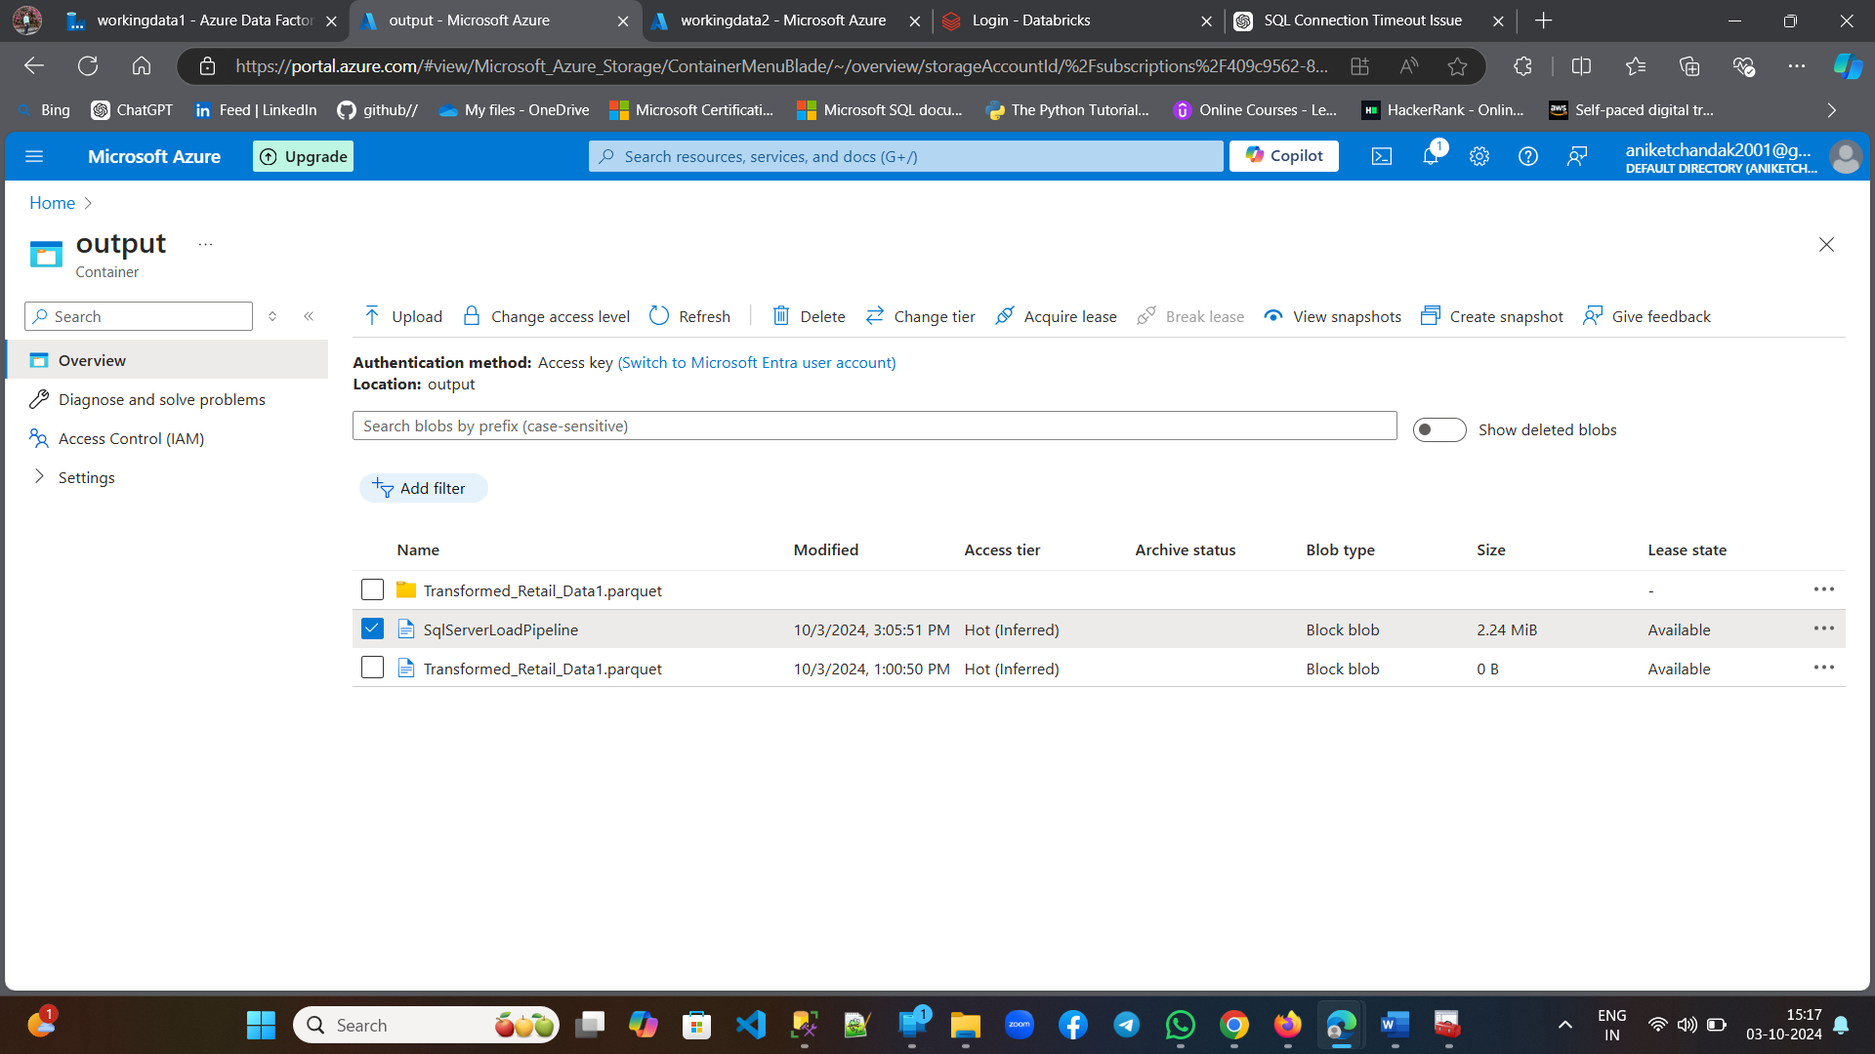
Step 2: Loading into Azure ADLS Gen2
The extracted CSV data is loaded into ADLS Gen2 storage
Data is stored in a designated folder for further processing
Benefits: Scalable storage, secure access

Slide 5
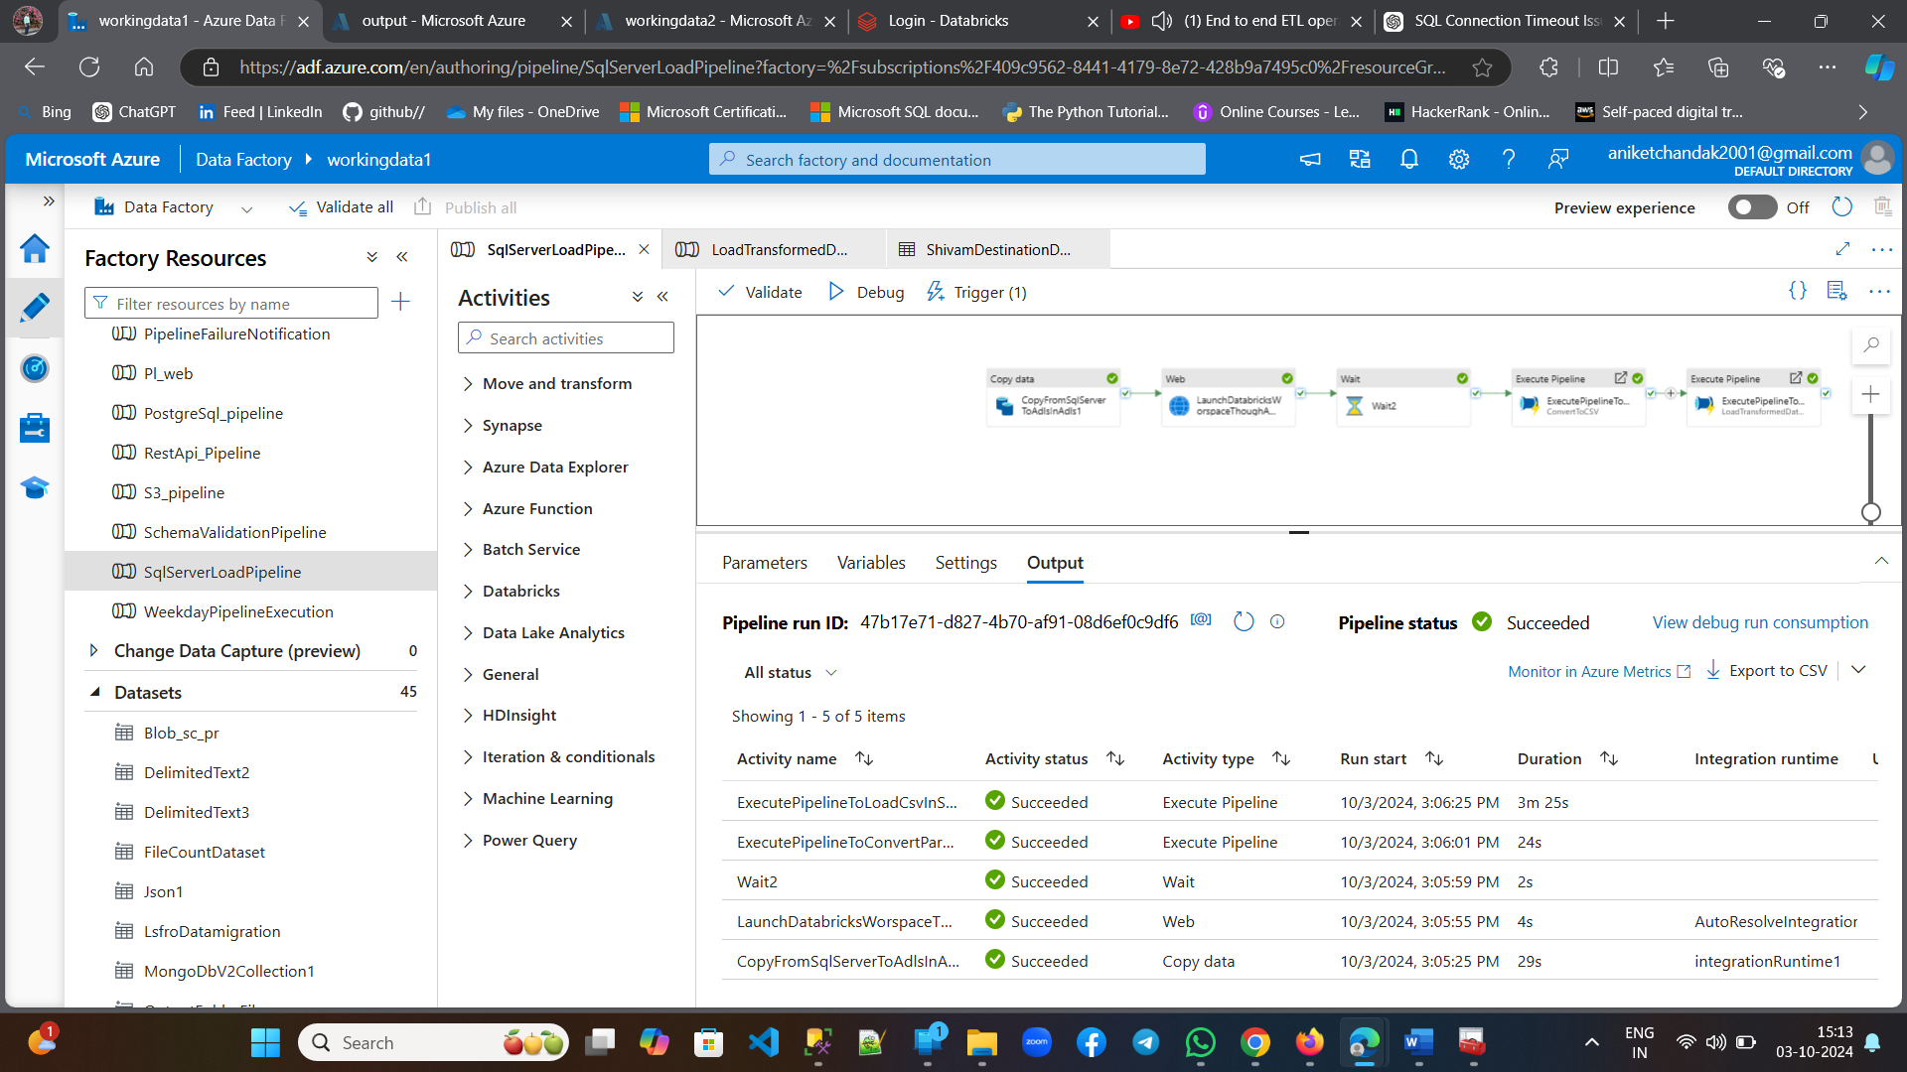
Step 3: Triggering ADF Pipelines
Use Azure Data Factory 1 (ADF1) to trigger ADF2 through a Web Activity
ADF2 handles calling Databricks for data transformation
Key Task: Orchestration of data flow

Slide 6
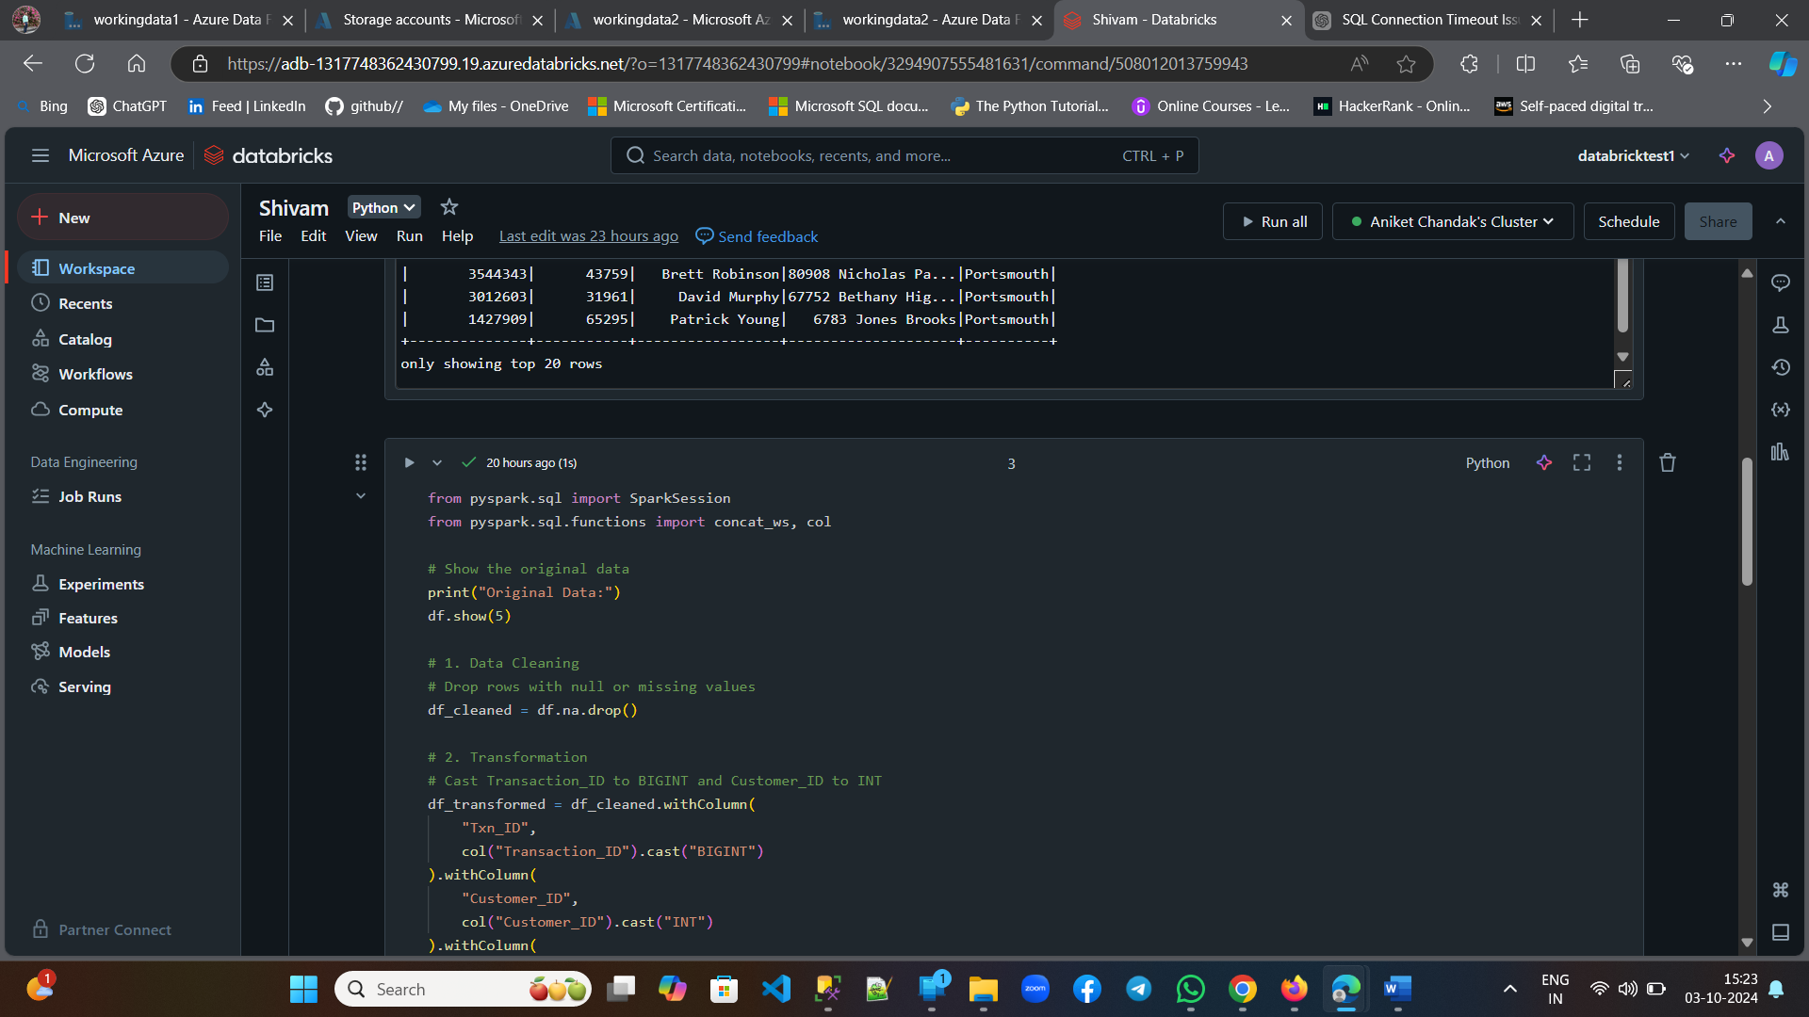
Step 4: Data Transformation in Databricks
Databricks processes and transforms the raw CSV data from ADLS
Transformed data is saved as a Parquet file in a separate folder in ADLS
Flexible, scalable processing using Databricks notebooks

Slide 7
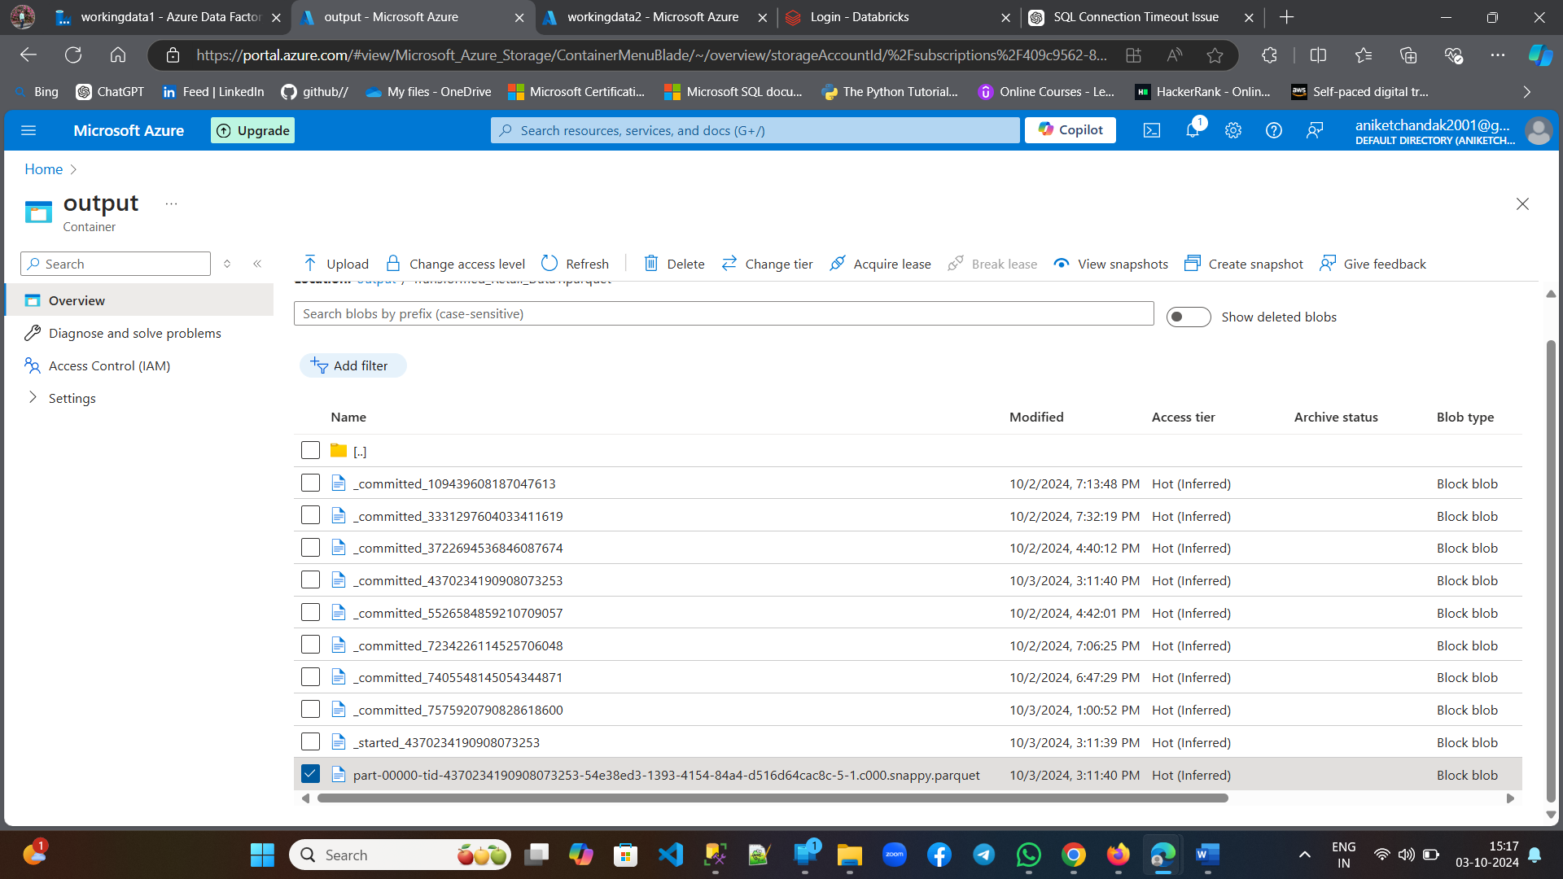
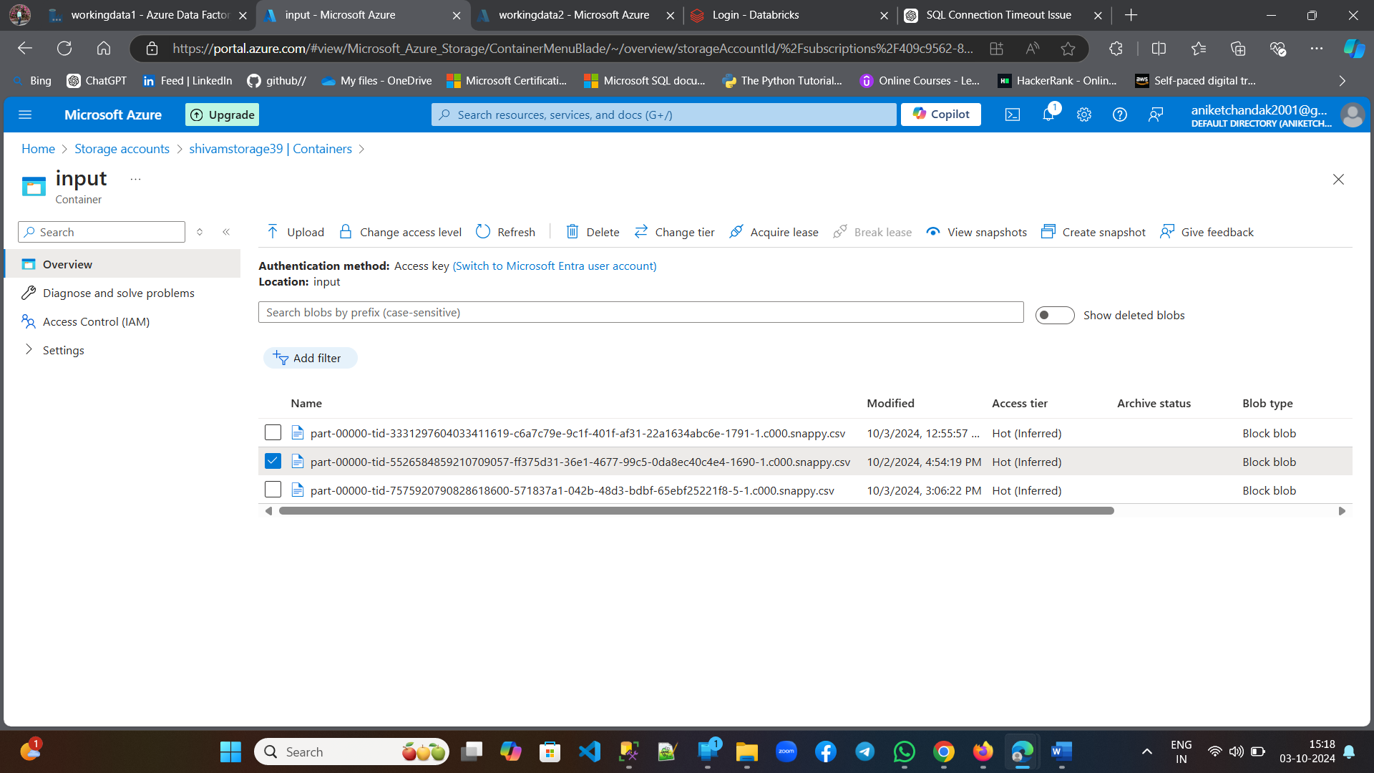
Step 5: Converting Parquet to CSV
Pipeline 'ConvertToCSV' reads Parquet files from ADLS
Conversion of the transformed data back to CSV format
The converted CSV file is saved in another folder/container(input) within the same ADLS storage account

Slide 8
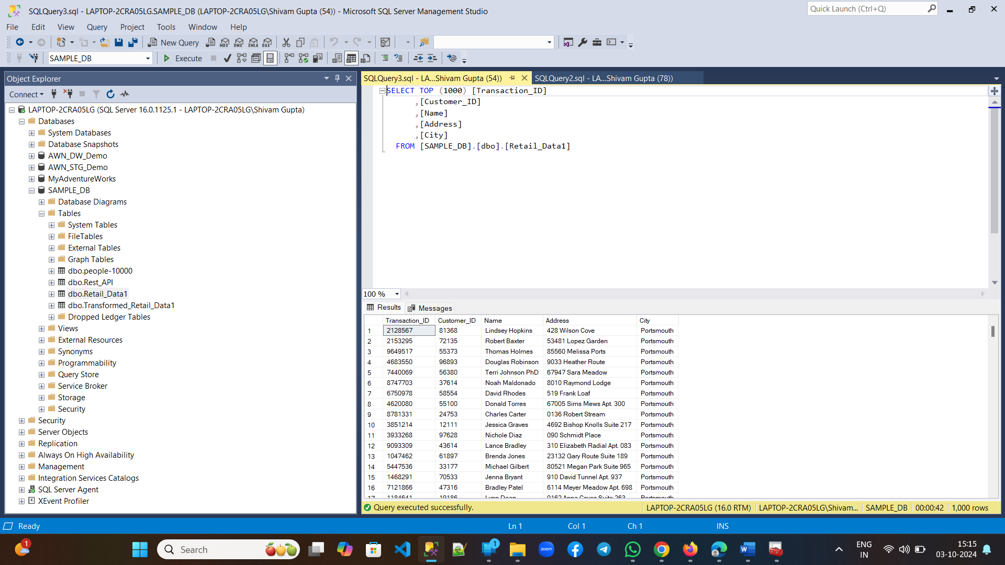
Step 6: Load CSV Back into SQL Server
Pipeline 'LoadToSqlServer' takes the CSV file from ADLS
Loads the CSV into the on-premise SQL Server database
Ensures data is available for operational or analytical use

Slide 9
Benefits and Key Takeaways
Automation of data flow using Azure tools (ADF, Databricks)
Scalable data processing and transformation in the cloud
Streamlined end-to-end data pipeline from raw data to SQL Server

