Slide 1
UNIT-1

Slide 2
Data
Data can be defined as raw facts, figures, symbols that have no inherent meaning on their own.
Data is typically represented in the form of numbers, letters, words, images, audio, video or any other format that can be processed and analyzed.
Data is processed to get useful information.
For Example : 35, 22 , 67, 45 represent ages of persons can be treated as data(raw facts). Sorting(processing) these data can give different information like min age, max age etc .

Slide 3
Database
A database is a collection of related data that is stored, managed and accessed using a computer system.
Ex : A university Database contains information about students, faculty, courses, rooms.

Slide 4
Database Management System
A Database Management System (DBMS) is a software that provides an organized and efficient way to store, manage, manipulate, and retrieve data from a database.
The DBMS serves as an intermediary between users or applications and the physical data stored in the database.

Slide 5
Problems with File systems
1. Data Redundancy and Inconsistency
Same data may be duplicated at several places or files (Redundancy).
All copies may not be updated properly (Inconsistency).
2. Difficulty in accessing data
May have to write a new application program to meet a new request .

Slide 6
Problems with File systems
3. Data isolation
Data in different formats.
Difficult to write new application programs to access data of different formats.
4. Multiple users.
Need protection from concurrent access by different users.
Example : Account has 5000 Rs ,if two customers are trying to withdraw 1000 and 500 at same time. The resulting balance may be 4000 or 4500 0r 3500 if no proper access is provided.

Slide 7
Problems with File systems
5. Security problems
Every user of the system should be able to access only the data they are permitted to see.
E.g. payroll people only handle employee records, and cannot see customer accounts.
Difficult to enforce this with files.
6. Integrity problems
Data may be required to satisfy constraints.
Ex: Account balance not below 500.
Again, difficult to enforce or to change constraints with the file-processing approach.

Slide 8
File Systems | DBMS
More Data Redundancy due to copies of same data at multiple places. | Less data Redundancy due to centralized data storage and sharing.
Difficult to enforce data integrity constraints. | DBMS enforces data integrity constraints.
Less security for data access. | More security for data access.
No concurrent access mechansims. | Supports concurrent access mechansims.
Backup and Recovery is challenging. | DBMS provides tools and processes for creating regular backups and recovering data in case of failures.

Slide 9
Advantages of DBMS
Data independence: Application programs should be as independent as possible from details of data representation and storage. DBMS can provide an abstract view of the data to insulate application code from such details.
Efficient data access: A DBMS utilizes powerful querying mechanisms to store and retrieve data efficiently.

Slide 10
Advantages of DBMS
Data integrity and security: DBMS enforces data integrity by implementing constraints, such as unique keys and data validation rules.
Also, DBMS enforces security through user authentication, access control, and encryption. Administrators can define user roles and permissions, limiting access to authorized users.

Slide 11
Advantages of DBMS
Data administration: When several users share the data, centralizing the administration of data can offer significant improvements.
Data Redundancy Reduction: By centralizing data storage, DBMS reduces data redundancy and the associated risks of inconsistent or conflicting data.

Slide 12
Advantages of DBMS
Concurrent Access: DBMS provides concurrent access to data, preventing conflicts and ensuring data consistency when multiple users or applications access the database simultaneously.
Crash Recovery: DBMS protects users from the effects of system failures by creating regular backups and recovering data.

Slide 13
Advantages of DBMS
Reduced application development time
DBMS provides interfaces that allow applications to interact with the database, making it easier to integrate databases into software systems.

Slide 14
Data Models
A Data model is visual representation of data elements and the relations between them.
It is a collection of high level data description constructs that hide low level storage details. These constructs typically include entities, attributes, relationships, and constraints.
It is used to describe the logical structure of database.
Data model is used for database design.

Slide 15
Data Models
There are a variety of data models.
Hierarchical Model
Network Model
Relational Model
Entity-Relationship Model
Object-Oriented Data Model
Object-Relational Data Model

Slide 16
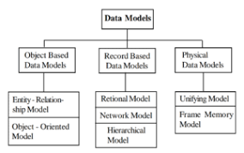
Data Models

Slide 17
Hierarchical Model
This was oldest data model developed in the 1950s.
Example : IBM’s IMS DBMS.
In this model , data is organized in the form of a hierarchical tree structure.
The hierarchy begins at the root, which contains root data, and then grows into a tree as child nodes are added to the parent node.

Slide 18
Hierarchical Model
This model allows one-to-one and one-to-many relationships between two nodes but not many-to-many or many-to-one.
A parent node might have several child nodes. But a child node is not permitted to have more than one parent.
Pointers are used to connect the parent and child nodes and to traverse and navigate between the stored data. There is only one path between two nodes.

Slide 19
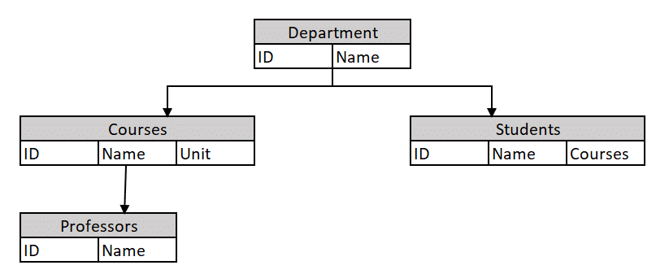
Hierarchical Model

Slide 20
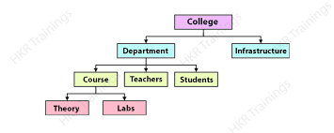
Hierarchical Model

Slide 21
Network Model
This model was formalized by the Database Task group in the 1960s.
The hierarchical model is extended into the network model.
The main difference between this model and the hierarchical model is that any record can have several parents. i.e. supports many to many relationship.
It uses a graph instead of a hierarchical tree and with that there can be more general connections among different nodes.

Slide 22
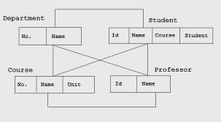
Network Model

Slide 23
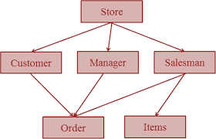
Network Model

Slide 24
Relational Model
E.F. Codd proposed the relational Model where data is represented in the form of relations or tables.
The central data description construct in this model is a relation.
A Relation(table) is two-dimensional. All of the data is kept in the form of rows and columns.
A relational database consists of a collection of tables, each of which is assigned a unique name.

Slide 25
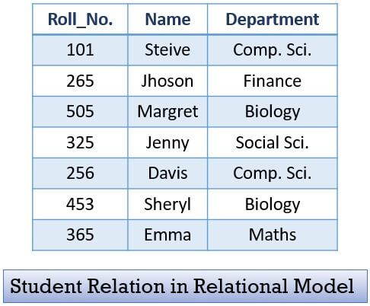
Relational Model

Slide 26
Relational Model
Relation Schema: A relation schema defines the structure of the relation and represents the name of the relation along with its attributes.
Example: Relation schema for STUDENT
STUDENT (Roll_No integer, Name string, Department string)
Tuple : Each row in the relation is known as a tuple.
Attribute/Field : Name of the Column in the relation.
Degree: The number of attributes in the relation is known as the degree of the relation.
Cardinality: The number of tuples in a relation is known as Cardinality.

Slide 27
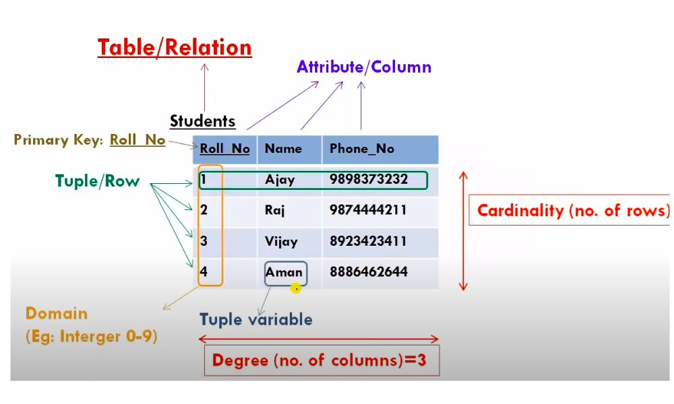
Relational Model

Slide 28
Object Oriented Data Model
To represent the complex real world problems there was a need for a data model.
Object Oriented Data Model represents the real world problems easily.
In Object Oriented Data Model, data and their relationships are contained in a single structure which is referred as object.
Object properties are attributes. All objects have multiple relationships between them.

Slide 29
Object-Relational Data Model
An Object relational model is a combination of a Object oriented database model and a Relational database model.
It supports objects, classes, inheritance etc. just like Object Oriented models and has support for data types, tabular structures etc. like Relational data model.

Slide 30
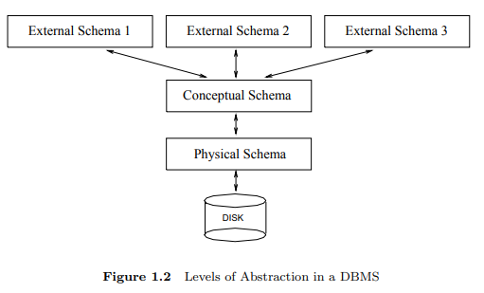
Levels of Abstraction in a DBMS

Slide 31
Levels of Abstraction in a DBMS
The data in a DBMS can be described at three levels of abstraction.
The goal is to separate user applications and the physical database.
Each level contains a schema that describes data.
Physical Schema
It describes the physical storage structure of database
i.e. how the relations are actually stored in storage devices like disk, tapes.

Slide 32
Levels of Abstraction in a DBMS
1. Physical Schema
It provides details of data storage and access paths.
what file organizations are required to store the relations, and creating indexes to speed up data retrieval operations.
A sample physical schema for the university database.
Store all relations as unsorted files of records.
Create indexes on the first column of the Students, Faculty, and Courses relations, the sal column of Faculty.

Slide 33
Levels of Abstraction in a DBMS
2. Conceptual Schema
It describes the logical structure of database , hiding the details of physical storage such as how the data is actually laid out on disk, the file structures.
In a relational DBMS, the conceptual schema describes all relations that are stored in the database.
i.e. entities, attributes, datatypes, relationships, constraints etc.

Slide 34
Levels of Abstraction in a DBMS
2. Conceptual Schema
Example: University database
Students(sid: integer, name: string, age: integer)
Faculty(fid: integer, fname: string, sal: real)
Courses(cid: integer, cname: string, credits: integer)
Rooms(rno: integer, address: string, capacity: integer)
Enrolled(sid: integer, cid: integer, grade: string)
Teaches(fid: integer, cid: integer)

Slide 35
Levels of Abstraction in a DBMS
3. External Schema
External schema allow data access to be customized at the level of individual users or groups of users.
Describes the part of the database that user needs and hides the remaining part of database.
Any given database has exactly one conceptual schema and one physical schema , but it may have several external schemas, each tailored to a particular group of users.

Slide 36
Levels of Abstraction in a DBMS
External Schema
Each external schema consists of a collection of one or more views and relations from the conceptual schema.
A view is conceptually a relation, but the records in a view are not stored in the DBMS.

Slide 37
Levels of Abstraction in a DBMS
External Schema
For example, we might want to allow students to find out the names of faculty members teaching courses, as well as course enrollments.
This can be done by defining the following view:
Courseinfo (cid: integer, fname: integer, enrollment: integer)

Slide 38
Data Independence
DBMS offers data independence which means that users or application programs are protected from changes in the way the data is structured and stored.
It can be defined as ability to change schema at one level of database system with out need to change schema at higher level.
Data independence is achieved through the three levels of data abstraction.

Slide 39
Types of Data Independence
1. Logical data independence :
Works between External schema and Conceptual schema.
It protects users or application programs from changes in the logical structure of the data. This property is called logical data independence.
Example: Add a column to a table etc.

Slide 40
Types of Data Independence
2. physical Data independence.
Works between internal and conceptual schemas.
It can be defined as ability to change the internal schema with out need to change the conceptual schema.
Examples of changes include file locations change, change access paths.
changes may be needed to improve speed of data retrieval.

Slide 41
Structure of DBMS
The DBMS accepts SQL commands from a variety of user interfaces, produces
Query evaluation plans
Executes these plans against the database and
Returns the answers.

Slide 42
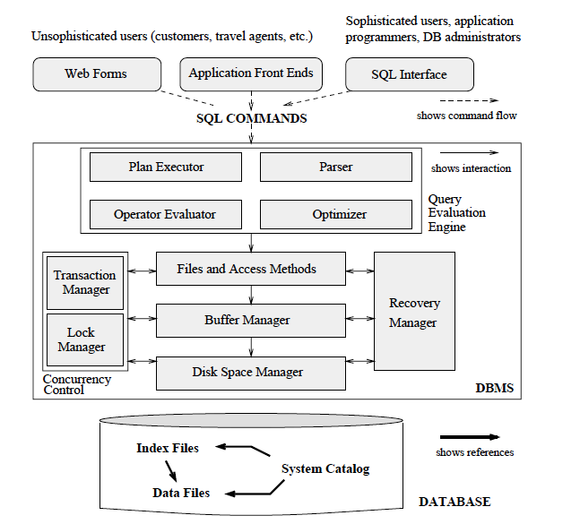

Slide 43
Structure of DBMS
1. Query Evaluation Engine
Parser: It breaks query into tokens. It ensures that the query is syntactically and semantically correct. If the query does not have any errors, then it is converted into algebraic expression.
Operator Evaluator: Operators in the query are evaluated using techniques like indexing, partitioning. A set of possible query evaluation plans are generated for executing the sql query.

Slide 44
Structure of DBMS
1. Query Evaluation Engine
Optimizer: It selects the optimized query execution plan to execute user request.
Plan Executor: This module executes the query as per query evaluation plan and display result.

Slide 45
Structure of DBMS
2. Files and access methods: It is responsible for providing access to desired file by creating indexes on the files.
3. Buffer manager: It fetches data from disk storage to main memory in response to read request.
4. Disk space manager: It manages space on the disk by providing space for new requests, deleting space when data is deleted by users.

Slide 46
Structure of DBMS
Concurrency control is achieved by Transaction manager and Lock manager.
5.Transaction manager: It ensures that transactions request and release locks according to a suitable locking protocol and schedules the execution of transactions.
6. Lock manager keeps track of requests for locks and grants locks on database objects when they become available and also release locks when transaction either commits or savepoints.

Slide 47
Structure of DBMS
7. Recovery manager, which is responsible for maintaining a log of all changes to the database, and restoring the system to a consistent state after a crash.
8. System catalog (Data dictionary): It contains all information about database. It contains description of all tables, views, data files, indexes etc.

Slide 48
Client-Server Architecture
A client-server architecture for DBMS is one in which data is stored on a central server, but clients connect to that server in order to access and manipulate the data.
All clients request to the server for different Service. The server displays the results according to the client’s request.
The user interfaces and application programs run on the client-side.

Slide 49
Client-Server Architecture
To communicate with the DBMS, client-side application establishes a connection with the server side.
For this interaction, API's like: ODBC, JDBC are used.
The server side is responsible to provide the functionalities like: query processing and transaction management.

Slide 50
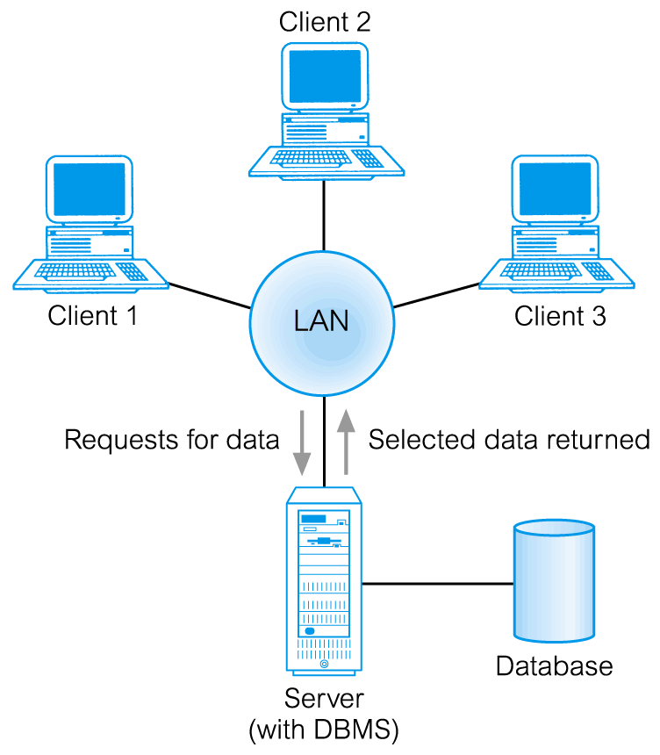
Client-Server Architecture

Slide 51
Client-Server Architecture
One of the main benefits of a client-server architecture is that it is more scalable. As the number of clients and/or the amount of data increases, the server can be upgraded or additional servers can be added to handle the load.
Another advantage of a client-server architecture is that it is more fault-tolerant . If a single server goes down, other servers can take over its responsibilities, and clients can still access the data.

Slide 52
E.F.Codd Rules
Dr. Edgar F. Codd (E.F.Codd) , also known as the ‘Father of Database Management Systems’ had designed 13 rules numbered from zero to twelve.
If a DBMS follows any 6 to 9 rules proposed by E.F.Codd, it qualifies to be a semi-Relational Database Management System (semi- RDBMS).
If a DBMS follows any 9 to 12 rules proposed by E.F.Codd, it qualifies to be a complete Relational Database Management System (RDBS).

Slide 53
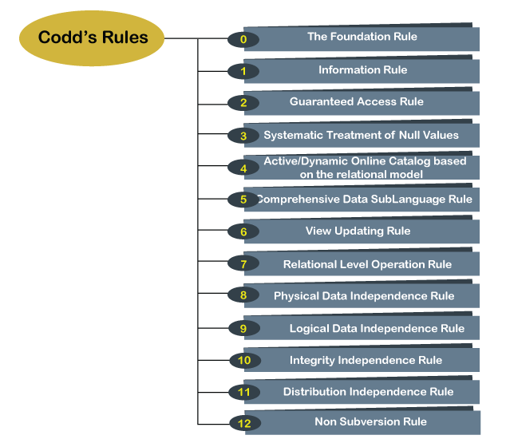

Slide 54
E.F.Codd Rules
Rule 0 − Foundation rule
Any system that is claimed to be RDBMS, must be able to manage database entirely through its relational capabilities.
i.e. Database must be in a relational form.
Rule 1 − Information Rule
A database contains various information and this information must be stored as values in the cells of the table in the form of rows and columns.

Slide 55
E.F.Codd Rules
Rule 2: Guaranteed Access Rule
Each and every piece of data (atomic) in a relational database, is guaranteed to be accessible by using the combination of table name, primary key and column name.
Ex: Select sname from student where sid=10;
Rule 3 − Systematic Treatment of Null Values
Null values are supported in relational databases and used for missing data or inapplicable data. Null values are independent of any data type. They should not be mistaken for blanks or zeroes or empty strings.

Slide 56
E.F.Codd Rules
Rule 4: Active/Dynamic Online Catalog based on the relational model
Data dictionary or catalog which contains metadata (data about the database or data about the data) must be stored online. It is accessible only by authorized users who have the required privileges. The same query language used for accessing the database should be used for accessing the data dictionary.

Slide 57
E.F.Codd Rules
Rule 5: Comprehensive Data SubLanguage Rule
A relational database may support various languages.
There must be atleast one language whose statements are well structured and it is comprehensive in supporting data definition, view definition, data manipulation, integrity constraints, and transaction management operations. Ex: SQL
If the database allows access to the data without any language, it is considered a violation.

Slide 58
E.F.Codd Rules
Rule 6: View Updating Rule
All the views that can be theoretically updatable must be updated by the database systems as well.
Rule 7: Relational Level Operation Rule
A database system supports high-level relational operations such as insert, update, and delete in each level or a single row. It also supports union, intersection and minus operations.

Slide 59
E.F.Codd Rules
Rule 8: Physical Data Independence Rule
If physical structure of the database is changed, it should not have any effect on external applications that are accessing the data from the database.
Rule 9: Logical Data Independence Rule
If any changes are made to the logical level (table structures), it should not affect the end users.
For example, suppose a table either split into two tables, or two table joins to create a single table, these changes should not be impacted on the user view application.

Slide 60
E.F.Codd Rules
Rule 10: Integrity Independence Rule
A database must maintain integrity independence when inserting data into table's cells using the SQL query language.
All entered values should not depend on any external application to maintain integrity.
It is also helpful in making the database-independent for each front-end application.

Slide 61
E.F.Codd Rules
Rule 11: Distribution Independence Rule
A database system must work properly even if the database is geographically distributed, end Users should always get impression that the data is located at one site only.
End user must not be able to see that data is distributed over various locations.
This is foundation for distributed systems.

Slide 62
E.F.Codd Rules
Rule 12 Rule of Non Subversion
If a relational system has a low-level or separate language other than SQL to access the database system, it should not subvert or bypass integrity constraints expressed in high level language.

Slide 63
OVERVIEW OF DATABASE DESIGN
The database design process can be divided into six steps.
(1) Requirements Analysis:
The very first step is to understand what data is to be stored in the database and what operations are done. In other words, we must find out what users want from database.
This is usually an informal process that involves discussions with user groups, a study of the current operating environment and so on.

Slide 64
OVERVIEW OF DATABASE DESIGN
(2) Conceptual Database Design:
The information gathered in the requirements analysis step is used to develop a high-level description model of the data to be stored in the database, along with the constraints over this data.
This step is often carried out using the ER model.
(3) Logical Database Design:
We must choose a DBMS to implement our database design. If we consider a relational DBMS , the task in the logical design step is to convert an ER schema into a relational database schema.

Slide 65
OVERVIEW OF DATABASE DESIGN
(4) Schema Refinement:
The fourth step in database design is to analyze the collection of relations in our relational database schema to identify potential problems and to refine it.
(5) Physical Database Design:
In this step ,deciding on the physical layout of the database. Simply involve building indexes on some tables and clustering some tables and so on.

Slide 66
OVERVIEW OF DATABASE DESIGN
(6) Security Design:
we identify different user groups and different roles played by various users.
For each role and user group, we must identify the parts of the database that they must be able to access and the parts of the database that they should not be allowed to access, and take steps to ensure that they can access only the necessary parts.

Slide 67
ENTITY-RELATIONSHIP MODEL
Entity-Relationship (ER) data model allows us to describe the data involved in a real-world enterprise in terms of objects(entity) and their relationships.
It is widely used to develop an initial database design.
It was proposed by Peter P Chen in 1970s.
It provides useful concepts that allow us to convert an informal description of what users want from their database to a more detailed description that can be implemented in a DBMS.

Slide 68
ENTITY-RELATIONSHIP MODEL
Entity: It is a real world object of physical or conceptual existence and distinguishable from others.
Example: In the University database context,
an individual student , faculty member ,
a course are entities.

Slide 69
ENTITY-RELATIONSHIP MODEL
Entity Set:
Collection of entities having the same properties.
Example:
Student entity set –collection of all student entities.
Course entity set –collection of all course entities

Slide 70
ENTITY-RELATIONSHIP MODEL
Attributes
Each entity is described by a set of attributes/properties.
Attributes for Student entity
StudName– name of the student.
RollNumber– the roll number of the student.
Gender – the gender of the student.

Slide 71
ENTITY-RELATIONSHIP MODEL
Types of Attributes
Simple Attributes
Cannot be divided further or indivisible .
example: Deptno – an integer
Location – a string.
Composite Attributes
having several components in the value.
Example: studName with components
(FirstName, LastName)

Slide 72
ENTITY-RELATIONSHIP MODEL
3. Derived Attributes
Attribute value is dependent on some other attribute.
example: Age depends on DateofBirth.
So Age is a derived attribute.
4. Single-valued Attribute
having only one value.
Example: DateofBirth – single date value.
Rollno - single number

Slide 73
ENTITY-RELATIONSHIP MODEL
5. Multi-valued
having a set of values rather than a single value.
for instance, EmailAddress attribute for student
MobileNo attribute for student

Slide 74
Notations for Entities
entity – rectangle
attribute - ellipse connected to rectangle
multi-valued attribute - double ellipse
composite attribute - ellipse connected to ellipse
derived attribute- dashed ellipse

Slide 75
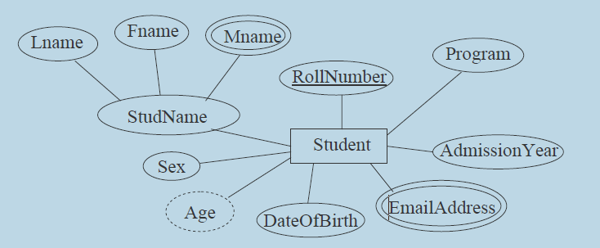
Notations for Entities

Slide 76
ENTITY-RELATIONSHIP MODEL
Domain of Attributes
Each attribute takes values from a set called its domain.
For instance, studentAge – {17,18, …, 55} .
Key Attributes
Key–an attribute or a collection of attributes whose value(s) uniquely identify an entity in the entity set.
For instance, RollNumber - Key for Student entity set
EmpID - Key for Faculty entity set

Slide 77
ENTITY-RELATIONSHIP MODEL
Relationships
A relationship is an association among two or more entities.
E.g.: student Ramesh enrolls in DBMS course.
Relationship enrolls has Student and Course as the participating entity sets.
Formally, enrolls ⊆ Student ×Course
(s , c) ∈ enrolls ⇔ Student ‘s’ has enrolled in Course ‘c’

Slide 78
ENTITY-RELATIONSHIP MODEL
Degree of a relationship
Degree: the number of participating entities.
Degree 2: binary
Degree 3: ternary
Degree n: n-ary
Binary relationships are very common and widely used.

Slide 79
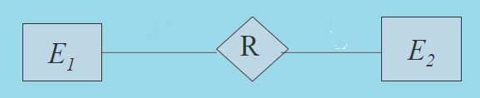
Notations for Relationship

Slide 80
ENTITY-RELATIONSHIP MODEL
Types of Relationships
One-to-one:
An entity in E1 may be associated with atmost one entity in E2 and similarly an entity in E2 may be associated with atmost one E1 entity.
One-to-many: An E1 entity may be associated with many E2 entities whereas an E2 entity may be associated with at most one E1 entity.

Slide 81
ENTITY-RELATIONSHIP MODEL
Types of Relationships
Many-to-one: Many E1 entities may be associated with atmost one E2 entity whereas a single E2 entity may be associated with many E1 entities.
Many-to-many:
Many E1 entities may be associated with a single E2 entity and a single E1 entity may be associated with many E2 entities.

Slide 82
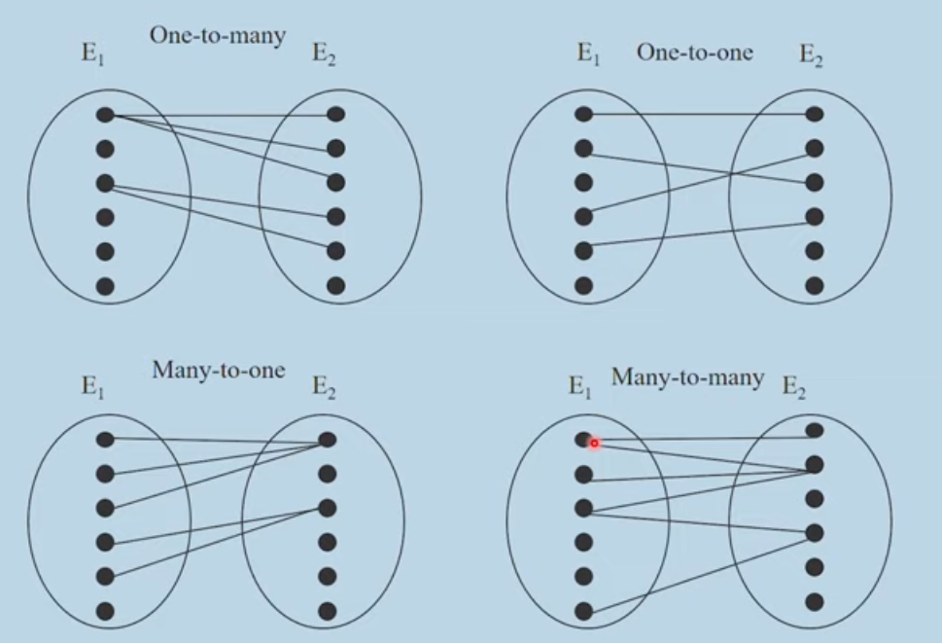
Types of Relationships

Slide 83
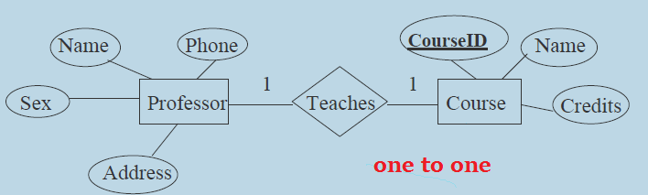
ENTITY-RELATIONSHIP MODEL

Slide 84
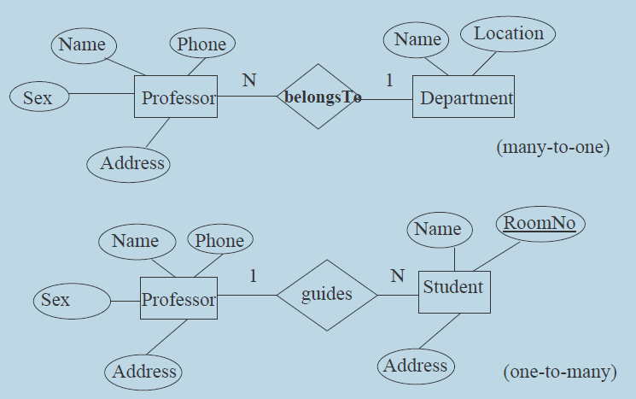
ENTITY-RELATIONSHIP MODEL

Slide 85
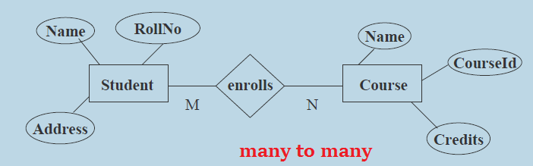
ENTITY-RELATIONSHIP MODEL

Slide 86
ENTITY-RELATIONSHIP MODEL
Attributes for Relationship
Relationship can also have attributes called descriptive attributes.
Descriptive attributes are used to record information about the relationship, rather than about any one of the participating entities.
In the following example, ‘grade’ gives the letter grade (S,A,B, etc.) earned by the student for a course.
Neither an attribute of student nor that of course.

Slide 87
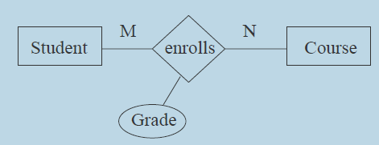
ENTITY-RELATIONSHIP MODEL
Attributes for Relationship

Slide 88
ENTITY-RELATIONSHIP MODEL
Participation Constraints
An entity set may participate in a relation either totally or partially.
1.Total participation: Every entity in the set is involved in the relationship.
2.Partial participation: Not all entities in the set are involved in the relationship.

Slide 89
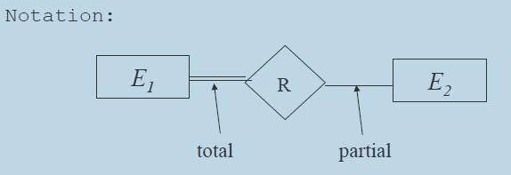
ENTITY-RELATIONSHIP MODEL

Slide 90
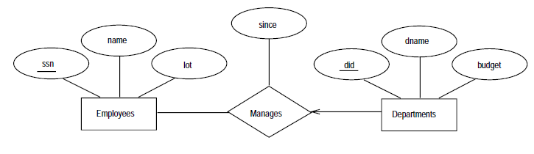
ENTITY-RELATIONSHIP MODEL

Slide 91
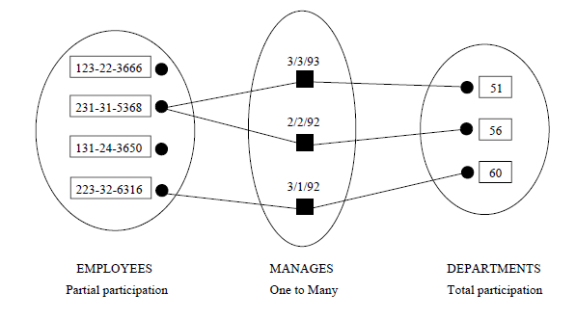
ENTITY-RELATIONSHIP MODEL

Slide 92
Weak Entity set
Weak Entity Sets:
In a weak entity set , entity owe its existence to some other entity in a strong entity set.
A weak entity is associated with some entity of the owner entity set through a special relationship.
A weak entity can be identified uniquely only by considering some of its attributes in conjunction with the primary key of owner entity set.

Slide 93
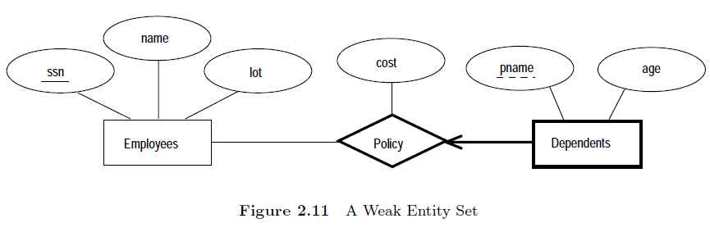
Weak Entity set

Slide 94
Weak Entity set
Dependents is an example of a weak entity set.
Attributes of the Dependents entity are pname and age.
The attribute pname does not identify a dependent uniquely.
A Dependents entity can be identified uniquely only if we take the key (ssn) of the owning Employees entity and the pname of the Dependents entity.

Slide 95
Weak Entity set
The set of attributes of a weak entity set that uniquely identify a weak entity for a given owner entity is called a partial key of the weak entity set.
In our example pname is a partial key for Dependents.
Dependents is a weak entity and Policy is its identifying relationship, we draw both with dark lines.
To indicate that pname is a partial key for Dependents, we underline it using a broken line.

Slide 96
ENTITY-RELATIONSHIP MODEL
Ternary Relationships
suppose that each department has offices in several locations and we want to record the locations at which each employee works.
This relationship works-in is ternary because we must record an association between an employee, a department and a location.

Slide 97
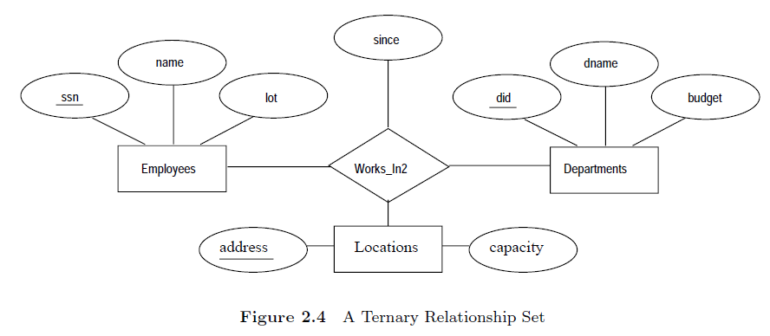
ENTITY-RELATIONSHIP MODEL

Slide 98
