Slide 1
Data Engineering Project
Dennis Ross, Saxon Kidder, Dylan Skonicki, Austin Justus
Group 8
1

Slide 2
TABLE OF CONTENTS
01
02
03
PROBLEM & SOLUTION
OUR PROCESS
TARGET
Build fully automated pipeline to extract daily data via task scheduler from URL to analyze via dashboard and Flask
URL -> Python -> postgreSQL -> Dashboard -> Flask API
Create visually appealing/easily readable dashboard and flask app
2

Slide 3


Data Extraction
Set up task scheduler to pull data daily from URL with python
Append data to existing .csv file
Copy data to PostgreSQL database on server on Saxon’s PC
3
Notes:
Do not change

Slide 4
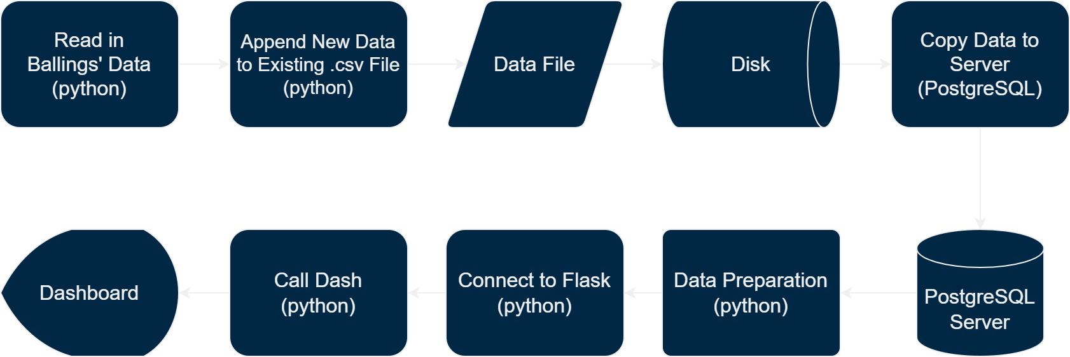
Pipeline
7
Notes:
Do not change

Slide 5



Dashboard/Flask API
Initialize dashboard utilizing stylesheet and dataframe
Create bar chart indicating regions and items sold
Finalize dashboard with Python and HTML
Designed Flask app with layout containing button
Display 10 random records via bootstrap
Referenced JSON files to push through flask
API Callbacks -> Interactive + Static Plots
4

Slide 6
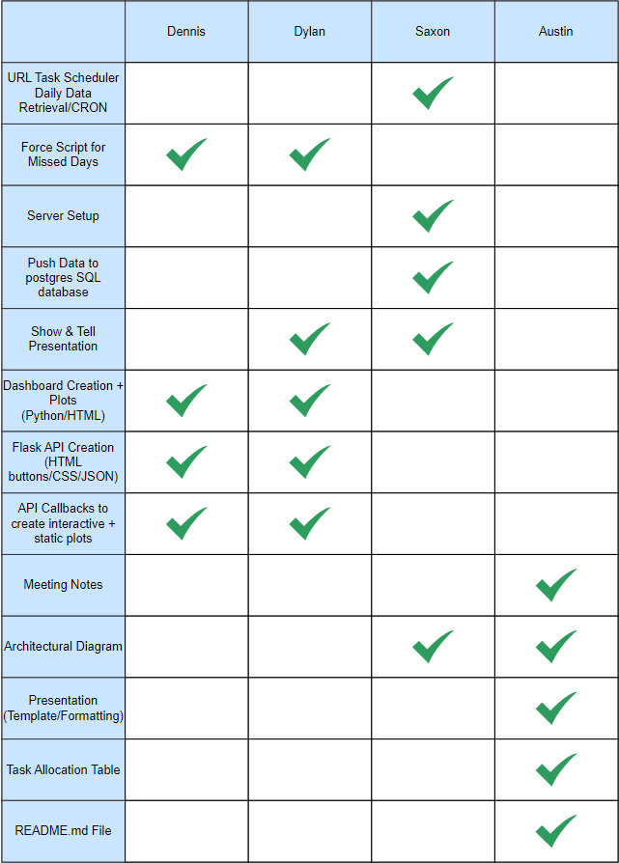
Task Designation
5

Slide 7
6

Slide 8
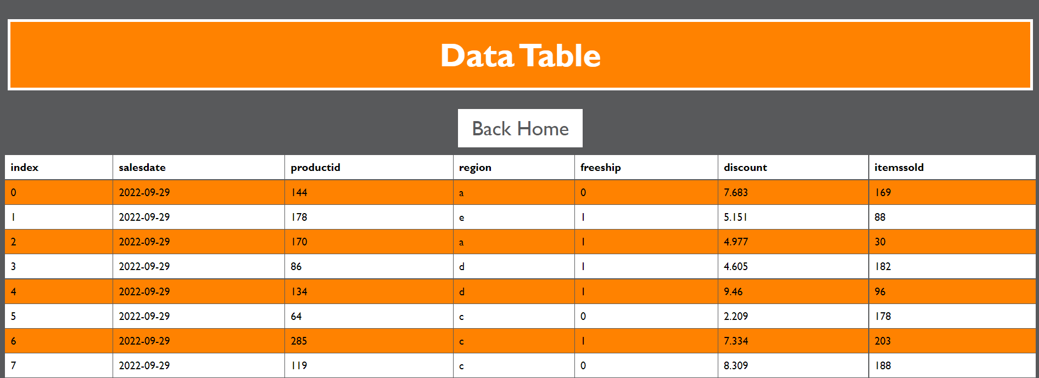
6

Slide 9
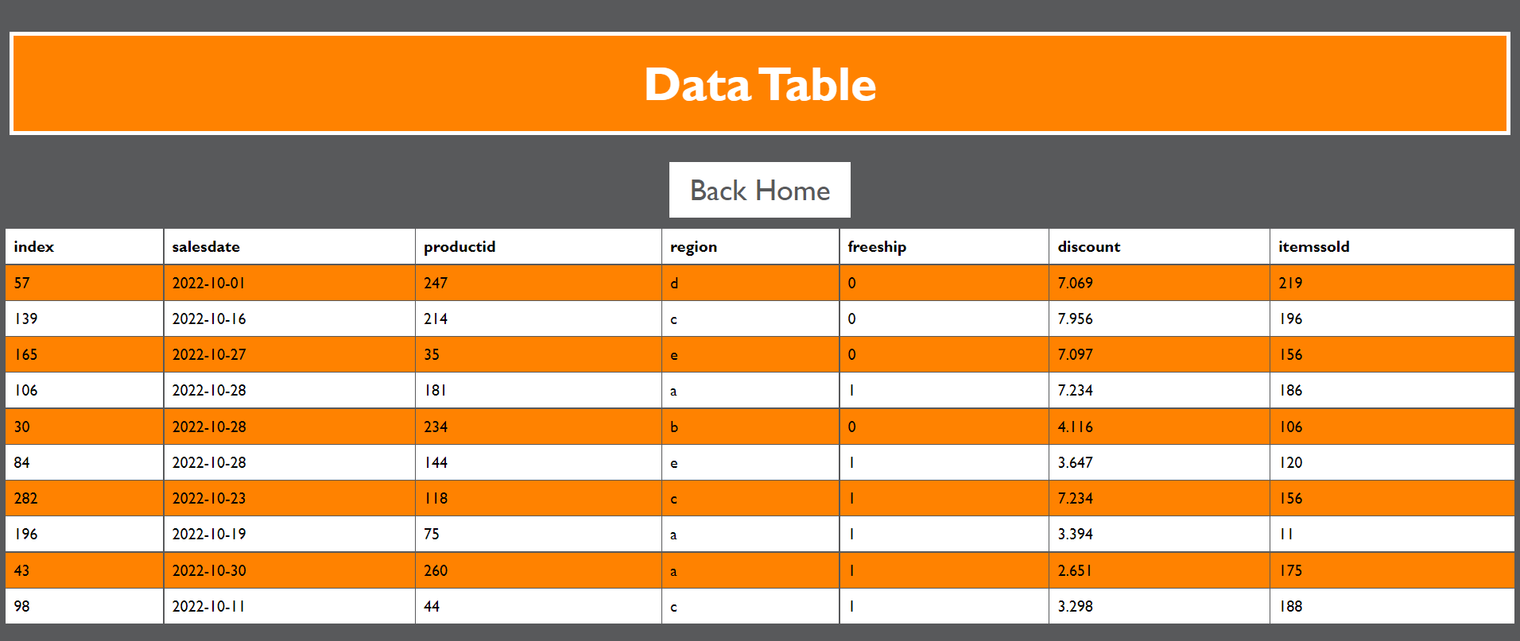
6

Slide 10
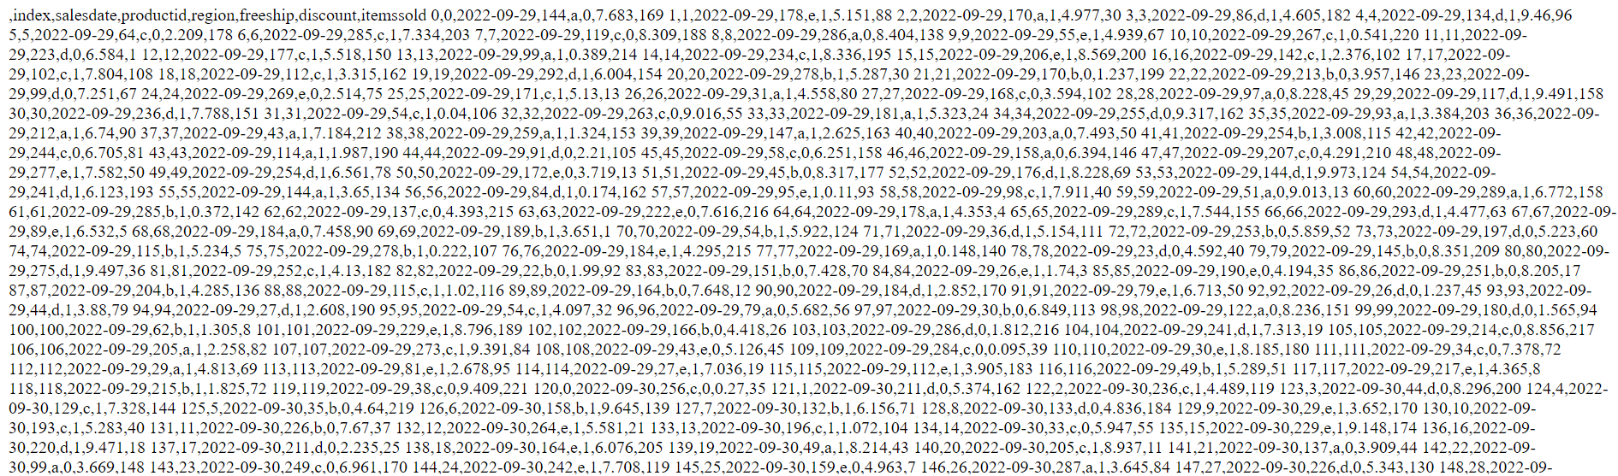
6

Slide 11
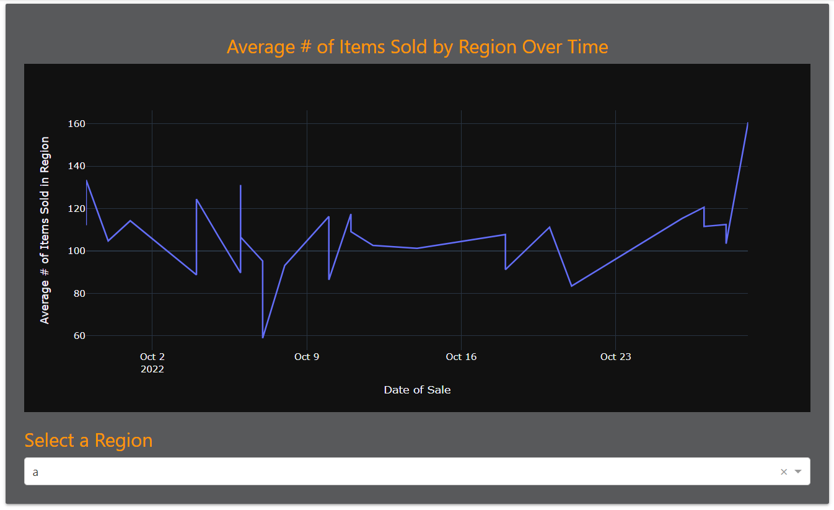
6

Slide 12
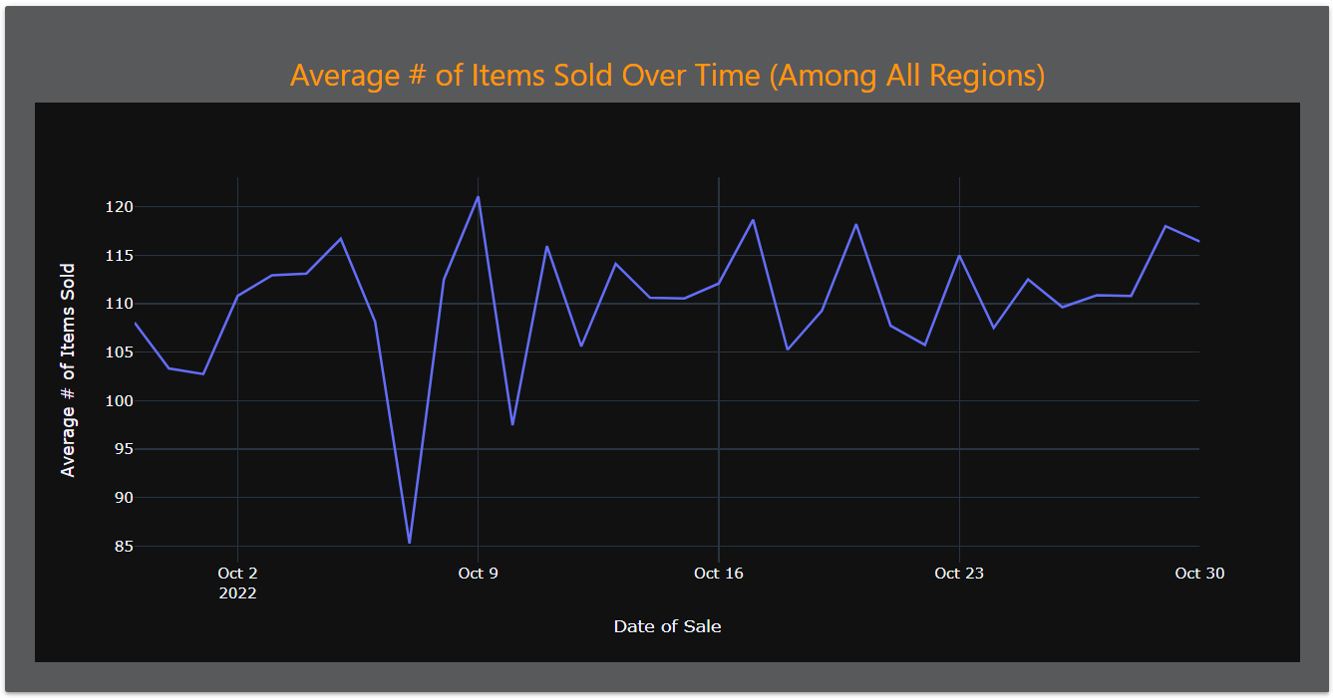
6

Slide 13
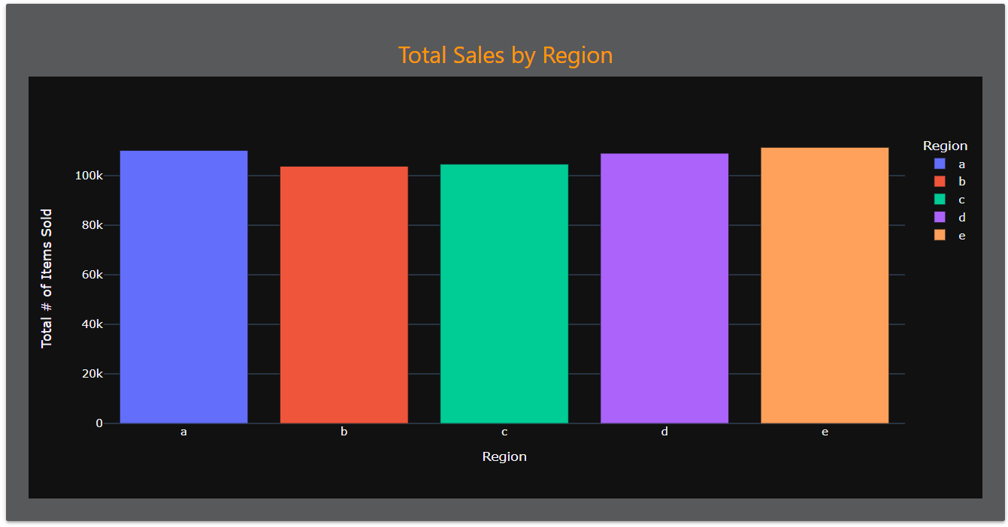
6

Slide 14

Feedback + Questions?
8

