Slide 1
Cricket Analytics Report
Generated from delivery-level match data

Slide 2
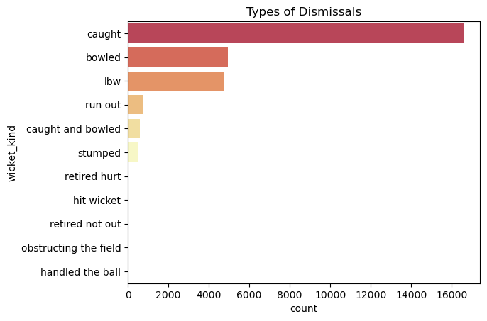
Dismissal Types

Slide 3
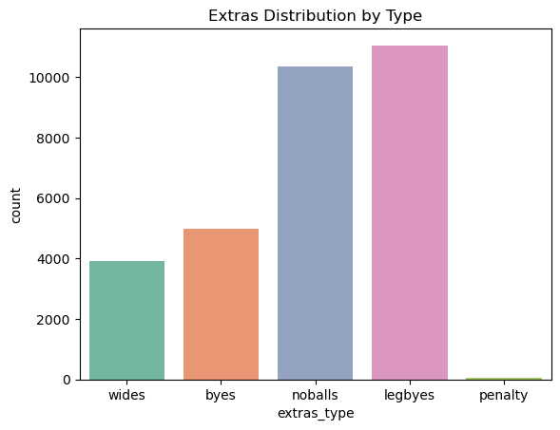
Extras Breakdown

Slide 4
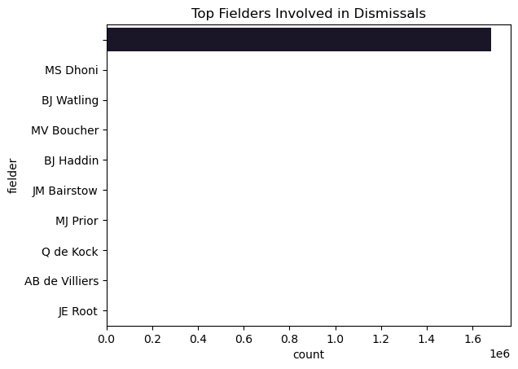
Fielders Involved

Slide 5
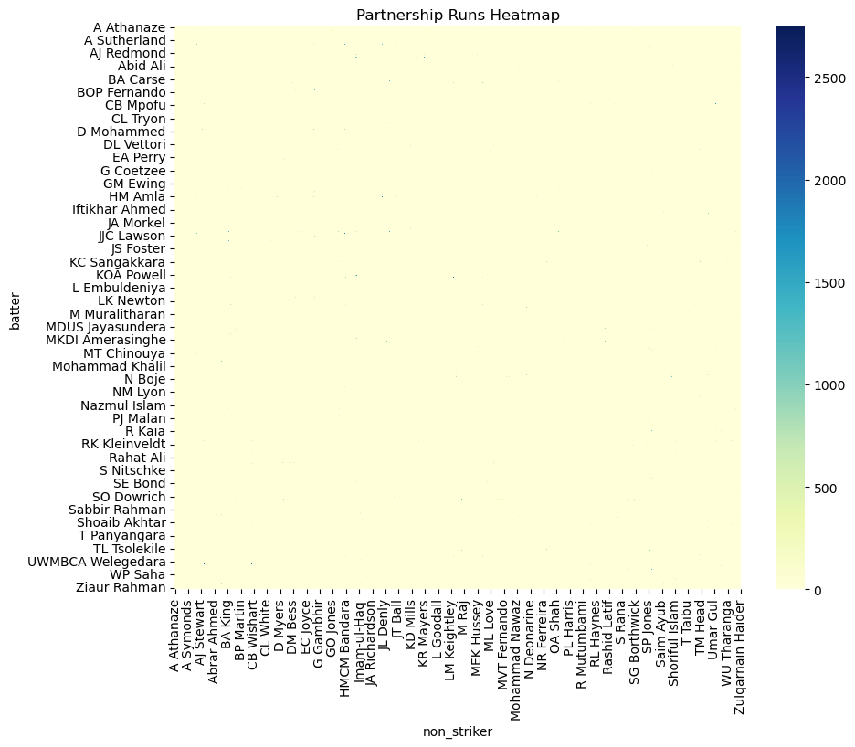
Partnership Heatmap

Slide 6
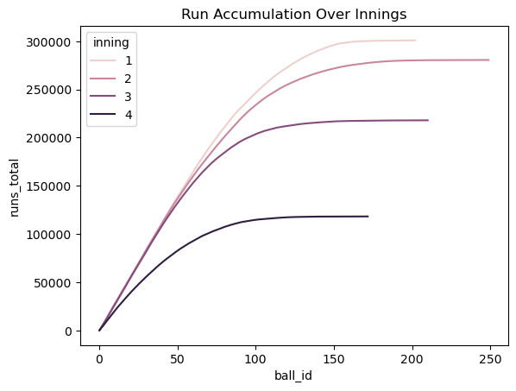
Run Accumulation

Slide 7
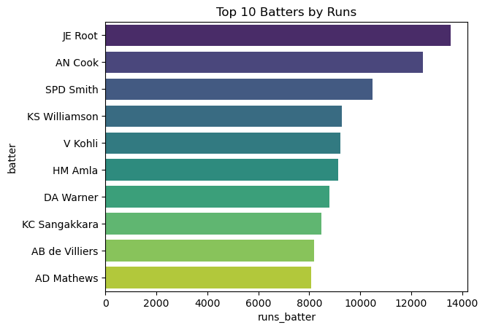
Top Batters

Slide 8
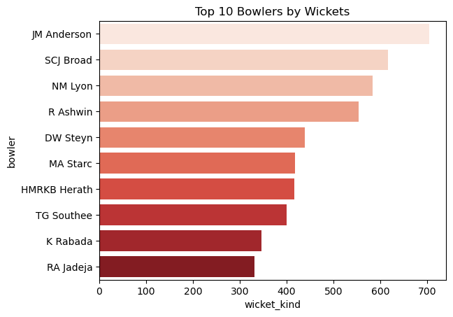
Top Bowlers

Slide 9
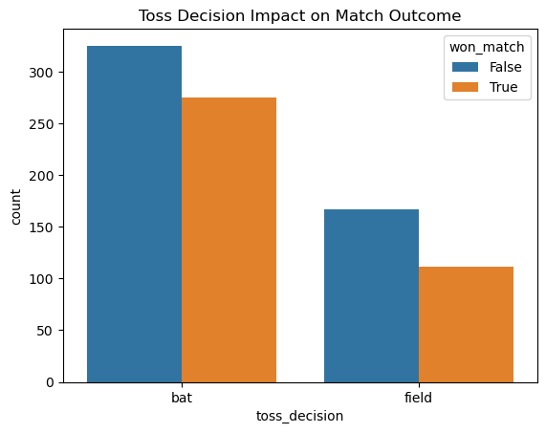
Toss Impact

Slide 10
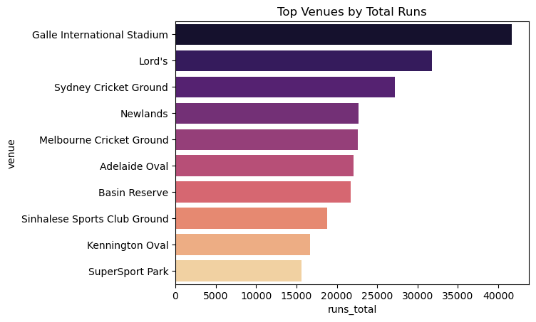
Venue Runs

Slide 11
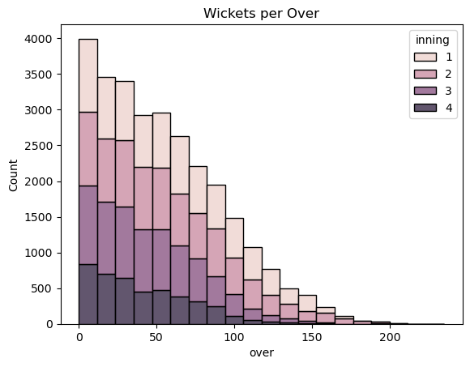
Wickets Per Over

