Slide 1

SAMSUNG PRISM
Generative AI
Hackathon
3rd Edition 2026 – 27
Theme ID - Streaming Live RAG 04
Team Name - ThaparInstituteOfEngineeringAndTechnology_TheMeowfias
Project / Product - Aegis
College Name - Thapar Institute of Engineering and Technology
Member Name & Email 1 - Naman Kumar (nkumar1_be23@thapar.edu)
Member Name & Email 2 – Samairaa Chhabra (schhabra_be23@thapar.edu)
Submission Github Link - https://github.com/GithubNaman259/Samsung-Prism-Aegis-Streaming-Live-RAG

Slide 2
Theme
THE CORE IDEA
a
TRADITIONAL RAG
AEGIS
Search before the user finishes speaking.
wait → retrieve → generate
Latency arrives after speech ends.
listen → speculate → patch
Work begins before the turn is complete.
Then patch only what changed.
Aegis turns RAG from a stateless retrieve→generate chain into a stateful claim processor for streaming voice and conversational refinement.
01
02
03
04
Speculate
Decompose
Synthesize
Patch
STREAMING
STATEFUL
HYBRID
GROUNDED
The result: lower refine-turn latency, less repeated retrieval, and explicit claim-level grounding.

Slide 3
Existing Solutions & Gaps
WHY NAIVE RAG BREAKS WHEN CONVERSATION BECOMES REAL-TIME
01 LATENCY
02 MULTI-INTENT
03 LATE CONSTRAINTS
04 NUMERIC FACTS
3–5 s delay
Waits for utterance_end before retrieval + generation.
context dilution
Top-k chunks mix unrelated intents; claims become entangled.
restart the pipeline
“Actually, 500 people” can trigger a full re-run.
LLMs are not calculators
Capacity / fee / limit values need deterministic handling.
Design requirement → latency must overlap with intent processing; intents must stay isolated; refinements must be surgical; hard numbers must bypass probabilistic generation.
OVERLAP WORK
ISOLATE INTENTS
PATCH STATE
SOLVE NUMBERS

Slide 4
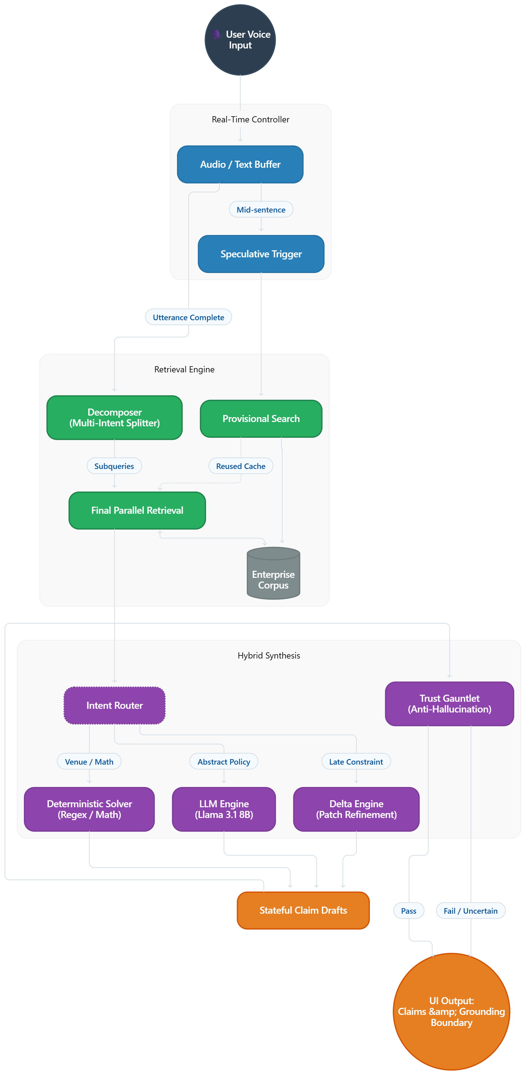
Our Solutions & Architecture Diagram
AEGIS = REAL-TIME CONTROLLER + RETRIEVAL ENGINE + HYBRID SYNTHESIS + TRUST BOUNDARY
INPUT / CONTROL
RETRIEVAL
Provisional search
Multi-intent decomposition
Final parallel retrieval
Enterprise corpus
User voice / text
Audio-text buffer
Speculative trigger
SYNTHESIS
GROUNDING
Intent router
Deterministic regex / math
Llama 3.1 8B
Delta Engine
Stateful claim drafts
Trust Gauntlet
Grounding boundary / UI
THE REFINEMENT LOOP
Speculate early → reuse provisional evidence → route by intent → patch only the changed claim
TRUSTED OUTPUT

Slide 5
Demo & Product Walkthrough
ONE CONVERSATION → FOUR SYSTEM BEHAVIORS
01 MULTI-INTENT
02 LATE CONSTRAINT
“I need a venue in Mumbai and the corporate pet policy.”
Split → retrieve independently → isolate claims.
“Actually, I need capacity for 500 people.”
Delta Engine patches capacity claim; preserves policy claim.
03 PRESENTATION-ONLY
04 TRUST GAUNTLET
“Present this.”
Suppression Gate reuses existing evidence; zero-search path.
Conflicting / unsupported number
Claim ↔ chunk binding; uncertainty moves to grounding boundary.
Result: Aegis preserves what is still valid instead of regenerating the whole answer.
Demo Video:Click Here

Slide 6
Tools and tech stack used
THE IMPLEMENTATION IS DELIBERATELY LIGHTWEIGHT AND LOCAL-FIRST
APPLICATION
Python • Asyncio
FastAPI + Uvicorn
WebSocket streaming
RETRIEVAL
Custom in-memory vector engine
Fast local embeddings
Cosine similarity + chunk management
LLM
Llama 3.1 8B • Ollama
Local generation
Abstract policy / language synthesis
GUARDRAILS
Regex + exact token overlap
Deterministic extraction
Claim-level grounding validation
ARCHITECTURE PRINCIPLE
Use the LLM where language is useful; use deterministic logic where precision matters.

Slide 7
Impact & Use case
WHERE STREAMING LIVE RAG CREATES VALUE
CORPORATE TRAVEL & EVENTS
Capacity, pricing and policy questions benefit from fast retrieval + deterministic hard constraints.
HR & COMPLIANCE
Multi-intent policy questions remain isolated and grounded instead of mixing evidence.
CUSTOMER SUPPORT
A conversational copilot can retrieve while the customer is still talking, then refine only what changed.
LOWER REWORK
BETTER GROUNDING
REAL-TIME UX

Slide 8
Innovation highlights, results and limitations
INNOVATION HIGHLIGHTS, RESULTS & LIMITATIONS
11.2 ms
42.9%
100%
0
TRUST
4/4 adversarial tests passed
median TTFT - refine turn
retrieval reduction on refine turns
grounded claims • 39/39
fabricated document IDs
INNOVATION
LIMITATIONS
• Speculative retrieval overlaps latency with speech
• Deterministic solver handles hard numbers
• Delta Engine preserves unaffected claims
• Trust boundary makes uncertainty explicit
• Concurrent local LLM generation can spike latency
• Speculation can be weak if a critical noun arrives after a pause
• Refine turns therefore bypass stale speculative context

Slide 9
What’s next
ROADMAP: FROM LOCAL HYBRID RAG → PREDICTIVE, ROUTED KNOWLEDGE SYSTEM
01 DYNAMIC MODEL ROUTING
02 PREDICTIVE SPECULATION
03 KNOWLEDGE GRAPH INTEGRATION
Route complex reasoning to frontier models; keep extraction local.
Use small models to predict likely sentence endings and prefetch evidence.
Extend deterministic reasoning to relationships, policies and organizational context.
NORTH STAR
Make retrieval predictive, reasoning specialized, and knowledge continuously reusable across turns.

Slide 10
Brownie points slide( differentiation)
THE KEY SHIFT: FROM A STATELESS RAG CHAIN TO A STATEFUL CLAIM PROCESSOR
Aegis treats knowledge as a compiled, stateful object - not just retrieved text handed to an LLM.
STATEFUL
SURGICAL
DETERMINISTIC
GENERIC RAG
AEGIS
Query → retrieve → prompt → generate
Every refinement restarts the pipeline.
LLM handles language and numbers together.
Claims → state → semantic diff → surgical patch
Unchanged evidence stays valid.
Hard numbers bypass probabilistic generation.

Slide 11
Checklist- Updated on Public GitHub
Working prototype code - public or shared GitHub repo - Yes
README with reproducible setup instructions - Yes
Demo video, max 5 minutes (YouTube or Drive link)- https://drive.google.com/file/d/11YE5tzn1XtS09P18pabqhoy7KuI7gPUi/view?usp=sharing
Presentation file (PPT or PDF) - Yes

Slide 12
Thank you
Thapar Institute of Engineering and Technology • TheMeowfias
Organised by the Language AI Team and the PRISM Team, Samsung R&D Institute India
Notes:
Closing slide. Add the Google Form URL and a contact email before sharing. Edition 2 organising team for reference: Language AI - Sourabh Tiwari, Gaurav, Sanjeeth Pothireddy, Gorang Maniar; PRISM - Binny Lakra, Prakhar Chandrakar, Vishu Kumar; Kick-off and mentors - Giridhar Jakki, Deepraj Prabhakar Patkar (Language AI), Srimanu Prasad Nagaraju, Ashish Kumar (Tech Strategy).

