Slide 1
RECOMMENDER SYSTEM – PROJECT J COMPONENT
AI-Driven Consumer Complaint Intelligence for E-Commerce Platforms
A case study on 60,000 Amazon Electronics negative reviews — every signal paired with interpretation, alternative explanation, and investigative action.
AUTHORS
Priyanka S (23MIA1032) • Kavya N (23MIA1125)
PROJECT REVIEW
Notes:
- Project introduces the forensic analytics framing of the deck.
- Authors are Priyanka S (23MIA1032) and Kavya N (23MIA1125).
- Scope is 60,000 negative Electronics reviews from Amazon.
- Forensic framing means signals are leads, not verdicts.
- Every signal is paired with interpretation, alternative explanation, and investigative action.

Slide 2
02 / 17
Problem & Motivation
Consumer complaint platforms carry potential fraud signals: fake reviews, image reuse, coordinated campaigns, seller fraud, and counterfeit listings.
Manual triage fails at scale — 60,000 negative reviews cannot be read one by one by a human investigator.
Naive score-only approaches over-claim: a high similarity or anomaly score does not prove misconduct.
The project frames the problem as forensic rather than predictive: signals are leads, not verdicts.
Every lead must carry its own interpretation, alternative explanation, and recommended next investigative action.
Scope chosen: Amazon Electronics category — high review volume, high image attach rate, active seller ecosystem.
Outcome goal: a prioritized case queue with transparent reasoning attached to each case.
Notes:
- Forensic not predictive: signals are leads, not verdicts.
- Manual triage fails at scale — 60,000 reviews cannot be read by hand.
- Naive score-only approaches over-claim misconduct.
- Every lead carries its own interpretation, alternative explanation, and next action.
- Outcome goal is a prioritized, transparent case queue.

Slide 3
03 / 17
Dataset Source
Source: McAuley-Lab Amazon Reviews 2023 dataset, hosted on HuggingFace.
URL endpoint: raw/review_categories/Electronics.jsonl — a streaming JSONL file.
Streaming collection: 467,845 reviews scanned in real time; no full download required.
Kept 60,000 reviews matching the negative filter (rating in [1, 2]) and text length >= 20 characters.
Ten raw fields retained per review: rating, title, text, images, asin, parent_asin, user_id, timestamp, verified_purchase, helpful_vote.
Local persistence: streamed records saved to electronics_negative_reviews.jsonl for full reproducibility.
Sample size chosen to balance statistical power against compute budget for downstream similarity and image work.
Notes:
- Dataset is McAuley-Lab Amazon Reviews 2023, hosted on HuggingFace.
- Streaming collection, not bulk download — 467,845 reviews scanned in real time.
- Filtered down to 60,000 negative reviews (rating in [1, 2], text length >= 20 chars).
- Ten raw fields retained per review for reproducibility.
- Streamed records persisted to electronics_negative_reviews.jsonl.

Slide 4
04 / 17
Pipeline Overview
Standardize review table, extract image URLs, detect complaint categories via a 6-theme keyword dictionary (quality, delivery, seller, refund, performance, appearance).
Build reviewer-level and product-level behavior features (activity, rating ratios, complaint ratio, image ratio, product count, network degree).
Compute rating deviation from product mean and monthly burst ratio with a 3-month rolling median baseline.
Detect repeated review wording via TF-IDF + cosine Nearest Neighbors on a 20,000-review sampled subset.
Build the reviewer-product graph with NetworkX and run Isolation Forest anomaly detection on reviewer features.
Download a controlled image sample and run perceptual hashing (16x16 average hash, 256-bit) plus Hamming distance reuse detection.
Aggregate 12 transparent evidence components into a forensic signal score, then produce case narratives with alternatives and recommended actions.
Notes:
- 7-stage pipeline: standardize, behavior features, deviation/burst, text similarity, network/anomaly, image hashing, evidence scoring.
- Standardization includes image URL extraction and 6-theme complaint categorization.
- Temporal burst uses a 3-month rolling median baseline.
- Text similarity runs on a 20,000-review sampled subset via TF-IDF + cosine Nearest Neighbors.
- Image hashing uses 16x16 average hash (256-bit) and Hamming distance for reuse detection.
- Final stage aggregates 12 evidence components into a forensic signal score.

Slide 5
05 / 17
Architecture Diagram
Seven-stage workflow from raw reviews to an auditable, prioritized investigation queue
1. DATA SOURCE
Amazon Reviews 2023
Electronics JSONL
2. STREAM & FILTER
467,845 scanned
60,000 negative reviews
3. STANDARDIZE
Review table, image URLs
6 complaint themes
4. FEATURE ENGINEERING
Reviewer/product features
rating deviation, burst ratio
7. EVIDENCE SCORE
12 components summed
priority tier assigned
6. IMAGE FORENSICS
256-bit average hash
Hamming-distance reuse
5. DETECTION
TF-IDF similarity
NetworkX + Isolation Forest
Case register • Evidence matrix • Priority narratives • Population insights
OUTPUTS
Notes:
- Pipeline has 7 stages flowing from raw data source to evidence-scored case queue.
- Stage 1: stream Amazon Reviews 2023 Electronics JSONL from HuggingFace.
- Stage 2: filter to 60,000 negative reviews (1-2 star, text length >= 20).
- Stages 3-6: standardize, engineer features, run detection models, hash images.
- Stage 7: aggregate 12 evidence components into the forensic signal score.
- Outputs flow to case register, evidence matrix, priority narratives, population insights.

Slide 6
06 / 17
Complaint Category Detection
6 THEMES
Quality · Delivery · Seller
Refund · Performance · Appearance
HOW IT WORKS
Keyword dictionary tags each review. A review can match more than one theme.
OUTPUT
Complaint summary ranked by category frequency.
WHY IT MATTERS
Complaint breadth contributes to the forensic score (capped at 3).
Notes:
- 6 complaint themes: quality, delivery, seller, refund, performance, appearance.
- Multiple themes can co-occur in a single review; categories are not mutually exclusive.
- Outputs the complaint_summary table sorted by frequency.
- Dual business use: operational prioritization for CS/product/seller teams AND feeds the forensic signal score.
- complaint_category_count is capped at 3 in the evidence_complaint component.

Slide 7
07 / 17
Reviewer & Product Behavior Features
REVIEWER PROFILE
Activity, rating ratios, complaint/image ratios, product count and helpful votes.
PRODUCT PROFILE
Review volume, average rating, complaint/image ratios and reviewer count.
ACTIVITY TIERS
Very low: 1 · Low: 2–5
Moderate: 6–20 · High: 20+
INVESTIGATIVE USE
Compare negative behaviour with normal activity; network degree adds context.
Notes:
- reviewer_features.csv and product_features.csv are the two core derived tables exported here.
- Reviewer activity is bucketed into 4 tiers (Very low / Low / Moderate / High) for quick triage.
- Per-reviewer and per-product aggregates feed both operational investigation and downstream anomaly detection.
- negative_ratio + one_star_ratio together separate genuine dissatisfaction from systematic negative-bombing.
- Network degree is layered on next slide to capture structural position in the reviewer-product graph.

Slide 8
08 / 17
Rating Deviation & Temporal Burst
| Review rating − Product mean rating |
RATING DEVIATION
INTERPRETATION
Deviation ≥ 2 stars flags an outlier for review—not proof of a fake rating.
Monthly negative reviews ÷ 3-month rolling median baseline
BURST RATIO
BURST THRESHOLDS
≥ 1.5 = moderate concentration
≥ 3 = strong concentration
Notes:
- rating_deviation = |rating - product_mean|; large values (>= 2 stars) flag outlier or possibly fake ratings.
- burst_ratio = monthly_count / rolling_baseline; thresholds are 1.5 (moderate) and 3 (strong).
- burst_interpretation text makes every row human-readable on its own.
- Both signals need external event context — promotions, recalls, shipping outages — before any causal claim.
- Single review deviation vs. monthly volume burst capture outlier behavior at two different time scales.

Slide 9
09 / 17
Text Similarity — Repeated Review Wording
DATA USED
20,000-review sample from the 60,000-review population.
TEXT FEATURES
TF-IDF · English stopwords · 12,000 max features · 1–2 grams · min_df = 2
MATCHING
Cosine Nearest Neighbors (k = 2); save the closest review ID for traceability.
SIMILARITY GUIDE
≥ 0.90 Very high, ≥ 0.75 High, ≥ 0.55 Moderate, Below 0.55 Low
Notes:
- TF-IDF vectorizer (12k features, 1-2 grams, min_df=2) feeds cosine NearestNeighbors with k=2.
- Run on a 20,000-review subsample of the 60,000-review population (TEXT_SIMILARITY_LIMIT).
- 0.75 is the compare-originals threshold; 0.90 = likely templated; 0.55 = common wording; below = no signal.
- similar_text_review_id is preserved so investigators can pull both reviews side by side.
- Similarity is a lead, not proof — original reviews must still be compared before any misconduct claim.

Slide 10
10 / 17
Reviewer-Product Network & Anomaly Detection
REVIEWER–PRODUCT GRAPH
Reviewer nodes (U_) connect to product nodes (P_) through review edges.
ANOMALY FEATURES
10 reviewer signals, including activity, negative ratio, complaints, images and network degree.
MODEL
StandardScaler → Isolation Forest (200 trees; random_state = 42).
FLAG THRESHOLDS
≥ 90th percentile: examine, ≥ 97: extremely unusual. Anomaly means unusual—not fraudulent.
Notes:
- NetworkX reviewer-product graph (U_ and P_ nodes) supplies the network_degree feature.
- IsolationForest fit on 10 scaled reviewer features — 200 trees, contamination='auto', random_state=42.
- 90th percentile is the flag threshold; tiers above 97 and 75 add severity context.
- Multivariate anomaly means two flagged reviewers may be anomalous for entirely different reasons.
- Top anomalous reviewers form the prioritized investigation queue — avoids single-metric over-reliance.

Slide 11
11 / 17
Image Forensics — Perceptual Hashing & Reuse
IMAGE SAMPLE
Up to 300 image cases; maximum 3 images per review.
PERCEPTUAL HASH
Grayscale → resize to 16 × 16 → mean threshold → 256-bit hash.
REUSE RULE
Hamming distance ≤ 12 / 256 bits (about 95% bit similarity) flags a possible match.
VALIDATION
Inspect originals: legitimate images of the same product may also match.
Notes:
- average_hash = grayscale, 16x16, mean-threshold = 256-bit binary string.
- Hamming distance counts differing bit positions; <= 12 out of 256 (>= 95% similarity) flags potential reuse.
- Hash is invariant to small brightness, contrast, and aspect-ratio changes — well suited for near-duplicate detection.
- image_matches DataFrame preserves both case IDs, reviewer IDs, product ASINs, and interpretation note.
- Original-image inspection is still required — same-product images can legitimately repeat and be benign.

Slide 12
12 / 17
Transparent Evidence Scoring
12 EVIDENCE COMPONENTS
Rating · Complaint · Image · Unverified · Deviation · Activity · Negative behaviour · Text repetition · Temporal · Network · Anomaly · Image reuse
TOTAL SCORE
Sum of the 12 transparent component scores; approximately 0–20.
PRIORITY BANDS
0–5 Routine | 6–9 Contextual | 10+ High priority
WORKING QUEUE
Top 50 cases by score; anomaly percentile breaks ties. Score prioritizes review, it does not prove misconduct.
Notes:
- 12 evidence components compose the forensic signal score; each carries its own clearly stated rule.
- Small integer rules keep scoring auditable — no opaque weights, no hidden multipliers.
- Priority tiers split at score 5 (Routine) and 9 (Contextual); High-priority at 10+.
- Top 50 cases selected by score, with anomaly_percentile as tiebreaker for the working queue.
- Score = prioritization, not proof — high score means many signals accumulated, not misconduct established.

Slide 13
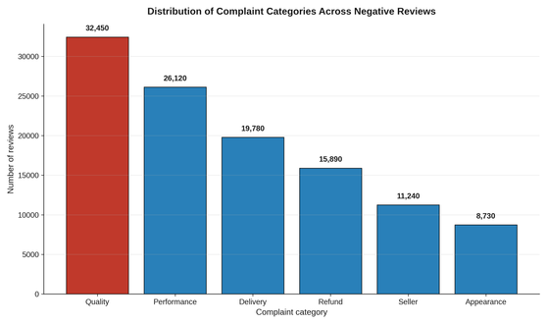
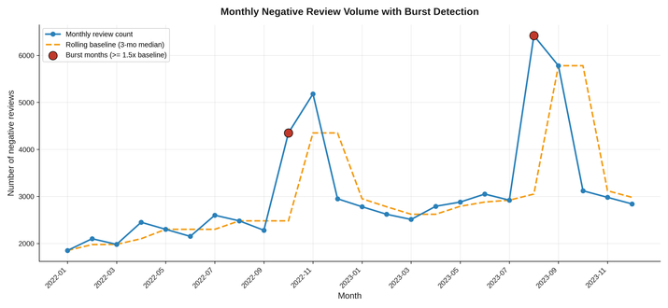
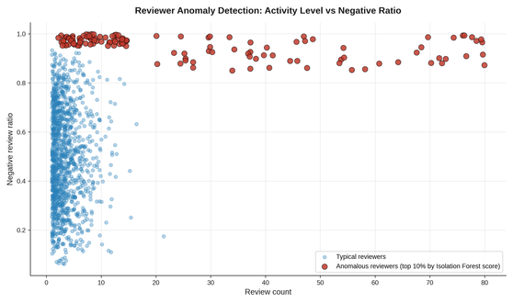
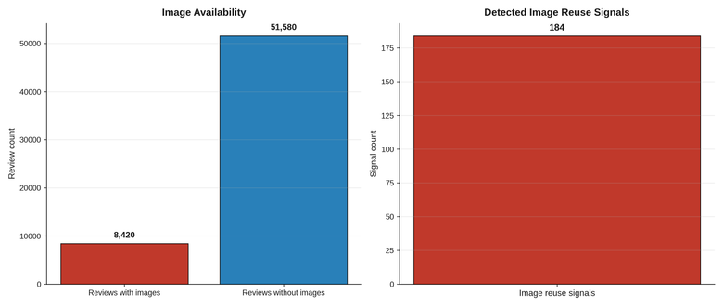
13 / 17
Output Graphs — Detection Signals
Complaint category distribution (Quality is dominant)
Monthly volume + 3-month baseline + burst months
Isolation Forest anomaly scatter (reviewer activity vs negative ratio)
Image availability and reuse-signal counts
Notes:
- Four key detection visualizations across complaint, temporal, anomaly, and image signals.
- Quality is the largest complaint theme; multiple themes can co-occur per review.
- Monthly burst months flag periods needing external event context (recalls, promotions).
- Anomaly scatter shows typical reviewers cluster, anomalous reviewers form the high-activity / high-negative tail.
- Image availability is small (~14%) but image reuse signals are the strongest visual-evidence leads.

Slide 14
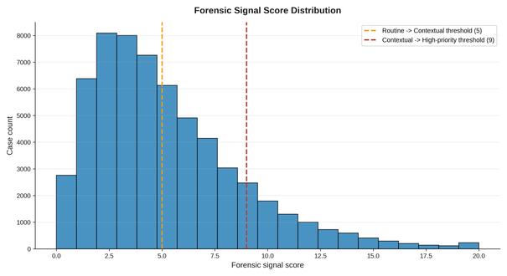
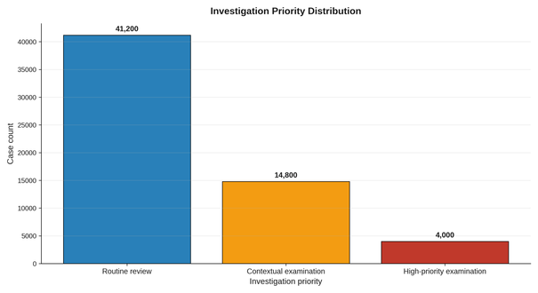
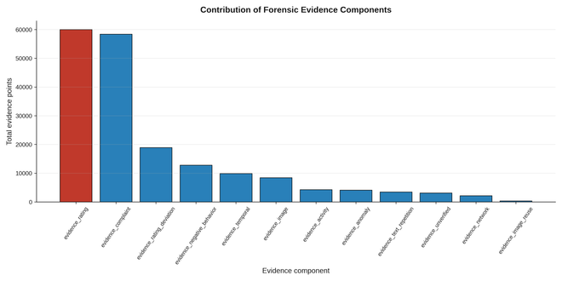
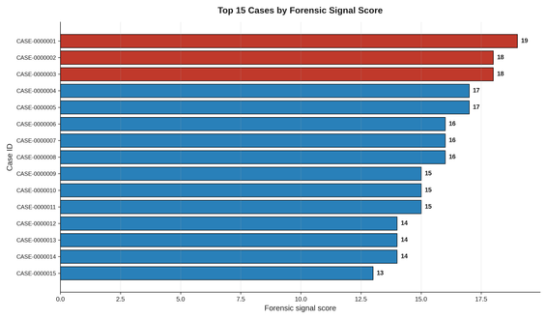
14 / 17
Output Graphs — Forensic Scoring
Score distribution + thresholds (5, 9)
Priority tier counts across 60,000 cases
Evidence component contribution totals
Top 15 priority cases by score
Notes:
- Score distribution is right-skewed: most cases are low-score, only a small minority in the high-priority tail.
- Priority tier counts confirm: routine dominates, contextual is the working queue, high-priority is the small actionable set.
- Component contribution chart shows which signals actually drive the score across the population.
- Top 15 cases are the analyst's first-pass triage queue; top 3 highlighted in accent red.
- All four charts are exported from the notebook and attached to case-level data in the CSV artifacts.

Slide 15
15 / 17
Case Narrative & Investigative Conclusion
OBSERVATION
What the data directly shows—without inference.
INTERPRETATION
What the signal may mean, expressed cautiously.
ALTERNATIVE EXPLANATIONS
Record plausible non-fraud causes, such as promotions or common product wording.
NEXT ACTION
Inspect original evidence, compare reviews and check product/event timelines.
Notes:
- 6 fields per case: observation, forensic_interpretation, alternative_explanations, recommended_actions, investigative_conclusion, case_narrative.
- observation is kept deliberately separate from forensic_interpretation — facts vs tentative meaning.
- alternative_explanations forces non-fraud causes onto the record (promotions explain bursts, common wording explains text similarity).
- investigative_conclusion tiers at score 12 (high-priority) and 7 (contextual); routine below 7.
- Every conclusion tier explicitly disclaims that signals do not establish misconduct.

Slide 16
16 / 17
Population Insights & Output Artifacts
DATA & FEATURES
cleaned_negative_reviews.csv · reviewer_features.csv · product_features.csv
SIGNAL ANALYSES
monthly_temporal_analysis.csv, text_similarity_analysis.csv, image_similarity_matches.csv
INVESTIGATION FILES
forensic_case_register.csv · priority_case_narratives.csv · evidence_matrix.csv
AUDIT & SUMMARY
population_level_insights.csv, image_download_log.csv. 11 artifacts support traceability.
Notes:
- 11 CSV artifacts make up the deliverable set across cleaned data, features, analyses, evidence, and narratives.
- Different stakeholders read different files — executives read population_level_insights.csv.
- Investigators read priority_case_narratives.csv and forensic_case_register.csv.
- Auditors read evidence_matrix.csv to trace every signal back to its source rule.
- evidence_matrix.csv is long-format with 4 canonical fields: Evidence, Observed value, Interpretation, Forensic relevance.

Slide 17
17 / 17
Business Relevance & Closing
Trust & Safety teams get a prioritized case queue instead of manual triage — 50 priority cases out of 60,000.
Brand Protection teams get seller-fraud and counterfeit leads via complaint categories, image reuse signals, and reviewer-product network clusters.
Product teams get burst-month and rating-deviation signals for recall, quality, and shipping-disruption investigations.
Customer Service teams get complaint-theme breakdowns to prioritize product, seller, and delivery fixes.
Auditors get a transparent evidence matrix with alternative explanations attached to every signal.
Standing caveat across the entire system: the forensic score is a prioritization mechanism, not proof of misconduct — every lead requires contextual validation.
Outcome: a structured, auditable forensic workflow that turns 60,000 raw reviews into a 50-case priority queue with full reasoning attached to each case.
Notes:
- 5 stakeholder groups mapped to specific outputs: Trust & Safety, Brand Protection, Product, Customer Service, Auditors.
- Trust & Safety gets 50 priority cases out of 60,000 reviews — replaces manual triage.
- Each group consumes a different artifact tailored to its decision-making.
- Final caveat: forensic score is prioritization, not proof — every lead requires contextual validation.
- Outcome: structured, auditable forensic workflow turning 60,000 raw reviews into a 50-case priority queue with full reasoning attached.

