Slide 1
Secure Data Hiding in Image Using Steganography
CAPSTONE PROJECT
Presented By
Student Name : Arun Kumar Jangam
College Name & Department : JNTUACEA & Chemical Engineering

Slide 2
OUTLINE
Problem Statement
Technology used
Wow factor
End users
Result
Conclusion
Git-hub Link
Future scope

Slide 3
Problem Statement
Traditional encryption methods leave identifiable traces, making secure communication vulnerable to detection and interception. This raises the need for a covert method to hide confidential data while maintaining the integrity of the cover medium.
Key Challenges:
Detectability of Encryption 🚨 – Encrypted files can raise suspicion if intercepted.
Data Security 🔐 – Protecting hidden messages from unauthorized extraction.
Image Integrity 🖼️ – Embedding data without visibly altering the image.
User Accessibility 💻 – Making encryption and decryption simple for non-technical users.
This project tackles these challenges by embedding messages inside images using steganography, where pixel values are modified to store data without noticeable distortion. A passcode-based decryption mechanism adds a layer of security, ensuring only authorized users can retrieve the hidden information.

Slide 4
Technology used
Programming Language : Python 3 (Core programming language for implementation).
Image Processing Library : OpenCV (cv2) – Image processing and manipulation.
ASCII Encoding : Converting text into numerical pixel values.
OS Module : Handling file operations and opening images
File Handling & Security : Basic encryption logic for password protection
Platform : Windows 11

Slide 5
Wow factors🚀
🔍 Undetectable Data Hiding
Unlike traditional encryption, which leaves clear traces, this project embeds messages inside images without altering their appearance.
🔐 Passcode-Protected Decryption
Ensures that only authorized users with the correct passcode can retrieve the hidden message.
🖼️ Image Integrity Preserved
The cover image remains visually unchanged, making it difficult for anyone to suspect data is hidden inside.
⚡ Fast & Lightweight
No need for complex external tools—just a simple script using OpenCV to encode and decode messages.
📂 Works with Any Image
The technique can be applied to different image formats, making it versatile and adaptable.
🖥️ Simple User Interaction
A user-friendly approach were hiding and retrieving messages is as easy as running the script.
🔄 Reversible Process
The original message can be retrieved perfectly without any data loss, ensuring accuracy in decryption.

Slide 6
End users
🕵️‍♂️ Intelligence Agencies : Covert communication without detection.
💼 Corporations & Businesses : Secure data transfer within organizations.
🎭 Whistleblowers & Journalists : Protect sensitive information from surveillance.
👨‍💻 Cybersecurity Enthusiasts : Experimenting with data security techniques.
🔐 Privacy-Conscious Individuals : Safeguarding personal information.
📜 Digital Forensics Experts : Analyzing hidden data in images.
🎨 Digital Artists & Watermarking : Embedding copyright information secretly.

Slide 7
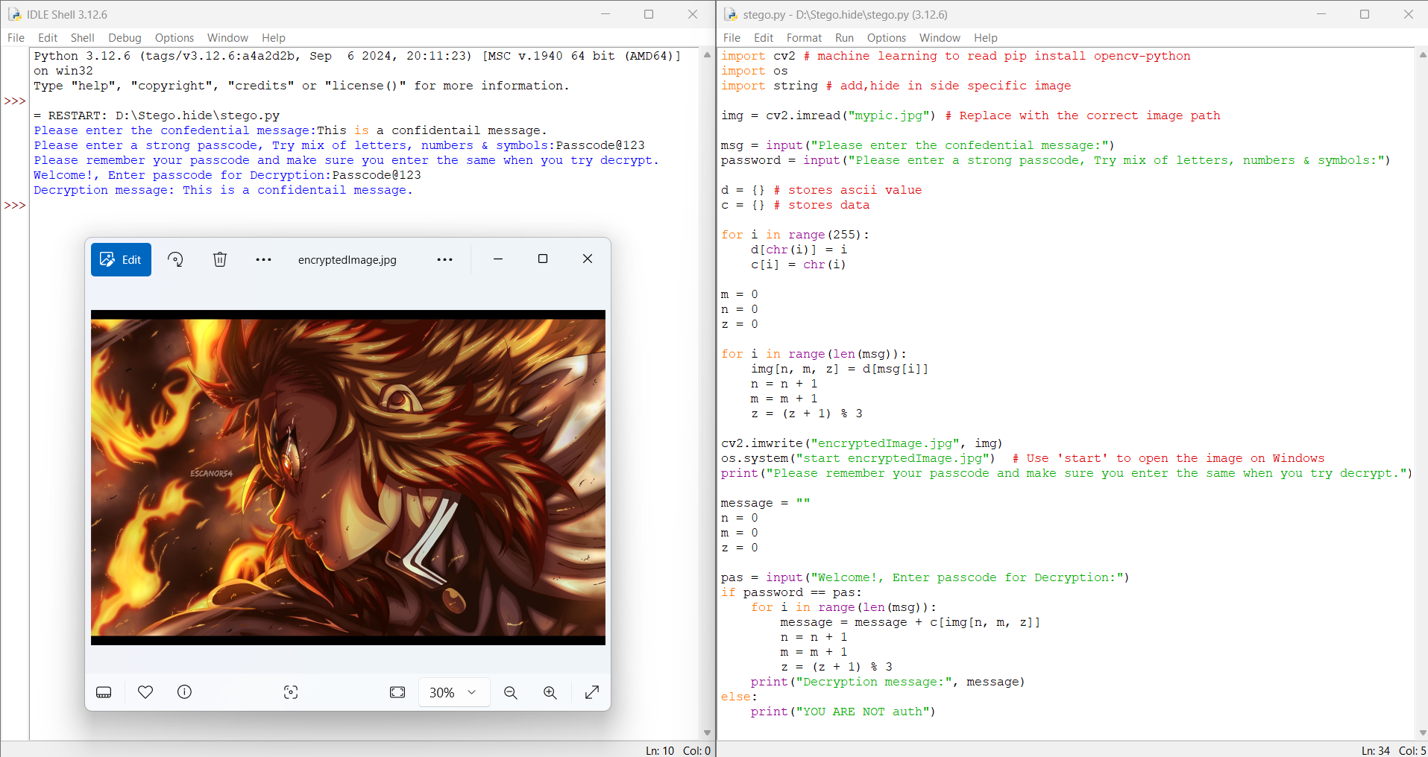
Results
2>Encryption(Hiding text in a picture) & Decryption(Retrieving data from encrypted file by giving password) by command line interface
4>Decrypted message
1>Code for encryption & decryption
3>Encrypted Image

Slide 8
Conclusion
Secure Data Transmission – Utilizes steganography to embed confidential information within images while maintaining visual integrity.
Undetectable Information Hiding – Subtle pixel modifications ensure the hidden data remains inconspicuous and resistant to detection.
Passcode-Protected Access – Enhances security by restricting decryption to authorized users with the correct credentials.
Lightweight & Efficient – Requires minimal computational resources, making it a practical solution for various applications.
Real-World Applications – Useful in cybersecurity, digital forensics, and privacy protection, addressing modern data security challenges.

Slide 9
GitHub Link
https://github.com/Githubarunkumar847/Stego.hide.git

Slide 10
Future scope
🖼️ Advanced Steganography Techniques: Implementing Least Significant Bit (LSB) or frequency-domain methods for better stealth and efficiency.
📱 Cross-Platform Application: Developing a GUI-based tool or mobile application for user-friendly encryption and decryption.
🌍 Cloud-Based Secure Communication: Extending the project to support secure, cloud-based data transmission using steganography.
🧠 AI-Powered Steganalysis Resistance: Improving resistance against AI-based detection methods to ensure undetectable data hiding.

Slide 11
THANK YOU

