Slide 1
Entire Dataset
Training Data
Evaluation Data
70%
30%

Slide 2
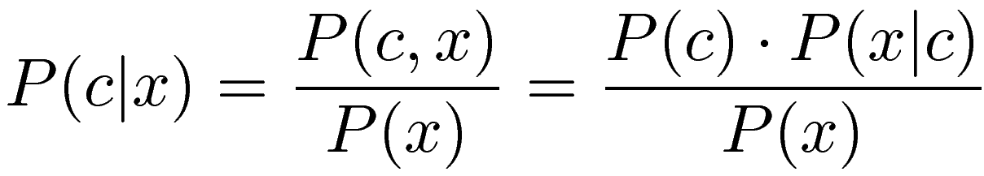
Prior
Likelihood
Posterior
Evidence

Slide 3
Actual Class
Positive
Negative
True Positives
False Positives
Positive
Predicted Class
False Negatives
True Negatives
Negative

Slide 4
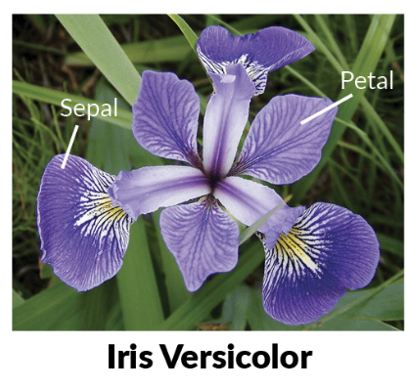
“Real-World” Observation
Features (Measurements)
Labels
# | Sepal length (cm) | Sepal width (cm) | Petal length (cm) | Petal width (cm) |  | Class
0 | 6.4 | 3.2 | 4.5 | 1.5 |  | Versicolor
1 | 5.1 | 3.5 | 1.4 | 0.2 |  | Setosa
2 | 5.8 | 2.7 | 5.1 | 1.9 |  | Verginica
… | … | … | … | … |  | …
149 | 5.0 | 3.6 | 1.4 | 0.2 |  | Setosa
Observations

Slide 5

“Law of Large Numbers”
Central Limit Theorem
“mean to be estimated”
“standard deviation to be estimated”
P(x) \approx \mathcal{N}(x | \mu, \sigma) = \frac{1}{\sqrt{2\pi\sigma^2}}e^{-\frac{(x-\mu)^2}{2\sigma^2}}

Slide 6

“Law of Large Numbers”
Central Limit Theorem
“mean to be estimated”
“class to be conditioned on”
“standard deviation to be estimated”
P(x) \approx \mathcal{N}(x | \mu, \sigma) = \frac{1}{\sqrt{2\pi\sigma^2}}e^{-\frac{(x-\mu)^2}{2\sigma^2}}

Slide 7
“Law of Large Numbers”
Central Limit Theorem
“mean to be estimated”
“class to be conditioned on”
“standard deviation to be estimated”
P(x) \approx \mathcal{N}(x | \mu, \sigma) = \frac{1}{\sqrt{2\pi\sigma^2}}e^{-\frac{(x-\mu)^2}{2\sigma^2}}

