Slide 1

ACROPOLIS INSTITUTE OF TECHNOLOGY
AND RESEARCH
SUBJECT- EVALUATION OF INTERNSHIP
(CYBER SECURITY)
SUBMITTED TO:
PROF. NIDHI NIGAM
SUBMITTED BY:
GITIKA CHOUKSEY
(0827CI201068)

Slide 2
CONTENT
IP Address
CLASSES OF IP ADDRESS
DNS servers
OSI layers
Types of hackers

Slide 3
IP ADDRESS
An IP address is a unique address that identifies a device on the internet or a local network.
IP stands for "Internet Protocol," which is the set of rules governing the format of data sent
via the internet or local network.
IP addresses are made up of 32 bits. Each bit is a binary digit. The value of a bit is either
zero (0) or one (1). Having 32 bits allows us to have a total of 4,294,967,296 (2^32)
addresses in the IPv4 scheme.

Slide 4
CLASSES OF IP ADDRESS
IP defines five classes of IP addresses: class A, B, C, D, and E. Each class has a range of valid IP
addresses. The value of the first octet determines the class. IP addresses from the first three classes
(A, B and C) can be used for host addresses. The other two classes are used for other purposes – class
D for multicast and class E for experimental purposes.
The system of IP address classes was developed for the purpose of Internet IP addresses assignment.
The classes created were based on the network size. For example, for the small number of networks with
a very large number of hosts, the Class A was created. The Class C was created for numerous networks
with small number of hosts.

Slide 5
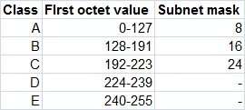
Classes of IP addresses are:
For the IP addresses from Class A, the first 8 bits (the first decimal number) represent the network part,
while the remaining 24 bits represent the host part. For Class B, the first 16 bits (the first two numbers)
represent the network part, while the remaining 16 bits represent the host part. For Class C, the first 24
bits represent the network part, while the remaining 8 bits represent the host part.

Slide 6
DNS SERVER
A DNS server is a computer server that contains a database of public IP addresses and their associated
hostnames, and in most cases serves to resolve, or translate, those names to IP addresses as requested.
DNS servers run special software and communicate with each other using special protocols.
The Domain Name System (DNS) is the hierarchical and distributed naming system used to identify
computers reachable through the Internet or other Internet Protocol (IP) networks. The resource records
contained in the DNS associate domain names with other forms of information. These are most commonly
used to map human-friendly domain names to the numerical IP addresses computers need to locate
services and devices using the underlying network protocols,^{[1]} but have been extended over time to
perform many other functions as well. The Domain Name System has been an essential component of the
functionality of the Internet since 1985.

Slide 7
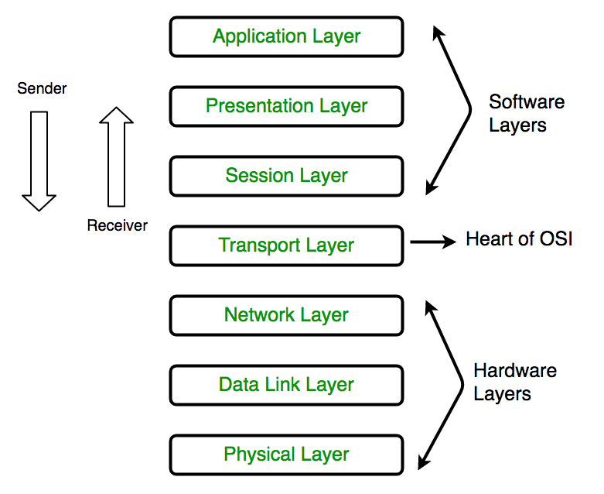
OSI MODEL
The Open Systems Interconnection (OSI) model describes seven layers that computer systems use to
communicate over a network. It was the first standard model for network communications, adopted by
all major computer and telecommunication companies in the early 1980s

Slide 8
TYPE OF HACKERS
Black hat hacker
Black hat hackers are criminals who break into computer networks with malicious intent. They may
also release malware that destroys files, holds computers hostage, or steals passwords, credit
card numbers, and other personal information.
Black hats are motivated by self-serving reasons, such as financial gain, revenge, or simply to
spread havoc. Sometimes their motivation might be ideological, by targeting people they strongly
disagree with.

Slide 9
White hat hacker
White hat hackers use their capabilities to uncover security failings to help safeguard organizations from
dangerous hackers. They can sometimes be paid employees or contractors working for companies as
security specialists who attempt to find gaps in security.
White hat hackers are one reason large organizations typically have less downtime and experience fewer
issues with their websites. Most hackers know it will be harder to get into systems managed by large
companies than those operated by small businesses that probably don't have the resources to examine
every possible security leak.

Slide 10
Gray hat hacker
Somewhere between white and black are gray hat hackers. Gray hat hackers enact a blend of both black
hat and white hat activities. Gray hat hackers often look for vulnerabilities in a system without the owner's
permission or knowledge. If issues are found, they report them to the owner, sometimes requesting a
small fee to fix the problem.
Some gray hat hackers like to believe they are doing something good for companies by hacking their
websites and invading their networks without permission. Still, company owners rarely appreciate
unauthorized forays into their business information infrastructure.

Slide 11
Thank you

