Slide 1
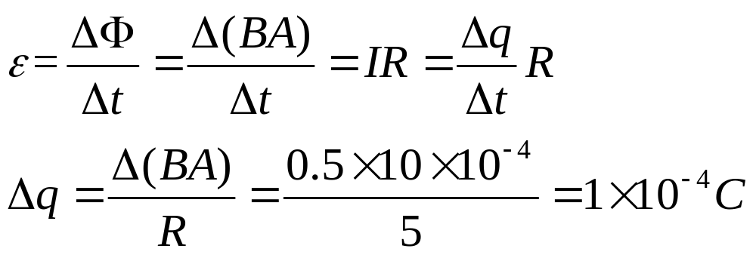
浙江大学20 13 –20 14 学年 秋冬 学期
《 普通物理II 》课程期中考试试卷
I. Fill in the space underlined (40% in total)
1. A wire loop that encloses an area of 10 cm² has a resistance of 5 Ω. The loop is placed in a magnetic field of 0.5 T with its plane perpendicular to the field. The loop is suddenly removed from the field. How much charge flows past a given point in the wire? _________________

Slide 2
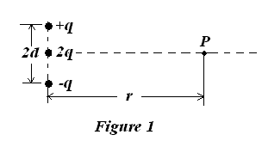
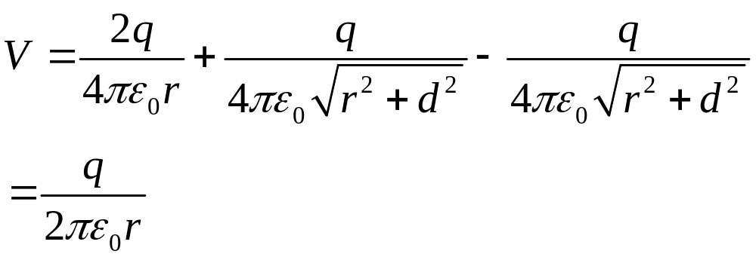
2. For the charge configuration of Fig. 1, the electric potential V(r) for points on the x axis, assuming r>>d is given by . Set V=0 at infinity.

Slide 3
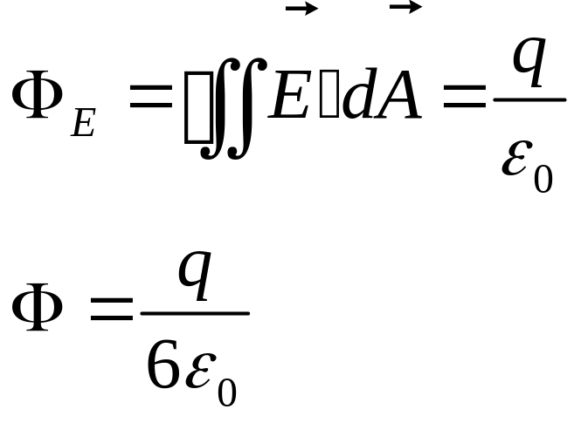
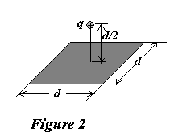
3. As shown in Fig. 2, a point charge +q is a distance d/2 from a square surface of side d and is directly above the center of the square. The electric flux through the square is of .

Slide 4
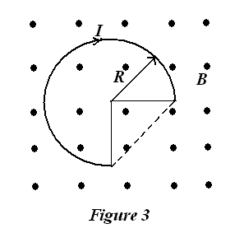
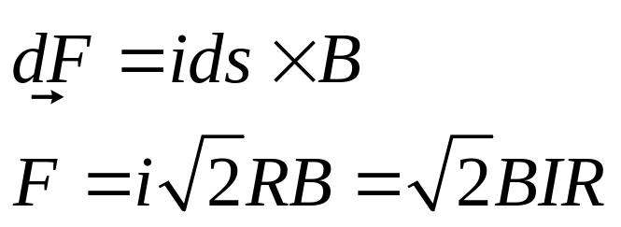
4. As shown in Fig. 3, a wire with a 3/4 circle is placed in a uniform magnetic field B which points out of the plane of the figure. If the wire carries a current I, the magnetic force acted on it is ______________________.

Slide 5
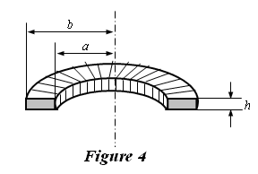
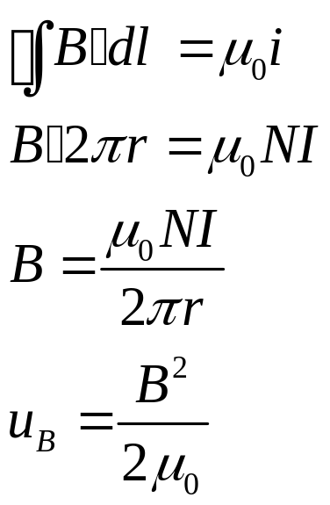
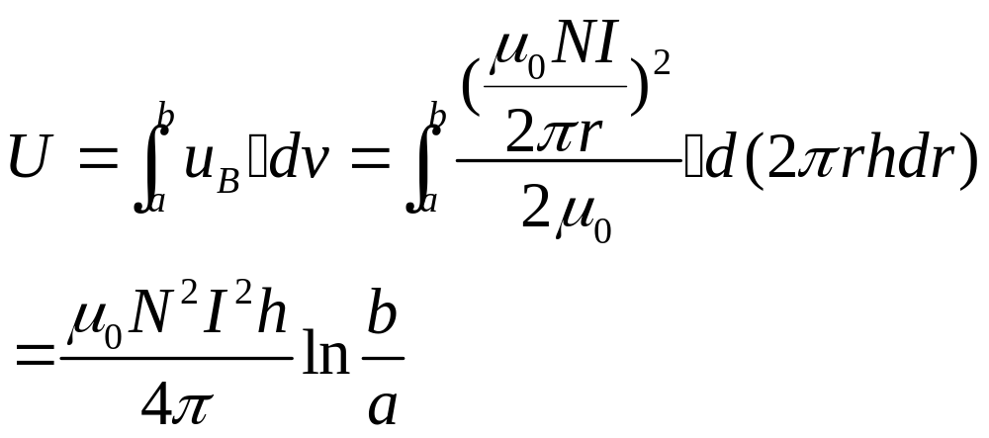
5. Figure 4 shows the cross section of a toroid, the total turn number of wire is N. If the electric current in the wire is I, how much is energy stored in the toroid?________________.

Slide 6
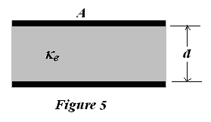
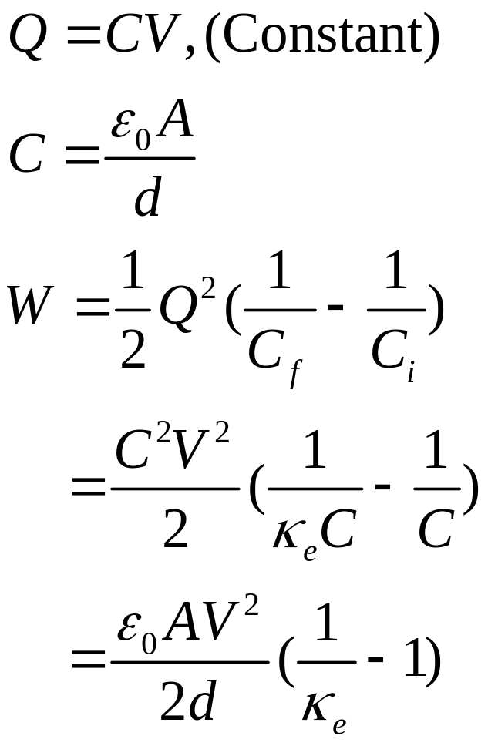
6. As shown in Fig. 5, a parallel plate capacitor with capacitance C is charged to a potential difference V and is then disconnected from the charging source. The capacitor has an area A and a plate separation d. Assume that a glass plate of the same area A completely fills the space between the plates, and which has a dielectric constant κ_{e}. How much work is required to pull the glass plate out of the capacitor? __________. Neglect fringe effects at the edges of the plates.

Slide 7
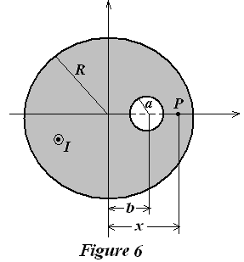
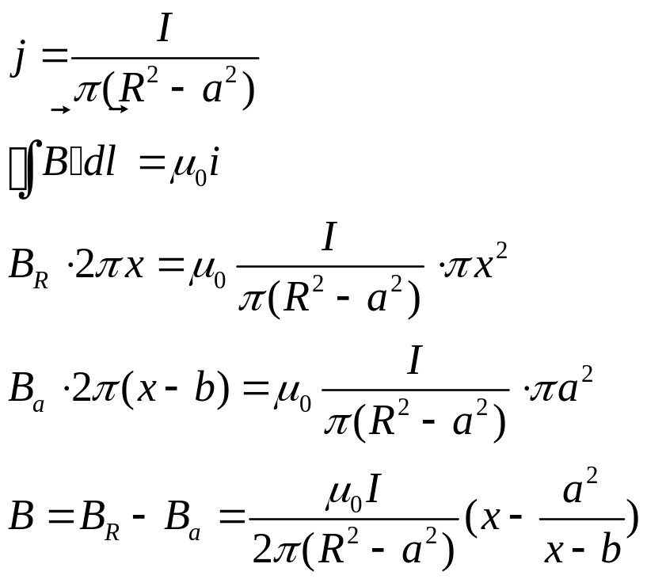
7. As shown in Fig. 6, a long, straight conductor with a circular cross section of radius R carries a current I. There is a cylindrical hole inside the conductor, whose radius is of a, and whose axis is parallel to the axis of the conductor but offset a distance b from the axis of the conductor. The current I is uniformly distributed across the cross section of the conductor and is directed out of the page. The magnetic field at P point (R>x>a+b) at the x axis is .

Slide 8
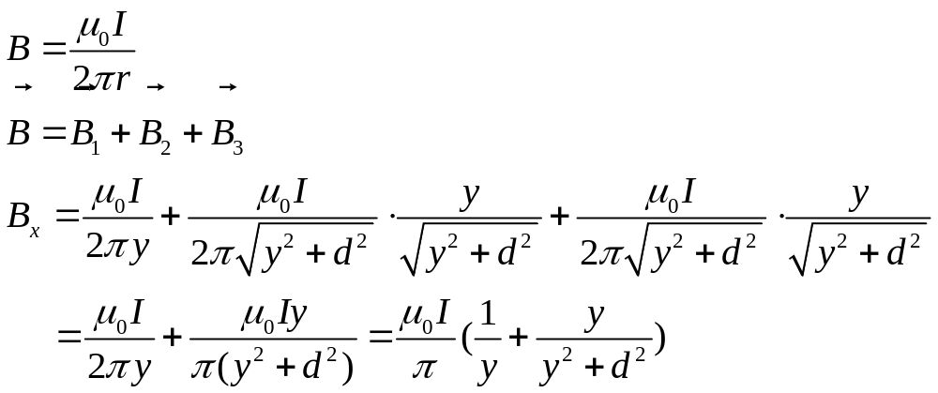
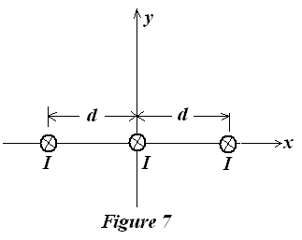
  8. Figure 7 shows three long wires in the z direction, each wire carries a current of I in the negative z direction. The separation distance between them is d. The magnetic field B in y-axis for y >0 is________________.

Slide 9
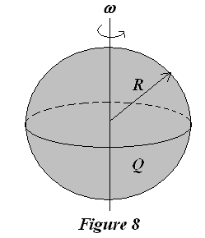
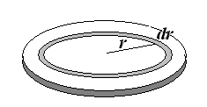
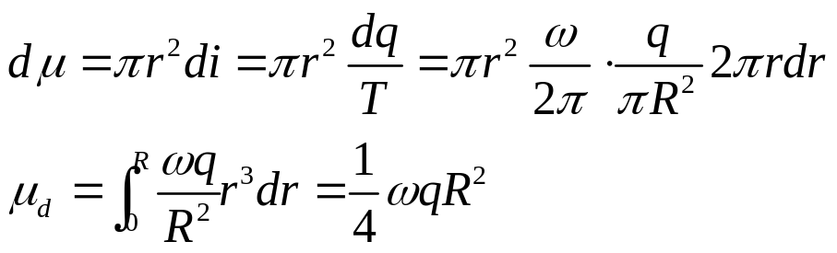
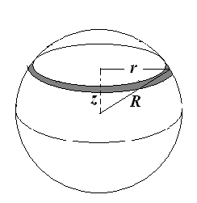
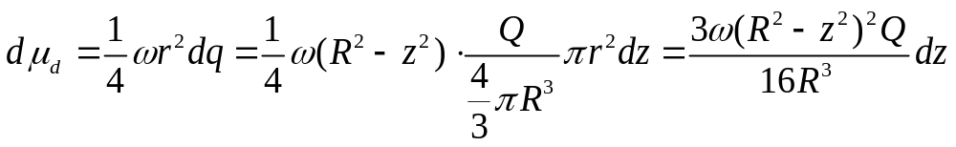
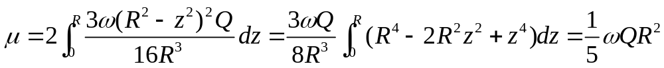
II. Problems (present the necessary equations in solution) (60%)
1. (12%) Please calculate the magnetic moment for a uniformly charged, rotating sphere, as shown in Fig.7, which has a radius R, and carried a charge Q, and is rotating with a angular speed of ω.
Solution: At first, we consider a disk with radius of R, charge of q.

Slide 10
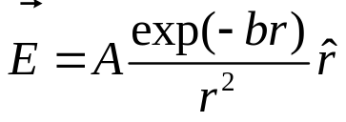
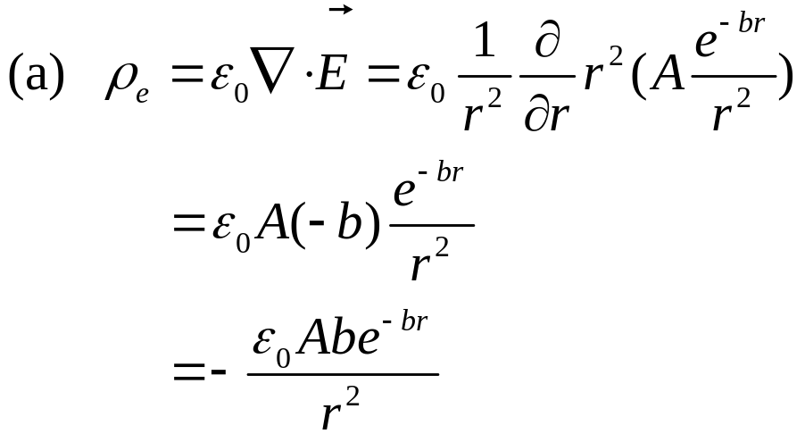
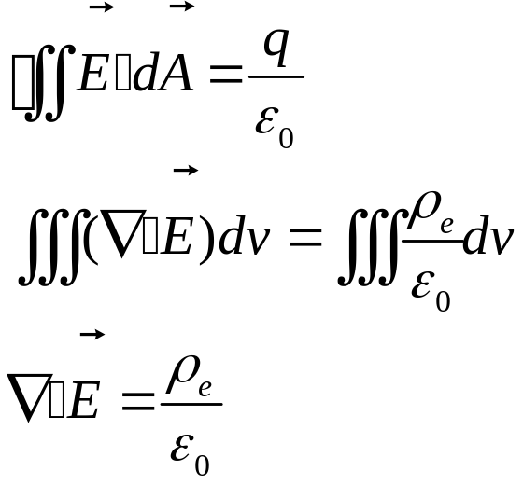
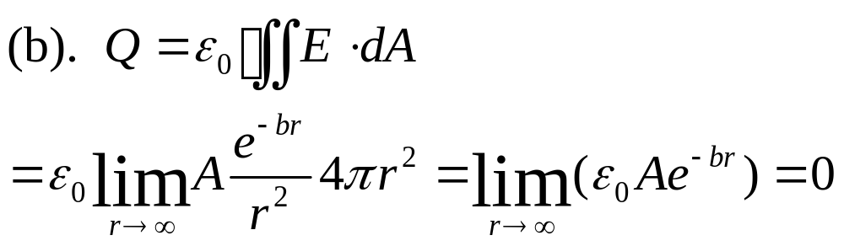
2. (13%) A static charge distribution produces a spherically radial electric field:
, where A and b > 0 are the constants.
(a). What is the charge density ρ(r)?
(b). What is the total charge Q?
Solution:

Slide 11
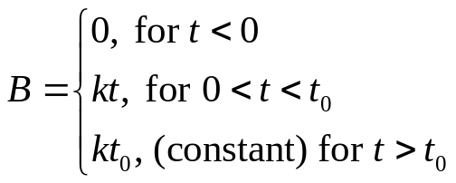
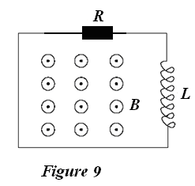
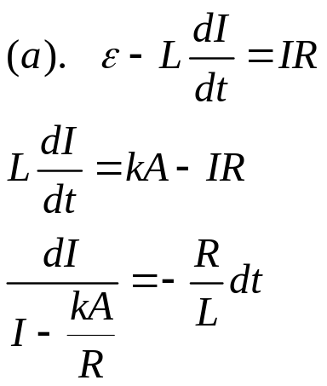
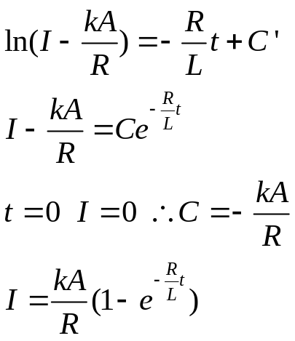
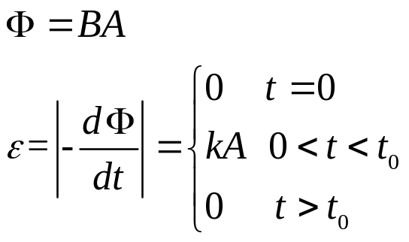
3. (15%) As shown in Fig. 9, a loop of wire of resistance R and a coil of self-inductance L encloses an area A. A spatially uniform magnetic field is applied perpendicular to the plane of the loop with the following time dependence:
(a) Calculate the current I in the loop for all times t > 0, given that I = 0 for t = 0.
(b) Make simple sketches of the current vs. time for t₀< L/R and t₀ >> L/R.
Solution:

Slide 12
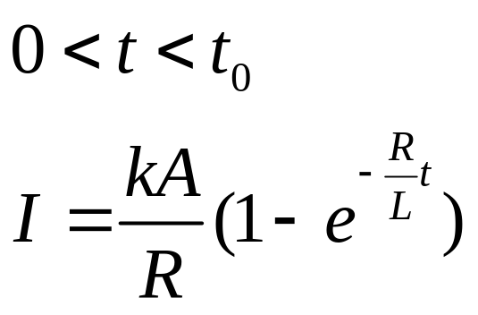
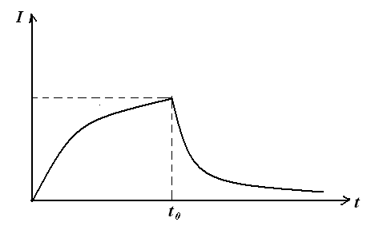
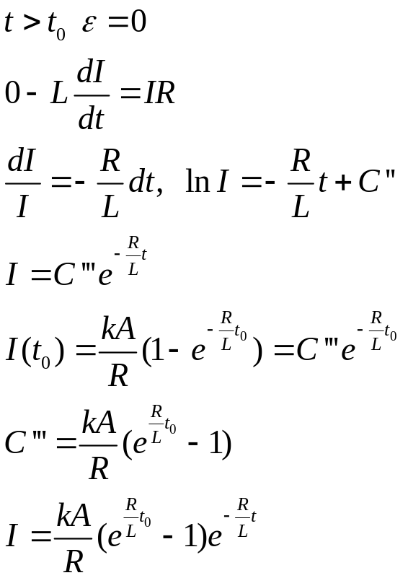
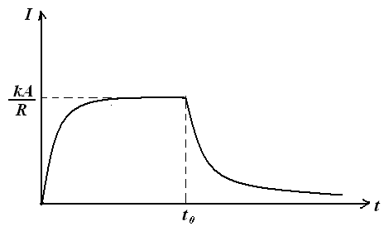
(b): as t₀<L/R
as t₀>>L/R

Slide 13
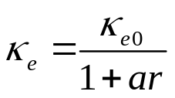
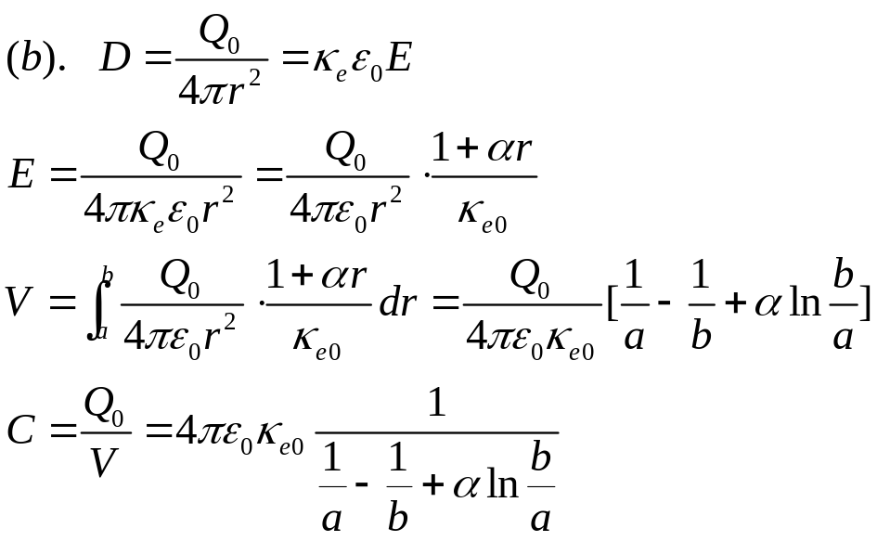
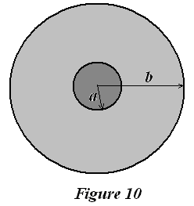
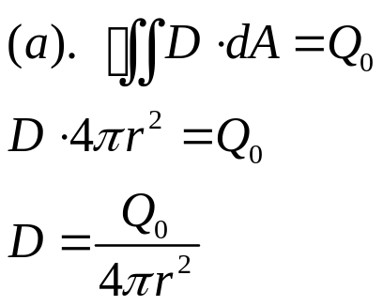
4. (20%) Figure 10 shows a cross section of a spherical capacitor, in which the inner conductor is a solid sphere of radius a with a charge Q₀, and the outer conductor is a hollow spherical shell of inner radius b. The space between them is filled by the non-uniform dielectrics with a dielectric constant:
where κ_{e0} and α are the constants, r is the distance for the points inside dielectrics. Please calculate:
(a). The electric displacement vector for the region of a<r<b.
(b). The capacitance for this system C.
(c). The volume density of the polarization charge, ρ_{e}’(r), in the region of a<r<b.
(d). The surface density of the polarization charge σ_{e}(a) and σ_{e}(b), at the r=a and r=b surfaces, respectively.

Slide 14
