Slide 1
2014年期中考试答卷

Slide 2
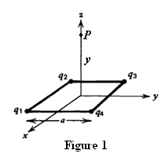
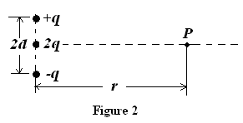
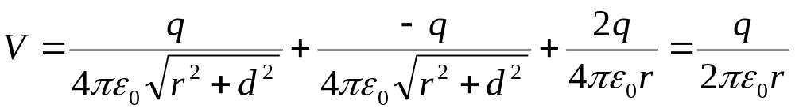
I. Fill in the space underlined. (50% in total)
The four point charges are placed on the vertices of a square with sides of length a in the xy plane centered at the origin, with q₁= q₃= q and q₂= q₄= -q, as shown in Figure 1. The electric field along the z axis at P point is ____________E=0___________.
2. For the charge configuration of Fig. 2, the electric potential V(r) for points on the x axis, assuming r>>d is given by . Set V=0 at infinity.

Slide 3
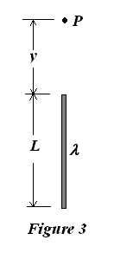
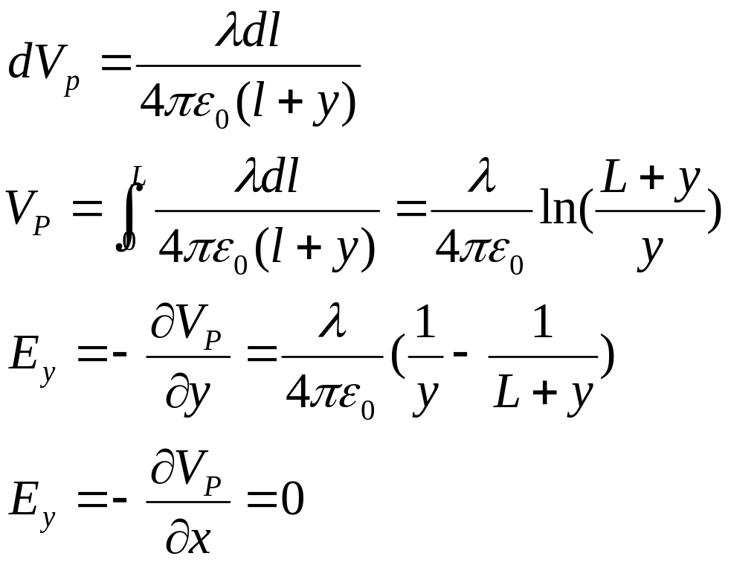
3. A charge per unit length λ is distributed uniformly along a thin rod of length L. The potential (chosen to be zero at infinity) at a point P a distance y from one end of the rod and in line with it is V_{P}=______________。 The component of the electric field at P in the y direction (along the rod) is E_{y}=______ __________________. The component of the electric field at P in a direction perpendicular to the rod is E_{x}= _______________________________.

Slide 4
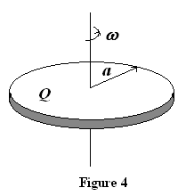
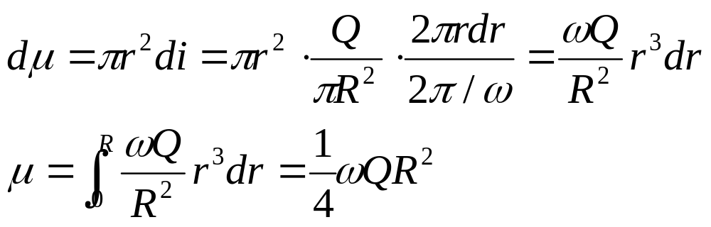
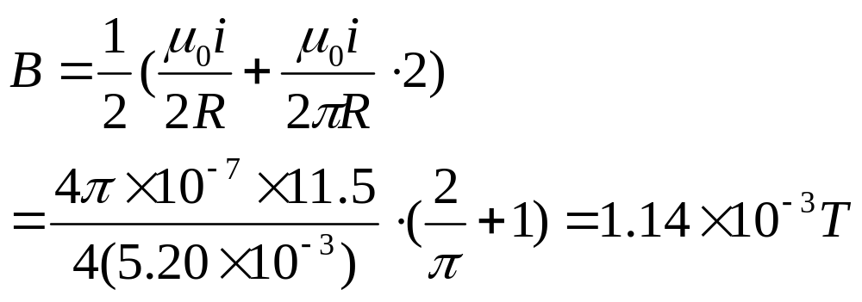
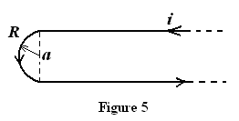
4. There is a thin disk of radius a, with total charge Q uniformly distributed on its surface, rotating at a constant angular speed ω, as shown in Fig. 4. What is the magnetic dipole moment (磁偶极矩)? ____________________
5. A long hairpin is formed by bending a piece of wire as shown in Fig. 5. If the wire carries a current i=11.5 A, Which is the direction Out of Page and what is magnitude ______________ of magnetic induction strength B at point a, taking R=5.20 mm.

Slide 5
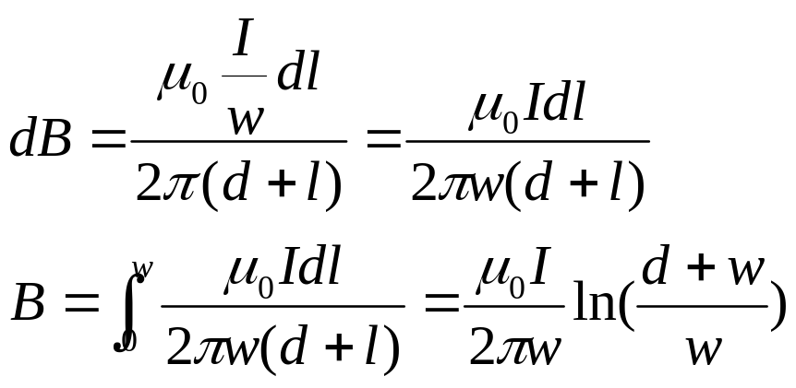
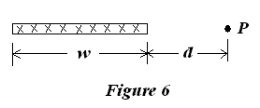
6. Figure 6 shows a cross section of a long, thin ribbon (薄带) of width w that is carrying a uniformly distributed total current I into the paper. Calculate the magnitude _____________________and the direction ________________ of the magnetic field B at a point P in the plane of the ribbon at a distance d from its edge.

Slide 6
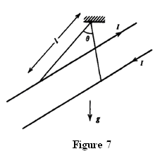
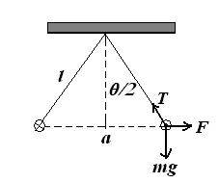
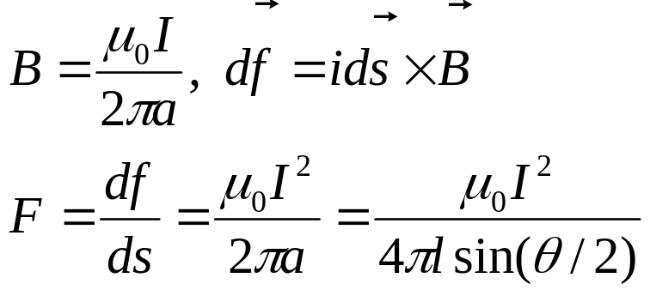
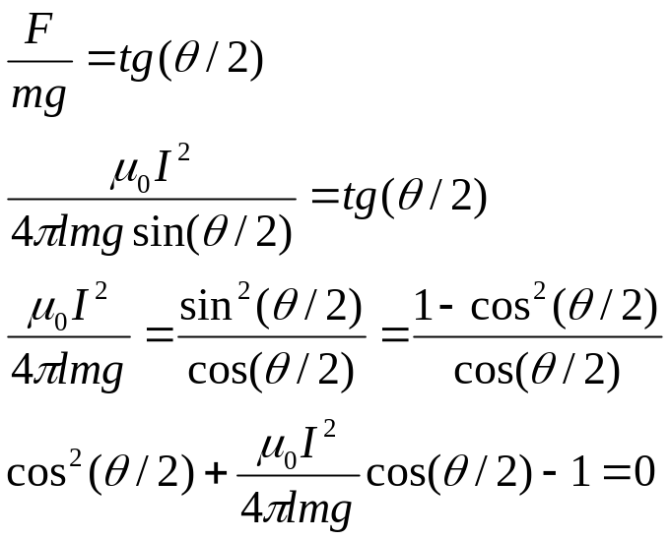
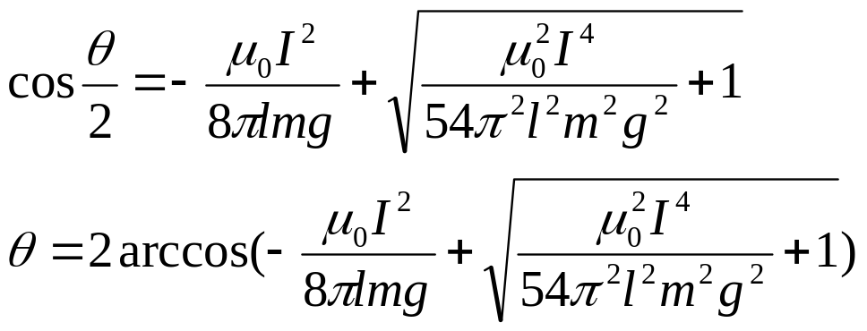
7. Two long parallel line currents of mass per unit length m in a gravity field g each carry a current I in opposite directions. They are suspended by cords (细线) of length l. What is the angle θ between the cords? __________________________

Slide 7
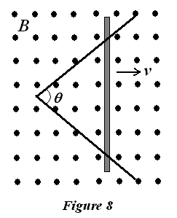
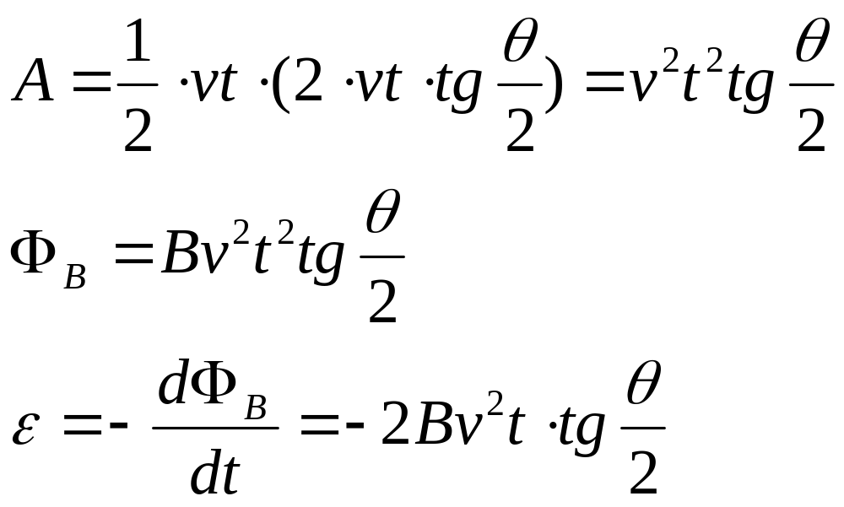
8. Two straight, conducting rails form an angle θ where their ends are joined. A conducting bar in contact with the rails and forming an isosceles triangle (等腰三角形) with them starts at the vertex at time t =0 and moves with constant velocity v to the right, as shown in Fig. 8. A magnetic field B points out of the paper. The emf (电动势) induced as a function of time is ________________________

Slide 8
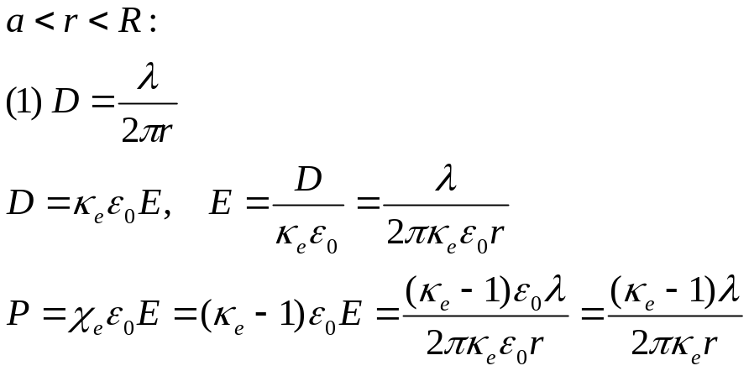
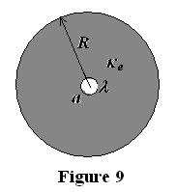
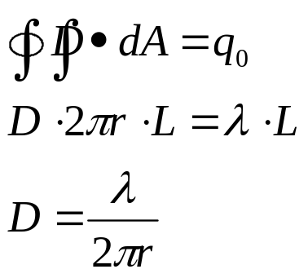
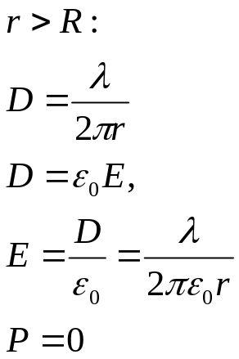
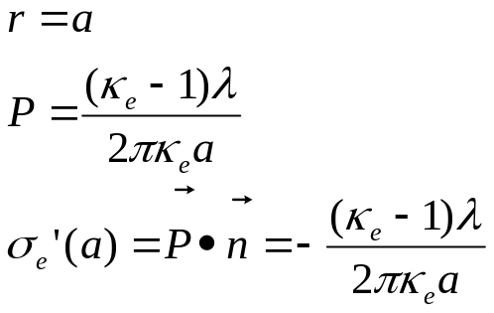
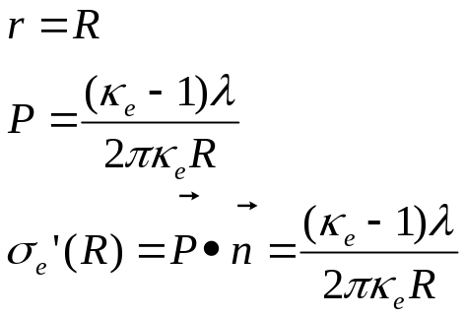
II. Problems (Present the necessary equations in solution) (50%)
1. (12%) As shown in Fig. 9, an infinitely long line of radius a with a line charge density λ is placed at the center of a dielectric cylinder (圆柱形电介质) of radius R and dielectric constant κ_{e}. Please calculate the electric field E, displacement vector D, and polarization vector P for both a < r <R and r ≥ R regions and the surface induced charge density σ_{e} at r = a and r = R surfaces.

Slide 9
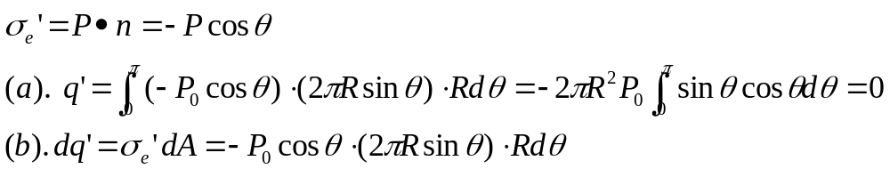
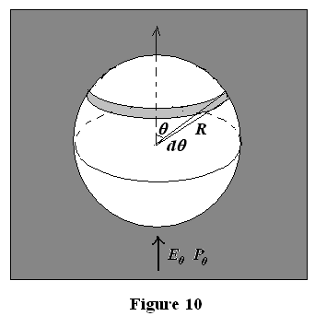
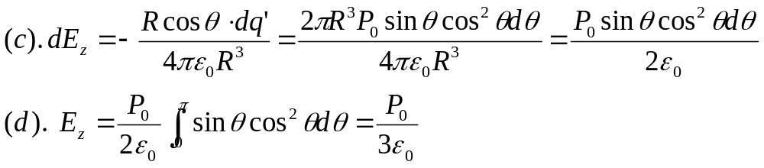
2. (18%) Lorentz calculated the local electric field acting on a dipole due to a surrounding uniformly polarized medium stressed by a macroscopic field E₀i_{z}, by encircling the dipole with a small spherical free space cavity of radius R, as shown in Fig. 10.
(a). If the medium outside the cavity has polarization P_{o}i_{z} , what is the induced surface charge on the spherical interface?
(b) Break this surface induced charge distribution into hoop line charge elements of thickness dθ. What is the total charge on a particular shell at angle θ?
(c) What is the electric field due to this shell at the center of the sphere where the dipole is?
(d). By integrating over all shells, find the total electric field acting on the dipole. This is called the Lorentz field.

Slide 10
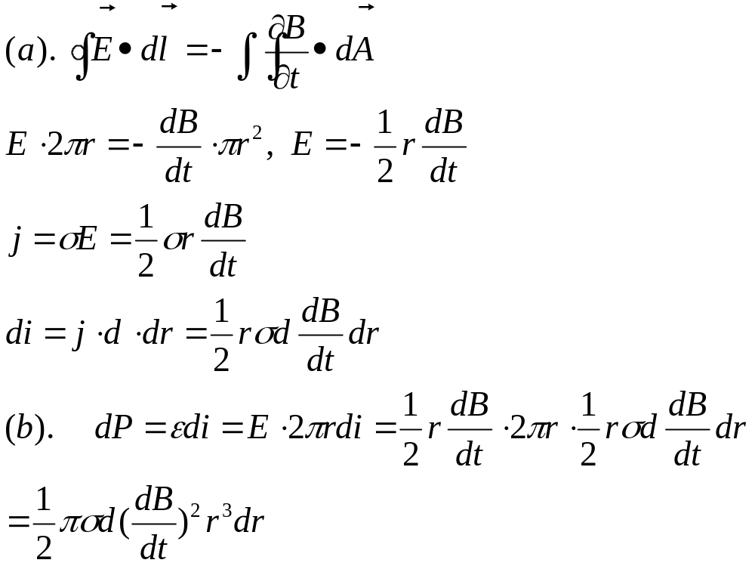
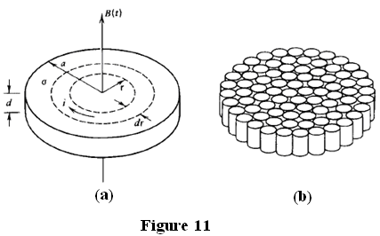
3. As shown in Fig.11 (a), a thin circular disk of radius a, thickness d, and conductivity (电导率) σ is placed in a uniform time varying magnetic field B(t).
(a). Neglecting the magnetic field of the eddy currents, what is the current induced in a thin circular filament at radius r of thickness dr.
(b). What power is dissipated (损耗) in this thin current loop?
(c). How much power is dissipated in the whole disk?
(d). If the disk is cut up into N smaller circular disks with negligible wastage (缝隙), as shown in Fig. 11(b), what is the approximate radius of each smaller disk?
(e). If these N smaller disks are laminated (叠压) together to form a thin disk of closely packed cylindrical wires, what is the power dissipated?

Slide 11
