Slide 1
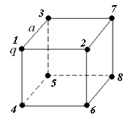
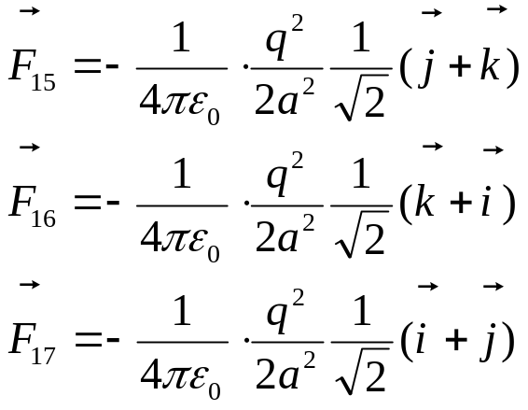
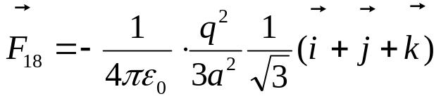
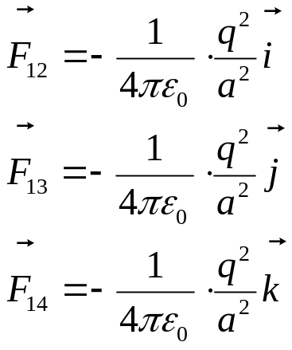
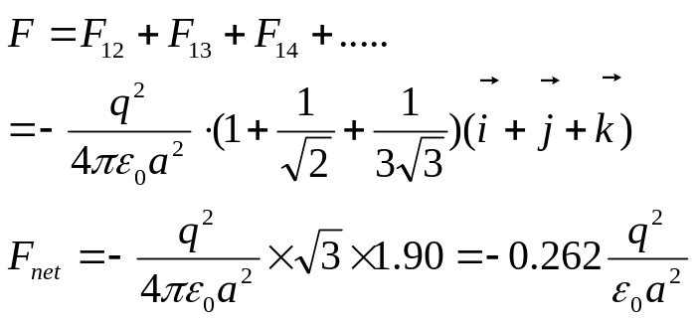
期中考试卷
I. Fill in the space underlined (50% in total)
1. As shown in Fig. 1, a cube of edge a carriers a point charge q at each corner. The resultant electric force on any one of the charges is given by +5 , and its direction is along +4 .

Slide 2
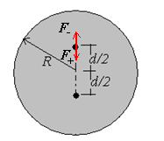
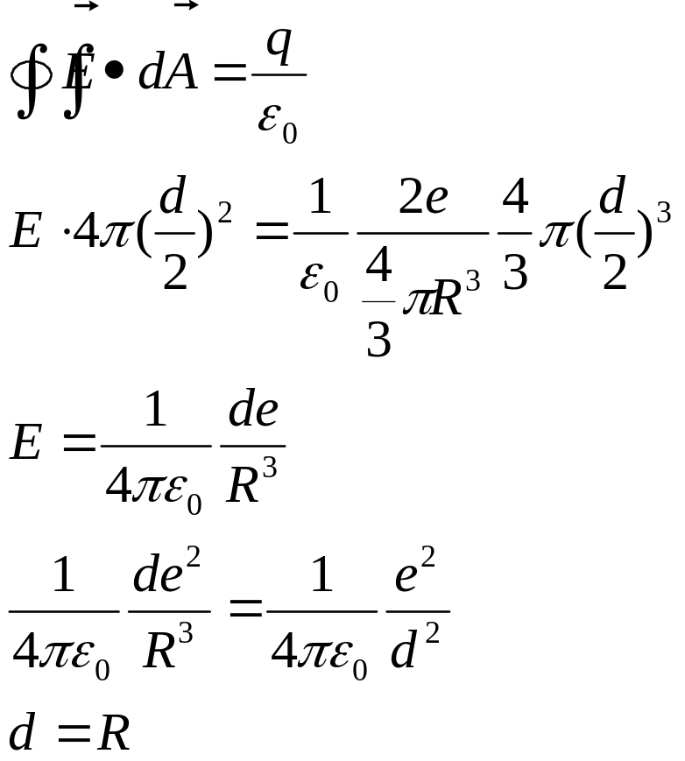
2. Figure 2 shows a Thomson atom model of helium (Z=2). Two electrons, at rest, are embedded inside a uniform sphere of positive charge 2e. Find the distance d between the electrons so that the configuration is in static equilibrium. +5

Slide 3
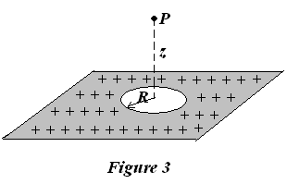
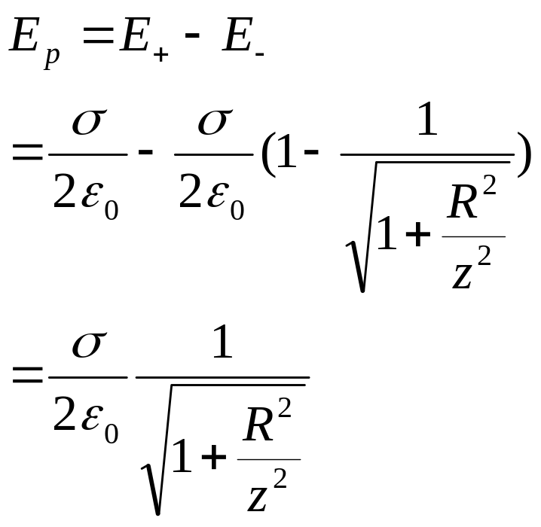
3. A large, flat, nonconducting surface carriers a uniform charge density σ. A small circular hole of radius R has been cut in the middle of the sheet, as shown in Fig. 3. Ignore fringing of the field lines around all edges, please calculate the electric field E at the point P, a distance z from the center of the hole along its axis. +5

Slide 4
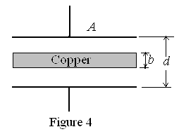
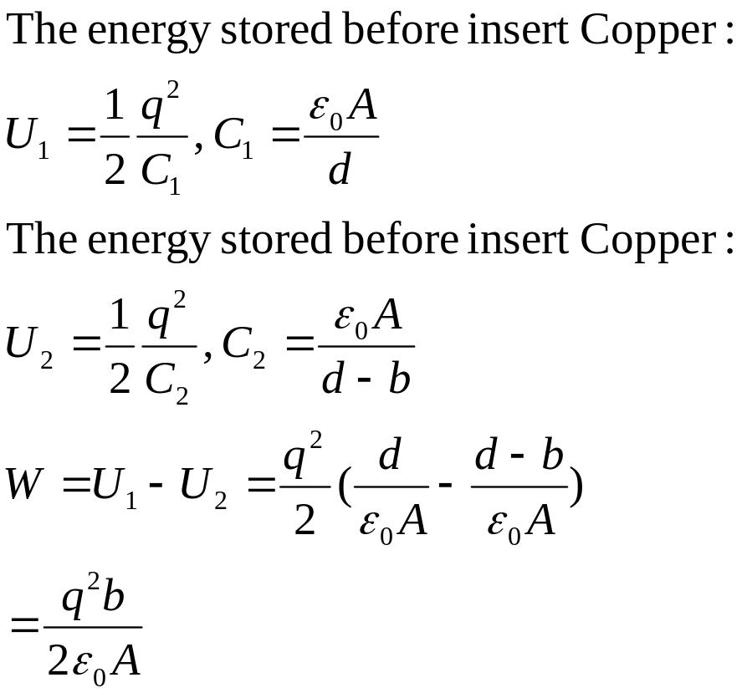
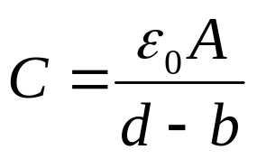
4. A slab of copper of thickness b is thrust into a parallel-plate capacitor as shown in Fig. 4.
(a) What is the capacitance after the slab is introduced? +4 .
(b) If a charge q is maintained on the plates, how much work is done on the slab as it is inserted? +4 .

Slide 5
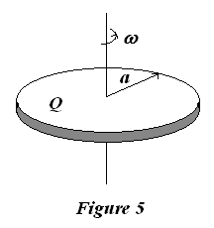
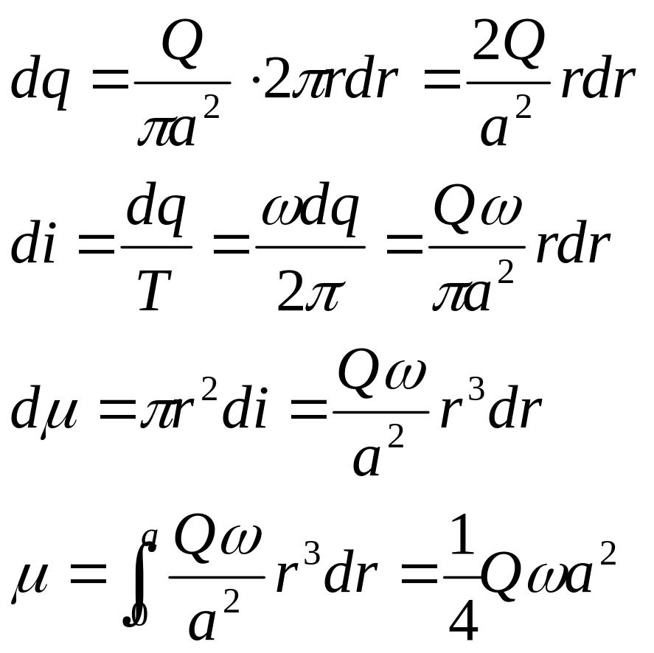
5. There is a thin disk of radius a, with total charge Q uniformly distributed on its surface, rotating at a constant angular speed ω, as shown in Fig. 5. What is the magnetic dipole moment (磁偶极矩)? _______+5_______

Slide 6
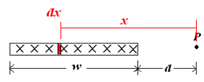
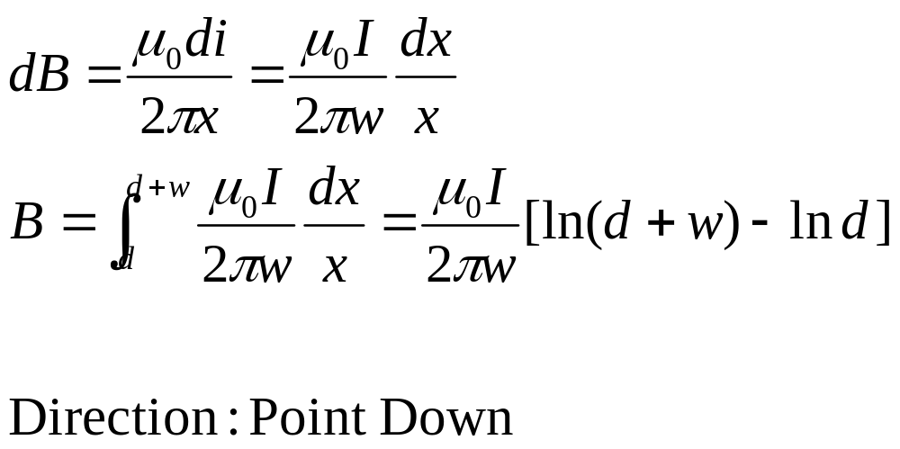
6. Figure 6 shows a cross section of a long, thin ribbon (薄带) of width w that is carrying a uniformly distributed total current I into the paper. Calculate the magnitude ______+4________and the direction ______+4______ of the magnetic field B at a point P in the plane of the ribbon at a distance d from its edge.

Slide 7
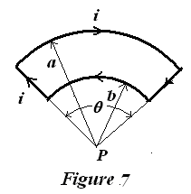
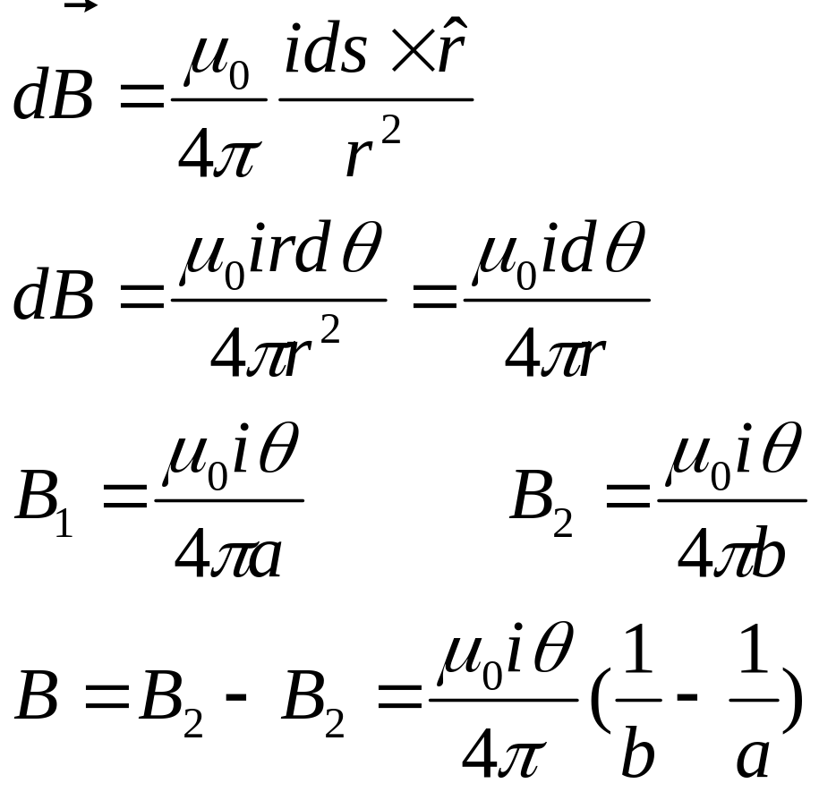
7. Consider the circuit of Fig. 7. The curved segments are arcs of circles of radii a and b. The straight segments are along the radii. The magnetic field B at P is +5 , assuming a current i in the circuit.

Slide 8
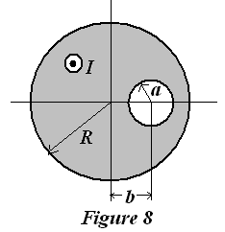
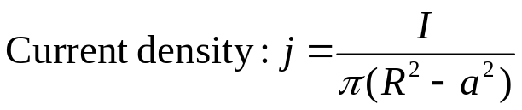
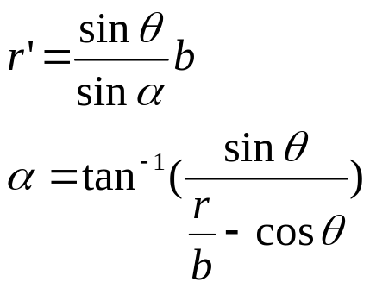
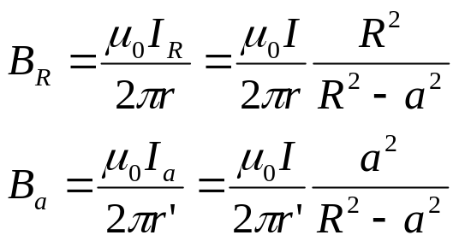
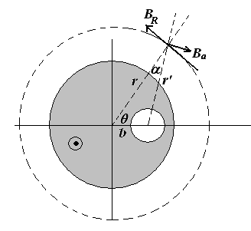
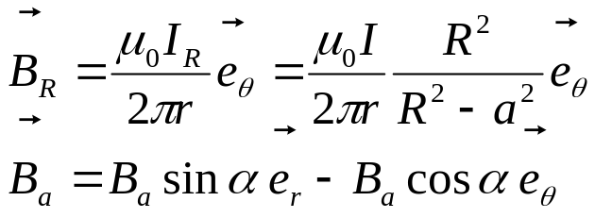
8. A very long, straight conductor with a circular cross section of radius R carries a current I. Inside the conductor is a cylindrical hole of radius a whose axis is parallel to the axis of the conductor but offset a distance b from the axis of the conductor. The current I is uniformly distributed across the cross section of the conductor and is directed out of the page. Find the magnetic field everywhere outside the conductor. +5 .

Slide 9
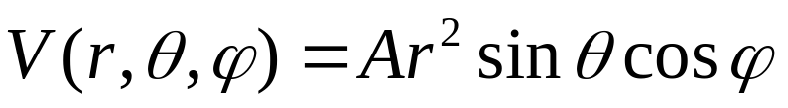
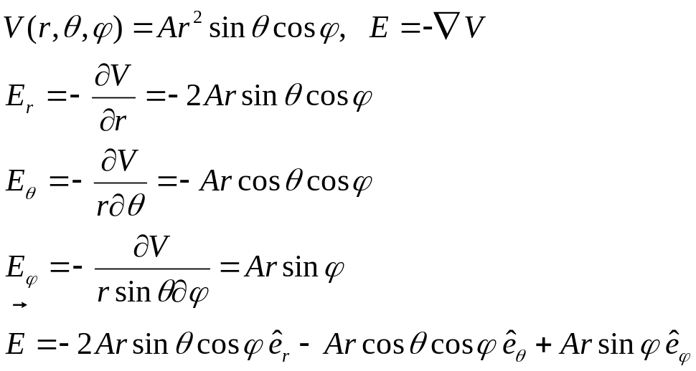
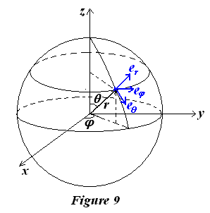
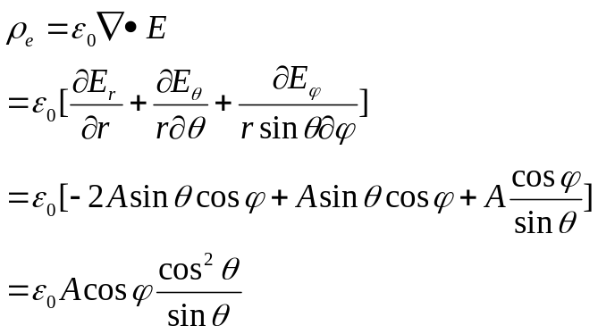
II. Problems (Present the necessary equations in solution) (50%)
(10%)In a spherical space, as shown in Fig.9, if we know the electrical potential distribution as
Please find the distributions of the electric field E(r,θ,ϕ), and volume charge density ρ_{e}(r,θ,ϕ).

Slide 10
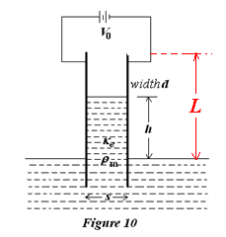
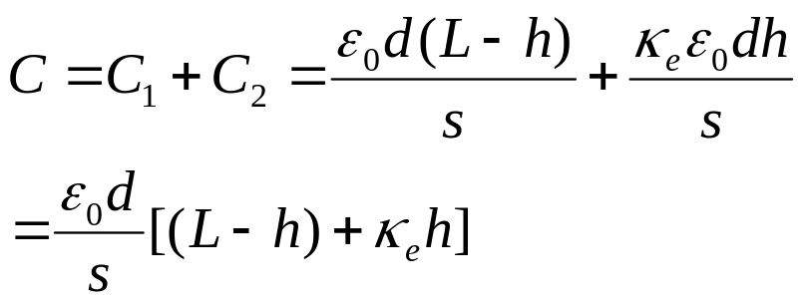
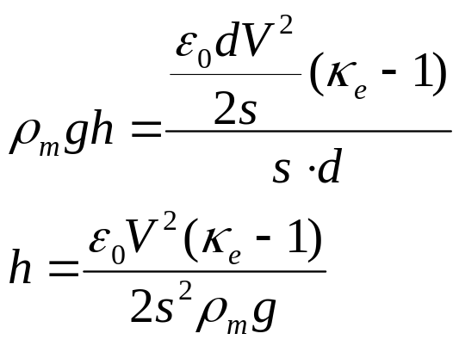
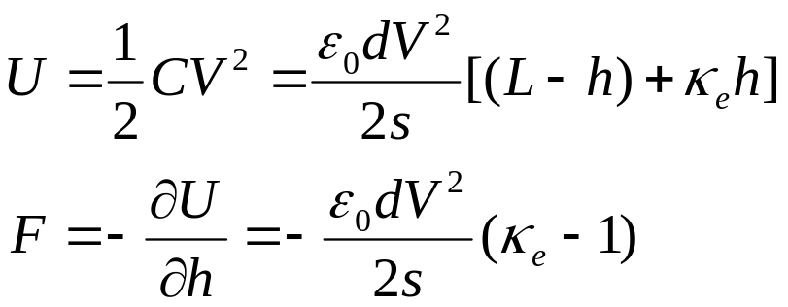
2. (13%) As shown in Fig. 10, a pair of parallel plate electrodes with a width d and a distance s apart at a voltage difference V₀ is dipped into a dielectric fluid with dielectric constant κ_{e}. The fluid has a mass density ρ_{m} and gravity acts downward. How high does the liquid rise between the plates?

Slide 11
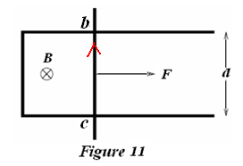
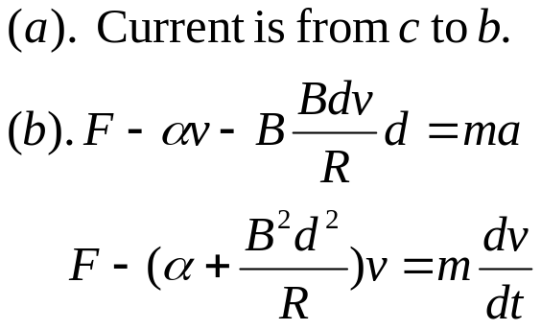
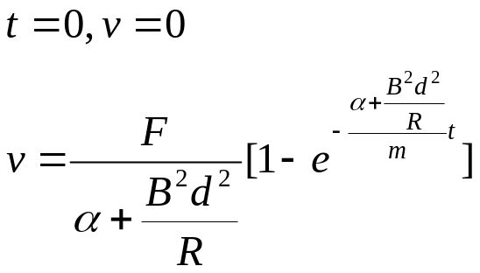
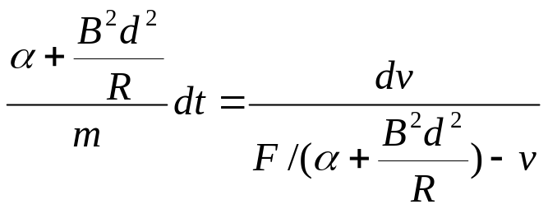
3. (12%) The two rails of a superconducting track are separated by a distance d. A conductor can slide along the track. The conductor, initially at rest, is pulled to the right by a constant force F. The friction between the conductor and the track is directly proportional to its velocity with a proportionality constant α. The portion of the conductor between the rails has a resistance of R. The entire setup is in a uniform magnetic field, B, as shown in Fig. 11. The field B points into the page.
(a). What is the direction of the induced current in the conductor?
(b). Determine the magnitude of the velocity of the conductor as a function of time.
(c). Determine the magnitude of the induced current as a function of time.
(d). Determine the terminal velocity of the conductor.

Slide 12
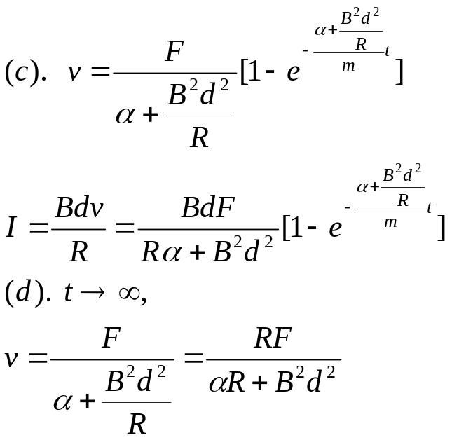
3. (12%) The two rails of a superconducting track are separated by a distance d. A conductor can slide along the track. The conductor, initially at rest, is pulled to the right by a constant force F. The friction between the conductor and the track is directly proportional to its velocity with a proportionality constant α. The portion of the conductor between the rails has a resistance of R. The entire setup is in a uniform magnetic field, B, as shown in Fig. 11. The field B points into the page.
(a). What is the direction of the induced current in the conductor?
(b). Determine the magnitude of the velocity of the conductor as a function of time.
(c). Determine the magnitude of the induced current as a function of time.
(d). Determine the terminal velocity of the conductor.

Slide 13
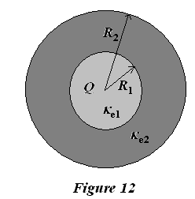
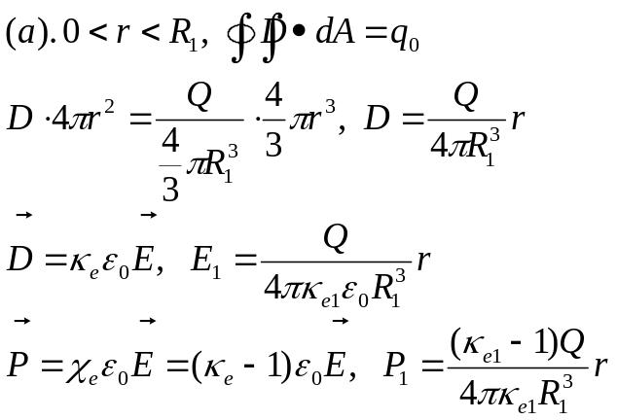
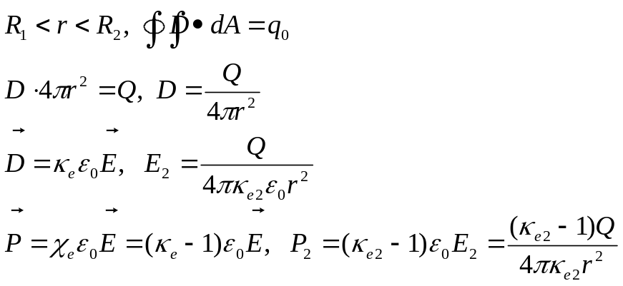
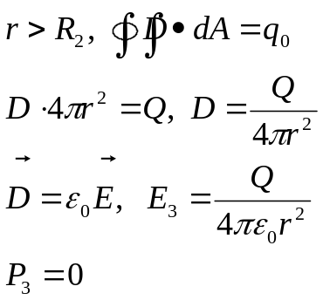
4. (15%) As shown in Fig. 12, a uniformly charged dielectric sphere with dielectric constant κ_{e1}, radius R₁ and Q, is placed in a dielectric sphere (电介质球) with a radius R₂ and dielectric constant κ_{e2}.
(a). Please calculate the electric field E, displacement vector D, and polarization vector P for the three regions: 0 < r < R₁, R₁ < r < R₂ and r > R₂;
(b). The surfaces induced charge density σ_{e} at both r = R₁ and r = R₂ surfaces.

Slide 14
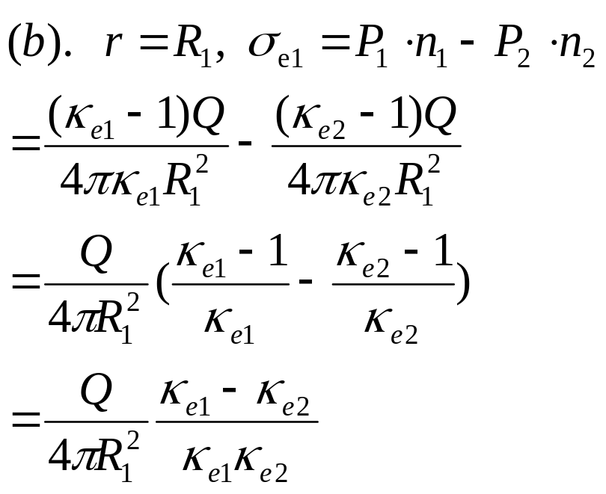
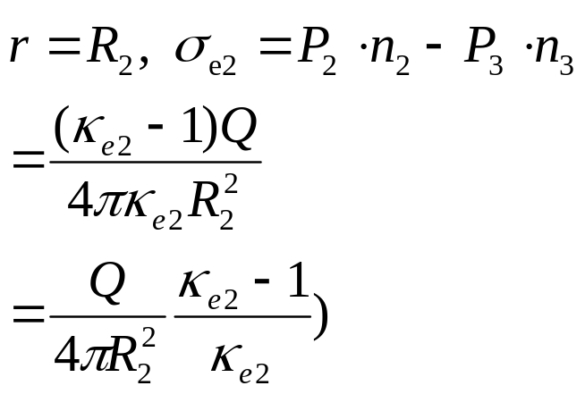
4. (15%) As shown in Fig. 12, a uniformly charged dielectric sphere with dielectric constant κ_{e1}, radius R₁ and Q, is placed in a dielectric sphere (电介质球) with a radius R₂ and dielectric constant κ_{e2}.
(a). Please calculate the electric field E, displacement vector D, and polarization vector P for the three regions: 0 < r < R₁, R₁ < r < R₂ and r > R₂;
(b). The surfaces induced charge density σ_{e} at both r = R₁ and r = R₂ surfaces.

