Slide 1
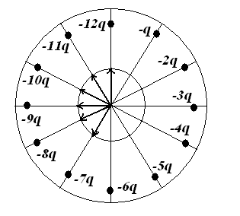
2016年期中考试卷答案
I. Fill in the space underlined (40% in total)
1. A clock face (钟面) has negative charges –q, -2q, -3q,…..-12q fixed at the positions of the corresponding numerals. The clock hands do not perturb the field. At what time does the hour hand point in the same direction as the electric field at the center of the dial? ___9:30____.
.

Slide 2
2. A spherical drop of water carrying a charge of 32.0 pC has a potential of 512 V at its surface. Set V = 0 at infinity. (a). What is the radius of the drop? _______________________. (b). If two such drops of the same charge and radius combine to form a single spherical drop, what is the potential at the surface of the new drop? _______________________.

Slide 3
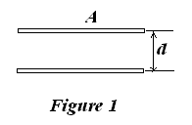
3. As shown in Fig. 1, a parallel-plate capacitor has plates of area A and separation d and is charged to a potential difference ∆V. The charging battery is then disconnected and the plates are pulled apart until their separation is 2d. The work required to separate the plates is ____

Slide 4
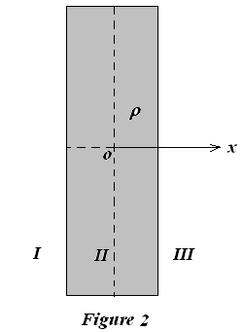
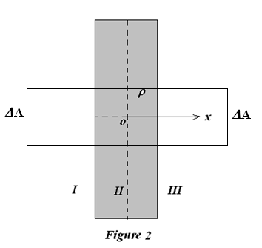
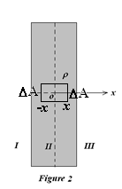
4. As shown in Fig. 2, a plane slab of thickness d has a uniform volume charge density ρ. Find the magnitude of the electric field in region I _________, II________, and III__________, in terms of x, the distance measured from the median plane of the slab.

Slide 5
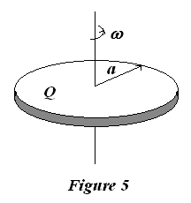
5. There is a thin disk of radius a, with total charge Q uniformly distributed on its surface, rotating at a constant angular speed ω, as shown in Fig. 5. What is the magnetic dipole moment (磁偶极矩)?

Slide 6
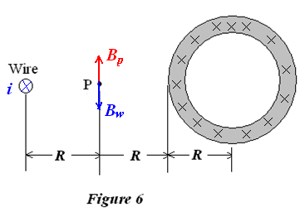
6. A long, circular pipe, with an outside radius of R, carries a (uniformly distributed) current of i₀ (into the paper as shown in Fig. 6). A wire runs parallel to the pipe at a distance 3R from the center to center. What are the magnitude _________________ and direction ________________ of the current in the wire that would cause the resultant magnetic field at the point P to have the same magnitude, but the opposite direction.

Slide 7
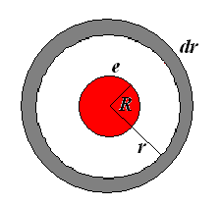
7. Assume that the electron is not a point but a sphere of radius R over whose surface the electron charges is uniformly distributed. The energy associated with the external electric field in vacuum of the electron is .

Slide 8
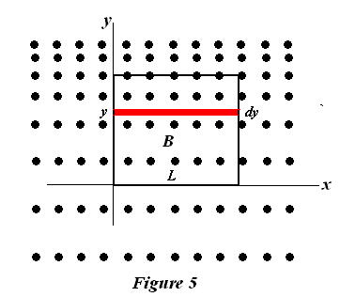
8. As shown in Fig. 5, there is a square with side length 2.0 cm. A magnetic field points out of the page, its magnitude is changing with time by B = (4 T/m⋅s²)t²y. The emf (电动势) around the square at t =2.5s is , and its direction is .
Direction: Clockwise

Slide 9
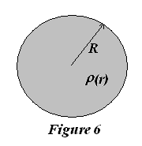
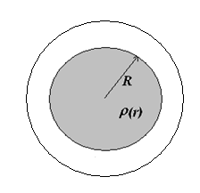
II. Problems (Present the necessary equations in solution) (50%)
1. (15%) As shown in Fig. 6, a (non-conducting) solid sphere of radius R carries a charge density ρ(r) = k r² (where k is a constant). Find the electric field at a distance r such that:
(a) r ≥ R,
(b) 0 ≤ r ≤ R;
(c) Calculate the electric potential for all r. Let V = 0 at r = ∞.
(d) Find the work required to assemble this charge distribution.

Slide 10
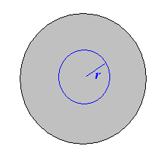

Slide 13
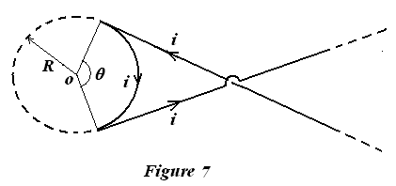
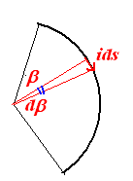
2. (10%) A wire carrying current i has the configuration shown in Fig. 7. Two semi-infinite straight sections, each tangent to the same circle, are connected by a circular arc, of angle θ , along the circumference of the circle, with all sections lying in the same plane. What must θ be in order to for B to be zero at the center of the circle?

Slide 14
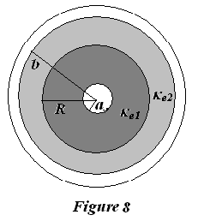
3. (15%) As shown in Fig. 8, a long cylindrical capacitor (圆柱形电容器), with radius a and b, length L, is filled by two kind dielectrics, whose dielectric constants are κ_{e1}, κ_{e2}, respectively, and are separated at a radius of R. If the inner conductor (with the radius of a) is charged with a line charge density λ, please
(a). Calculate the electric field E, displacement vector D, and polarization vector
P for both a < r <R and R < r< b regions.
(b). The surface induced charge density σ_{e}’ at r = a, r = R and r = b surfaces.
(c). The capacitance (电容) for this cylindrical capacitor.

Slide 17
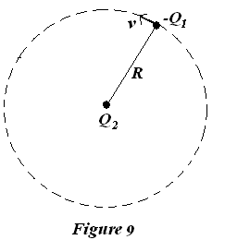
4. (20%) As shown in Fig. 9, a point charge –Q₁ of mass m travels in a circular orbit of radius R about a charge of opposite sign Q₂.
(a). What is the equilibrium angular speed (平衡角速度) of the charge -Q₁?
(b). This problem describes Bohr's one electron model of the atom if the charge
-Q₁ is that of an electron and Q₂ = Ze is the nuclear charge, where Z is the
number of protons. According to the postulates of quantum mechanics the
angular momentum (角动量) L of the electron must be quantized,
L= mvR = nh/2π n = 1, 2, 3 …
Where h = 6.63×10⁻ ³⁴J⋅s is Planck's constant. What are the allowed values of R?
(c). For the hydrogen atom (Z = 1) what is the radius of the smallest allowed
orbit and what is the electron's orbital velocity?

