Slide 1
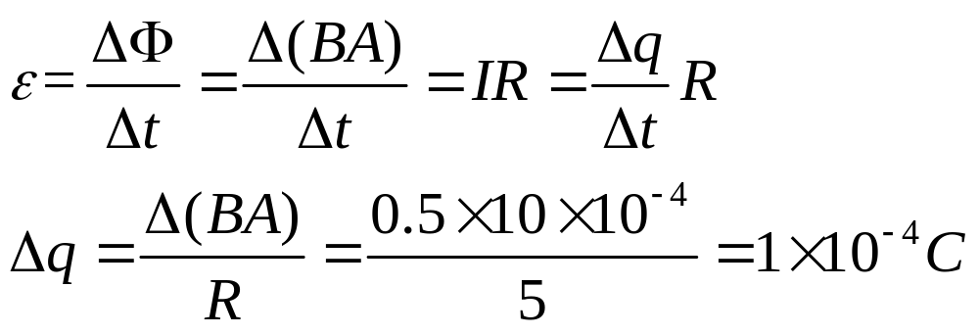
浙江大学20 17 –20 18学年 秋冬 学期
《 普通物理II 》课程期中考试试卷
I. Fill in the space underlined (40% in total)
1. A wire loop that encloses an area of 10 cm² has a resistance of 5 Ω. The loop is placed in a magnetic field of 0.5 T with its plane perpendicular to the field. The loop is suddenly removed from the field. How much charge flows past a given point in the wire? _________________

Slide 2
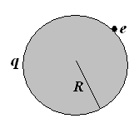
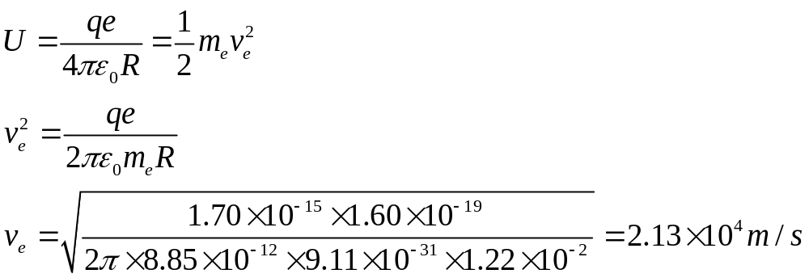
  2. The escape speed (逃逸速度) for an electron from the surface of a uniformly charged sphere of radius 1.22 cm and total charge 1.70×10⁻¹⁵ C is of . Neglect gravitational forces.

Slide 3
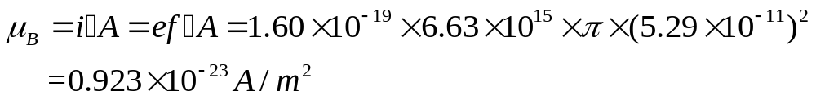
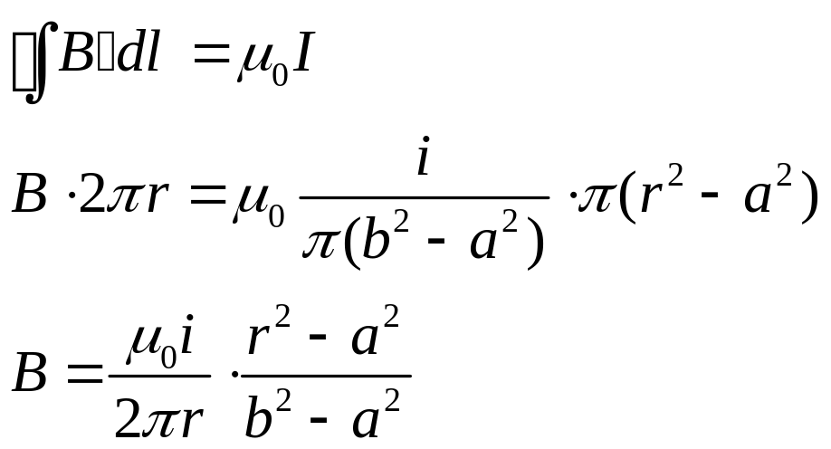
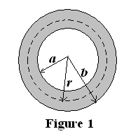
  3. In the Bohr model of the hydrogen atom, the electron circulates around the nucleus in a circular path of radius 5.29×10⁻¹¹ m at a frequency f of 6.60×10¹⁵ Hz. What value of the equivalent magnetic dipole moment (等效磁偶极矩) is .
As shown in Fig. 1, a hollow, cylindrical conductor of radii a and b, carries a uniformly distributed current i. The magnetic induction strength B(r) for the range a < r < b is given by: .

Slide 4
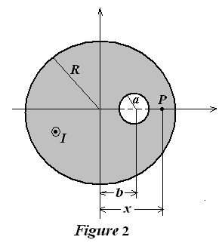
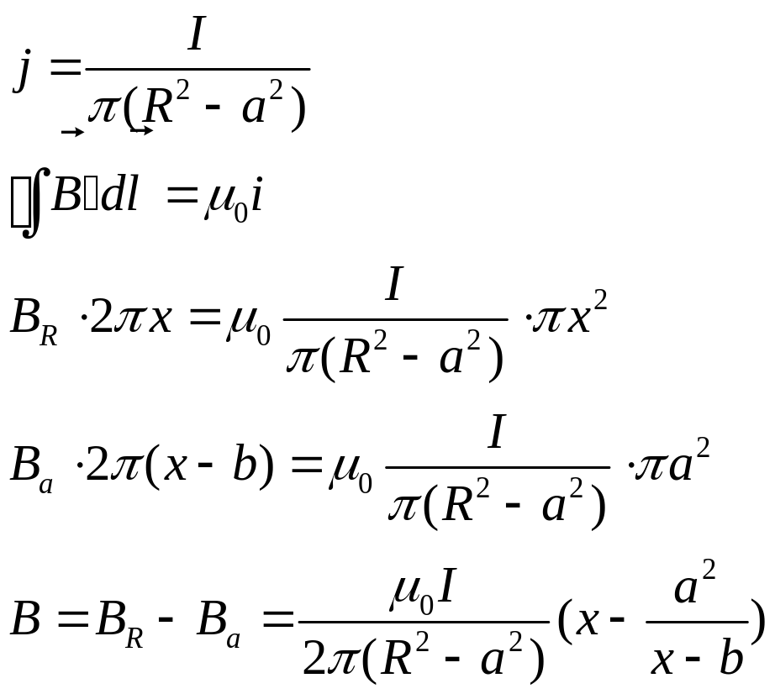
5. As shown in Fig. 2, a long, straight conductor with a circular cross section of radius R carries a current I. There is a cylindrical hole inside the conductor, whose radius is of a, and whose axis is parallel to the axis of the conductor but offset a distance b from the axis of the conductor. The current I is uniformly distributed across the cross section of the conductor and is directed out of the page. The magnetic field at P point (R>x>a+b) at the x axis is .

Slide 5
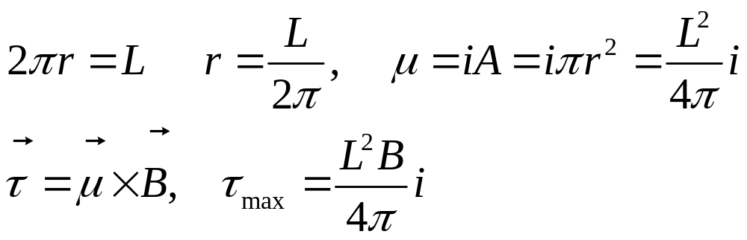
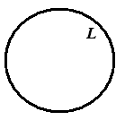
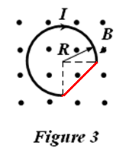
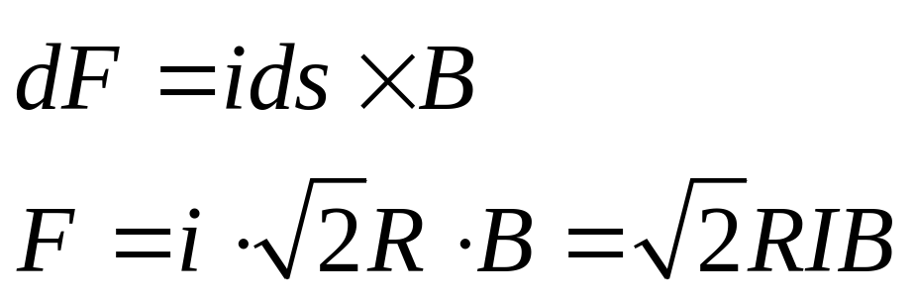
  6. A length L of wire carries a current i. If the wire is formed into a circular coil with one turn (一匝) only, the maximum torque (力矩) in a given magnetic field B has a magnitude .
7. As shown in Fig. 3, a wire with a 3/4 circle is placed in a uniform magnetic field B which points out of the plane of the figure. If the wire carries a current I, the magnetic force acted on it is ______.

Slide 6
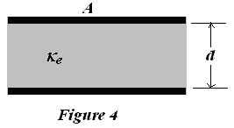
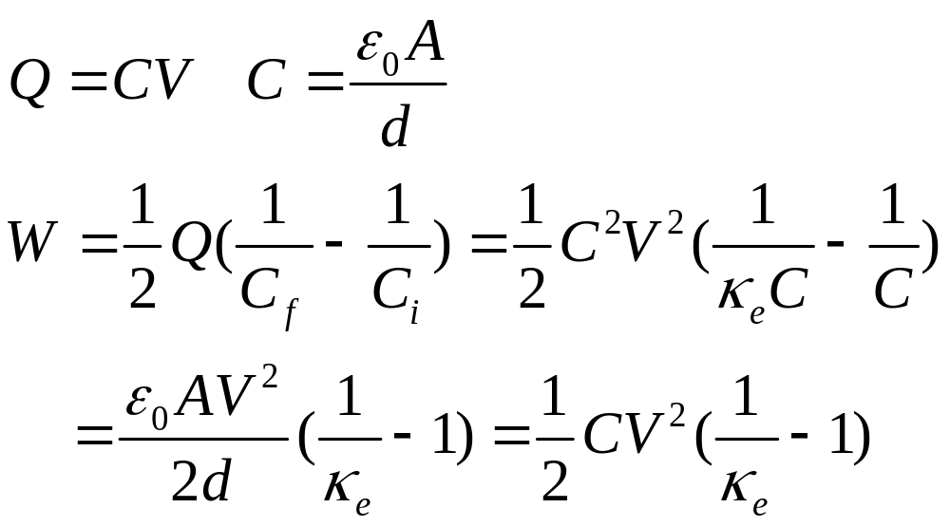
8. As shown in Fig. 4, a parallel plate capacitor with capacitance C is charged to a potential difference V and is then disconnected from the charging source. The capacitor has an area A and a plate separation d. Assume that a glass plate of the same area A completely fills the space between the plates, and which has a dielectric constant κ_{e}. How much work is required to pull the glass plate out of the capacitor? ______. Neglect fringe effects at the edges of the plates.

Slide 7
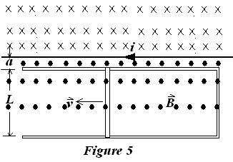
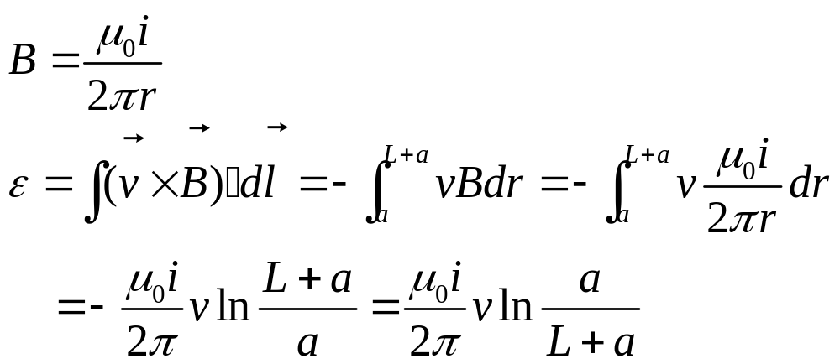
9. Figure 5 shows a rod of length L caused to move at constant speed v along horizontal conducting rails. In this case the magnetic field in which the rod moves is not uniform but is provided by a current i in a long, parallel wire. Assume the v=4.86 m/s, a =10.2 mm, L=9.83 cm, and i =110 A. The emf induced in the rod is of .

Slide 8
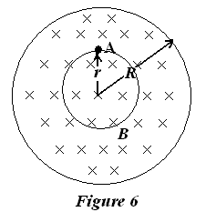
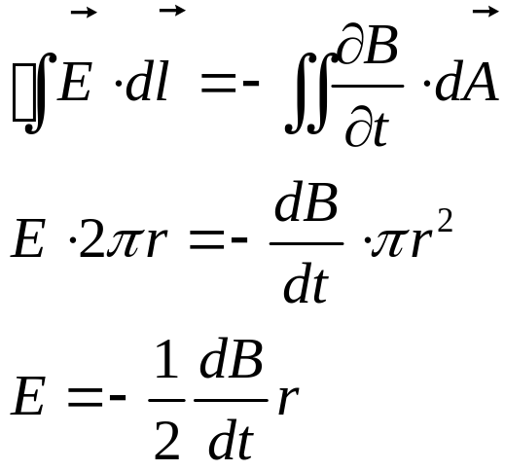
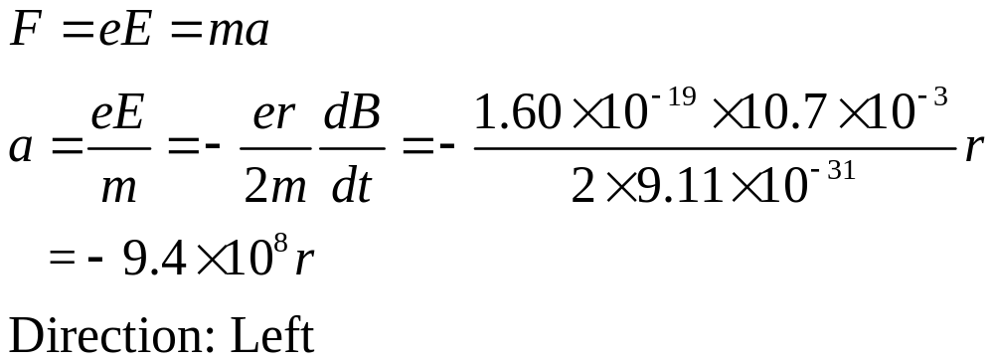
10. Figure 6 shows a uniform magnetic field B confined to a cylindrical volume of radius R. B is decreasing in magnitude at a constant rate of 10.7 mT/s. What is the instantaneous acceleration (direction and magnitude) experienced by an electron placed at A point? .

Slide 9
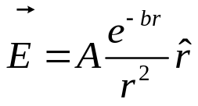
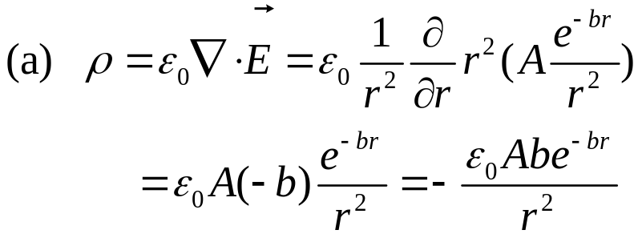
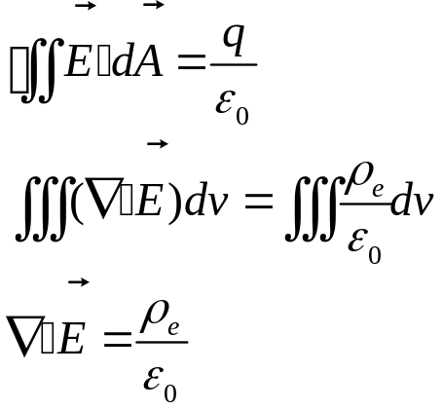
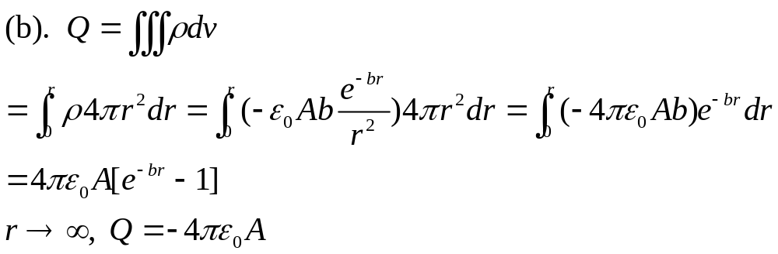
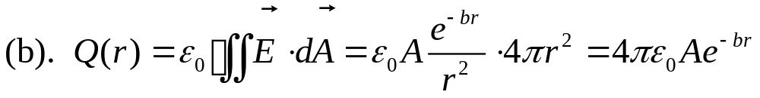
II. Problems (present the necessary equations in solution) (60%)
(13%) A static charge distribution produces a spherically radial electric field: , where A and b > 0 are the constants.
(a). What is the charge density ρ(r)?
(b). What is the total charge Q?
Solution:
It is not the total charge.

Slide 10
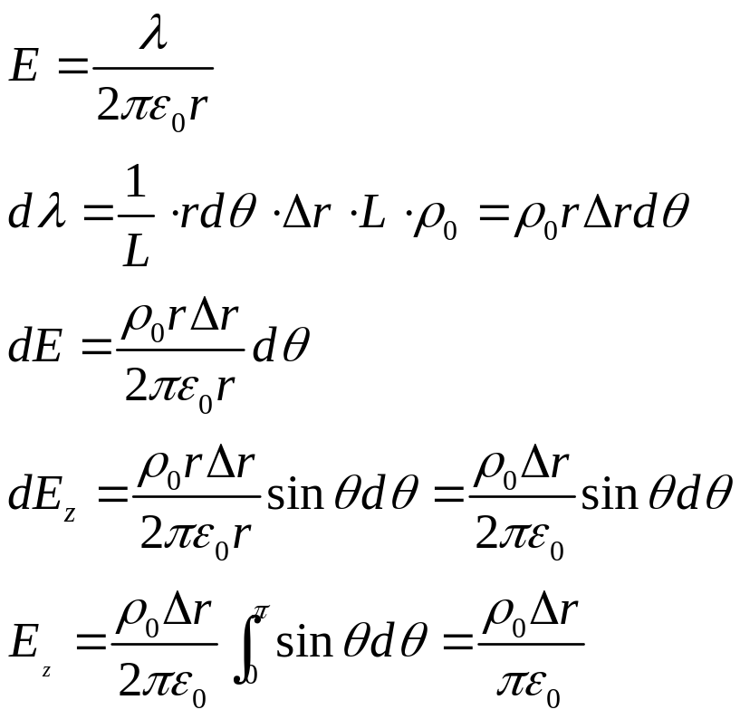
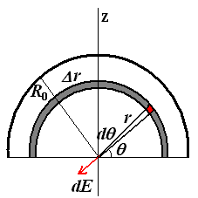
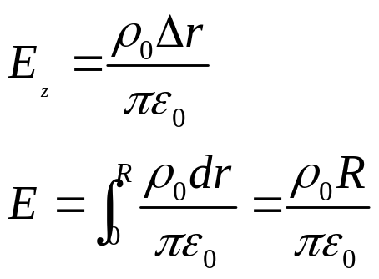
2. (12%) As shown in Fig.7, an infinitely long semi-cylinder (半圆柱形) insulator of radius R₀ carries a uniform volume charge distribution ρ_{o}. Please calculate the electric field along the axis of the cylinder.
Solution:

Slide 11
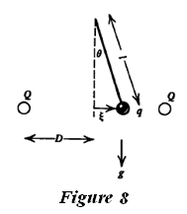
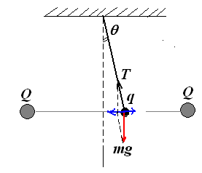
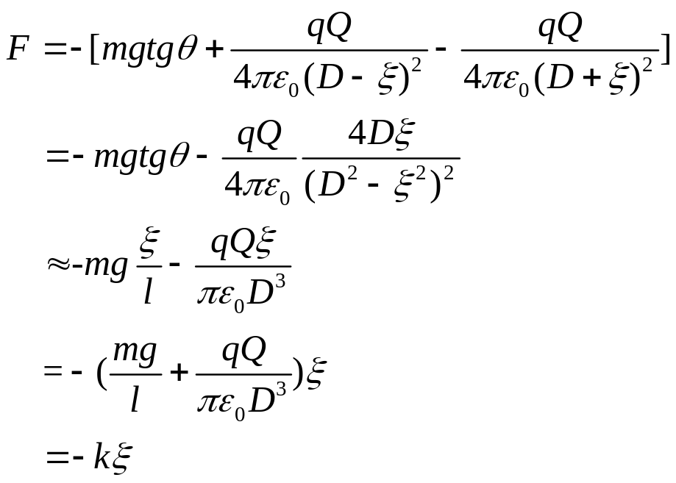
3. (15%) As shown in Fig.8, a pendulum with a weightless string of length l has on its end a small sphere with charge q and mass m. A distance D away on either side of the pendulum mass are two fixed spheres each carrying a charge Q. The three spheres are of sufficiently small size that they can be considered as point charges and masses.
(a). Assuming the pendulum displacement ξ to be small (ξ<< D), and at t = 0 the pendulum is released from rest with ξ = ξ_{o}. What is the subsequent pendulum motion? Please write out the ξ(t) function.
(b). For what values of qQ is the motion unbounded with time?
Solution:

Slide 12
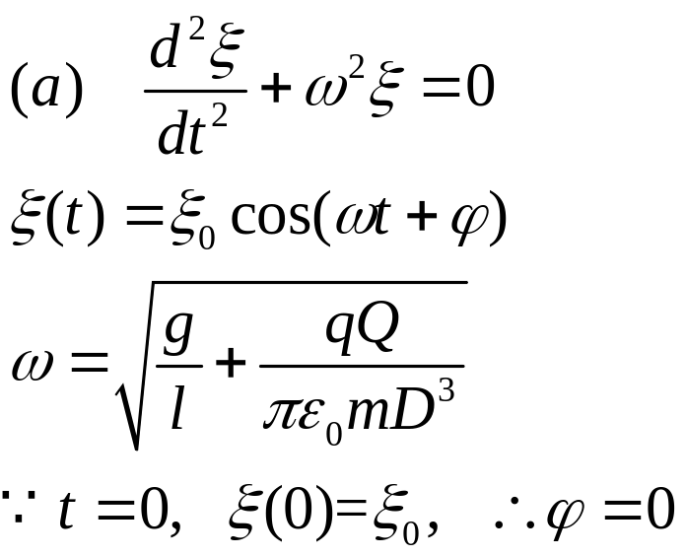
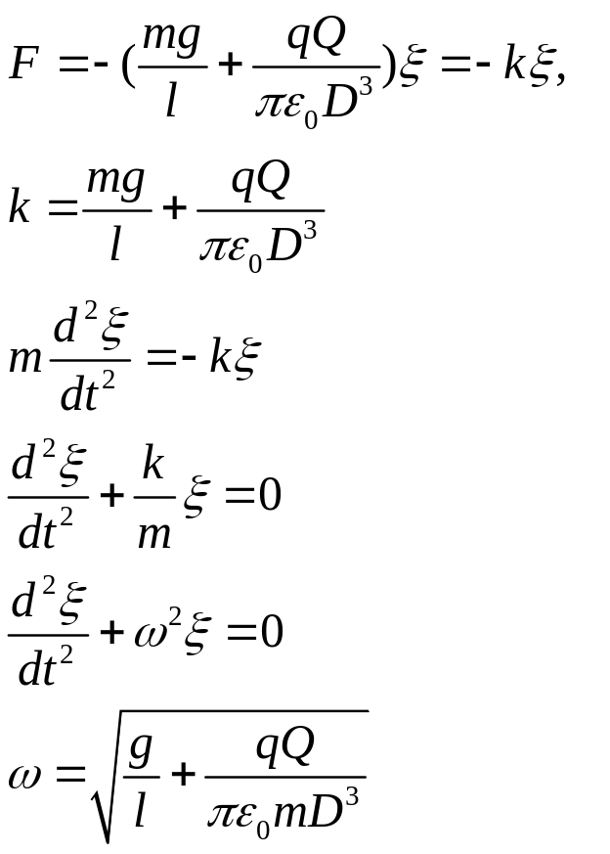
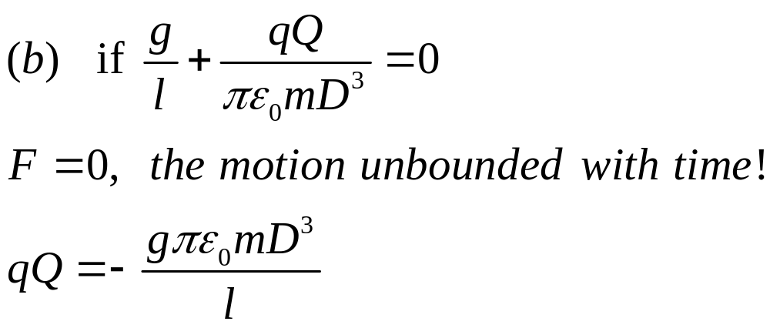
Simple harmonic vibration!
简谐振动！

Slide 13

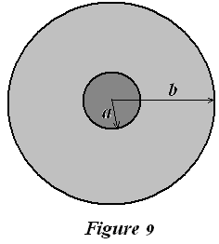
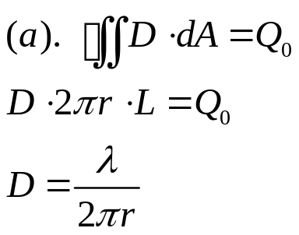
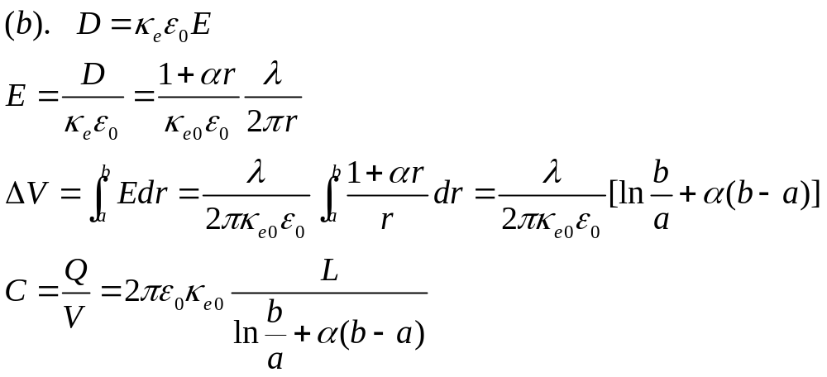
4. (20%) Figure 9 shows a cross section of a cylinder capacitor (圆柱形电容器) , in which the inner conductor radius is of a, and the outer conductor is a hollow cylinder shell with radius of b. The space between them is filled by the non-uniform dielectrics (非均匀电介质) with a dielectric constant (介电常数) , where κ_{e0} and α are the constants, r is the distance for the points
inside dielectrics from the axis. Please calculate:
(a) The electric displacement vector for the region of a < r < b as the inner conductor is charged with a line density of λ.
(b) The capacitance (电容) for this system C.
(c) The volume density of the polarization charge, ρ_{e}’(r), in the region of a<r<b.
(d). The surface density of the polarization charge σ_{e}(a) and σ_{e}(b), at the r = a and r = b surfaces, respectively.

Slide 14
