Slide 1
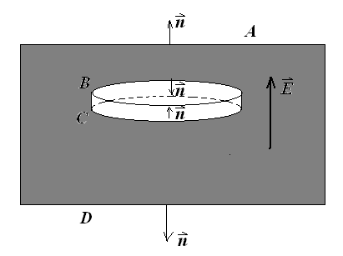
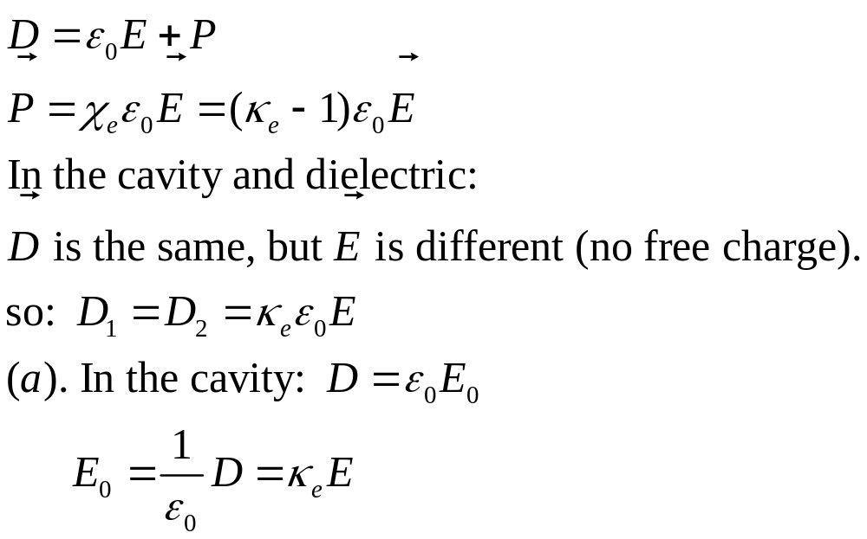
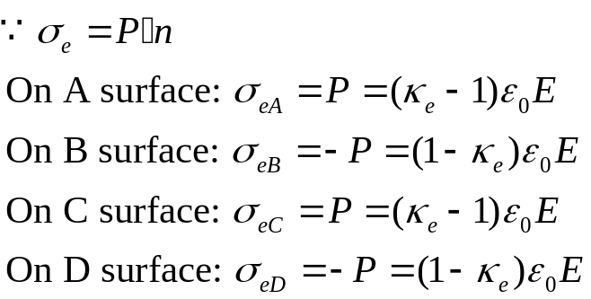
1. A cylindrical cavity of diameter d and height h (d >>h) is cut in a homogeneous, isotropic dielectric with a dielectric constant κ_{e} . An electric field E is in the dielectric oriented perpendicular to circular faces of the cavity as shown in Figure. Find the electric field within the cavity, and the induced charge surface density on the A, B, C and D surfaces.

Slide 2
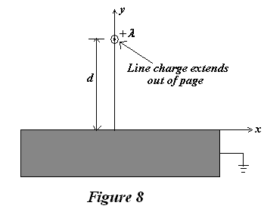
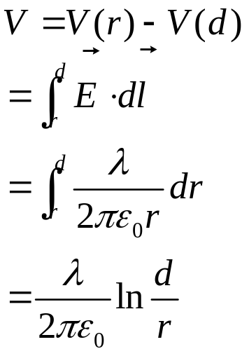
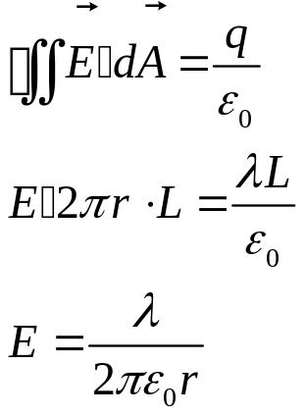
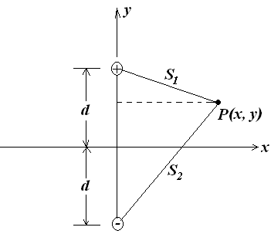
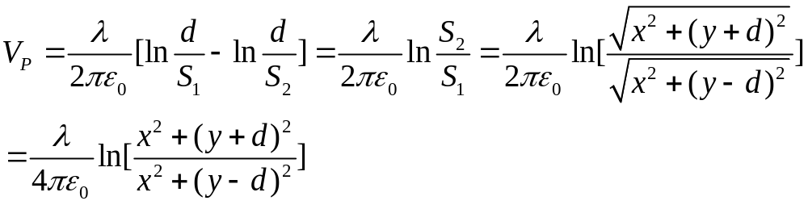
2. An infinite, grounded, conducting plane is in the xz-plane. A line of charge, with linear charge density λ runs parallel to the z-axis, a distance d above the conducting plane, as shown in Fig. Assume the whole region exclusive of the conductors is a vacuum.
(a) Calculate the electric potential V(x,y,z =0) for y>0.
Solution:

Slide 3
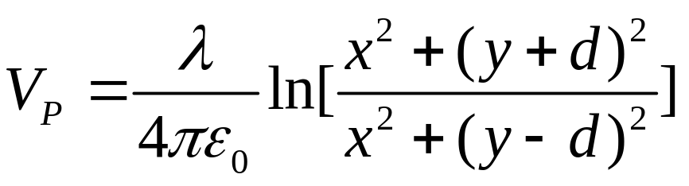
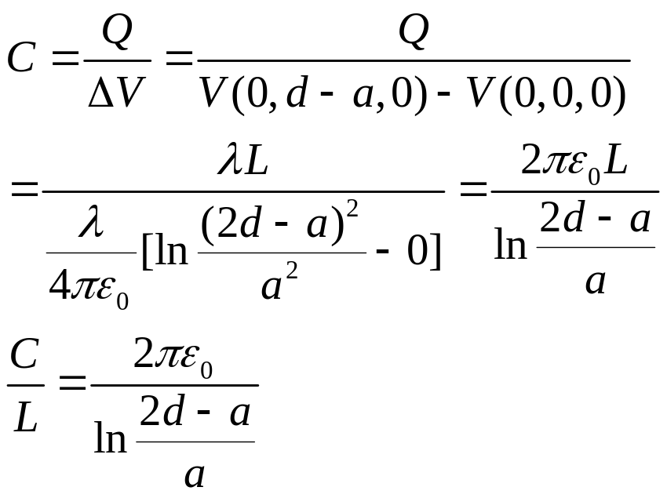
(b) Calculate the capacitance per unit length of a thin wire of radius a, placed a distance d above a ground plane. Assume that the wire radius is much smaller than d (i.e. a<< d ) so that the solution of part (a) is approximately correct in the region exclusive of the conductors.
Solution:

Slide 4
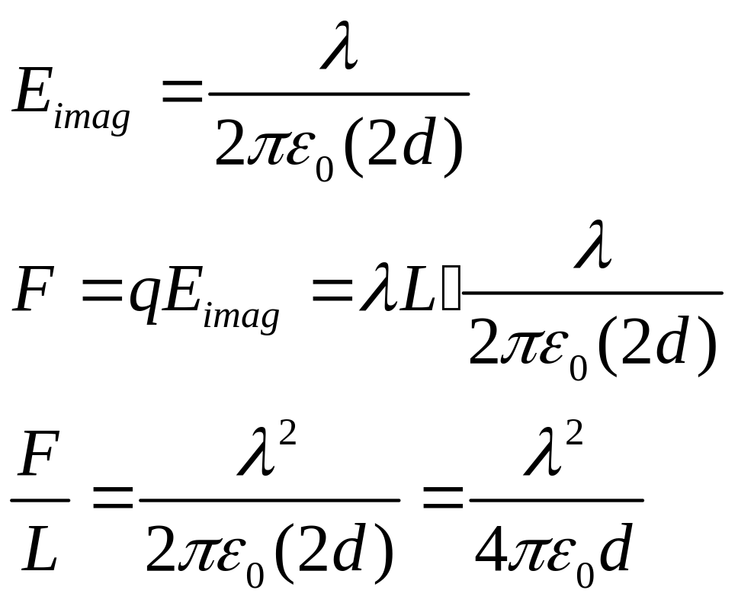
(c) Find the force per unit length on the wire (including its direction).

Slide 5
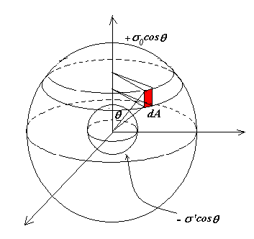
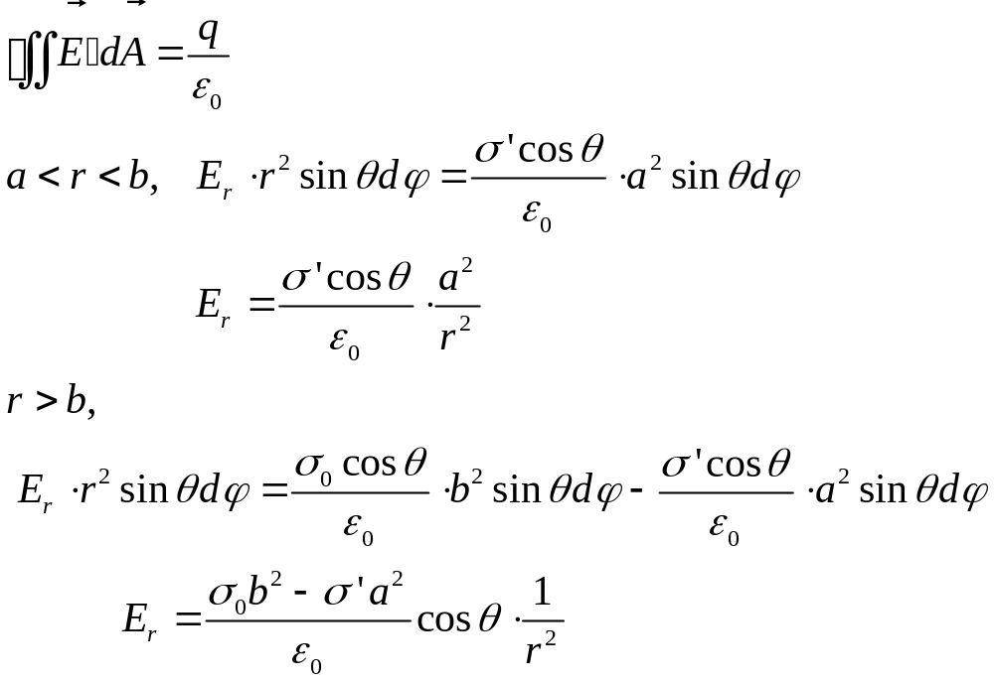
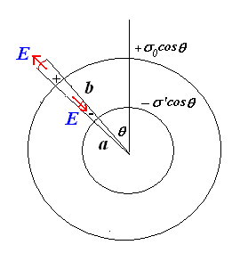
3. A grounded conducting sphere of radius a is inside a sphere of radius b. The region between radius a and radius b is vacuum. The outer sphere is non-conducting, and carries a surface charge density σ₀cosθ. Find the electric potential V in the both regions: a < r < b and r>b.
Solution: assume -σ’cosθ on the inside surface

Slide 6
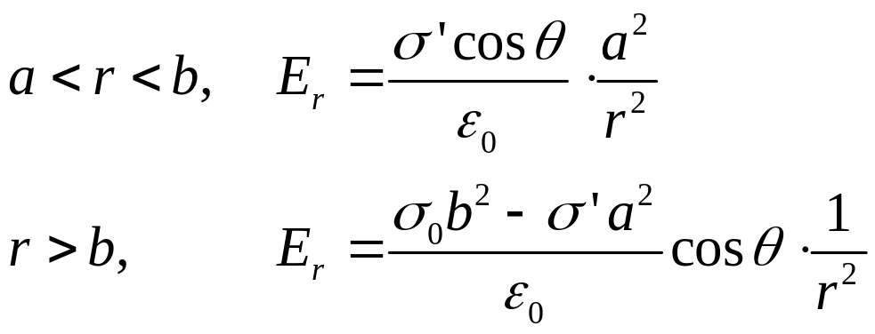
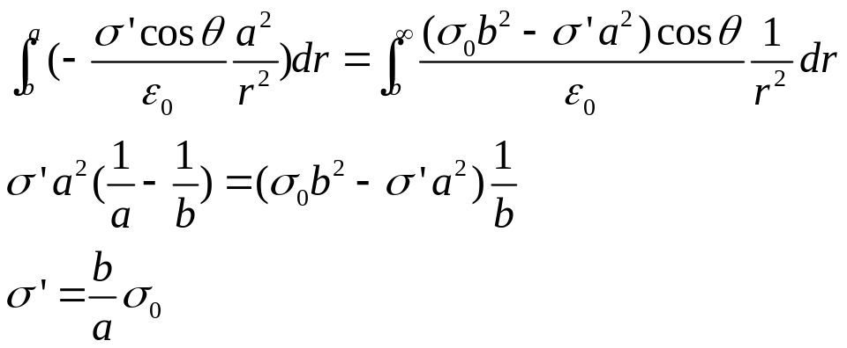
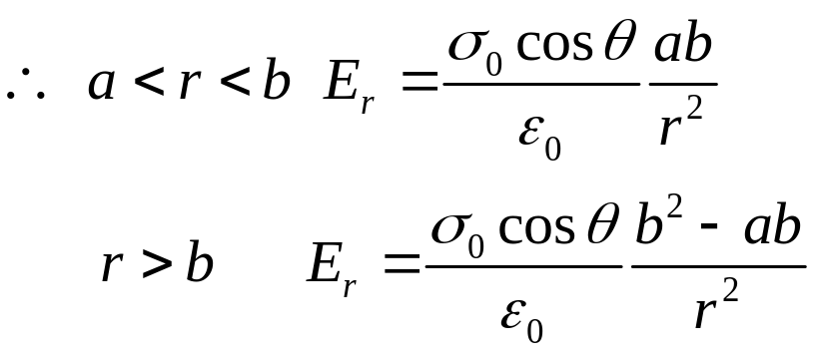
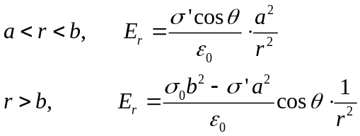
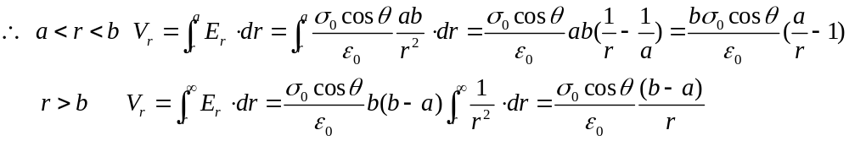

Slide 7
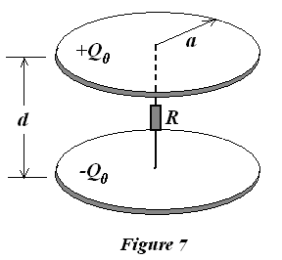
4. As shown in Fig. 7, a parallel-plate capacitor has circular disk
electrodes of radius a that are separated by a distance d (d<<a).
A resistor of resistance R connects the plates along their common
axis. At t = 0, the capacitor is suddenly given charge Q₀. Neglect
all edge effects.
(a) What is the capacitance of the capacitor?
(b) Obtain the time-dependent charge on the capacitor plates.
(c) Find the electric field between the plates.
(d) Obtain the magnetic field between the plates as a function of
position and time.
(e) Derive an expression for the Poynting vector as a function of
position between the plates.

Slide 8
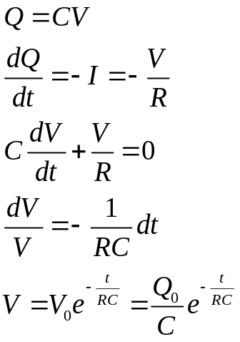
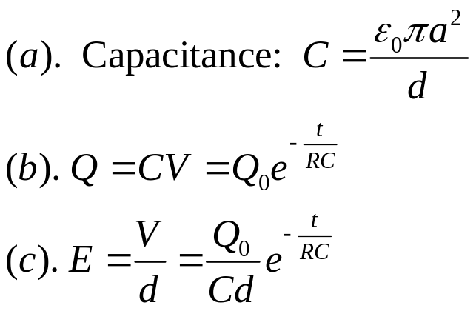
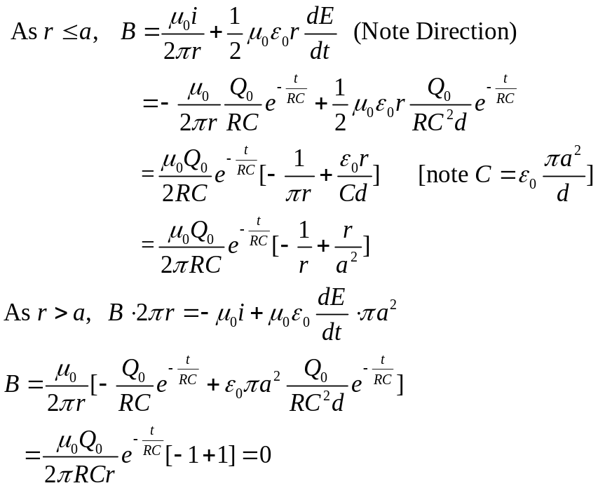
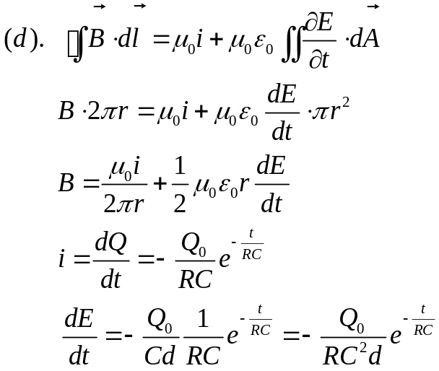
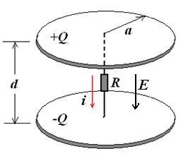
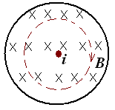
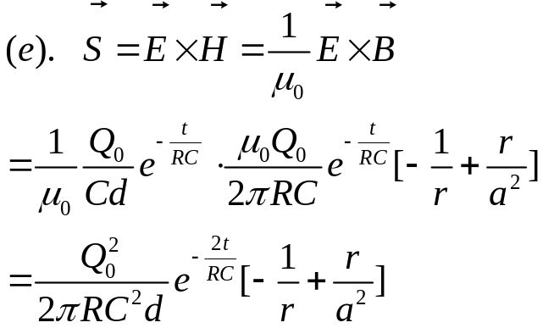
solution

Slide 9
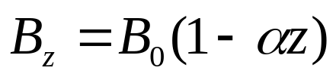
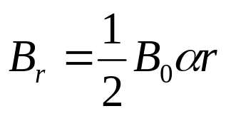
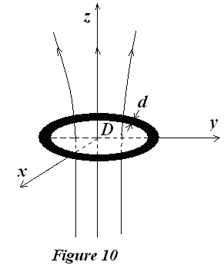
(b). If the conducting circular loop is changed by a superconducting loop with a self-inductance (自感系数) L, what kind motion this superconducting loop will be? Find the maximum current in the superconducting loop.
5. As shown in Fig. 10, there is a non-uniform magnetic field with cylindrical symmetry , its component along z axis,
its radial component
(a). A conducting circular loop made of wire diameter d, resistivity ρ, and a mass density ρ_{m} is falling from the origin point (z=0). At beginning (t=0), there is no current in circular. The loop of diameter D is always parallel to the x-y plane. Disregarding air resistance, find the terminal velocity of loop.

Slide 10
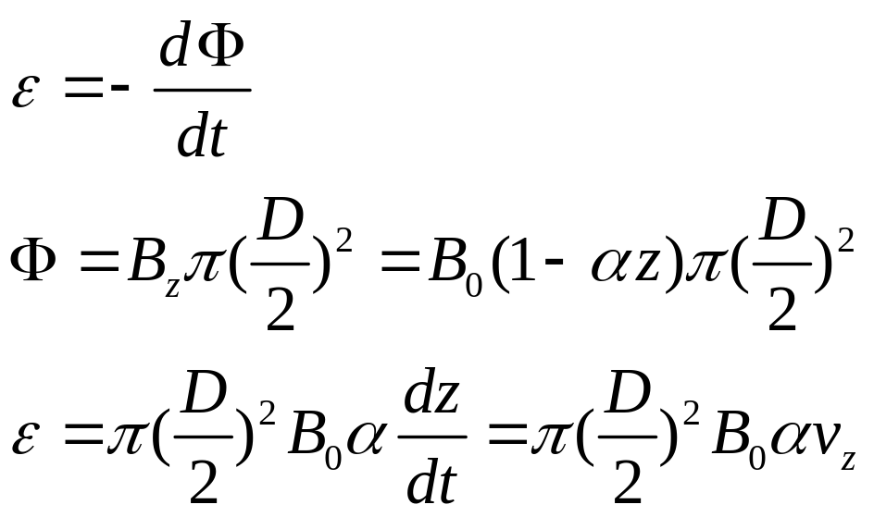
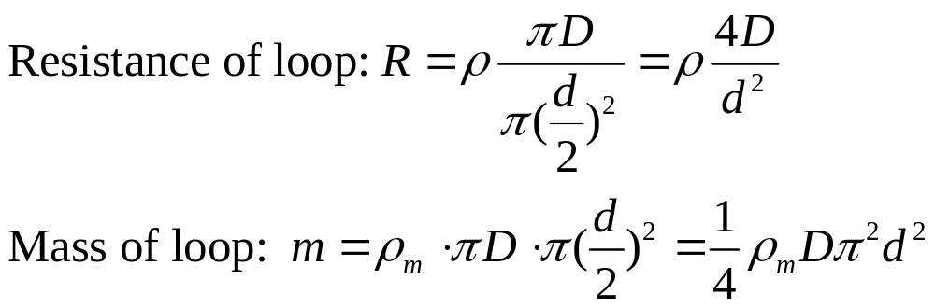
(a). A conducting circular loop made of wire diameter d, resistivity ρ, and a mass density ρ_{m} is falling from the origin point (z=0). At beginning (t=0), there is no current in circular. The loop of diameter D is always parallel to the x-y plane. Disregarding air resistance, find the terminal velocity of loop.
  Solution:

Slide 11
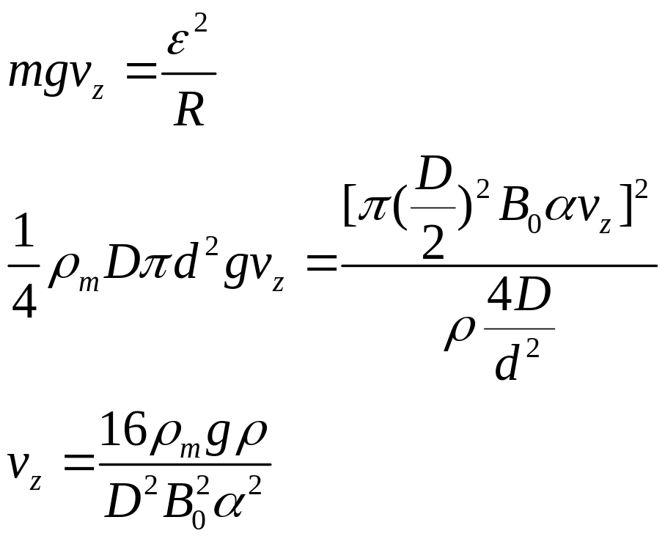
Solution (1)
重力提供的功率=焦耳损耗

Slide 12
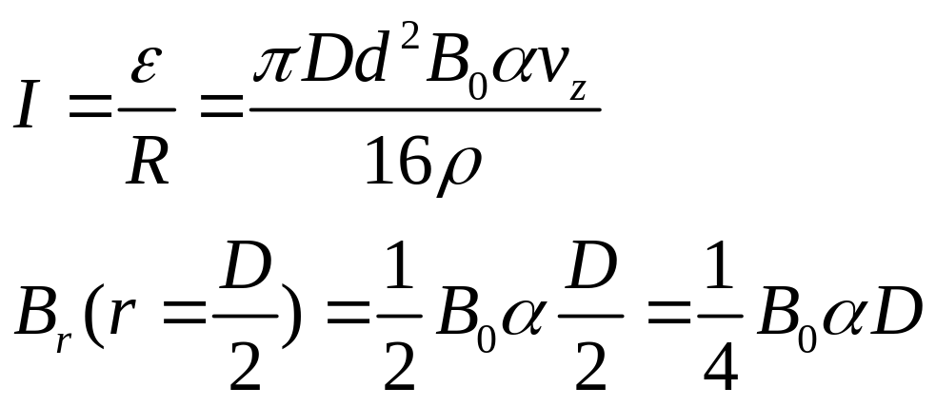
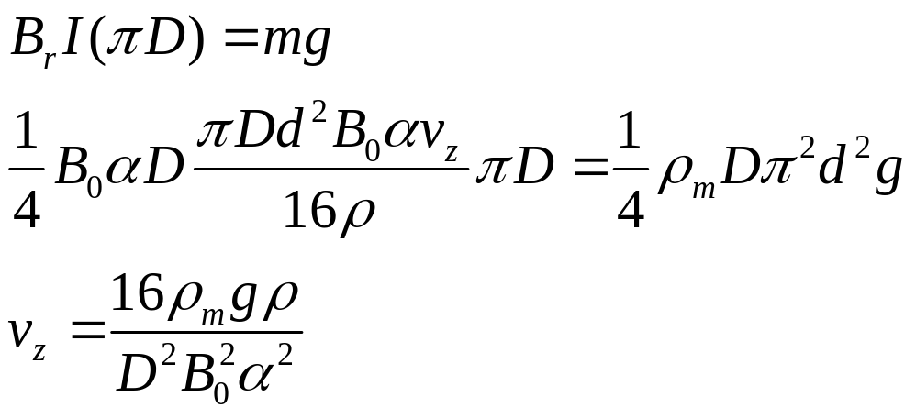
Solution (2)

Slide 13
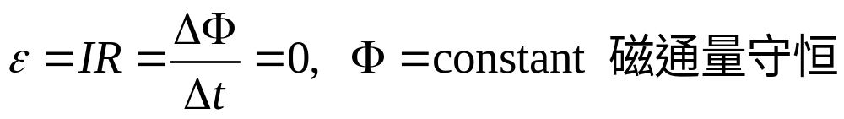
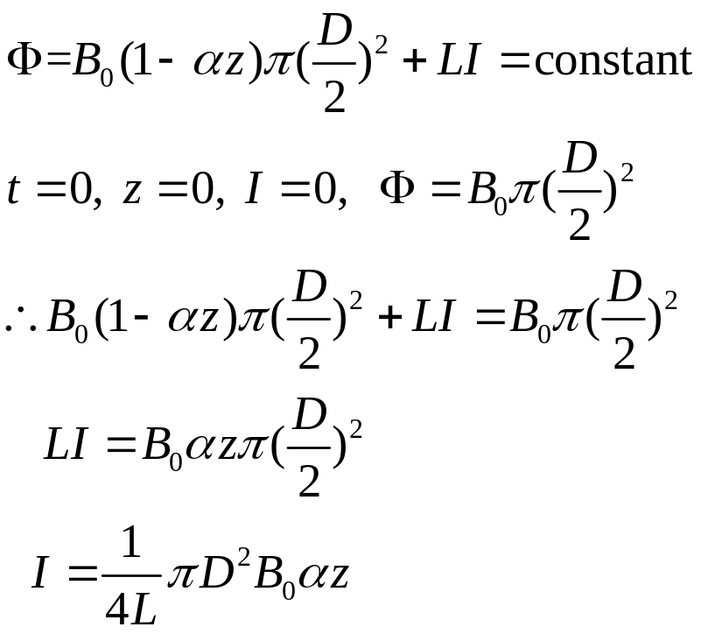
(b) If the conducting circular loop is changed by a superconducting loop with a self-inductance (自感系数) L, what kind motion this superconducting loop will be? Find the maximum current in the superconducting loop.
Superconducting loop: R=0

Slide 14
