Slide 1
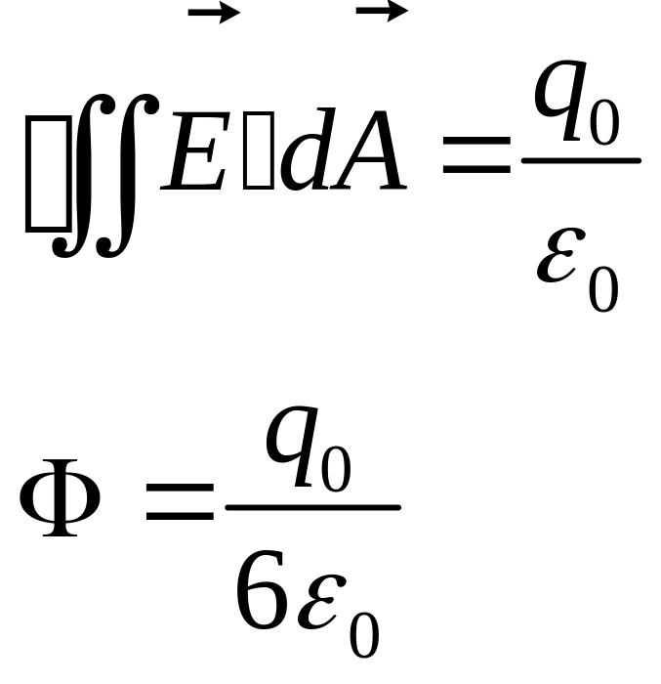
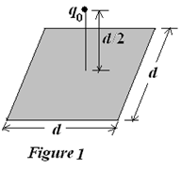
I. Fill in the space underlined (40%)
1. (4%)As shown in Figure 1, a point charge +q₀ is a distance d/2 from a square surface of side d and is just above the center of the square. The electric flux through the square is of _______.

Slide 2
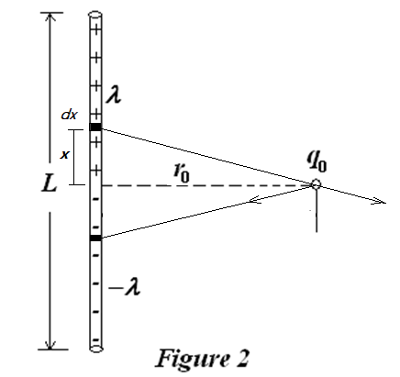
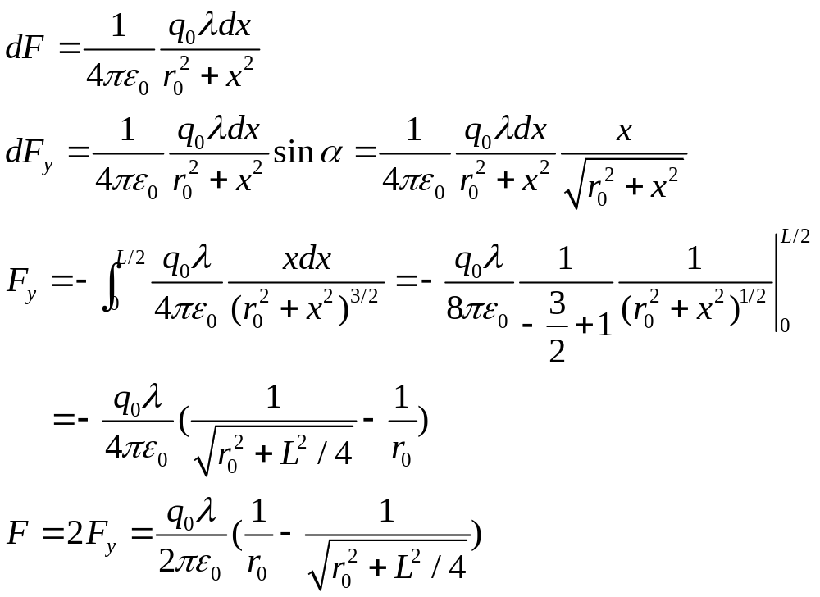
  2. (5%) As shown in Figure 2, the rod has a uniform positive charge density λ on the top half of the rod and a uniform charge density -λ on the bottom half of the rod. The net force on the point charge q₀ is ______________.

Slide 3
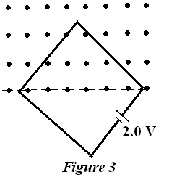
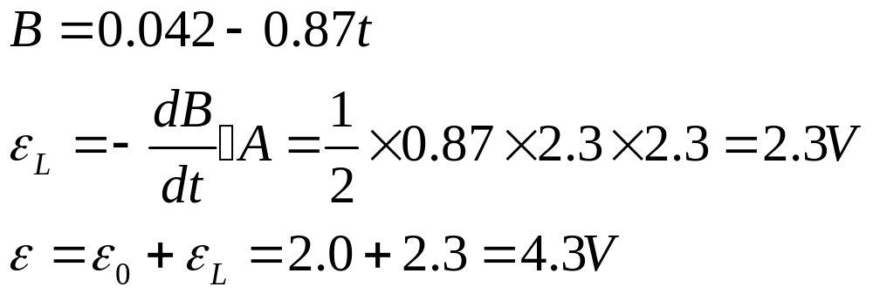
  3. (5%) A square wire loop with 2.3m sides is perpendicular to a uniform magnetic field, with half the area of the loop in the field, as shown in Fig. 3. The loop contains a 2.0V battery with negligible internal resistance (内阻). If the magnitude of the field varies with time according to B = (0.042 T – (0.87 T/s)t, the total emf(电动势) in the circuit is ____________________.

Slide 4
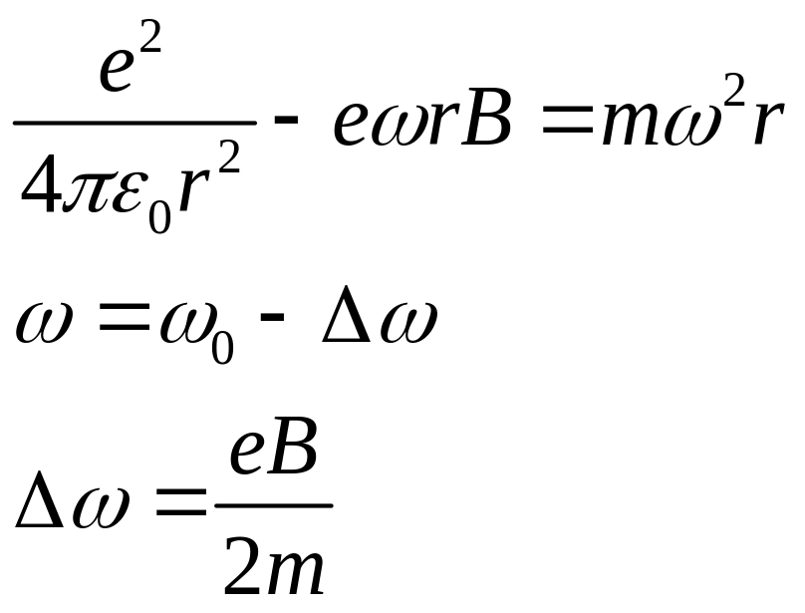
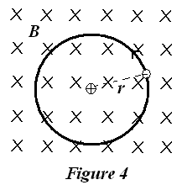
  4. (5%) In Bohr’s theory of hydrogen atom, the electron can be thought of as moving in a circular orbit of radius r about the proton (质子). Suppose that such an atom is placed in a magnetic field B, with the plane of the orbit at right angles to B, as shown in Fig. 4. If the electron is circulating counterclockwise (反时针), as viewed by an observer sighting along B, and assume the orbit radius does not change. the change in the frequency of revolution caused by the magnetic field is given approximately by _______________________. Such frequency shifts were observed by Zeeman in 1896.

Slide 5
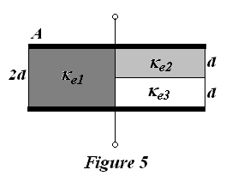
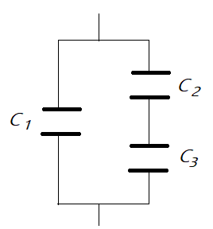
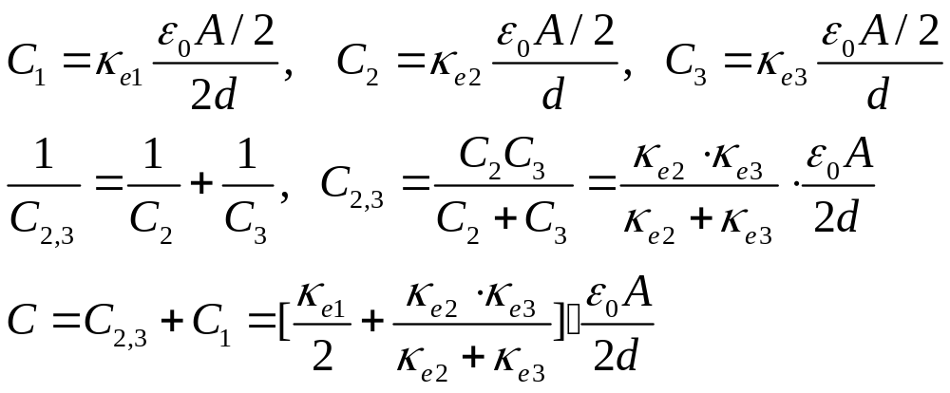
  5. (5%) A parallel-plate capacitor is filled with three dielectrics as in Fig. 5, the capacitance is given by _____________________ .

Slide 6
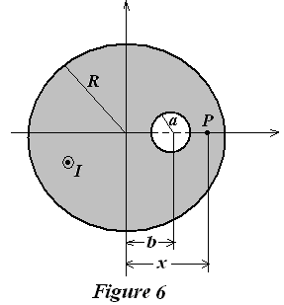
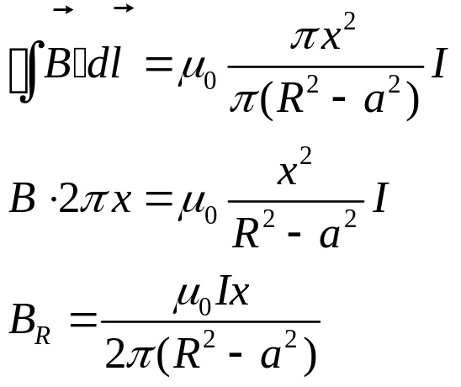
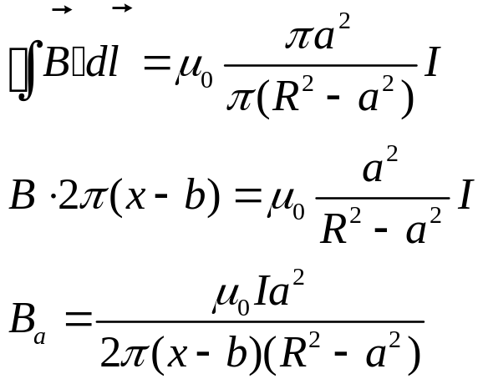
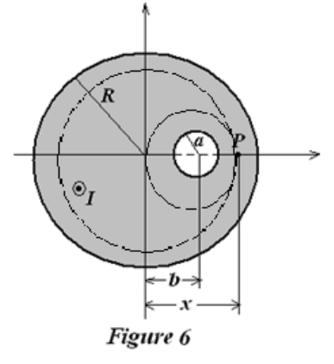
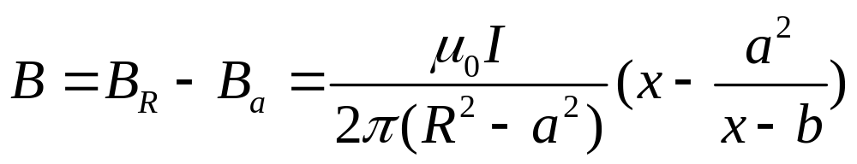
  6. (5%) As shown in Fig. 6, a long, straight conducting wire with circular cross section of radius R carries a current I. There is a cylindrical hole inside the conductor, whose radius is of a, and whose axis is parallel to the axis of the conductor but offset a distance b from the axis of the wire. The current I is uniformly distributed and is directed out of the page. The magnetic field at P point (R > x > a+b) at the x axis is .

Slide 7
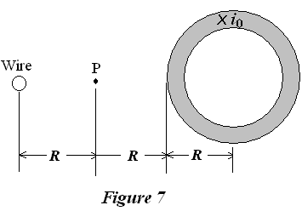
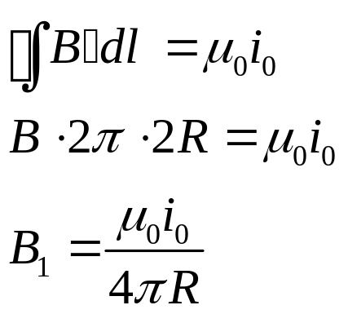
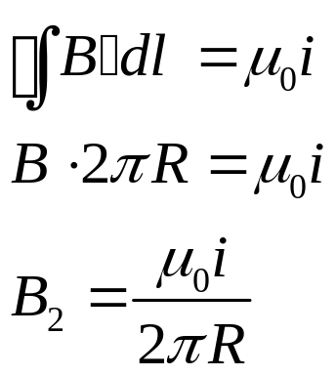
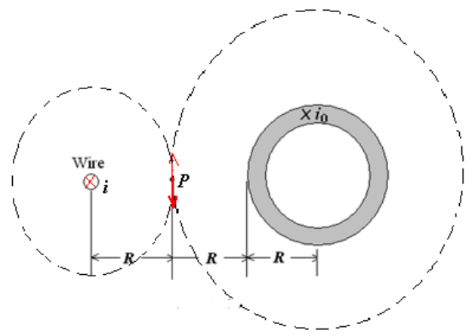
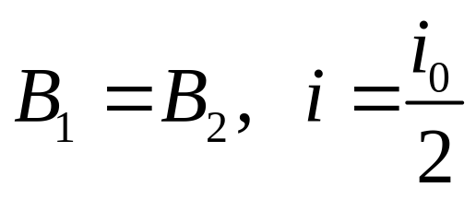
  7. (5%) A long, circular pipe, with an outside radius of R, carries a (uniformly distributed) current of i₀ (into the paper as shown in Fig. 7). A wire runs parallel to the pipe at a distance 3R from the center to center. What are the magnitude _________________ and direction ________________ of the current in the wire that would cause the resultant magnetic field at the point P to be zero.

Slide 8
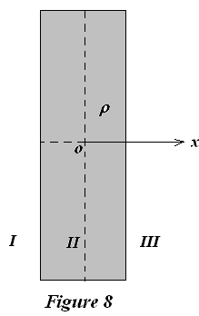
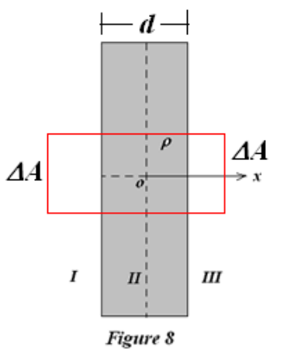
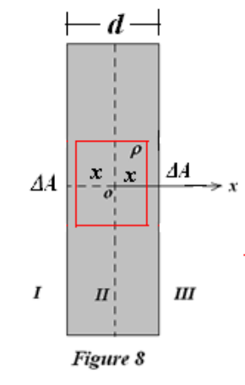
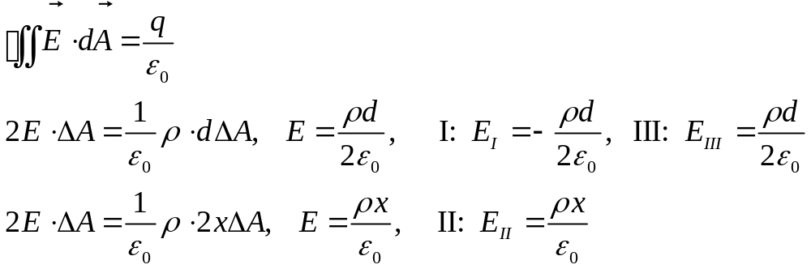
  8. (6%) As shown in Fig. 8, an infinity slab (无限大平板) of thickness d has a uniform volume charge density ρ. Find the magnitude of the electric field in region I _________, II________, and III_____ _____, in terms of x, the distance measured from the median plane of the slab.

Slide 9
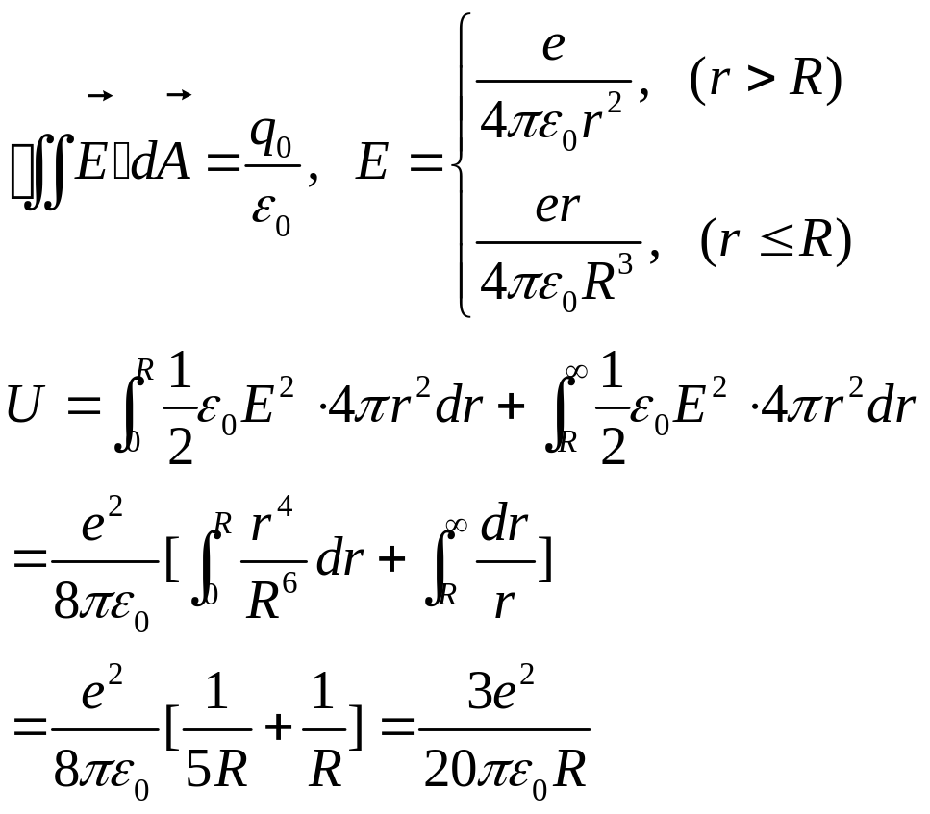
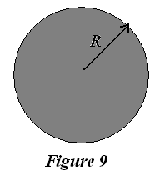
II. Problems (Present the necessary equations in solution) (60%)
1. (12%)As shown in Fig. 9, assume that the electron is not a point, but a sphere of radius R having a uniform volume charge distribution (均匀体电荷分布). Please calculate the total electrostatic energy for such electron.

Slide 10
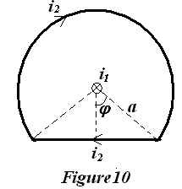
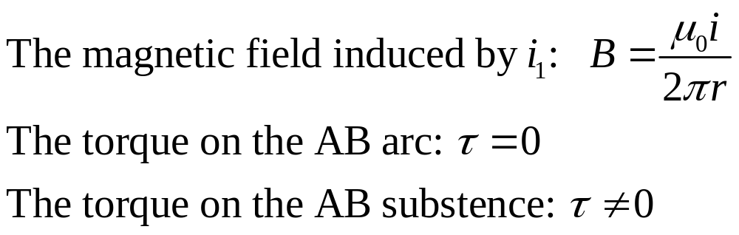
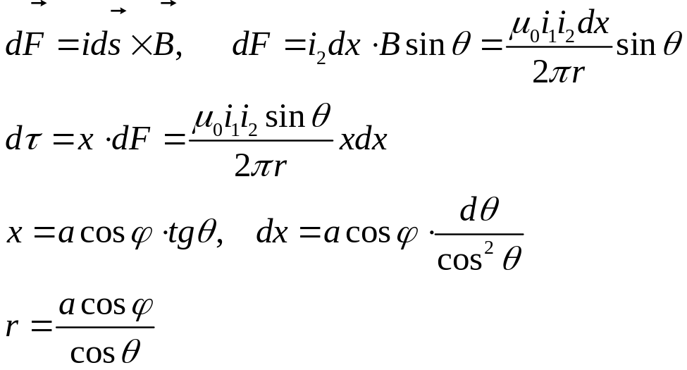
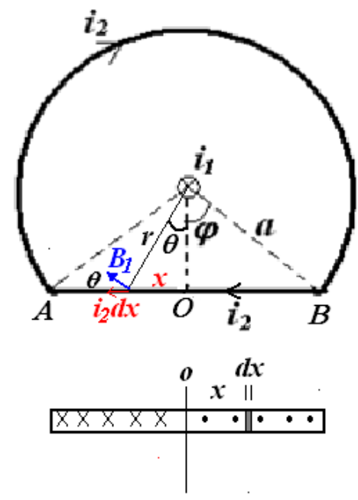
2. (13%) As shown in Figure 10, a wireframe (线框) with current i₂ is composed of an arc (圆弧) with the flare angle (张角) of 2(π-ϕ) and the radius of a, and a subtense (弦) connecting two ends of the arc. Meanwhile, there is a long straight conducting wire with current i₁, which is located at the center of the arc and perpendicular to the plane of the wireframe. Please calculate the torque (力矩) τ acted on the wireframe.

Slide 11
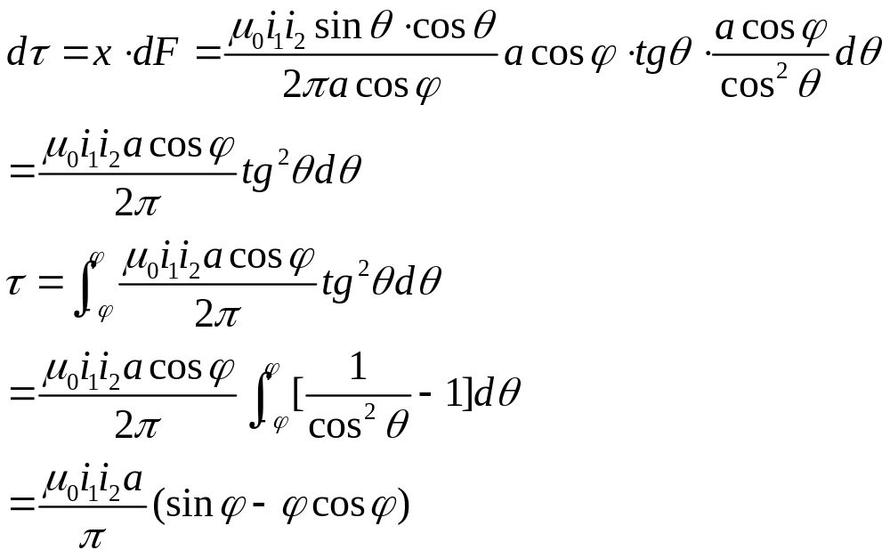

Slide 12
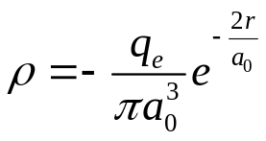
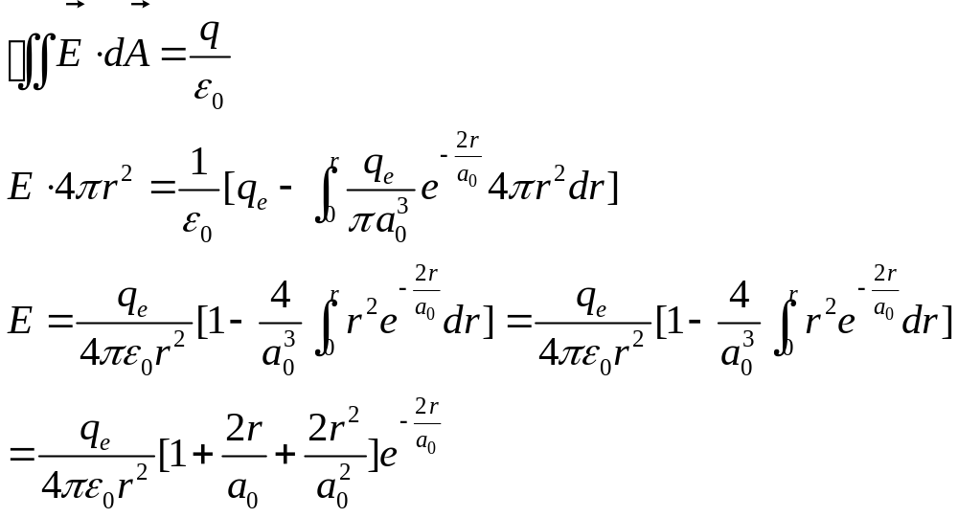
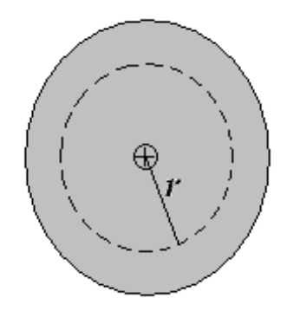
3. (15%)According to the quantum mechanics, H atom is composed of a positive charge q_{e} (considered as a point charge) in nucleus, and the electron cloud. At the normal condition (s orbit), the charge volume density of electron cloud is as:
where a₀ is a constant, i.e. Bohr radius. Please calculate the electric field distribution E(r).

Slide 13
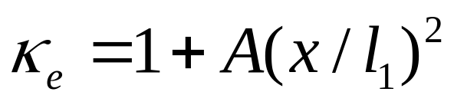
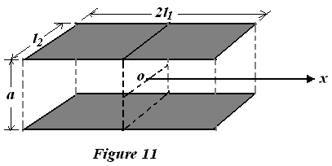
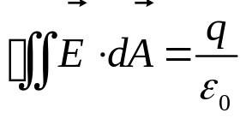
4. (20%)As shown in Fig. 11, a parallel plate capacitor is composed of two plates with length of 2l₁ and width of l₂, separated by a distance of a. It is filled with a non-uniform dielectrics (非均匀电介质), its dielectric constant as a function of position x is：
where A is a constant. The capacitor is connected with a battery, thus the potential difference between plates is V. Please calculate:
(a) The area charge density distribution, σ_{e}(x), on the plates.
(b) The total charge on the plates, Q.
(c) The capacitance, C.
(d) The polarization P(x) distribution in dielectrics.
(e) The induced charge density distribution, σ’_{e}(x), on the surface of dielectrics.

Slide 14
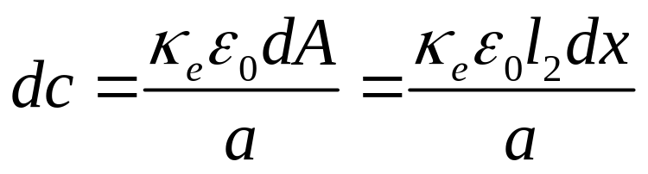
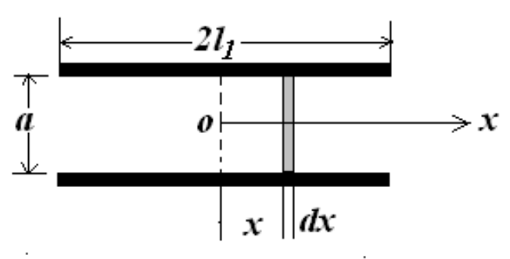
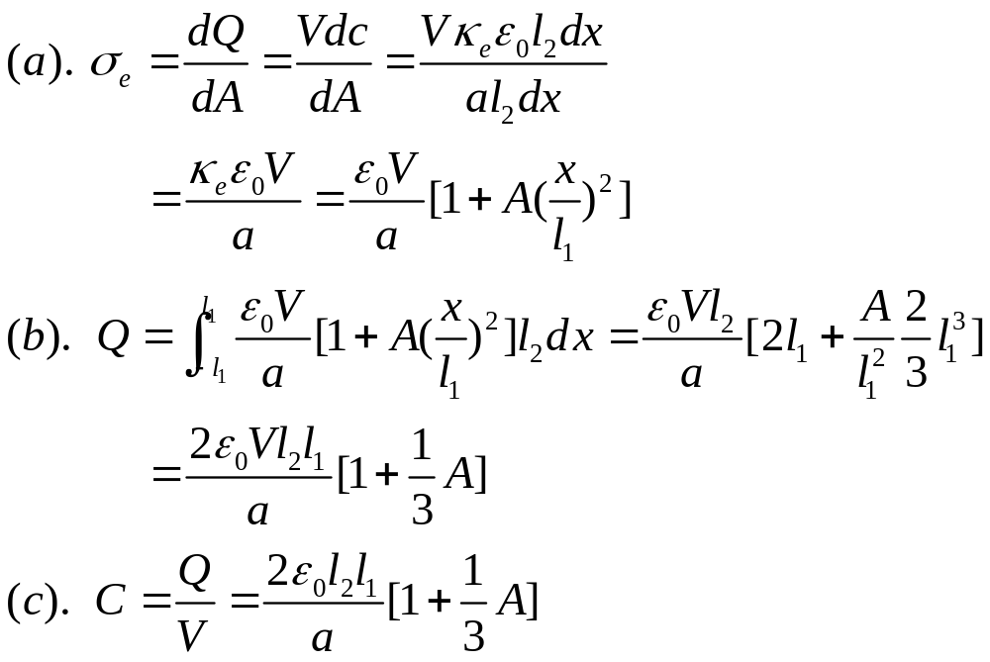

Slide 15
