Slide 1
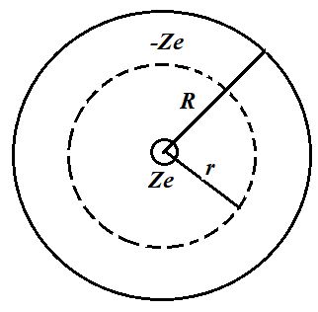
2019年期中考试卷答案
I. Fill in the space underlined (40% in total)
1. In a 1911 paper, Ernest Rutherford said: In order to form some idea of the forces required to deflect an α particle through a large angle, consider an atom containing a point positive charge Ze at its center and surrounded by a distribution of negative electricity -Ze uniformly distributed within a sphere of radius R. The electric field E for a point inside an atom at a distance r from the center is .

Slide 2
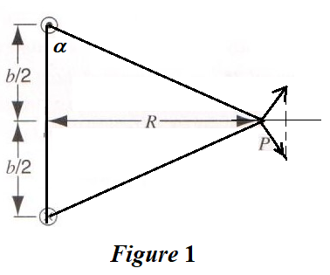
2. As shown in Fig. 1, two long wires a distance b apart carry equal antiparallel currents i. The magnetic induction strength B at the point P, which is equidistant from the wires, is given by .

Slide 3
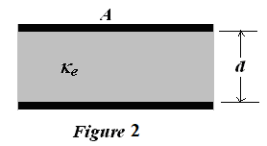
3. As shown in Fig. 2, a parallel plate capacitor with capacitance C is charged to a potential difference V and is then disconnected from the charging source. The capacitor has an area A and a plate separation d. Assume that a glass plate of the same area A completely fills the space between the plates, and which has a dielectric constant κ_{e}. How much work is required to pull the glass plate out of the capacitor? ­­­__________________________. Neglect fringe effects.

Slide 4
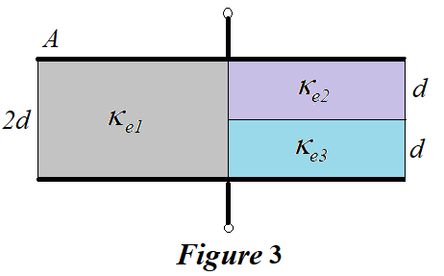
4. The capacitance of the capacitor in Fig. 3 is .

Slide 5
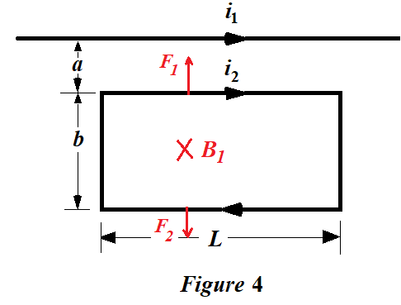
5. Figure 5 shows a long wire carrying a current i₁. The rectangular loop carries a current i₂. Assume that a = 1.10 cm, b = 9.20 cm, L = 32.3 cm, i₁ = 28.6 A, and i₂ = 21.8 A. The resultant force acting on the loop is .

Slide 6
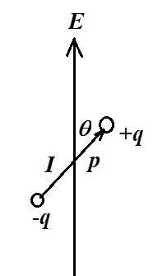
6. If an electric dipole with moment p (电偶极矩) and rotational inertia I (转动惯量) is placed in a uniform electric field E, the frequency for small amplitudes of oscillation about its equilibrium position is .

Slide 7
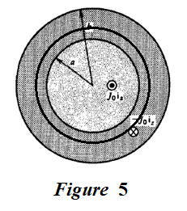
7. As shown in Fig. 5, there is a coaxial cable (同轴电缆) with a current density J₀ along z axis (out paper) in the region of 0 ≤ r ≤ a, and a current density J₀ along -z axis (inside paper) in the region of a ≤ r ≤ b. The magnetic induction strength B(r) in the region of a ≤ r ≤ b is .

Slide 8
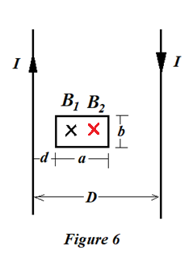
8. As shown in Fig. 6, there is a very long rectangular current loop, considered as two infinitely parallel line currents, a distance D apart, carrying the same current I in opposite directions. Another small rectangular loop with a size of a × b is located at the place with a distance d away from the left line current. The mutual inductance (互感系数) between them is .

Slide 9
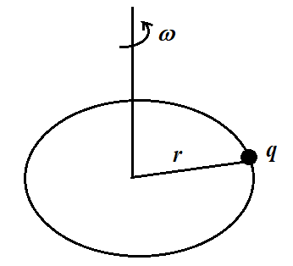
9. A charge q is distributed uniformly around a thin ring of radius r. The ring is rotating about an axis through its center and perpendicular to its plane at an angular speed ω. The magnetic moment due to the rotating charge is .

Slide 10
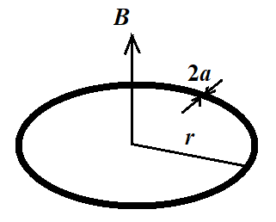
10. A uniform magnetic field B is changing in magnitude a constant rate dB/dt. You are given a mass m of copper, which has the resistivity (电阻率) ρ and the density (密度) δ, that is to be drawn a circular loop (圆环). The induced current i, assuming B perpendicular to the loop, is given by

Slide 11
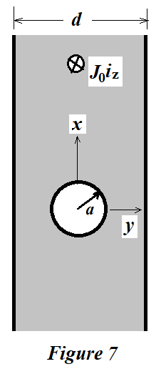
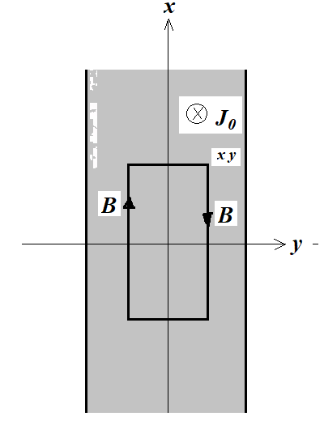
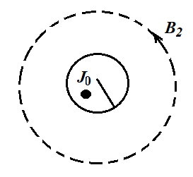
II. Problems (Present the necessary equations in solution) (60%)
(10%) As shown in Fig. 7, an infinite slab of thickness d carries a uniform current density J₀i_{z} except within a cylindrical hole of radius a centered within the slab. Please calculate the magnetic field inside and outside slab.

Slide 12
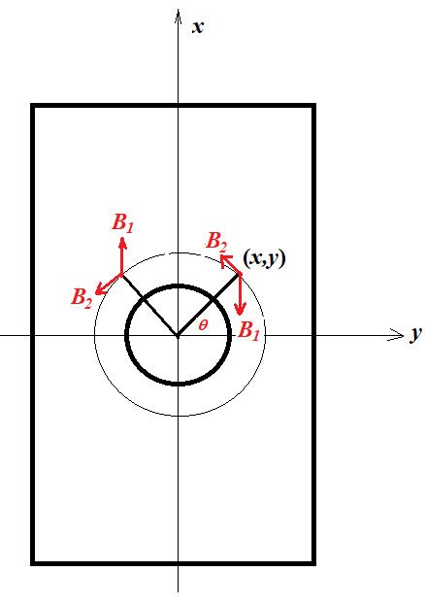

Slide 13
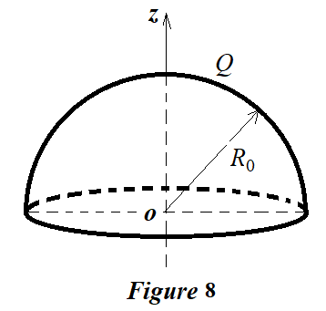
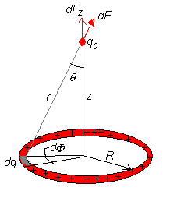
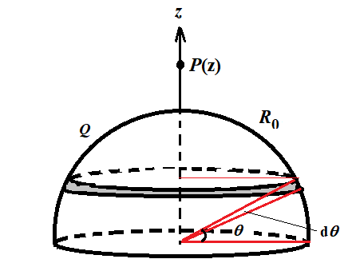
2. (15%) As shown in Fig. 8, a hemisphere of radius R₀ has a uniformly distributed surface charge with total charge Q.
(a) What is the electric potential at any position along the z axis due to the entire hemisphere of surface charge?
(b) What is the electric field at any position alone the z axis?

Slide 14
2. (15%) As shown in Fig. 8, a hemisphere of radius R₀ has a uniformly distributed surface charge with total charge Q.
(a) What is the electric potential at any position along the z axis due to the entire hemisphere of surface charge?
(b) What is the electric field at any position alone the z axis?

Slide 15
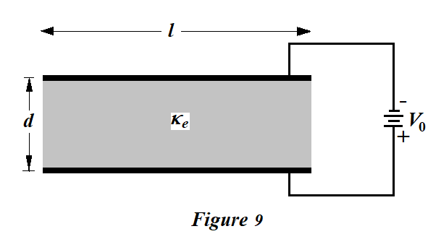
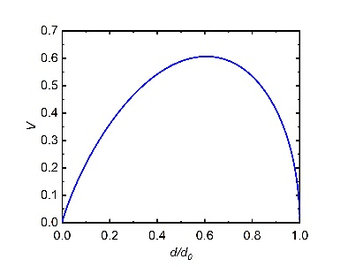
3. (15%) As shown in Fig. 9, parallel plate electrodes with a width of l and a length of D at voltage difference V₀ enclose an elastic dielectric with dielectric constant κ_{e}. The electric force of attraction between the electrodes is balanced by the elastic force of the dielectric.
(a) When the electrode spacing is d, what is the free surface charge density on the upper electrode?
(b) What is the electric force per unit area that the electrode exerts on the dielectric interface?
(c) The elastic restoring force per unit area is given by the relation
, where Y is the modulus of elasticity and d₀ is the unstressed (V₀ = 0) thickness of the dielectric. Write a transcendental expression (超越方程表达式) for the equilibrium thickness of the dielectric.
(d) What is the minimum equilibrium dielectric thickness and at what voltage does it occur? If a larger voltage is applied there is no equilibrium and the dielectric fractures as the electric stress overcomes the elastic restoring force (electromechanical breakdown).

Slide 16
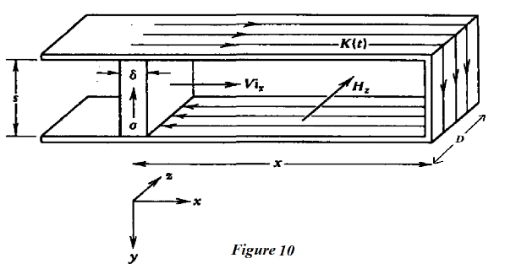
4. (20%) As shown in Fig. 9, a thin block with Ohmic conductivity σ and thickness δ moves with constant velocity vi_{x} between short circuited superconducting parallel plates. An initial surface current K₀ (the current density, the current per width) is imposed at t = 0 when x = x₀, but the source is then removed.
(a). The surface current on the plates K(t) will vary with time. What is the magnetic field in term of K(t)? Neglect fringing effects.
(b). Because the moving block is so thin, the current is uniformly distributed over the thickness δ. Please find K(t) as a function of time.
(c). What value of velocity will just keep the magnetic field constant with time until the moving block reaches the end?
(d). What happens to the magnetic field for larger and smaller velocities?

