Slide 1
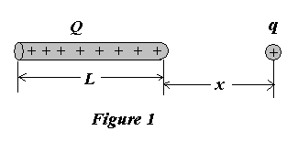
Example 1
The force on a positive point charge q is ??????????? . This point charge locates a distance x from the end of a rod of length L with uniformly distributed positive charge Q, as shown in Figure 1.

Slide 2
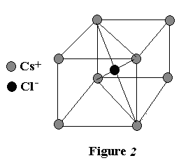
Example 2
In the compound CsCl, the Cs atoms are situated at the corners of a cube with a Cl atom at the cube’s center. The edge length of the cube is 0.4nm; as shown in Fig. 2. The Cs atoms are each deficient in one electron and the Cl atom carriers one excess electron. The strength of the net electric force on the Cl atom resulting from the eight Cs atoms is ?

Slide 3
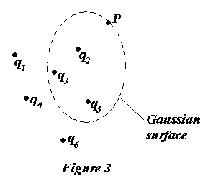
Example 3
Consider the Gaussian surface that surrounds part of the charge distribution shown in Fig. 3. Which of the charges contribute to the electric field at point P ????????????.

Slide 4
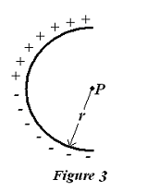
Example 4
A thin glass rod is bent into a semicircle of radius r. A charge +q is uniformly distributed along the upper half and a charge –q is uniformly distributed along the lower half, as shown in Fig. 3. The electric field E is of ????? at P, the center of the semicircle.

Slide 5
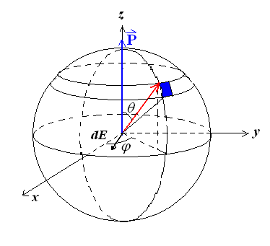
Example 5
A spherical shell, with a charge density of surface
σ_{e}’=Pcosθ
Calculating the electric field E at center.

Slide 6
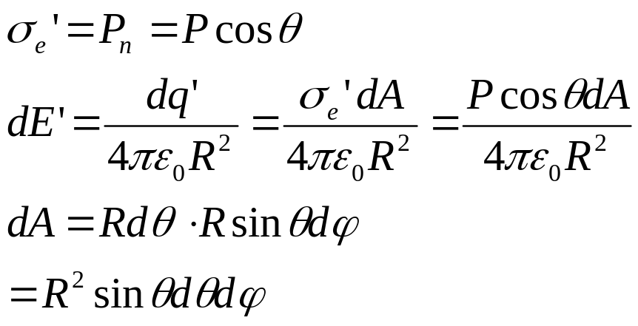
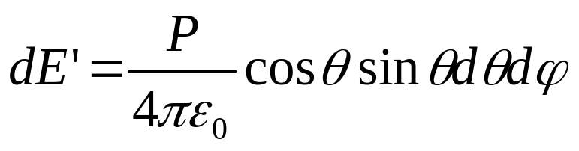
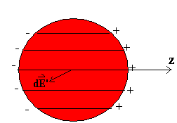
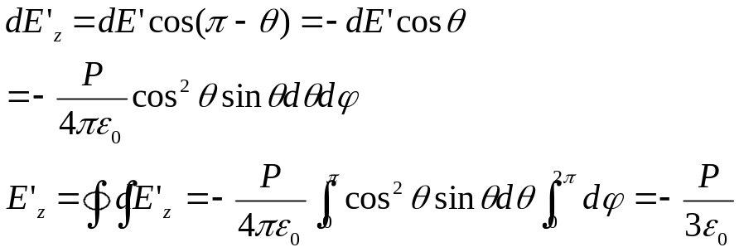
Solution

Slide 7
Example 6: planes
Suppose there are infinite planes positioned at x₁ and x₂. The plane at x₁ has a positive surface charge density of σ₁ while the plane at x₂ has negative surface charge density of σ₂. Find:
A
the x-component of the electric field at a point x>x₂
the x-component of the electric field at x₁<x<x₂
the x-component of the electric field at a point x<x₁
B
C
σ ₁
y
σ ₂
x₁
x₂
x

Slide 8


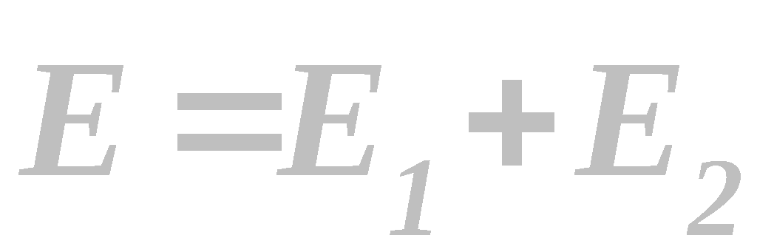
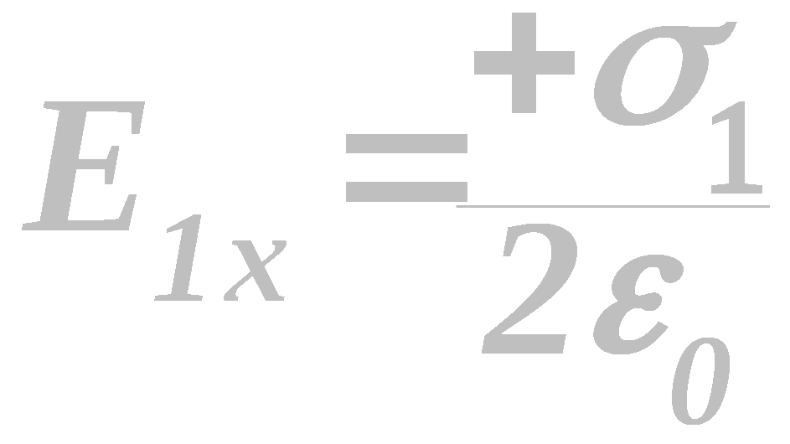
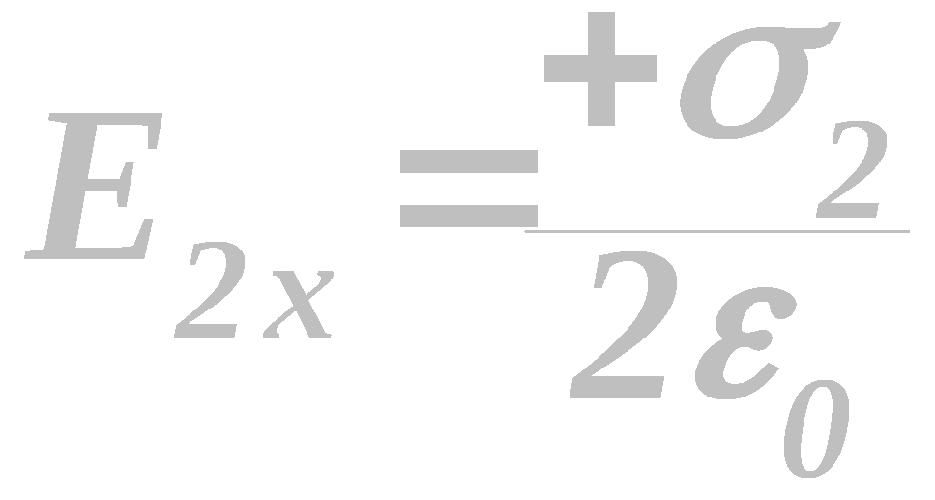
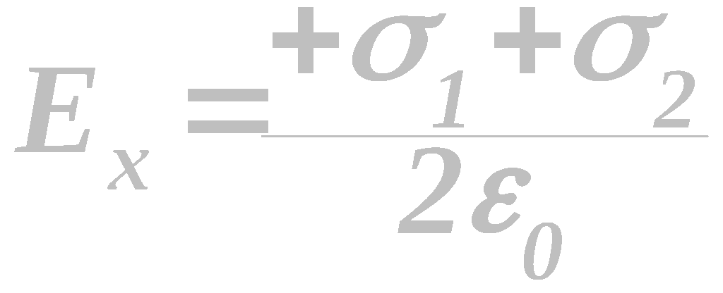
Solutions
A
E_{x}(x>x₂)
We can use superposition to find .
The E-field desired is to the right of both sheets. Therefore;
y
σ ₁
σ ₂
E₂
E₁
x₁
x₂
x

Slide 9
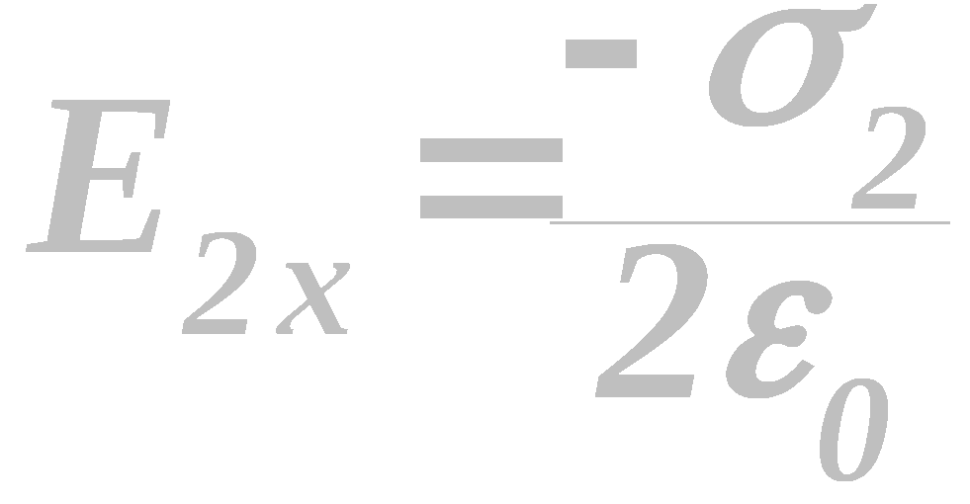
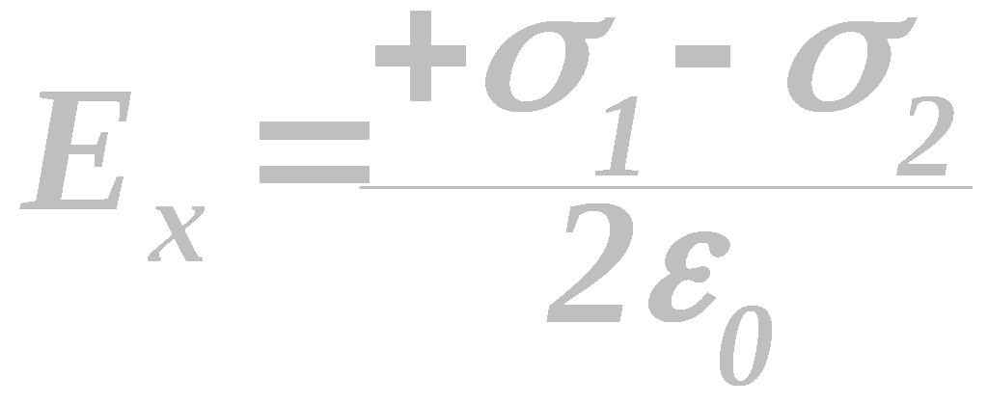
B
E_{x}(x₁<x<x₂)
This time the point is located to the left of σ₂ and to the right
of σ₁, therefore;
y
σ ₁
σ ₂
E₂
E₁
x₁
x₂
x

Slide 10
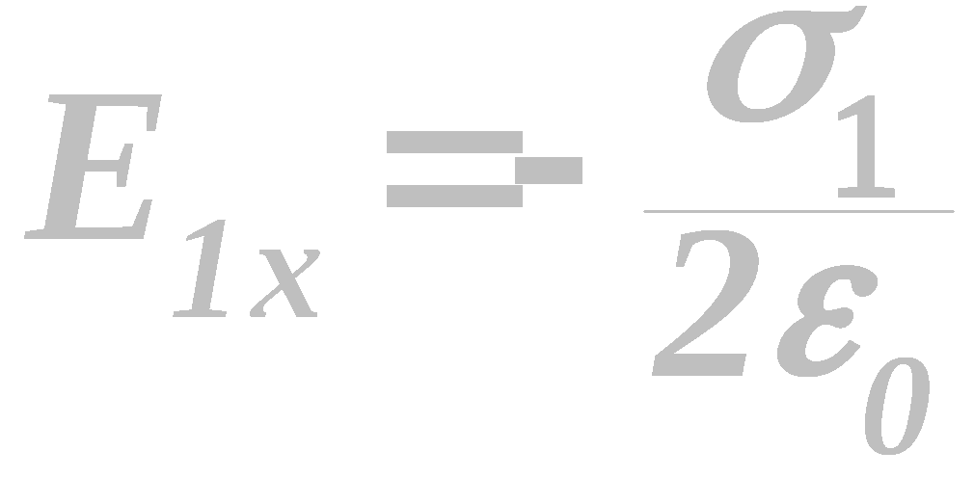
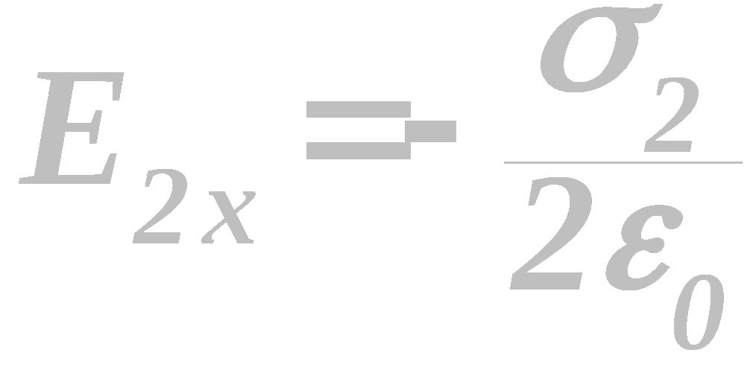
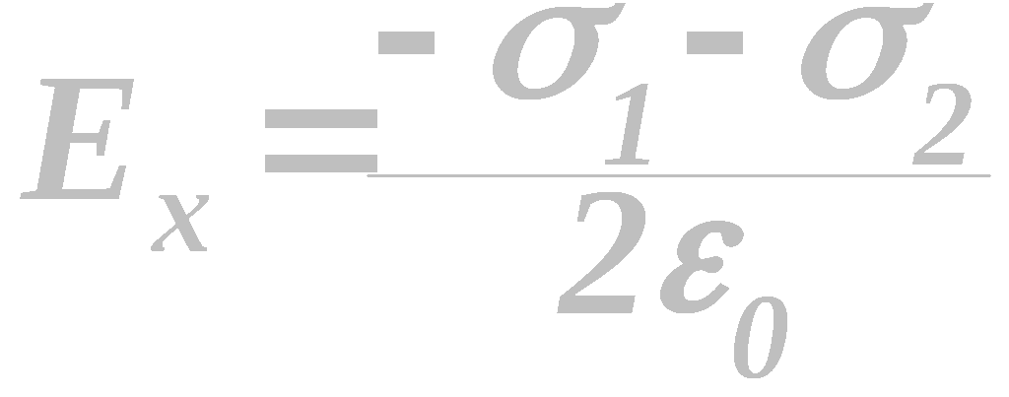
C
E_{x}(x<x₁)
When the point is located to the left of both sheets;
y
σ ₁
σ ₂
E₁
E₂
x₁
x₂
x

Slide 11
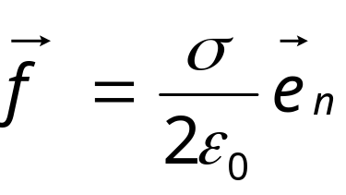
Example 7
试证静电平衡条件下导体表面单位面积上受的力为 其中σ为面电荷密度，e_{n} 为表面
的外法线方向的单位矢量。此力方向与电荷的符合无关，总指向导体外部。

Slide 12
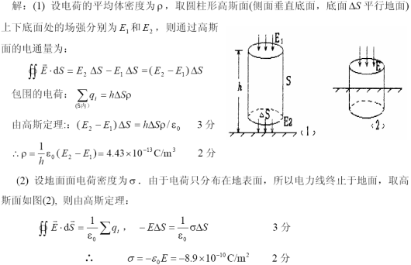

Slide 13
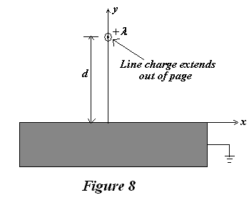
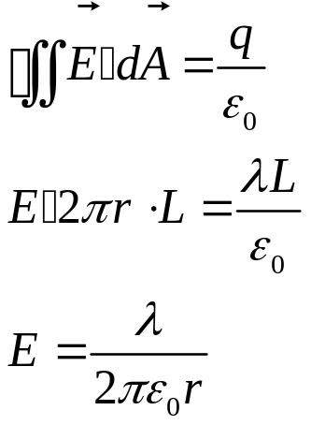
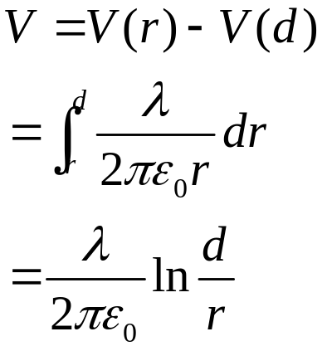
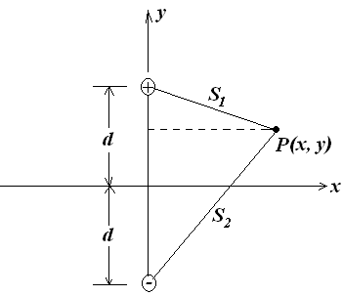
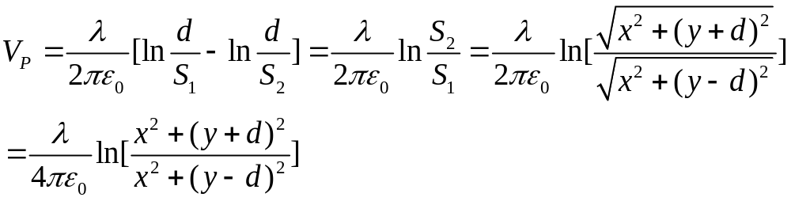
  An infinite, grounded, conducting plane is in the xz-plane. A line of charge, with linear charge density λ runs parallel to the z-axis, a distance d above the conducting plane, as shown in Fig. 8. Assume the whole region exclusive of the conductors is a vacuum.
    (a) Calculate the electric potential V(x,y,z) for y>0.
  Solution:

Slide 14
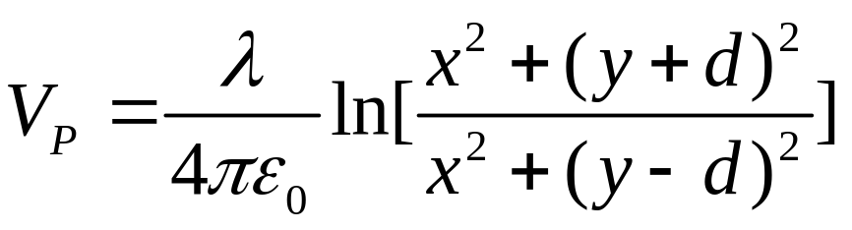
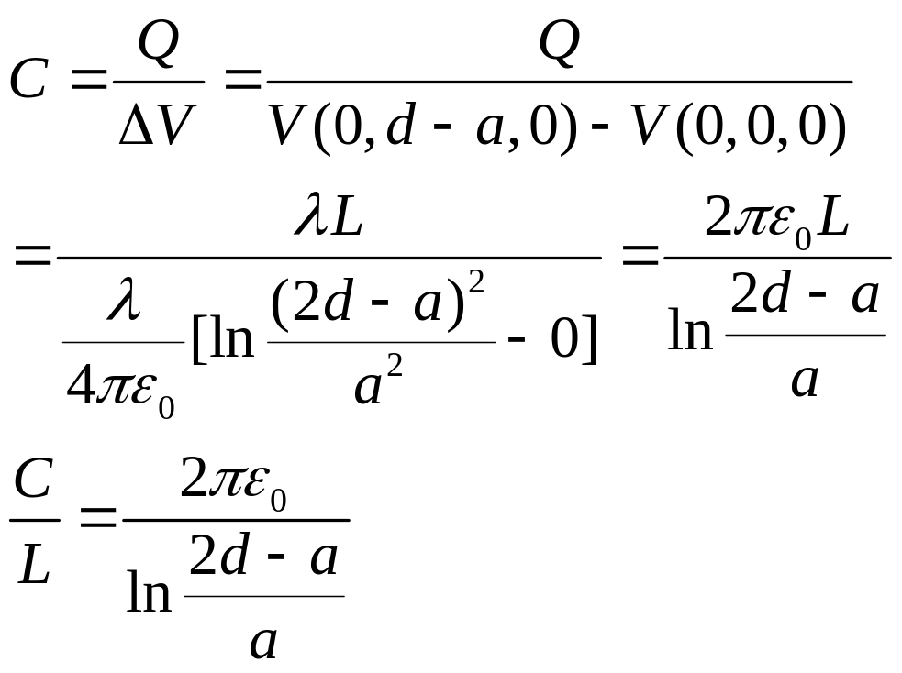
    (b) Calculate the capacitance per unit length of a thin wire of radius a, placed a distance d above a ground plane. Assume that the wire radius is much smaller than d (i.e. a<< d ) so that the solution of part (a) is approximately correct in the region exclusive of the conductors.
  Solution:

Slide 15
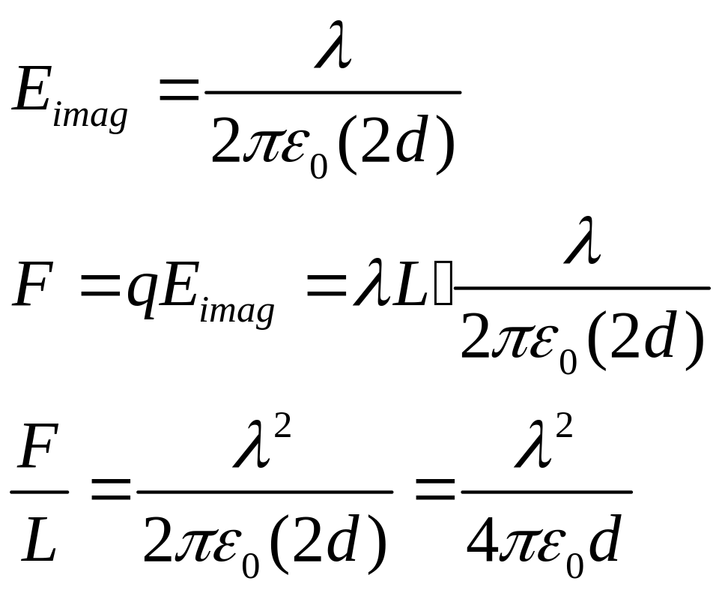
(c) Find the force per unit length on the wire (including the direction).

Slide 16
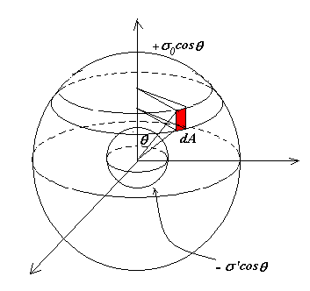
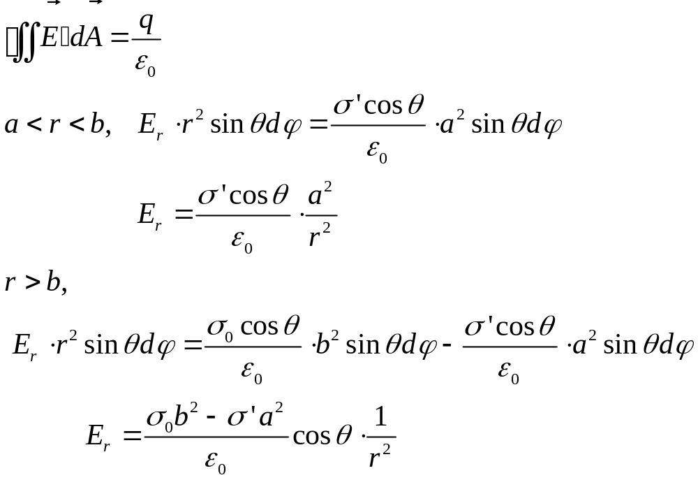
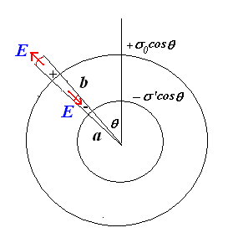
A grounded conducting sphere of radius a is inside a sphere of radius b. The region between radius a and radius b is vacuum. The outer sphere is non-conducting, and carries a surface charge density σ₀cosθ. Find the electric potential V in the both regions: a < r < b and r>b.
  Solution: assume -σ’cosθ on inside surface

Slide 17
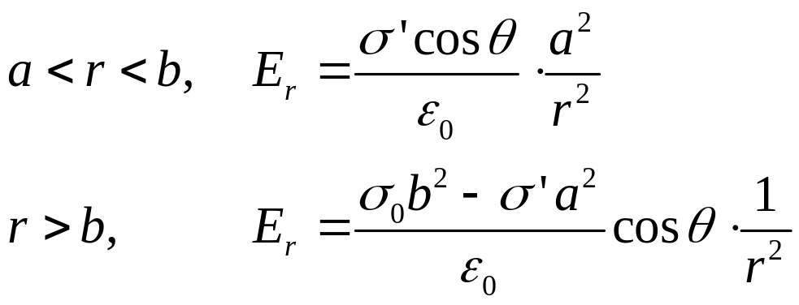
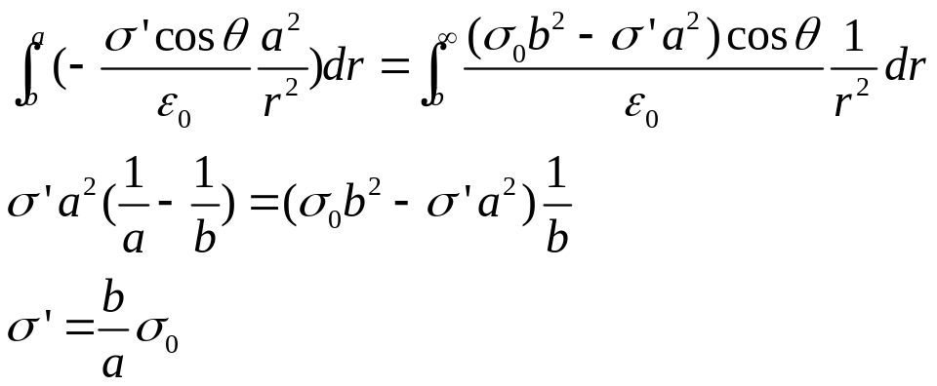
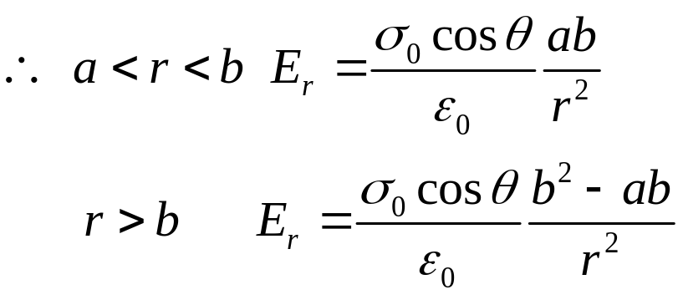
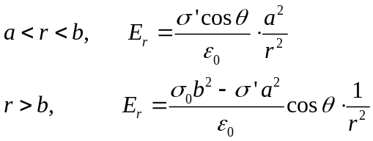
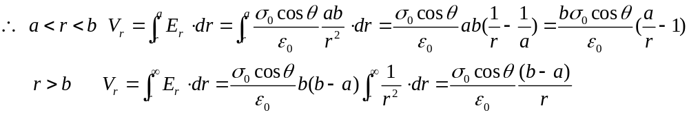

Slide 18

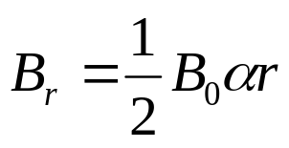
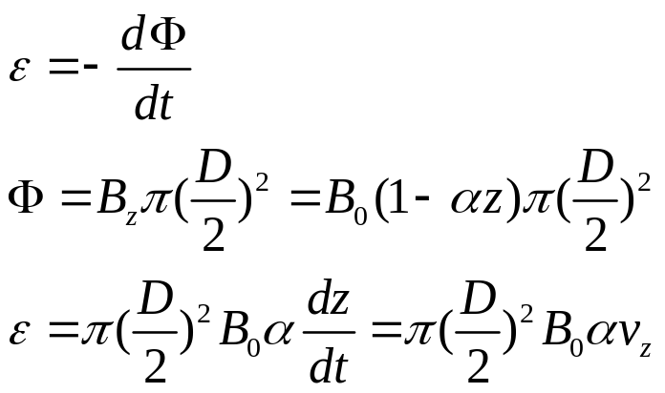
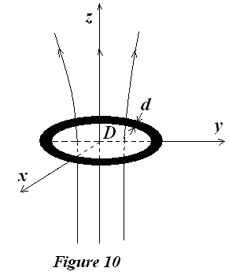
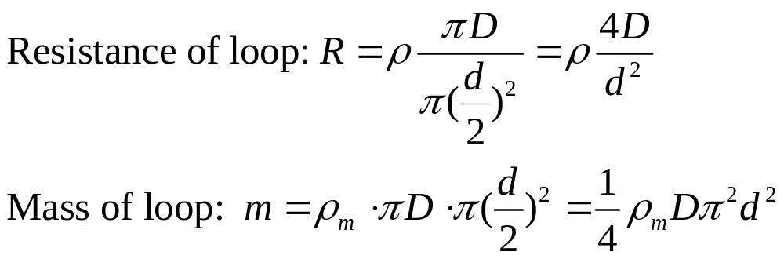
As shown in Fig. 10, there is a non-uniform magnetic field with cylindrical symmetry , its component along z axis,
its radial component
(a) A conducting circular loop made of wire diameter d, resistivity ρ, and a mass density ρ_{m} is falling from the origin point (z=0). At beginning (t=0), there is no current in circular. The loop of diameter D is always parallel to the x-y plane. Disregarding air resistance, find the terminal velocity of loop.
  Solution:

Slide 19
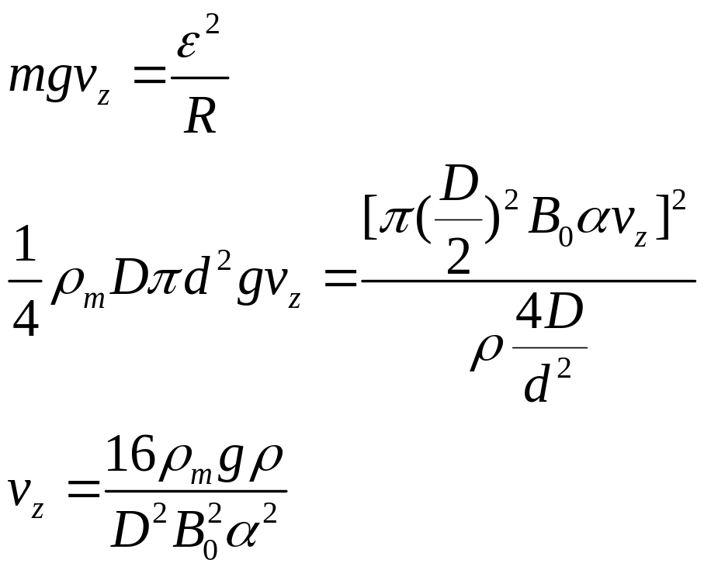
Solution 1
重力提供的功率=焦耳损耗

Slide 20
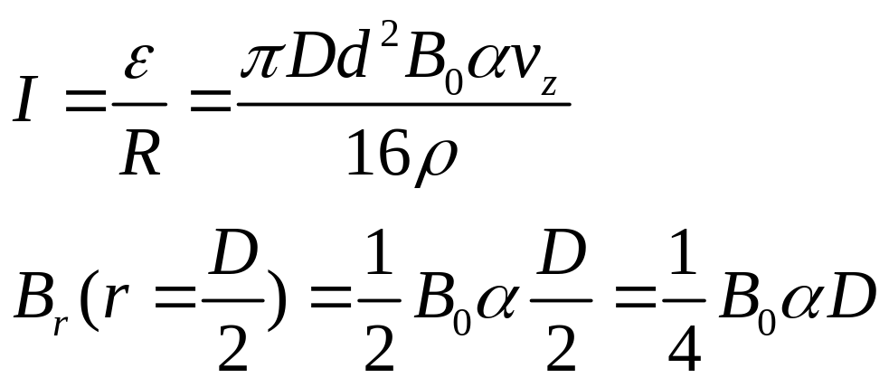
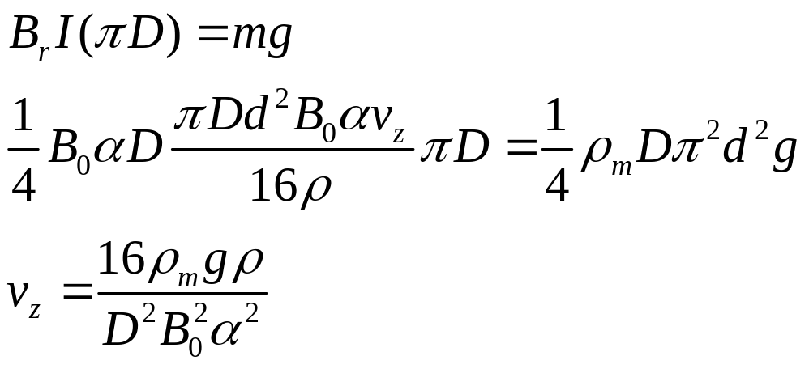
Solution 2

Slide 21
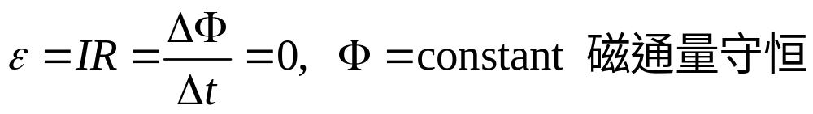
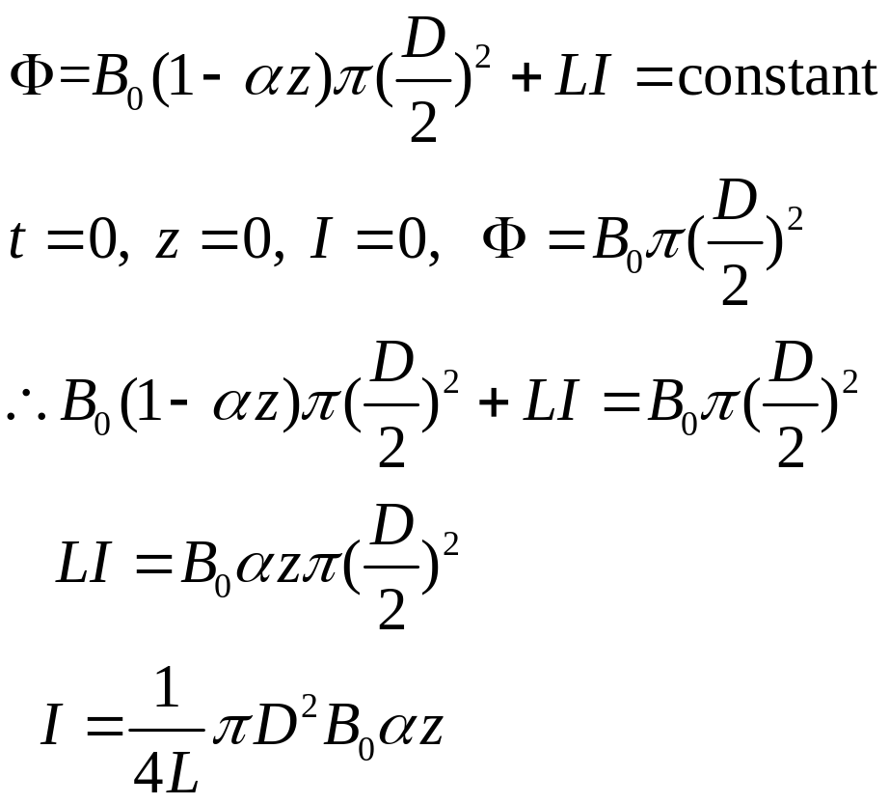
(b) If the conducting circular loop is changed by a superconducting loop with a self-inductance (自感系数) L, what kind motion this superconducting loop will be? Find the maximum current in the superconducting loop.
Change to Superconducting loop: R=0

Slide 22
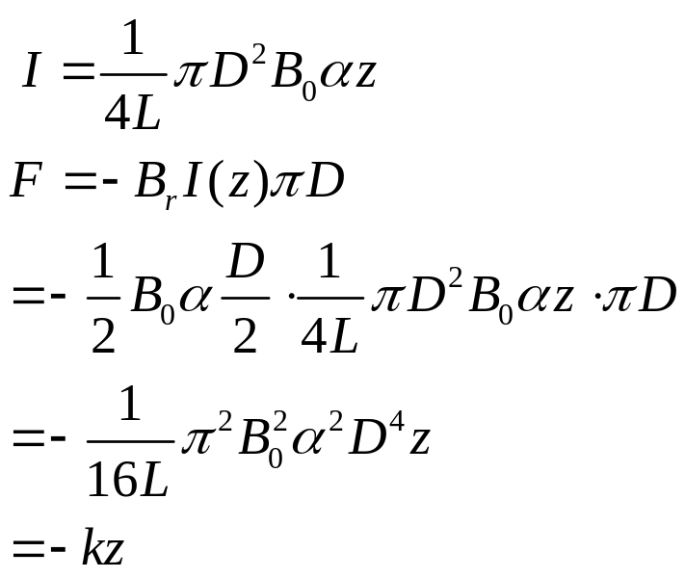
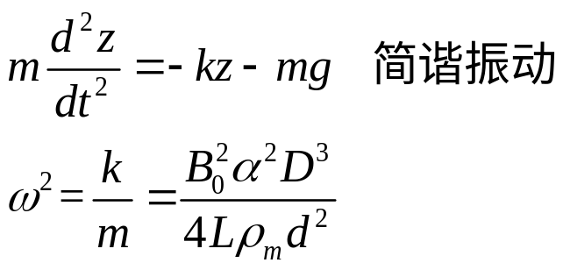
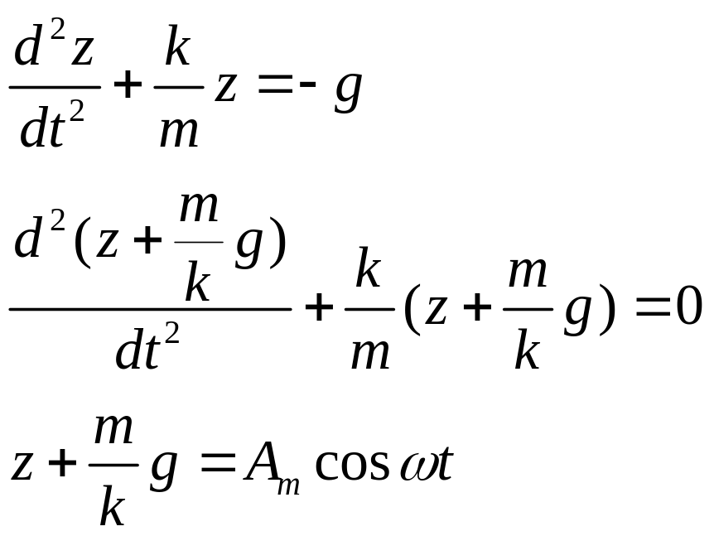
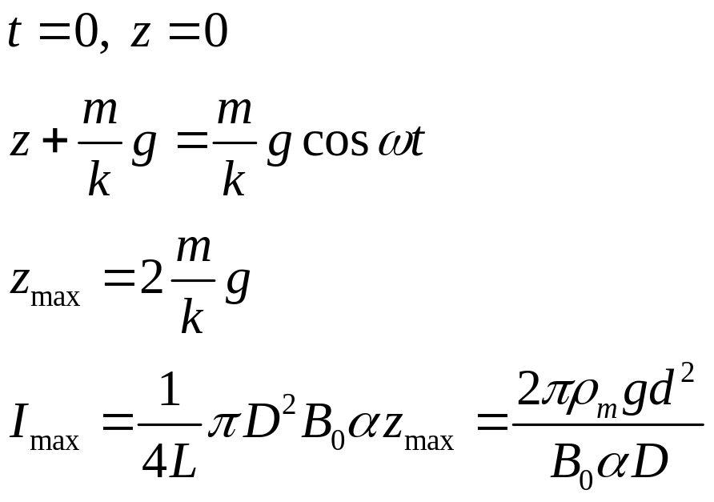

Slide 23
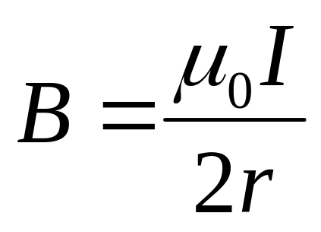
A thin plastic disk of radius R has a charge q uniformly distributed over its surface. If the disk rotates at an angular frequency ω about its axis, show that the magnetic field at the center of the disk is

Slide 24

2. A flat strip of metal of width 2a carries a current I. Find the magnetic field B at point P, at a distance a from the strip?

Slide 25
Example 9
实验表明， 在靠近地面处有相当强的电场，电场强度 垂直于地面向下，大小约为100N／C；在离地面1.5km高的地方, 也是垂直于地面向下的，大小约为25N／C。
(1) 试计算从地面到此高度大气中电荷的平均体密度；
(2) 假设地球表面处的电场强度完全是由均匀分布在地表面的电荷产生，求地面上的电荷面密度。

