Slide 1
Cache Optimization—— Critical Word First and Early Restart
——颜晗 姜溢
2022.10.26

Slide 2
Miss Penalty
On a cache miss processor will need just the loaded word (or byte) very soon, but processor has to wait until the whole block is brought into the cache!
sequence :0,1,2,3,4,5,6,7
Cache Miss
CPU Time
CPU Time
Miss Penalty
Notes:
一般情况，顺序取出，全部取完才重启cpu

Slide 3
Reducing Miss Penalty on Cache Miss
In the event of a cache miss, the processor needs to wait until an entire block in the cache is replaced from main memory. However, the data that is actually needed by the processor won’t be the entire block but some specific word(s) within this block. Thus, instead of waiting for the full block to be loaded, the processor can resume its operation as soon as the necessary word(s) are available.
Notes:
仅需要单字，不用等整个块加载进cache中,cpu即可继续。

Slide 4
Early Restart
In this optimization, the words in the block are fetched in the normal order (sequentially). However, as soon as the requested word of the block arrives, it is sent to the processor. The processor now continues execution. This mechanism is called early restart because the processor resumes execution before the entire cache block is loaded.
Cache Miss
Continue
CPU Time
CPU Time
Miss Penalty
sequence :0,1,2,3,4,5,6,7(Suppose the 3rd word stores the Critical Word)
Notes:
提前重启，依旧按顺序取字

Slide 5
Problem
In the worst case, the word that is requested may be the last word that is fetched into a cache block. In this case, the processor has to wait until the entire block is loaded to access that particular word. This makes the optimization inefficient.
the processor waits until the entire block is loaded to access that particular word
Cache Miss
CPU Time
CPU Time
Miss Penalty
sequence :0,1,2,3,4,5,6,7(Suppose the 7th word stores the Critical Word)
Notes:
当需要的字在较后面时，优化效果不大。

Slide 6
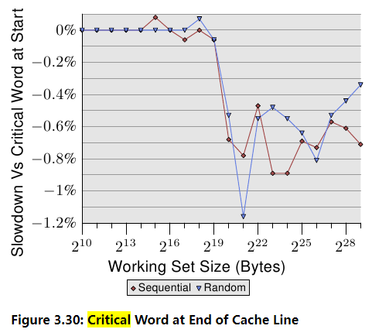
Shown is the slowdown of running the test with the pointer which is chased in the first word versus the case when the pointer is in the last word. The element size is 64 bytes, corresponding the cache line size.
As soon as the L2 is not sufficient to hold the working set size, the performance of the case where the critical word is at the end is about 0.7% slower. The sequential access appears to be affected a bit more.

Slide 7
Critical Word First
The word that the processor needs is tagged as a critical word. This missing critical word is first fetched from memory and sent to the processor. The processor now continues execution. The rest of the words in the block are then fetched in the normal order (sequentially).
Cache Miss
Continue
CPU Time
CPU Time
Miss Penalty
sequence :3,4,5,6,7,0,1,2(Suppose the 3rd word stores the Critical Word)
Notes:
关机字优先，然后向下循环

Slide 8
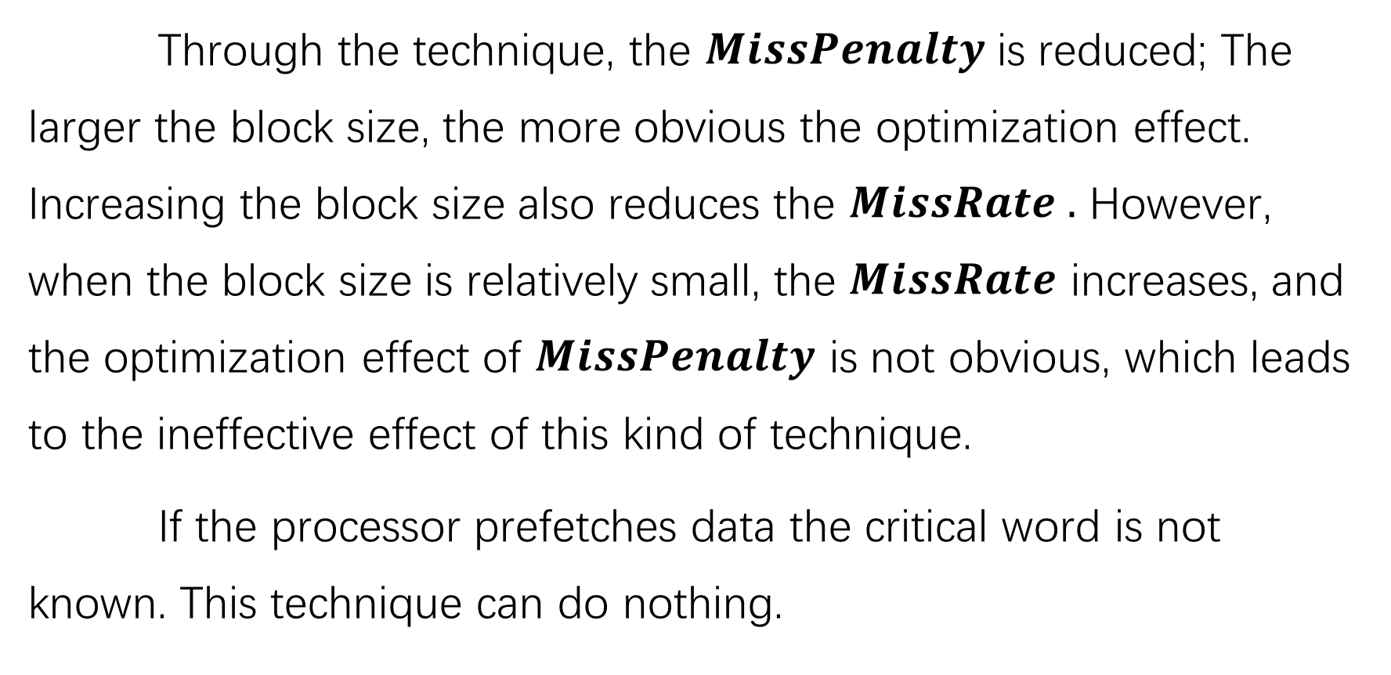
Analysis
Through the technique, the $MissPenalty$is reduced; The larger the block size, the more obvious the optimization effect. Increasing the block size also reduces the $MissRate .$ However, when the block size is relatively small, the $MissRate$ increases, and the optimization effect of $MissPenalty$ is not obvious, which leads to the ineffective effect of this kind of technique.
If the processor prefetches data the critical word is not known. This technique can do nothing.
Notes:
Average memory accesstime

Slide 9
Summary
Both the above optimizations, allow the processor to resume execution without waiting for the entire cache block to be fetched. Thus, a reduction in miss penalty is achieved.
Generally, these techniques only benefit designs with large cache blocks because the benefit is low unless blocks are large. Note that caches normally continue to satisfy accesses to other blocks while the rest of the block is being filled.

Slide 10
Summary
Given spatial locality, there is a good chance that the next reference is to the rest of the block. The miss penalty is not simple to calculate. When there is a second request in critical word first, the effective miss penalty is the nonoverlapped time from the reference until the second piece arrives. The benefits of critical word first and early restart depend on the size of the block and the likelihood of another access to the portion of the block that has not yet been fetched.

Slide 11
References:
Computer Architecture: A Quantitative Approach
http://thebeardsage.com/cache-optimization-critical-word-first-and-early-restart/
https://zhuanlan.zhihu.com/p/400095618
What Every Programmer Should Know About Memory, Part 2: CPU Caches

Slide 12

Some other things
Cache prefetching
Hardware based prefetching
Software based prefetching
speculative behaviour
Hyper-Threading
burst transfer

