Slide 1
MSCIT9128 — Advanced Distributed Systems | CAT diagram pack
Gitsimbanyi Prosper · University of Kigali · MsIT
Student revision deck for the October 2026 CAT (AgriMart / MedConnect / SwiftTrade / BrightStitch / EduNet).
Redraw these diagrams from memory. Label every box. Tie the recommendation to the case.
This file is original student work. Lecturer Pearson slides stay on the local PC only.

Slide 2
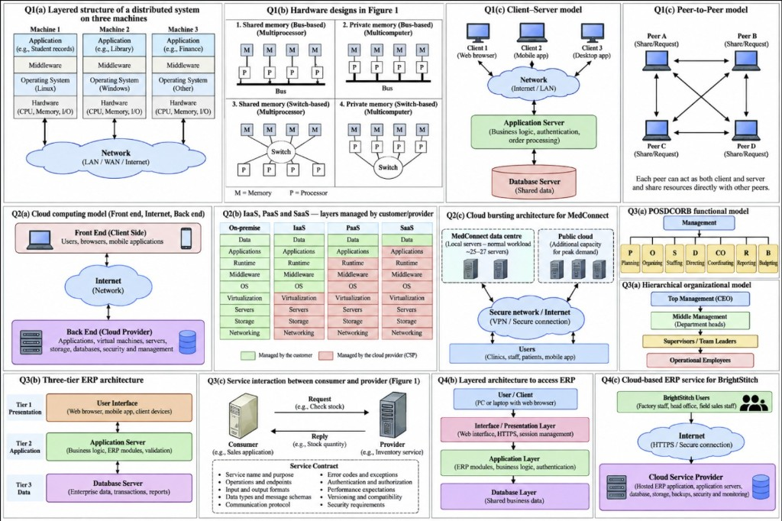
All CAT diagrams — one sheet (redraw in the exam)

Slide 3
Q1 — Distributed system drawings (EduNet / AgriMart)
• Q1(a) Three machines: Application → Middleware → OS → Hardware, joined by a network. Example: Linux student records, Windows library, other finance.
• Q1(b) Four hardware designs: shared vs private memory; bus vs switch. Shared memory = multiprocessor. Private memory = multicomputer.
• Q1(c) Client–server: browsers/apps → network → application server → database. Clear control; server can bottleneck.
• Q1(d) Peer-to-peer: every peer is client and server; share directly. Scales by adding peers; hard to keep one official copy (prices, exam pages).

Slide 4
Q2 — Cloud (MedConnect)
• Q2(a) Front end (users, browsers, mobile) → Internet → back end (CSP: apps, VMs, storage, databases, billing).
• Q2(b) Shade who manages each layer. Green = customer. Red = CSP. On-premise all green; SaaS almost all red; IaaS customer keeps OS and above; PaaS customer keeps apps and data.
• Q2(c) Bursting: private DC sized for normal load (~25–27 servers) + public cloud for the claims peak. Users reach both over a secure network.
• SLA is a credit when availability is missed. It does not by itself keep patient data in-country — add location, encryption, access clauses.
• Recommend hybrid for MedConnect: records and billing under hospital control; public IaaS for the peak; SaaS for email/collaboration.

Slide 5
Q3 — Organisation and ERP (SwiftTrade)
• Q3(a) POSDCORB: Planning, Organising, Staffing, Directing, Coordinating, Reporting, Budgeting under management.
• Hierarchy: CEO → department heads → supervisors → operational staff. Silos = sales cannot see stock; accounting re-types invoices.
• Q3(b) Three-tier ERP: Presentation (browser) → Application (business logic / modules) → Database (one set of figures).
• Q3(c) SOA: Consumer --request--> Service <--reply-- Provider. The contract is name, operations, messages, QoS, version — not the provider’s language.
• Use SOA to wrap the old inventory during migration. ERP stays the system of record. No big-bang throw-away.

Slide 6
Q4 — Layered and cloud ERP (BrightStitch)
• Q4(b) User/client (PC or laptop + browser) → Interface (HTTPS / session) → Application (ERP modules) → Database.
• Field sales: server-centric thin client. Do not install a full ERP on the laptop. Keep pages small; short offline notes then sync.
• Q4(c) BrightStitch users (factory, HO, field) → Internet → Cloud provider (hosted ERP, servers, storage, backups).
• Lease standard modules (accounting, HR, purchasing). Keep unique design/IP under BrightStitch with export and location clauses.

Slide 7
Exam timing — what to draw
• Section A is compulsory. Section B: any two of Questions 2–5.
• Always: draw the diagram asked, label every box, map the case (patient data, field laptops, exam load, old inventory).
• Balanced pairs: 2+4 (cloud + ERP) or 3+5 (organisation + hardware) or 2+5 (cloud + university DS).
• Lecturer slides (chapter 2–4, BI, Data Warehouse) are on this PC under assignments/lectures/ — not on GitHub.

