Slide 1
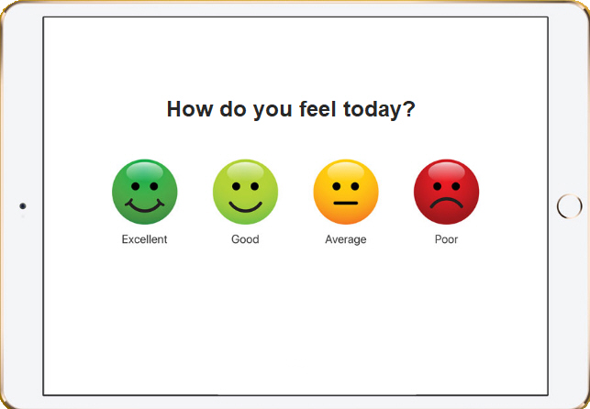
Promo Video – “Insight” App
Group 21 - Assignment 5 – Project
- Draft Storyboard & Script-

Slide 2
Intro
Visual: Opening Slide Showing Team Name and Name of Application
Audio: Backing track commences, acoustic guitar instrumental

Slide 3
Scene 1
Visual: Basic illustrated animation of family with 2 parents / 2 kids leaving for school / work on a weekday morning (TBA – illustrate faces only, full body, etc)
Audio: Voiceover - candid family dialog, 2 parents / 2 children getting ready for school
Mother: “Kids are you ready? You’re going to be late for the bus drop off if we don’t leave now and I’ll be late for work.” (calls out)
Son: “Muuum, I’m sooo tired, I was having bad dreams last night” (tired voice)
Mother: “I told you not to watch that movie before bed... You’re not even dressed yet? Have you had breakfast? C’mon hurry up...” (hastily)
Father: “Ok honey, I’m off to my interview. Wish me luck.” (nervous but chirpy)
Mother: “Hope you get this job sweetheart. It’s been 6 months, we need this...”
Father: “Yeah I know...” (humble) – Door closes sound effect
Mother: “Get off that device and get ready for school young lady” (stern)
Daughter: “I don’t want to go to school today” (low voice)
Mother: “Why you’re not sick? You were fine yesterday…” (stern)
Daughter: “They’re saying things about me again...” (low voice)
Mother: “Who’s saying things? …just ignore them… We’ll talk about it later, we don’t have time for that now we gotta go” (hastily)

Slide 4
Scene 2
Visual: Image of a student in the school yard, head in hands (TBA)
Audio: Narrator
“Life is busy and can be complicated, it’s no wonder that some kids come to school feeling …”

Slide 5
Scene 3
Visual: Illustration of facial expressions (maybe emoji’s?) with text for each emotion
Audio: Children’s voices calling out each emotion – uttered in the tone of the emotion
“Worried”
“Nervous”
“Angry”
“Sad”
“Grumpy”
“Lonely”
“Frightened”
“Hungry”
“Confused”

Slide 6
Scene 4
Visual: Panning video of school playgrounds, fast playback speed
Audio: Narrator
“There are approximately 2.2 million primary and 1.6 million secondary school students currently attending schools across Australia”
“While many of these students are from well-balanced households, come from healthy families and have stable social networks, there are still a significant proportion of students that arrive at school each day in a far from ideal frame of mind for learning.”

Slide 7
Scene 5
Visual: Flash up newspaper articles and video excerpts of news and current affair segments with headlines on bullying and child mental health
Audio: Narrator and fade in/out of news reader on keywords
“More intense feelings resulting from friendship and domestic struggles, teasing and bullying over longer term can distract from learning and lead to more serious mental health issues if ignored and unaddressed.”
Notes:
“These can be the result of struggling with friendships, being teased, outcast and bullying which can lead to .... demoralised, alienated, anxious and even traumatised.”

Slide 8
Scene 6
Visual: Panning video of students in classroom on their mobile devices, flashes of device screen with emoji survey
Audio: Narrator
“Insight is a mobile app designed for students to express how they feel each day through a short 5 question survey aimed at gathering feedback on various aspects of students’ psychological and physical wellbeing.”
“The information can then be used to address areas of concern and optimise the learning experience.”
“While it can be challenging and time consuming to discover how individual students feel through conventional face-to-face methods, use of technology can provide a means to efficiently and effectively gather this information via simple multiple choice questions and relatable emoji icons.”
Notes:
and newer generations feel more comfortable with expressing how they feel through technology.

Slide 9
Scene 7
Visual: Panning video of teacher in classroom on a tablet device pondering results
Audio: Narrator
“The survey results are then quickly and securely transmitted to the teacher’s device which will display aggregated information to provide insight into the general frame of mind of the class, and make adjustments to the day’s schedule, communication and teaching style to better engage students throughout the day.”
Notes:
to protect the anonymity of the students.”

Slide 10
Scene 8
Visual: Panning video of headmaster in office on a tablet device, flashes of graphs/charts on device screen
Audio: Narrator
“The school headmaster or administrator is provided a broader dashboard view of the school’s aggregated survey information, to monitor changes over time and introduce campaigns addressing concerning trends, prior to them becoming more significant problems and performance barriers.”

Slide 11
Scene 9
Visual: Illustration of tablet device transmitting data (e.g. lightning bolt/dotted line) to cloud database, panning out to multiple devices all transmitting data to cloud database, then cloud processing the data and transmitting data back to devices.
Audio: Narrator
“The survey results are encrypted and anonymously transmitted from each school to Insight’s secure central database. The database gathers and processes the information for statistical purposes, and based on the school’s country and region, feedback can be provided to school administrators for benchmarking their results against the average of other schools within the same region.”

Slide 12
Scene 10
Visual: Several scenes of school playgrounds with high activity, student(s) sitting in front of laptops in library’s or playgounds, student(s) using mobile devices, fast playback speed.
Audio: Narrator
“Given the ever changing world we live in, Insight can provide schools, educators and parents a window into the minds of the younger generation, and the challenges they face.”
“Equipped with this understanding teaching methods can be adapted to improve attentiveness and performance, campaigns run to target emerging areas of concern, and the health and wellbeing of students enhanced everywhere.
“Insight will provide the insight to help students achieve their best.” (Slogan TBA – too cliché)
Notes:
More positive learning experience?

Slide 13
Scene 11
Visual: Closing Slide Showing product logo (TBA) or happy emoji’s and website
Audio: Narrator, music level ramps up, children’s cheer
“For more information visit www.studentinsight.net”

