Slide 1
Abstract Factory Design Pattern

Slide 2
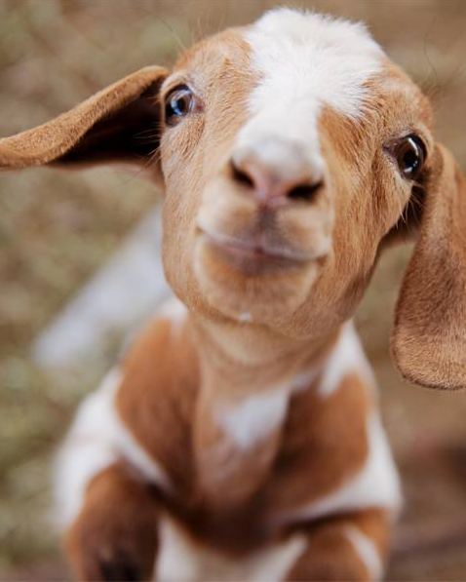
The Problem (again)
A Petting Zoo contains
A child
An animal
Food for the animal
How to create an animal which matches the child, AND food which matches the animal

Slide 3
Interface
Client
Base Class
Class

Slide 4
public class Child
{
public Child(string name, int age)
{
Name = name;
Age = age;
}
public string Name { get; }
public int Age { get; }
public int MoneyLimit { get { return Age * 3; } }
}

Slide 5
public interface IAnimal
{
string Description { get; }
int AgeMinimum { get; }
}

Slide 6
public interface IAnimalFactory
{
IAnimal CreateAnimal(int age);
}

Slide 7
public class PettingZooV60
{
public PettingZooV60(Child aChild, IAnimalFactory aFactory)
{
TheChild = aChild;
TheAnimal = aFactory.CreateAnimal(aChild.Age);
}
public Child TheChild { get; }
public IAnimal TheAnimal { get; }
public void Interact()
{
// Just pet the damn thing...
}
}

Slide 8

Petting
ZooV60
IAnimal
Child
IAnimal
Factory

Slide 9
public interface IFood
{
string Description { get; }
int CostPerKg { get; }
}

Slide 10
public interface IFoodFactory
{
IFood CreateFood(int money);
}

Slide 11
public class FoodFactoryCute : IFoodFactory
{
public IFood CreateFood(int money)
{
IFood aCucumber = new Cucumber();
IFood aCarrot = new Carrot();
IFood aCabbage = new Cabbage();
if (money >= aCucumber.CostPerKg) { return aCucumber; }
else if (money >= aCarrot.CostPerKg) { return aCarrot; }
else if (money >= aCabbage.CostPerKg) { return aCabbage; }
else { return new Hay(); }
}
}

Slide 12
public class FoodFactoryExotic : IFoodFactory
{
public IFood CreateFood(int money)
{
IFood aBeef = new Beef();
IFood aLiveMice = new LiveMice();
IFood aJarOfFlies = new JarOfFlies();
if (money >= aBeef.CostPerKg) { return aBeef; }
else if (money >= aLiveMice.CostPerKg) { return aLiveMice; }
else if (money >= aJarOfFlies.CostPerKg) { return aJarOfFlies; }
else { return new Worms(); }
}
}

Slide 13
public class PettingZooV70
{
public PettingZooV70(
Child aChild,
IAnimalFactory factoryAnimal,
IFoodFactory factoryFood)
{
TheChild = aChild;
TheAnimal = factoryAnimal.CreateAnimal(aChild.Age);
TheFood = factoryFood.CreateFood(aChild.MoneyLimit);
}
public Child TheChild { get; }
public IAnimal TheAnimal { get; }
public IFood TheFood { get; }
public void Interact()
{
// Just feed and pet the damn thing...
}
}

Slide 14
Petting
ZooV70
IAnimal
Child
IAnimal
Factory
IFood
Factory
IFood

Slide 15

Child c = new Child("James", 8);
IAnimalFactory facAnimal = new AnimalFactoryCute();
IFoodFactory facFood = new FoodFactoryCute();
PettingZooV70 zoo = new PettingZooV70(c, facAnimal, facFood);

Slide 16
Child c = new Child("James", 8);
IAnimalFactory facAnimal = new AnimalFactoryCute();
IFoodFactory facFood = new FoodFactoryExotic();
PettingZooV70 zoo = new PettingZooV70(c, facAnimal, facFood);

Slide 17
Petting
ZooV70
IAnimal
Child
IAnimal
Factory
IFood
Factory
IFood

Slide 18
Petting
ZooV70
IAnimal
Child
IAnimal
Factory
IFood
Factory
IFood
AnimalFactory
Cute
(cute animals)
(exotic food)
FoodFactory
Exotic

Slide 19
public interface IPettingZooElementsFactory
{
Child TheChild { set; }
IFood CreateFood();
IAnimal CreateAnimal();
}

Slide 20
public class PettingZooElementsFactoryCute : IPettingZooElementsFactory
{
private FoodFactoryCute _ffCute;
private AnimalFactoryCute _afCute;
private Child _theChild;
public PettingZooElementsFactoryCute()
{
_ffCute = new FoodFactoryCute();
_afCute = new AnimalFactoryCute();
}
public Child TheChild { set { _theChild = value; } }
public IFood CreateFood()
{
return _ffCute.CreateFood(_theChild.MoneyLimit);
}
public IAnimal CreateAnimal()
{
return _afCute.CreateAnimal(_theChild.Age);
}
}

Slide 21
public class PettingZooElementsFactoryExotic : IPettingZooElementsFactory
{
private FoodFactoryExotic _ffExotic;
private AnimalFactoryExotic _afExotic;
private Child _theChild;
public PettingZooElementsFactoryExotic()
{
_ffExotic = new FoodFactoryExotic();
_afExotic = new AnimalFactoryExotic();
}
public Child TheChild { set { _theChild = value; } }
public IFood CreateFood()
{
return _ffExotic.CreateFood(_theChild.MoneyLimit);
}
public IAnimal CreateAnimal()
{
return _afExotic.CreateAnimal(_theChild.Age);
}
}

Slide 22
public class PettingZooV80
{
public PettingZooV80(Child aChild, IPettingZooElementsFactory factory)
{
TheChild = aChild;
factory.TheChild = aChild;
TheAnimal = factory.CreateAnimal();
TheFood = factory.CreateFood();
}
public Child TheChild { get; }
public IAnimal TheAnimal { get; }
public IFood TheFood { get; }
public void Interact()
{
// Just feed and pet the damn thing...
}
}

Slide 23
Petting
ZooV80
IAnimal
Child
IPettingZoo
Elements
Factory
IFood

Slide 24
Child c = new Child("James", 8);
IPettingZooElementsFactory factory;
factory = new PettingZooElementsFactoryCute();
PettingZooV80 zoo = new PettingZooV80(c, factory);

Slide 25
Petting
ZooV80
IAnimal
Child
IPettingZoo
Elements
Factory
IFood

Slide 26
Petting
ZooV80
IAnimal
Child
IPettingZoo
Elements
Factory
IFood
Animal
FactoryCute
(cute animals)
PettingZoo
Elements
FactoryCute
Food
FactoryCute
(cute food)

Slide 27
Configurator
Child
Petting
ZooV80
PettingZoo
Elements
FactoryCute

Slide 28

IProductA
IAbstractFactory
IProductA CreateA(…);
IProductB CreateB(…);
…
IProductB
ProductAX
ProductBX
FactoryX
FactoryY

Slide 29
IProductA
IAbstractFactory
IProductA CreateA(…);
IProductB CreateB(…);
…
IProductB
ProductAX
ProductBX
FactoryX

Slide 30
IProductA
IAbstractFactory
IProductA CreateA(…);
IProductB CreateB(…);
…
IProductB
ProductAY
ProductBY
FactoryY

Slide 31
Client
IProductA
IAbstractFactory
IProductA CreateA(…);
IProductB CreateB(…);
…
IProductB

