Slide 1
public
private
⬄ Tilstand
 Opførsel
 Hukommelse
 Konstruktion

Slide 2
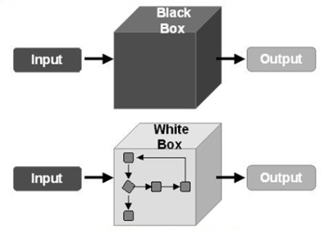

Slide 3

object (Car)
c =
Car c = new Car(…);

Slide 4

object (Car)
c1 =
object (Car)
c2 =
Car c1 = new Car(…);
Car c2 = new Car(…);

Slide 5

object (Car)
c1 =
= c2
Car c1 = new Car(…);
Car c2 = c1;

Slide 6
⬄
string brand = c.Brand; // get
c.Brand = "Mercedes"; // set

Slide 7

c.TurnOnEngine();
c.TurnOnSignalLight("Left", 50);

