Slide 1
Factory Method Design Pattern

Slide 2
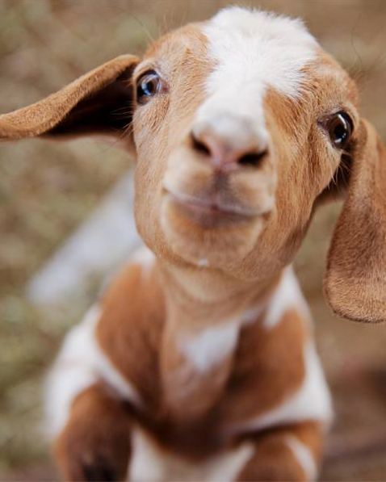
The Problem
A Petting Zoo contains
A child
An animal
How to create an animal which ”matches” the child

Slide 3
Interface
Client
Base Class
Class

Slide 4
public class Child
{
public Child(string name, int age)
{
Name = name;
Age = age;
}
public string Name { get; }
public int Age { get; }
}

Slide 5
public class Rabbit
{
public Rabbit(string description)
{
Description = description;
}
public string Description { get; }
}

Slide 6
public class PettingZooV10
{
public PettingZooV10()
{
TheChild = new Child("Jan", 6);
TheRabbit = new Rabbit("A white Rabbit");
}
public Child TheChild { get; }
public Rabbit TheRabbit { get; }
public void Interact()
{
// Just pet the damn thing...
}
}

Slide 7
Petting
ZooV10
Child
Rabbit

Slide 8
public class PettingZooV11
{
public PettingZooV11(Child aChild)
{
TheChild = aChild;
TheRabbit = new Rabbit("A white Rabbit");
}
public Child TheChild { get; }
public Rabbit TheRabbit { get; }
public void Interact()
{
// Just pet the damn thing...
}
}

Slide 9
Petting
ZooV11
Child
Rabbit

Slide 10
public class PettingZooV12
{
public PettingZooV12(Child aChild, Rabbit aRabbit)
{
TheChild = aChild;
TheRabbit = aRabbit;
}
public Child TheChild { get; }
public Rabbit TheRabbit { get; }
public void Interact()
{
// Just pet the damn thing...
}
}

Slide 11
Petting
ZooV12
Child
Rabbit

Slide 12
public class Animal
{
public Animal(string description)
{
Description = description;
}
public string Description { get; }
}

Slide 13
public class PettingZooV20
{
public PettingZooV20(Child aChild, string animalType)
{
TheChild = aChild;
if (animalType == "Rabbit")
{
TheAnimal = new Rabbit("A white Rabbit");
}
else
{
TheAnimal = new Goat("Cute little Goat");
}
}
public Child TheChild { get; }
public Animal TheAnimal { get; }
public void Interact()
{
// Just pet the damn thing...
}
}

Slide 14

Petting
ZooV20
Animal
Child
Rabbit
Goat

Slide 15
public PettingZooV21(Child aChild, string animalType)
{
TheChild = aChild;
if (animalType == "Rabbit")
{
TheAnimal = new Rabbit("A white Rabbit");
}
else if (animalType == "Goat")
{
TheAnimal = new Goat("Cute little Goat");
}
else
{
TheAnimal = new Pony("Li’l Sebastian");
}
}

Slide 16
Petting
ZooV21
Animal
Child
Rabbit
Goat
Pony

Slide 17
public class PettingZooV30
{
public PettingZooV30(Child aChild, Animal anAnimal)
{
TheChild = aChild;
TheAnimal = anAnimal;
}
public Child TheChild { get; }
public Animal TheAnimal { get; }
public void Interact()
{
// Just pet the damn thing...
}
}

Slide 18

Petting
ZooV30
Child
Animal

Slide 19
public interface IAnimal
{
string Description { get; }
}

Slide 20
public class PettingZooV31
{
public PettingZooV31(Child aChild, IAnimal anAnimal)
{
TheChild = aChild;
TheAnimal = anAnimal;
}
public Child TheChild { get; }
public IAnimal TheAnimal { get; }
public void Interact()
{
// Just pet the damn thing...
}
}

Slide 21
Petting
ZooV31
Child
IAnimal

Slide 22
The End ?

Slide 23
public interface IAnimal
{
string Description { get; }
int AgeMinimum { get; }
}

Slide 24
public class PettingZooV40
{
public PettingZooV40(Child aChild)
{
TheChild = aChild;
// Choose proper animal...
}
public Child TheChild { get; }
public IAnimal TheAnimal { get; }
public void Interact()
{
// Just pet the damn thing...
}
}

Slide 25
public PettingZooV40(Child aChild)
{
TheChild = aChild;
IAnimal aRabbit = new Rabbit("A White Rabbit");
IAnimal aGoat = new Goat("A cute little Goat");
if (aChild.Age >= aGoat.AgeMinimum)
{
TheAnimal = aGoat;
}
else if (aChild.Age >= aRabbit.AgeMinimum)
{
TheAnimal = aRabbit;
}
else
{
//...?
}
}

Slide 26
Petting
ZooV40
IAnimal
Child
Rabbit
Goat

Slide 27
public class PettingZooV50
{
public PettingZooV50(Child aChild)
{
TheChild = aChild;
TheAnimal = CreateAnimal(aChild.Age);
}
private IAnimal CreateAnimal(int age)
{
// Algorithm for creating age-matching animal…
}
// Rest of class omitted for brevity…
}

Slide 28
private IAnimal CreateAnimal(int age)
{
IAnimal aRabbit = new Rabbit("A white Rabbit");
IAnimal aGoat = new Goat("A cute little Goat");
if (age >= aGoat.AgeMinimum)
{
return aGoat;
}
else if (age >= aRabbit.AgeMinimum)
{
return aRabbit;
}
else
{
return null;
}
}

Slide 29
Petting
ZooV50
IAnimal
Child
Rabbit
Goat

Slide 30
public interface IAnimalFactory
{
IAnimal CreateAnimal(int age);
}

Slide 31
public class PettingZooV60
{
public PettingZooV60(Child aChild, IAnimalFactory aFactory)
{
TheChild = aChild;
TheAnimal = aFactory.CreateAnimal(aChild.Age);
}
public Child TheChild { get; }
public IAnimal TheAnimal { get; }
public void Interact()
{
// Just pet the damn thing...
}
}

Slide 32
Petting
ZooV60
IAnimal
Child
IAnimal
Factory

Slide 33
public class AnimalFactoryCute : IAnimalFactory
{
public IAnimal CreateAnimal(int age)
{
IAnimal aRabbit = new Rabbit("A white Rabbit");
IAnimal aGoat = new Goat("A cute little Goat");
IAnimal aPony = new Pony("Li'l Sebastian");
if (age >= aPony.AgeMinimum) { return aPony; }
else if (age >= aGoat.AgeMinimum) { return aGoat; }
else if (age >= aRabbit.AgeMinimum) { return aRabbit; }
else { return null; }
}
}

Slide 34
Petting
ZooV60
IAnimal
Child
IAnimal
Factory

Slide 35
Petting
ZooV60
IAnimal
Child
IAnimal
Factory
Animal
FactoryCute
Rabbit
Goat
Pony

Slide 36
public class AnimalFactoryExotic : IAnimalFactory
{
public IAnimal CreateAnimal(int age)
{
IAnimal aLizard = new Lizard("Mr. Green");
IAnimal aSnake = new Snake("Miss Stranguella");
IAnimal aHyena = new Hyena("Lassie");
if (age >= aHyena.AgeMinimum) { return aHyena; }
else if (age >= aSnake.AgeMinimum) { return aSnake; }
else if (age >= aLizard.AgeMinimum) { return aLizard; }
else { return new Toad("Lazy Larry"); }
}
}

Slide 37
Child c = new Child("James", 8);
IAnimalFactory fac = new AnimalFactoryCute();
PettingZooV60 zoo = new PettingZooV60(c, fac);

Slide 38
Child c = new Child("James", 8);
IAnimalFactory fac = new AnimalFactoryExotic();
PettingZooV60 zoo = new PettingZooV60(c, fac);

Slide 39
Configurator
Child
Petting
ZooV60
Animal
FactoryCute

Slide 40

ICreator
IProduct Create(…);
…
IProduct
ProductA
CreatorX
ProductB
CreatorY
ProductC
CreatorZ

Slide 41
Client
ICreator
IProduct Create(…);
…
IProduct

Slide 42
The End

