Slide 1
Inheritance (nedarvning)

Slide 2
Car
Wheel
has-a

Slide 3
Animal
Dog
is-a

Slide 4
Animal
base class
Inheritance
Dog
derived class

Slide 5
Dog
Cat

Slide 6

Common
Common
Dog
(specific)
Cat
(specific)

Slide 7
int _age;
int _age;
bool _canHunt;
double _purrDB;

Slide 8

Animal
(common)
Dog
(specific)
Cat
(specific)

Slide 9
int _age;
bool _canHunt;
double _purrDB;

Slide 10
class Dog : Animal
{
// Dog-specific parts…
}

Slide 11
class Animal
{
private int _age;
public int Age {…}
}

Slide 12
class Dog : Animal
{
private bool _canHunt;
public bool CanHunt {…}
}

Slide 13
Dog myDog = new Dog(…);
Console.WriteLine(myDog.Age);
Console.WriteLine(myDog.CanHunt);

Slide 14
private P;

Slide 15

public P;

Slide 16
protected P;

Slide 17
class Animal
{
public Animal(int age)
{
//…
}
//…
}

Slide 18
class Dog : Animal
{
public Dog(bool canHunt)
{
//…
}
//…
}

Slide 19
class Dog : Animal
{
public Dog(int age, bool canHunt)
: base(age)
{
//…
}
//…
}

Slide 20
int _age;
public Dog(int age, bool canHunt)
: base(age)
{
//…
}
bool _canHunt;

Slide 21
OOP.2.1

Slide 22
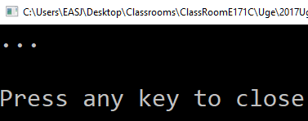
Animal
public void Sound()
{
Console.WriteLine("…");
}
Animal a = new Animal(…);
a.Sound();

Slide 23
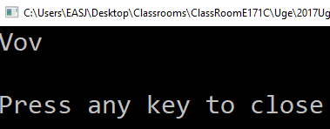
Dog
public void Sound()
{
Console.WriteLine("Vov");
}
Dog d = new Dog(…);
d.Sound();

Slide 24

Animal
Animal a = new Dog(…);
a.Sound();
Dog

Slide 25
Animal
public virtual void Sound()
{
Console.WriteLine("…");
}
public override void Sound()
{
Console.WriteLine("Vov");
}
Dog

Slide 26
Animal
Animal a = new Dog(…);
a.Sound();
Dog
Polymorphic behavior

Slide 27

Animal a = new Dog(…);
a.Sound();
Animal
Dog
Vov
a
Sound(); // Dog version

Slide 28

List<Animal> zoo = new List<Animal>();
zoo.Add(new Cat(…));
zoo.Add(new Dog(…));
zoo.Add(new Cat(…));
foreach (Animal a in zoo)
{
a.Sound();
}
List<Animal>
Cat
Miav
Dog
Vov
Cat
Miav

Slide 29
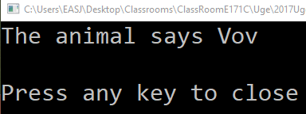
Animal
public virtual void Sound()
{
Console.Write("The animal says ");
}
public override void Sound()
{
base.Sound();
Console.WriteLine("Vov");
}
Dog

Slide 30
OOP.2.2

Slide 31
Animal
public void Sound()
{
Console.WriteLine("…");
}

Slide 32
Animal
public abstract void Sound();

Slide 33
Animal
public abstract void Sound();
public abstract class Animal
{
//…
}
protected Animal(…)
{
//…
}

Slide 34
Animal
public abstract void Sound();
Animal a = new Dog(…);
Animal a = new Animal(…);

Slide 35
 | Base class implementation? | Override? | Create objects of base class?
virtual | Yes | May | Yes
abstract | No | Must | No

Slide 36
OOP.2.3

Slide 37
public abstract class Animal
{
protected Animal(…)
{
//…
}
public abstract void Sound();
public abstract void Eat(…);
public abstract bool Sleeping { get; }
}

Slide 38
public interface IAnimal
{
void Sound();
void Eat(…);
bool Sleeping { get; }
}

Slide 39
class Dog : IAnimal
{
void Dog(bool canHunt)
{
//…
}
public void Sound()
{
//…
}
//…
}

Slide 40
List<IAnimal> zoo = new List<IAnimal>();
zoo.Add(new Cat(…));
zoo.Add(new Dog(…));
zoo.Add(new Cat(…));
foreach (IAnimal a in zoo)
{
a.Sound();
}
List<IAnimal>
Cat
Miav
Dog
Vov
Cat
Miav

Slide 41
IAnimal
ISaveable
Dog

Slide 42
OOP.2.4

Slide 43
Object
Animal

Slide 44
Object
Equals
GetHashCode
ToString
…
Animal

Slide 45
public override string ToString()
{
return $"{Name} is {Age} years old";
}
foreach (Animal a in zoo)
{
Console.WriteLine(a);
}
Object
Animal

Slide 46
OOP.2.5

