Slide 1
University of Wollongong in Dubai

Slide 2
CSIT242 - Mobile Application Development Android Widgets (progress bar, seek bar, Date and Time Picker Dialogs) Lesson 8 from Android ATC Team. (2021). Android application development (12th ed.). Android ATC.
Dr. Haitham Yaish

Slide 3
Document Change Control
Version | Author | Date | Change Description
1.0 | Dr. Haitham Yaish | Winter 2025 | Defined the first version

Slide 4
Outline
Progress Bar (ProgressBar)
Seek Bar (SeekBar)
Date and Time Picker Dialogs

Slide 5
Progress Bar (ProgressBar)

Slide 6
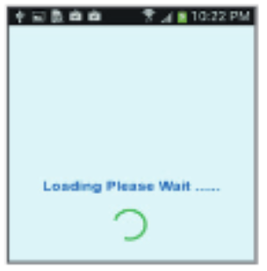
ProgressBar
The ProgressBar is a class used as a user interface element to indicate the progress of an operation.
The Progress bar class supports two modes of progress: determinate and indeterminate.
Indeterminate Progress
It is used when you do not know how much time an operation will take.
The Indeterminate mode shows a cyclic animation without indicating the amount of progress made

Slide 7
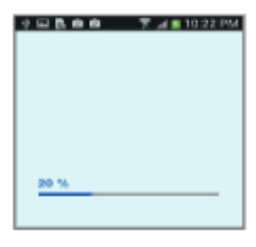
ProgressBar
Determinate Progress (Horizontal)
The determinate mode of the progress bar is used when you want to show how much progress has been made.
For example, the percent remaining of a file being retrieved, the amount records in a batch written to database, or the remaining percent of an audio file that is playing.

Slide 8
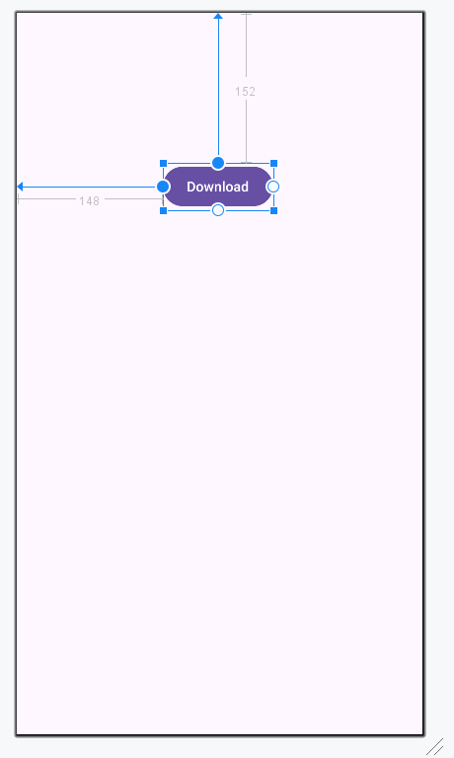
ProgressBar
Example:
Open the activity_main.xml in Design mode and Delete the “Hello World!” TextView.
Add a button to the activity, and set its text attribute value to: Download.
Set the button Id attribute value to: downloadBtn

Slide 9
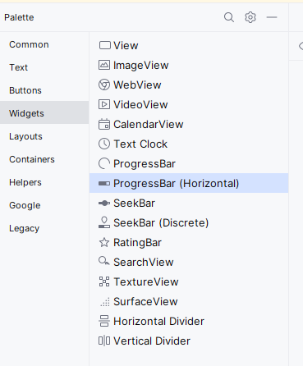
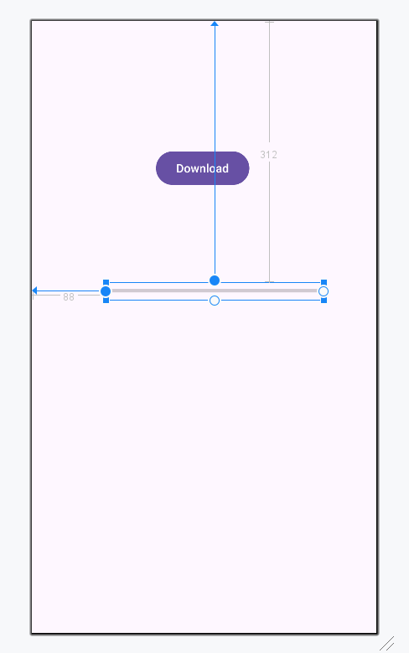
ProgressBar
Example:
From the Palette panel (Widgets) drag a “ProgressBar (Horizontal)” and drop into your activity.
Set the attribute values of the ProgressBar as illustrated in the following figure:

Slide 10
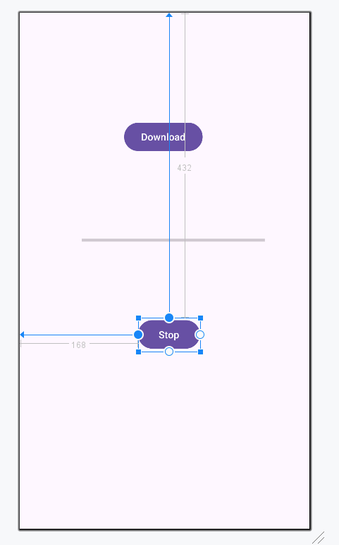
ProgressBar
Example:
Add a button to the activity, and set its text attribute value to: Stop.
Set the button Id attribute value to: stopBtn.
Note: The full code of activity_main.xml file is provided in the slide note of this slide.
Notes:
<?xml version="1.0" encoding="utf-8"?> <androidx.constraintlayout.widget.ConstraintLayout xmlns:android="http://schemas.android.com/apk/res/android" xmlns:app="http://schemas.android.com/apk/res-auto" xmlns:tools="http://schemas.android.com/tools" android:id="@+id/main" android:layout_width="match_parent" android:layout_height="match_parent" tools:context=".MainActivity"> <Button android:id="@+id/downloadBtn" android:layout_width="wrap_content" android:layout_height="wrap_content" android:layout_marginStart="148dp" android:layout_marginTop="152dp" android:text="Download" app:layout_constraintStart_toStartOf="parent" app:layout_constraintTop_toTopOf="parent" /> <ProgressBar android:id="@+id/progressBar" style="?android:attr/progressBarStyleHorizontal" android:layout_width="260dp" android:layout_height="21dp" android:layout_marginStart="88dp" android:layout_marginTop="312dp" android:max="100" app:layout_constraintStart_toStartOf="parent" app:layout_constraintTop_toTopOf="parent" /> <Button android:id="@+id/stopBtn" android:layout_width="wrap_content" android:layout_height="wrap_content" android:layout_marginStart="168dp" android:layout_marginTop="432dp" android:text="Stop" app:layout_constraintStart_toStartOf="parent" app:layout_constraintTop_toTopOf="parent" /> </androidx.constraintlayout.widget.ConstraintLayout>

Slide 11
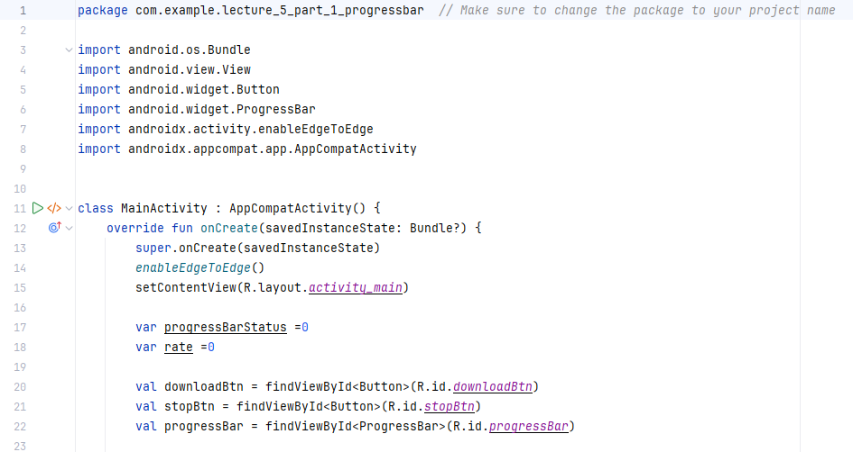
ProgressBar
Example:
Add this code to the MainActivity file. You can find it in the slide note.
Add a variable “progressBarStatus =0” which represents the download process from 0% to 100%, where the starting value is “0”.
Add variable “rate =0” which represents the filling process of the progress bar.
Notes:
package com.example.lecture_5_part_1_progressbar // Make sure to change the package to your project name import android.os.Bundle import android.view.View import android.widget.Button import android.widget.ProgressBar import androidx.activity.enableEdgeToEdge import androidx.appcompat.app.AppCompatActivity class MainActivity : AppCompatActivity() { override fun onCreate(savedInstanceState: Bundle?) { super.onCreate(savedInstanceState) enableEdgeToEdge() setContentView(R.layout.activity_main) var progressBarStatus =0 var rate =0 val downloadBtn = findViewById<Button>(R.id.downloadBtn) val stopBtn = findViewById<Button>(R.id.stopBtn) val progressBar = findViewById<ProgressBar>(R.id.progressBar) downloadBtn.setOnClickListener(){ view -> Thread(Runnable { while (progressBarStatus < 100) { try { rate += 10 Thread.sleep(500) }catch (e: InterruptedException) { e.printStackTrace() } progressBarStatus = rate progressBar.progress = progressBarStatus } progressBar.setVisibility(ProgressBar.INVISIBLE) }).start() } stopBtn.setOnClickListener(){ progressBar.setVisibility(View.GONE) } } }

Slide 12
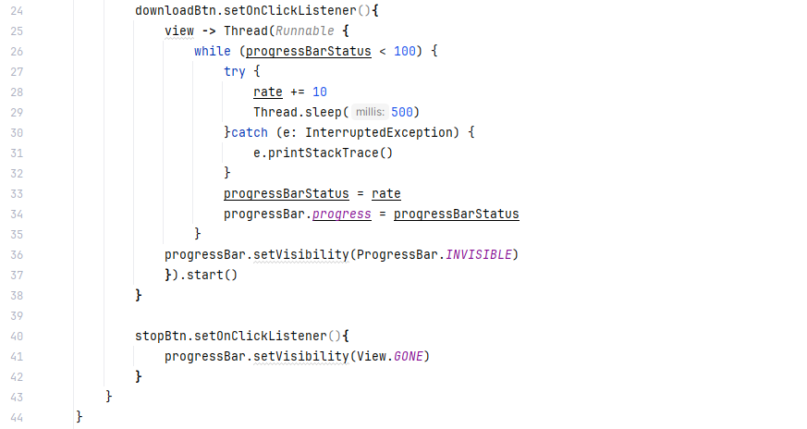
ProgressBar
Example:
Add this code to the MainActivity file. You can find it in the slide note.
This code of the while loop which displays the changes in the progress bar every 500 milliseconds.
This code will hide your progress bar when you tap the Stop button.
Notes:
package com.example.lecture_5_part_1_progressbar // Make sure to change the package to your project name import android.os.Bundle import android.view.View import android.widget.Button import android.widget.ProgressBar import androidx.activity.enableEdgeToEdge import androidx.appcompat.app.AppCompatActivity class MainActivity : AppCompatActivity() { override fun onCreate(savedInstanceState: Bundle?) { super.onCreate(savedInstanceState) enableEdgeToEdge() setContentView(R.layout.activity_main) var progressBarStatus =0 var rate =0 val downloadBtn = findViewById<Button>(R.id.downloadBtn) val stopBtn = findViewById<Button>(R.id.stopBtn) val progressBar = findViewById<ProgressBar>(R.id.progressBar) downloadBtn.setOnClickListener(){ view -> Thread(Runnable { while (progressBarStatus < 100) { try { rate += 10 Thread.sleep(500) }catch (e: InterruptedException) { e.printStackTrace() } progressBarStatus = rate progressBar.progress = progressBarStatus } progressBar.setVisibility(ProgressBar.INVISIBLE) }).start() } stopBtn.setOnClickListener(){ progressBar.setVisibility(View.GONE) } } }

Slide 13
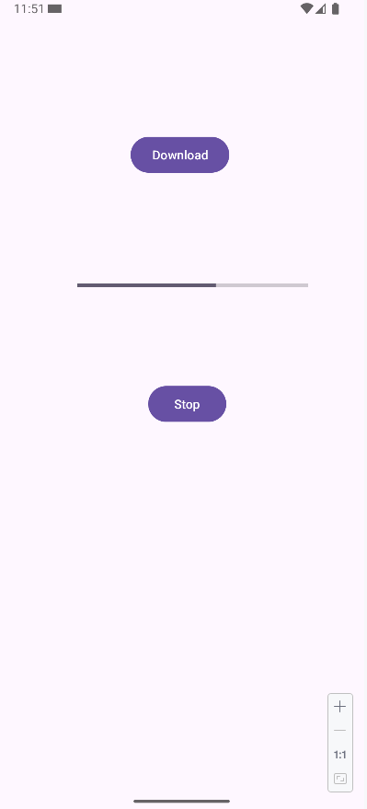
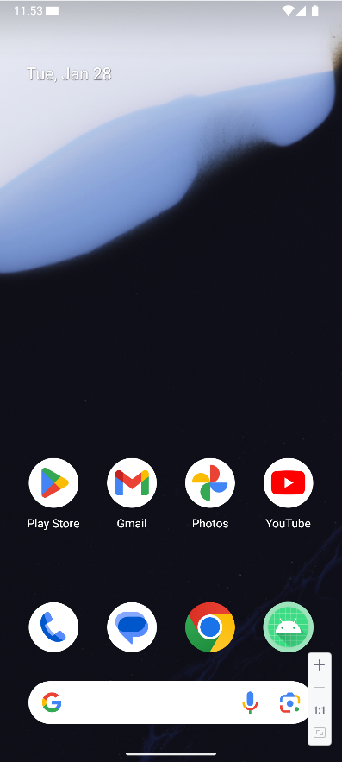
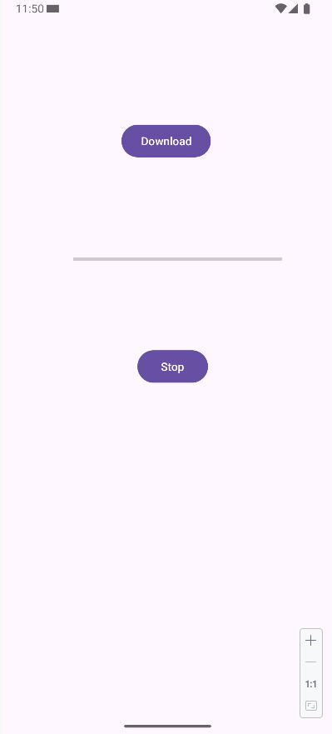
ProgressBar
Example:
Execute the application using the emulator.
The progressbar stopped and terminated
The progressbar is working
You can click the Stop button to stop the progressbar
Start the progressbar

Slide 14
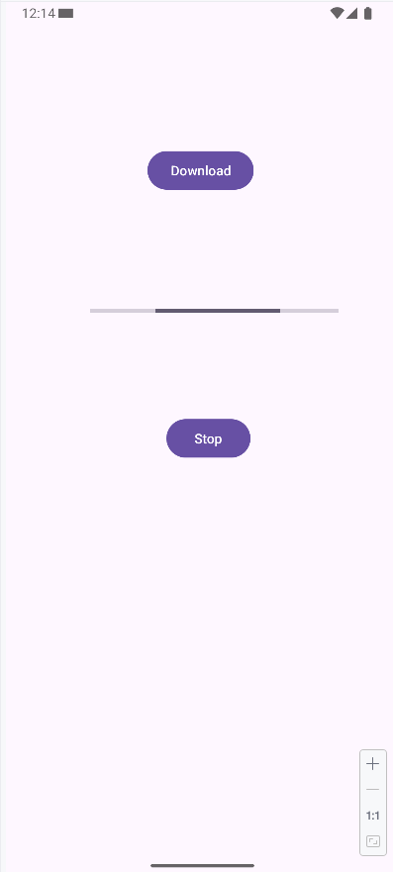
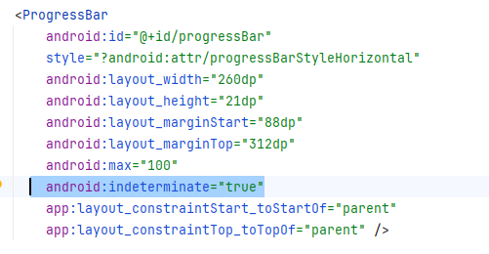
ProgressBar
Example:
Change this progress bar to an indeterminate progress bar, you can open the activity_main.xml in Code mode and add the following XML attribute: android:indeterminate=”true” to the ProgressBar tag as illustrated in the following XML code.
Note: The full code of activity_main.xml file is provided in the slide note of this slide.
Notes:
<?xml version="1.0" encoding="utf-8"?> <androidx.constraintlayout.widget.ConstraintLayout xmlns:android="http://schemas.android.com/apk/res/android" xmlns:app="http://schemas.android.com/apk/res-auto" xmlns:tools="http://schemas.android.com/tools" android:id="@+id/main" android:layout_width="match_parent" android:layout_height="match_parent" tools:context=".MainActivity"> <Button android:id="@+id/downloadBtn" android:layout_width="wrap_content" android:layout_height="wrap_content" android:layout_marginStart="148dp" android:layout_marginTop="152dp" android:text="Download" app:layout_constraintStart_toStartOf="parent" app:layout_constraintTop_toTopOf="parent" /> <ProgressBar android:id="@+id/progressBar" style="?android:attr/progressBarStyleHorizontal" android:layout_width="260dp" android:layout_height="21dp" android:layout_marginStart="88dp" android:layout_marginTop="312dp" android:max="100" android:indeterminate="true" app:layout_constraintStart_toStartOf="parent" app:layout_constraintTop_toTopOf="parent" /> <Button android:id="@+id/stopBtn" android:layout_width="wrap_content" android:layout_height="wrap_content" android:layout_marginStart="168dp" android:layout_marginTop="432dp" android:text="Stop" app:layout_constraintStart_toStartOf="parent" app:layout_constraintTop_toTopOf="parent" /> </androidx.constraintlayout.widget.ConstraintLayout>

Slide 15
Seek Bar (SeekBar)

Slide 16
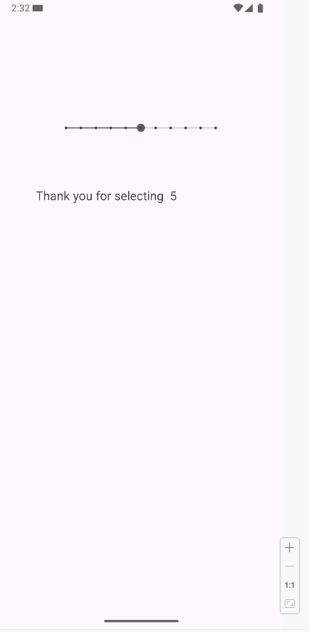
SeekBar
A SeekBar is an extension of the ProgressBar with a draggable thumb.
The app user can touch the thumb and drag it left or right to set the current progress level or he/she can use the arrow keys.
Placing focusable widgets to the left or right of a SeekBar is discourage.

Slide 17
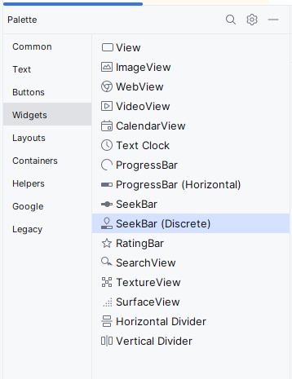
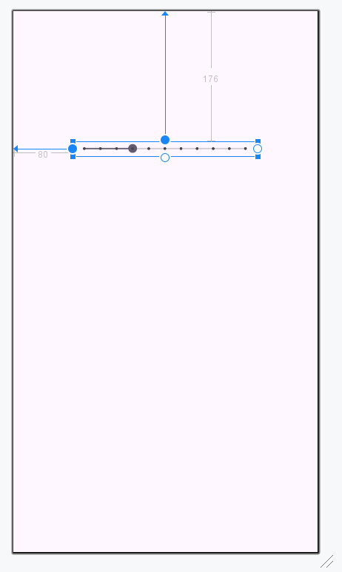
SeekBar
Example:
Create a new project.
Open the activity_main.xml in Design mode and Delete the “Hello World!” TextView.
From the Palette panel (Widgets) drag a SeekBar widget and drop into your activity.
Set the SeekBar constraints and configure its attributes values as follows:

Slide 18
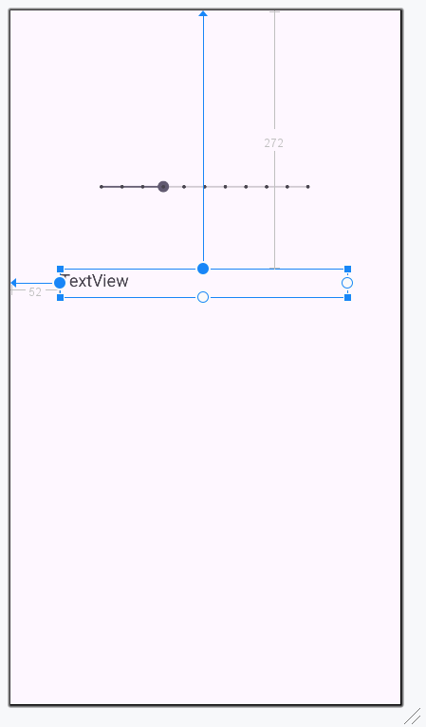
SeekBar
Example:
Add a TextView widget to your activity which will be used later to display the SeekBar values.
Set its constraints and change the TextView widget attributes as follows:
Note: The full code of activity_main.xml file is provided in the slide note of this slide.
Notes:
<?xml version="1.0" encoding="utf-8"?> <androidx.constraintlayout.widget.ConstraintLayout xmlns:android="http://schemas.android.com/apk/res/android" xmlns:app="http://schemas.android.com/apk/res-auto" xmlns:tools="http://schemas.android.com/tools" android:id="@+id/main" android:layout_width="match_parent" android:layout_height="match_parent" tools:context=".MainActivity"> <SeekBar android:id="@+id/mySeekBar" style="@style/Widget.AppCompat.SeekBar.Discrete" android:layout_width="250dp" android:layout_height="20dp" android:layout_marginStart="80dp" android:layout_marginTop="176dp" android:max="10" android:progress="3" app:layout_constraintStart_toStartOf="parent" app:layout_constraintTop_toTopOf="parent" /> <TextView android:id="@+id/seekBarResult" android:layout_width="303dp" android:layout_height="30dp" android:layout_marginStart="52dp" android:layout_marginTop="272dp" android:text="TextView" android:textSize="18sp" app:layout_constraintStart_toStartOf="parent" app:layout_constraintTop_toTopOf="parent" /> </androidx.constraintlayout.widget.ConstraintLayout>

Slide 19
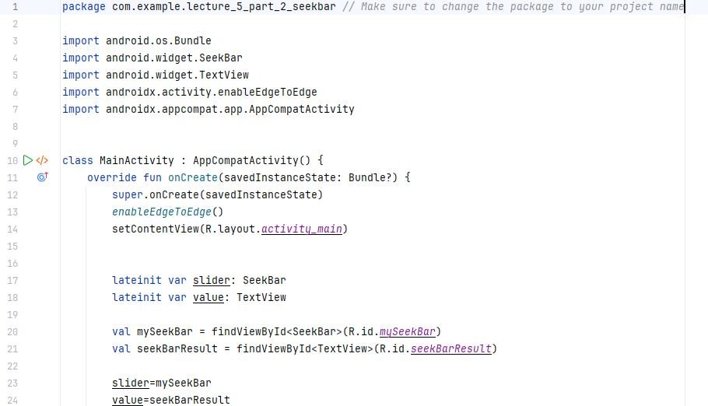
SeekBar
Example:
Add this code to the MainActivity file. You can find it in the slide note.
In Android Studio (Kotlin development), lateinit is a keyword used to declare late-initialized properties. It allows you to define a non-nullable variable without initializing it immediately.
Notes:
package com.example.lecture_5_part_2_seekbar // Make sure to change the package to your project name import android.os.Bundle import android.widget.SeekBar import android.widget.TextView import androidx.activity.enableEdgeToEdge import androidx.appcompat.app.AppCompatActivity class MainActivity : AppCompatActivity() { override fun onCreate(savedInstanceState: Bundle?) { super.onCreate(savedInstanceState) enableEdgeToEdge() setContentView(R.layout.activity_main) lateinit var slider: SeekBar lateinit var value: TextView val mySeekBar = findViewById<SeekBar>(R.id.mySeekBar) val seekBarResult = findViewById<TextView>(R.id.seekBarResult) slider=mySeekBar value=seekBarResult slider.setOnSeekBarChangeListener(object :SeekBar.OnSeekBarChangeListener{ override fun onProgressChanged(seekBar: SeekBar?, progress: Int, fromUser: Boolean) { value.text=progress.toString() } override fun onStartTrackingTouch(seekBar: SeekBar?) { value.text="Tracking Started ......" + slider.progress } override fun onStopTrackingTouch(seekBar: SeekBar?) { value.text="Thank you for selecting " + slider.progress } }) } }

Slide 20
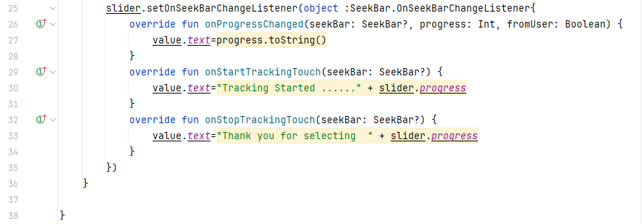
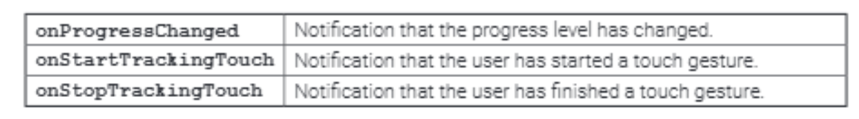
SeekBar
Example:
Add this code to the MainActivity file. You can find it in the slide note.
Notes:
package com.example.lecture_5_part_2_seekbar // Make sure to change the package to your project name import android.os.Bundle import android.widget.SeekBar import android.widget.TextView import androidx.activity.enableEdgeToEdge import androidx.appcompat.app.AppCompatActivity class MainActivity : AppCompatActivity() { override fun onCreate(savedInstanceState: Bundle?) { super.onCreate(savedInstanceState) enableEdgeToEdge() setContentView(R.layout.activity_main) lateinit var slider: SeekBar lateinit var value: TextView val mySeekBar = findViewById<SeekBar>(R.id.mySeekBar) val seekBarResult = findViewById<TextView>(R.id.seekBarResult) slider=mySeekBar value=seekBarResult slider.setOnSeekBarChangeListener(object :SeekBar.OnSeekBarChangeListener{ override fun onProgressChanged(seekBar: SeekBar?, progress: Int, fromUser: Boolean) { value.text=progress.toString() } override fun onStartTrackingTouch(seekBar: SeekBar?) { value.text="Tracking Started ......" + slider.progress } override fun onStopTrackingTouch(seekBar: SeekBar?) { value.text="Thank you for selecting " + slider.progress } }) } }

Slide 21
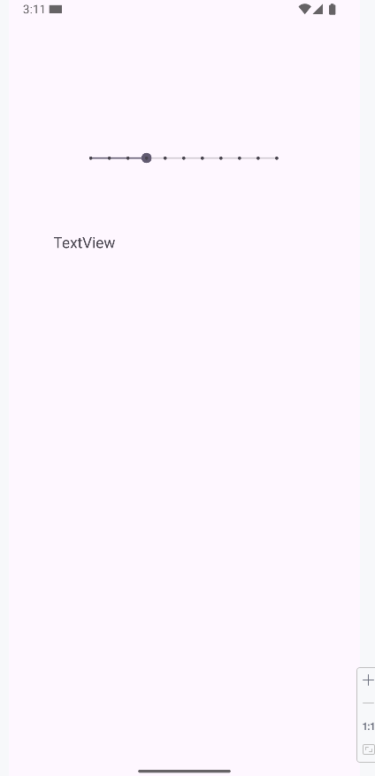
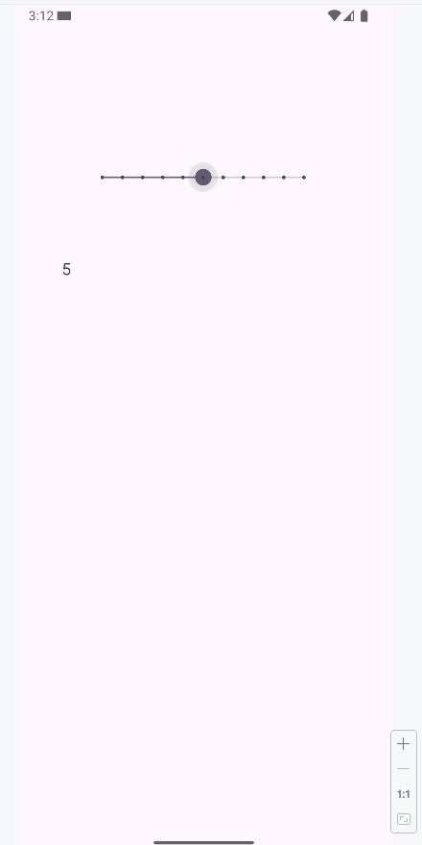
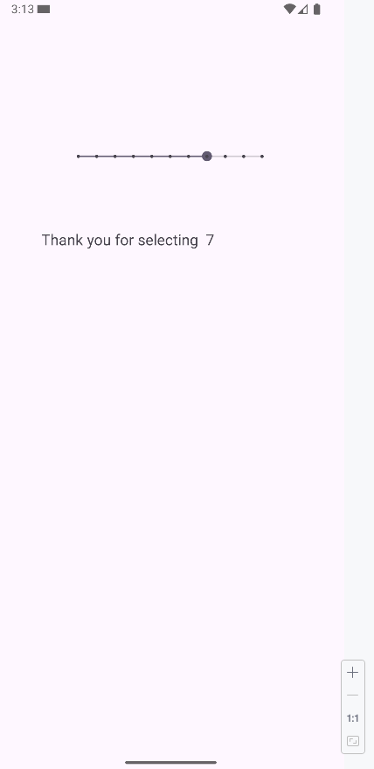
SeekBar
Example:
Execute the application using the emulator.
Once stop changing the SeekBar
Initial State
Once changing the SeekBar

Slide 22
Date and Time Picker Dialogs

Slide 23
Date and Time Picker Dialogs
Android provides controls for the user to pick a time or pick a date as ready-to-use dialogs.
Each picker provides controls for selecting each part of the time (hour, minute, AM/PM) or date (month, day, year).
Using these pickers helps ensure that your users can pick a time or date that is valid, formatted correctly, and adjusted to the user’s location.

Slide 24
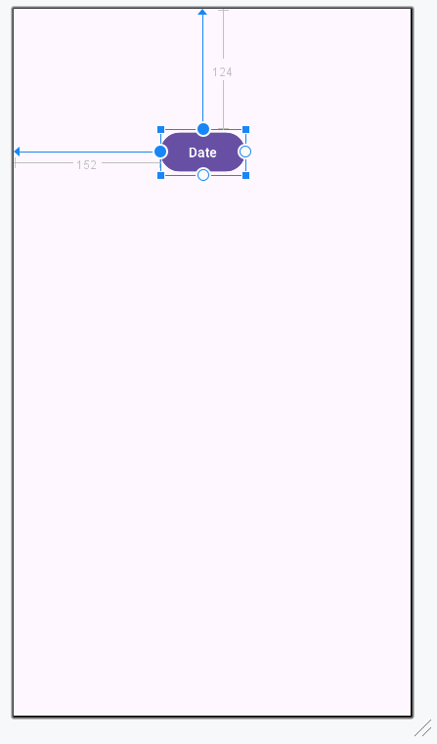
Creating a Date Picker
Example:
Create a new project.
Open the activity_main.xml in Design mode and Delete the “Hello World!” TextView.
Add a button to the activity, and set its text attribute value to: Date.
Set the button Id attribute value to: dateBtn

Slide 25
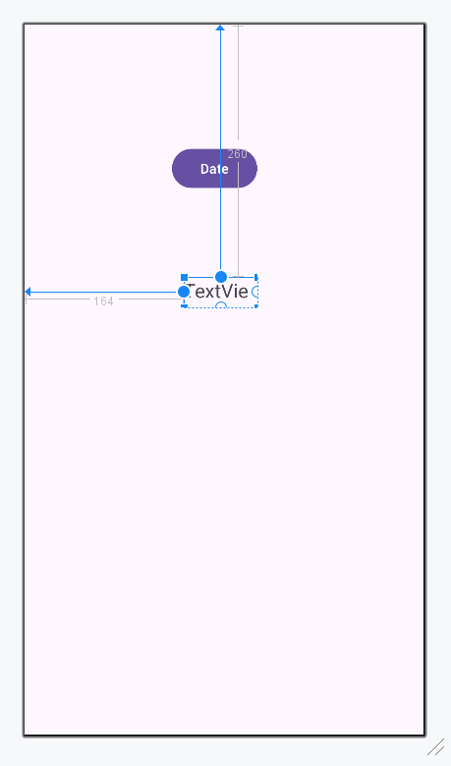
Creating a Date Picker
Example:
Add a TextView widget to the activity_main.xml file.
Set its constraints, and then configure its attribute values as follows:
Note: The full code of activity_main.xml file is provided in the slide note of this slide.
Notes:
<?xml version="1.0" encoding="utf-8"?> <androidx.constraintlayout.widget.ConstraintLayout xmlns:android="http://schemas.android.com/apk/res/android" xmlns:app="http://schemas.android.com/apk/res-auto" xmlns:tools="http://schemas.android.com/tools" android:id="@+id/main" android:layout_width="match_parent" android:layout_height="match_parent" tools:context=".MainActivity"> <Button android:id="@+id/dateBtn" android:layout_width="wrap_content" android:layout_height="wrap_content" android:layout_marginStart="152dp" android:layout_marginTop="124dp" android:text="Date" app:layout_constraintStart_toStartOf="parent" app:layout_constraintTop_toTopOf="parent" /> <TextView android:id="@+id/dateText" android:layout_width="155dp" android:layout_height="38dp" android:layout_marginStart="152dp" android:layout_marginTop="256dp" android:text="TextView" android:textSize="20sp" app:layout_constraintStart_toStartOf="parent" app:layout_constraintTop_toTopOf="parent" /> </androidx.constraintlayout.widget.ConstraintLayout>

Slide 26
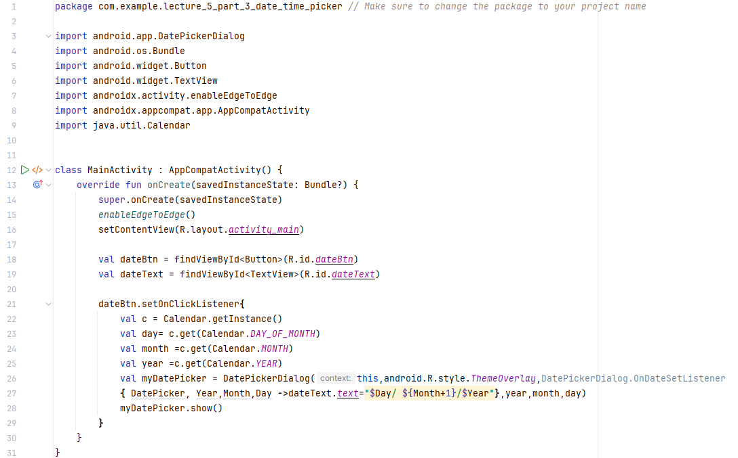
Creating a Date Picker
Example:
Add this code to the MainActivity file. You can find it in the slide note.
The date format
Notes:
package com.example.lecture_5_part_3_date_time_picker // Make sure to change the package to your project name import android.app.DatePickerDialog import android.os.Bundle import android.widget.Button import android.widget.TextView import androidx.activity.enableEdgeToEdge import androidx.appcompat.app.AppCompatActivity import java.util.Calendar class MainActivity : AppCompatActivity() { override fun onCreate(savedInstanceState: Bundle?) { super.onCreate(savedInstanceState) enableEdgeToEdge() setContentView(R.layout.activity_main) val dateBtn = findViewById<Button>(R.id.dateBtn) val dateText = findViewById<TextView>(R.id.dateText) dateBtn.setOnClickListener{ val c = Calendar.getInstance() val day= c.get(Calendar.DAY_OF_MONTH) val month =c.get(Calendar.MONTH) val year =c.get(Calendar.YEAR) val myDatePicker = DatePickerDialog(this,android.R.style.ThemeOverlay,DatePickerDialog.OnDateSetListener { DatePicker, Year,Month,Day ->dateText.text="$Day/ ${Month+1}/$Year"},year,month,day) myDatePicker.show() } } }

Slide 27
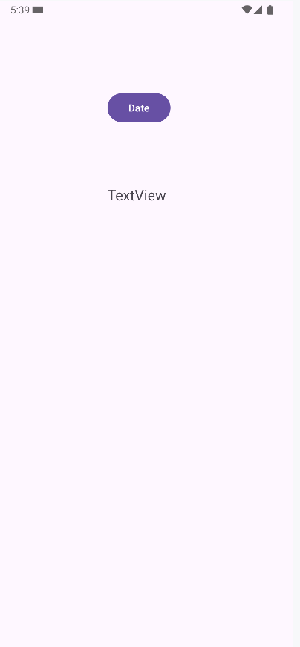
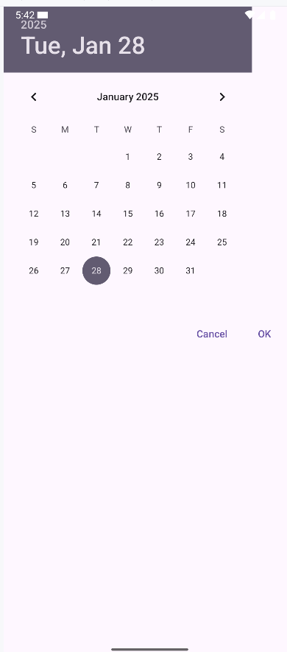
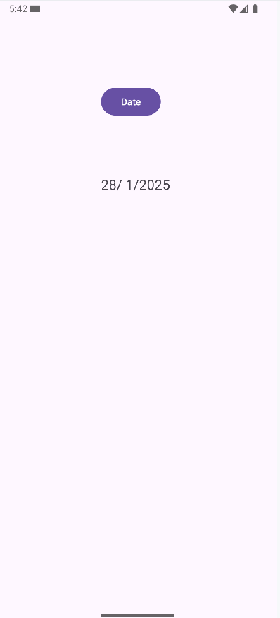
Creating a Date Picker
Example: Execute the application using the emulator.
Initial State
Displaying the Calendar
Displaying the date into the TextView

Slide 28
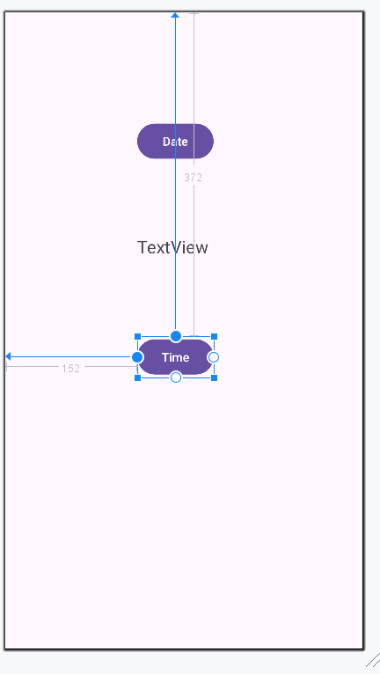
Creating a Time Picker
Example:
Continue using the same project.
Add a button to the activity, and set its text attribute value to: Time.
Set the button Id attribute value to: timeBtn

Slide 29
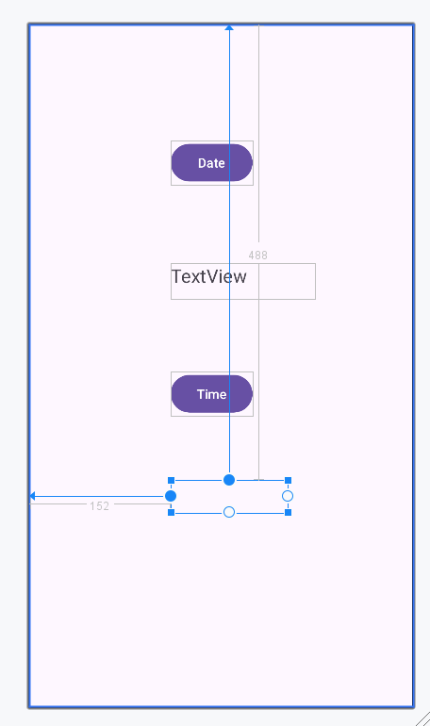
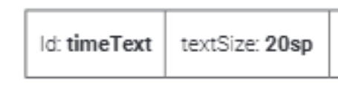
Creating a Time Picker
Example:
Add a TextView widget to your activity_main.xml file. Set its constraints and then configure its attributes values as follows:
Delete the text attribute value of this “TextView” or set it with a blank value. The activity will look like the figure
Note: The full code of activity_main.xml file is provided in the slide note of this slide.
Notes:
<?xml version="1.0" encoding="utf-8"?> <androidx.constraintlayout.widget.ConstraintLayout xmlns:android="http://schemas.android.com/apk/res/android" xmlns:app="http://schemas.android.com/apk/res-auto" xmlns:tools="http://schemas.android.com/tools" android:id="@+id/main" android:layout_width="match_parent" android:layout_height="match_parent" tools:context=".MainActivity"> <Button android:id="@+id/dateBtn" android:layout_width="wrap_content" android:layout_height="wrap_content" android:layout_marginStart="152dp" android:layout_marginTop="124dp" android:text="Date" app:layout_constraintStart_toStartOf="parent" app:layout_constraintTop_toTopOf="parent" /> <TextView android:id="@+id/dateText" android:layout_width="155dp" android:layout_height="38dp" android:layout_marginStart="152dp" android:layout_marginTop="256dp" android:text="TextView" android:textSize="20sp" app:layout_constraintStart_toStartOf="parent" app:layout_constraintTop_toTopOf="parent" /> <Button android:id="@+id/timeBtn" android:layout_width="wrap_content" android:layout_height="wrap_content" android:layout_marginStart="152dp" android:layout_marginTop="372dp" android:text="Time" app:layout_constraintStart_toStartOf="parent" app:layout_constraintTop_toTopOf="parent" /> <TextView android:id="@+id/timeText" android:layout_width="125dp" android:layout_height="35dp" android:layout_marginStart="152dp" android:layout_marginTop="488dp" android:textSize="20sp" app:layout_constraintStart_toStartOf="parent" app:layout_constraintTop_toTopOf="parent" /> </androidx.constraintlayout.widget.ConstraintLayout>

Slide 30
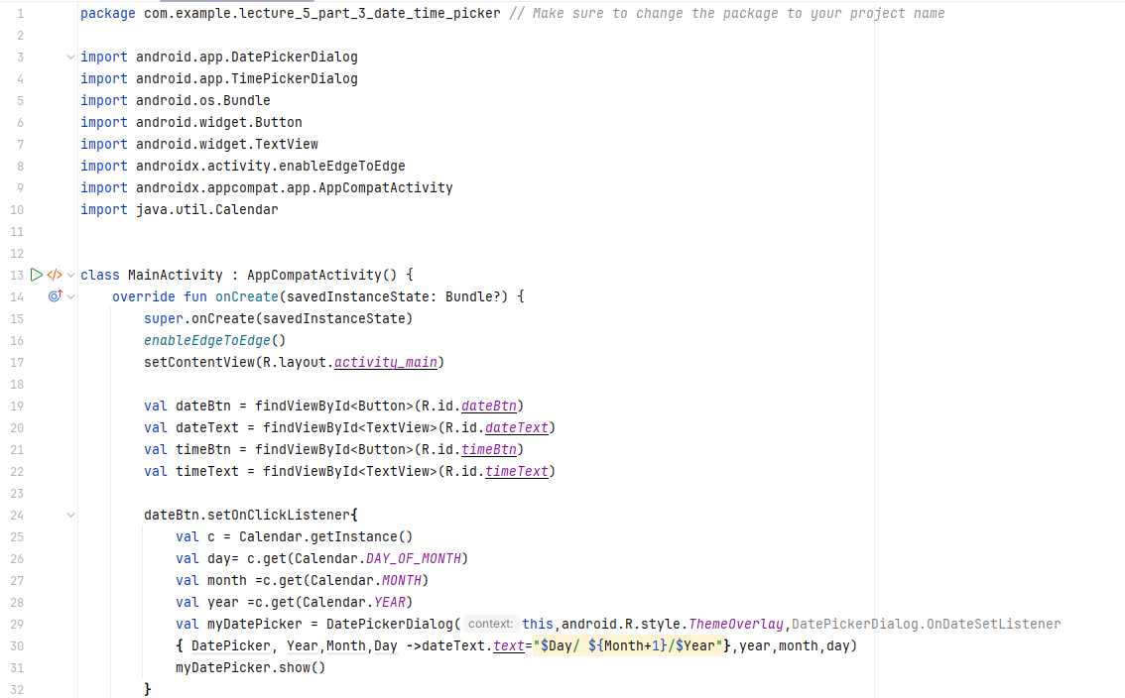
Creating a Time Picker
Example:
Add this code to the MainActivity file. You can find it in the slide note.
Notes:
package com.example.lecture_5_part_3_date_time_picker // Make sure to change the package to your project name import android.app.DatePickerDialog import android.app.TimePickerDialog import android.os.Bundle import android.widget.Button import android.widget.TextView import androidx.activity.enableEdgeToEdge import androidx.appcompat.app.AppCompatActivity import java.util.Calendar class MainActivity : AppCompatActivity() { override fun onCreate(savedInstanceState: Bundle?) { super.onCreate(savedInstanceState) enableEdgeToEdge() setContentView(R.layout.activity_main) val dateBtn = findViewById<Button>(R.id.dateBtn) val dateText = findViewById<TextView>(R.id.dateText) val timeBtn = findViewById<Button>(R.id.timeBtn) val timeText = findViewById<TextView>(R.id.timeText) dateBtn.setOnClickListener{ val c = Calendar.getInstance() val day= c.get(Calendar.DAY_OF_MONTH) val month =c.get(Calendar.MONTH) val year =c.get(Calendar.YEAR) val myDatePicker = DatePickerDialog(this,android.R.style.ThemeOverlay,DatePickerDialog.OnDateSetListener { DatePicker, Year,Month,Day ->dateText.text="$Day/ ${Month+1}/$Year"},year,month,day) myDatePicker.show() } timeBtn.setOnClickListener{ val c = Calendar.getInstance() val hour =c.get(Calendar.HOUR_OF_DAY) val minutes =c.get(Calendar.MINUTE) val myTimePicker= TimePickerDialog(this,TimePickerDialog.OnTimeSetListener { TimePicker, hourOfDay, minute -> timeText.text="$hourOfDay : $minute"},hour,minutes,true) myTimePicker.show()} } }

Slide 31
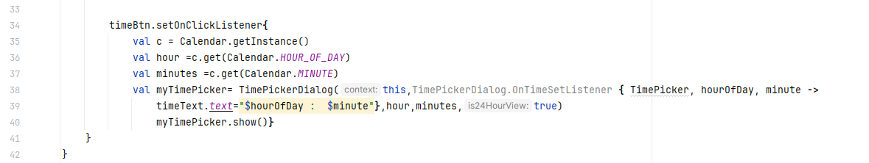
Creating a Time Picker
Example:
Add this code to the MainActivity file. You can find it in the slide note.
The time format
Notes:
package com.example.lecture_5_part_3_date_time_picker // Make sure to change the package to your project name import android.app.DatePickerDialog import android.app.TimePickerDialog import android.os.Bundle import android.widget.Button import android.widget.TextView import androidx.activity.enableEdgeToEdge import androidx.appcompat.app.AppCompatActivity import java.util.Calendar class MainActivity : AppCompatActivity() { override fun onCreate(savedInstanceState: Bundle?) { super.onCreate(savedInstanceState) enableEdgeToEdge() setContentView(R.layout.activity_main) val dateBtn = findViewById<Button>(R.id.dateBtn) val dateText = findViewById<TextView>(R.id.dateText) val timeBtn = findViewById<Button>(R.id.timeBtn) val timeText = findViewById<TextView>(R.id.timeText) dateBtn.setOnClickListener{ val c = Calendar.getInstance() val day= c.get(Calendar.DAY_OF_MONTH) val month =c.get(Calendar.MONTH) val year =c.get(Calendar.YEAR) val myDatePicker = DatePickerDialog(this,android.R.style.ThemeOverlay,DatePickerDialog.OnDateSetListener { DatePicker, Year,Month,Day ->dateText.text="$Day/ ${Month+1}/$Year"},year,month,day) myDatePicker.show() } timeBtn.setOnClickListener{ val c = Calendar.getInstance() val hour =c.get(Calendar.HOUR_OF_DAY) val minutes =c.get(Calendar.MINUTE) val myTimePicker= TimePickerDialog(this,TimePickerDialog.OnTimeSetListener { TimePicker, hourOfDay, minute -> timeText.text="$hourOfDay : $minute"},hour,minutes,true) myTimePicker.show()} } }

Slide 32
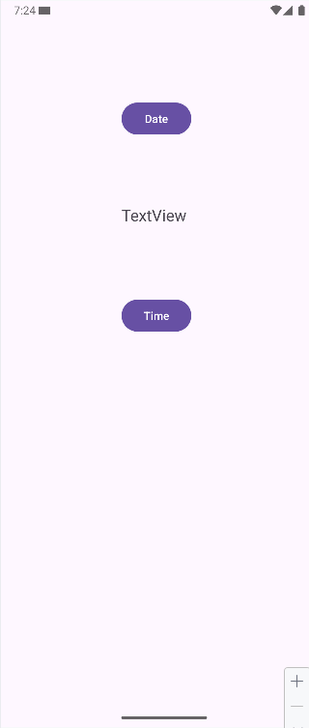
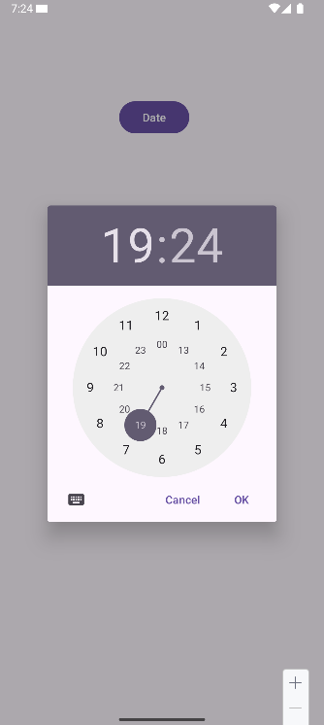
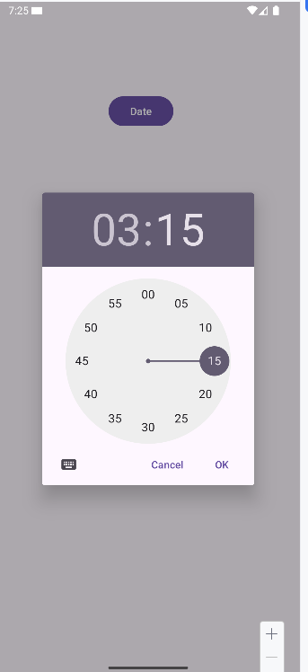
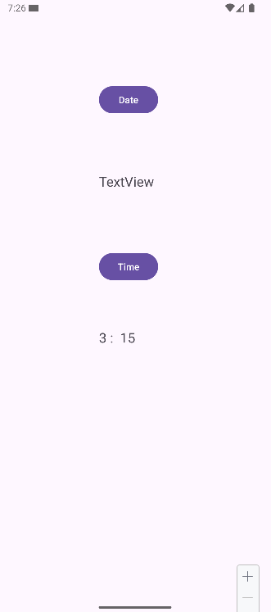
Creating a Time Picker
Example: Execute the application using the emulator.
Initial State
After pressing the Time Button
After selecting the hour and minutes
After pressing the Ok button

Slide 33
References
Android ATC Team. (2021). Android application development (12th ed.). Android ATC.

Slide 34
THANK YOU

Slide 35
Notes:
lecture_5_part_1_ProgressBar
lecture_5_part_2_SeekBar
lecture_5_part_3_Date_Time_Picker

