Slide 1
University of Wollongong in Dubai

Slide 2
CSIT242 - Mobile Application Development Introduction to the subject
Dr. Haitham Yaish

Slide 3
Outline
• Introduction to Kotlin
• Android Framework and Android Studio

Slide 4
Introduction to Kotlin

Slide 5
Introduction
What is Kotlin?
Kotlin is a modern, trending programming language that was released in 2016 by JetBrains.
Kotlin is easy to learn, especially if you already know Java (it is 100% compatible with Java). Which means that Java code (and libraries) can be used in Kotlin programs).
Kotlin is used for:
Mobile applications
Web development
Server side applications
Data science
And much, much more!

Slide 6
Introduction
Why Use Kotlin?
Kotlin is fully compatible with Java
Kotlin works on different platforms (Windows, Mac, Linux, Raspberry Pi, etc.)
Kotlin is concise and safe
Kotlin is easy to learn, especially if you already know Java
Kotlin is free to use
Big community/support

Slide 7
Kotlin – Main Function
To run a Kotlin program using the main function, you need to define a main entry point. This is similar to other programming languages like Java or C. The main function is the starting point of the Kotlin application.
Simplified version:
fun main() {
println("Hello CSIT242");
}
Version with command-line argumetns:
fun main(args: Array<String>) {
println("Hello CSIT242");
}
Output: Hello CSIT242

Slide 8
Kotlin – Comments
Single-line Comments //
e.g. // This is a comment
Multi-line Comments /* …. */
e.g. /* The code below will print the words Hello World
to the screen */
println("Hello World")

Slide 9
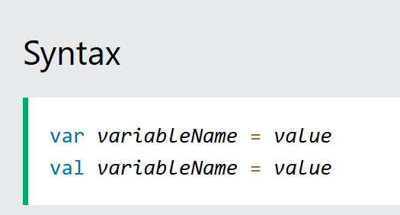
Kotlin – Variables
Variables are containers for storing data values.
To create a variable, use var or val, and assign a value to it with the equal sign (=)
The difference between var and val is that variables declared with the var keyword can be changed/modified, while val variables cannot.

Slide 10
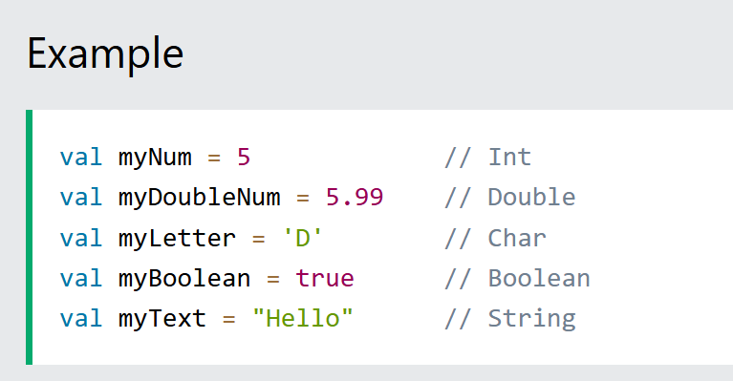

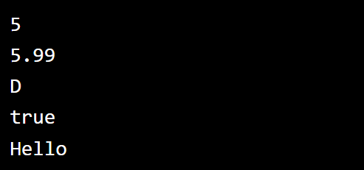
Kotlin – Data Types
In Kotlin, the type of a variable is decided by its value:
Try the code

Slide 11
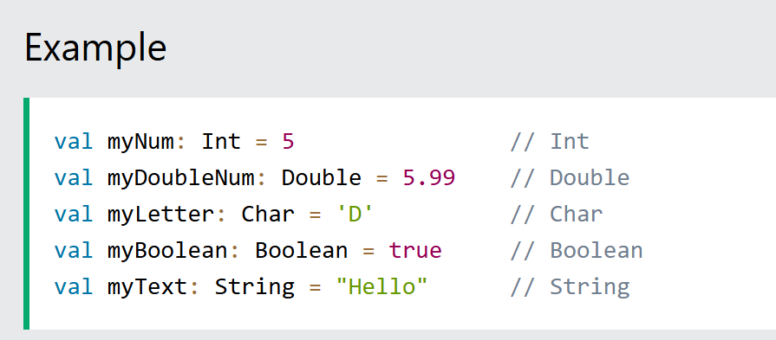
Kotlin – Data Types
It is possible to specify the type if you want:
Try the code

Slide 12
Kotlin – Data Types
Data types are divided into different groups:
Numbers (Byte, Short, Int and Long) .. More Details
Characters
Booleans
Strings
Arrays

Slide 13
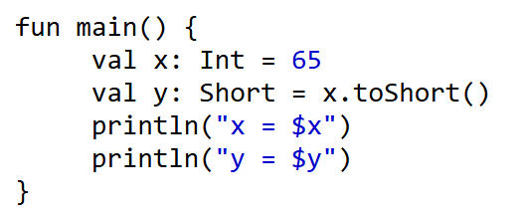
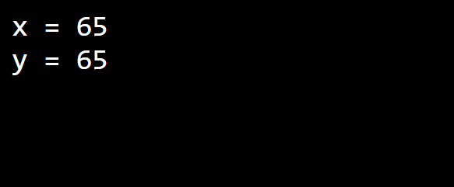
Kotlin – Data type Conversions
In some cases you may need to convert a data type for a variable to another data type such as changing an Integer to a short.
The following is a list of functions in Kotlin used for type conversions:
toByte()
toShort()
toInt()
toLong()
toFloat()
toDouble()
toChar()

Slide 14
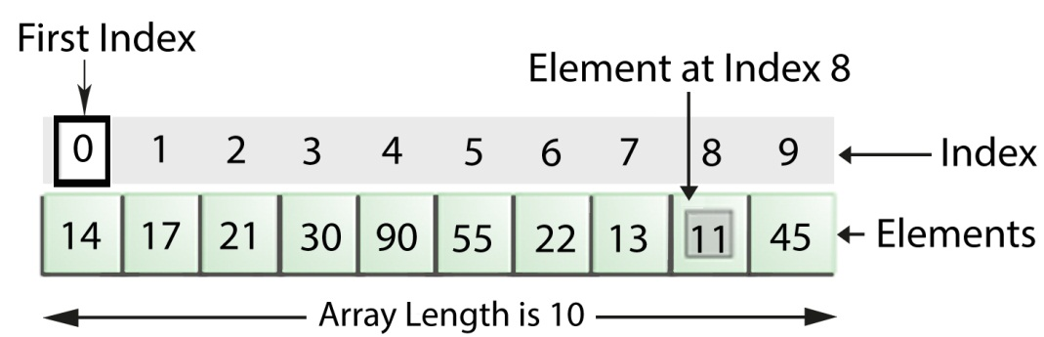
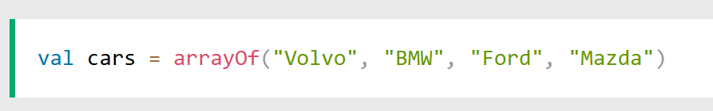
Kotlin – Variables - Arrays
Arrays are used to store multiple values in a single variable, instead of creating separate variables for each value.
To create an array, use the arrayOf() function, and place the values in a comma-separated list inside it.

Slide 15
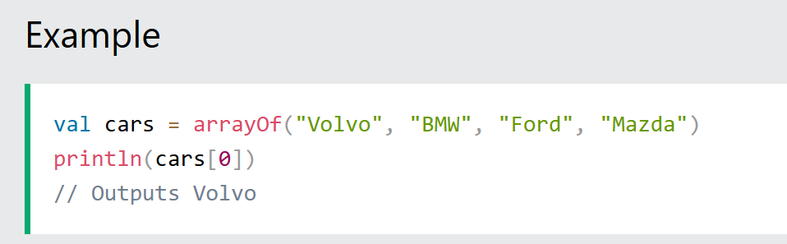
Kotlin – Variables - Arrays
Access the Elements of an Array
You can access an array element by referring to the index number, inside square brackets.

Slide 16
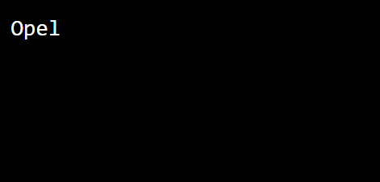
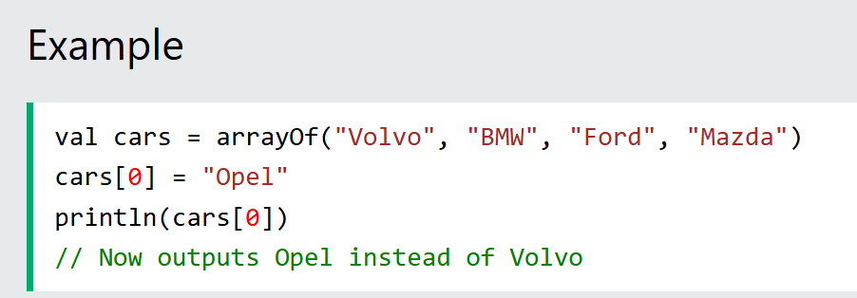
Kotlin – Variables - Arrays
Change an Array Element
To change the value of a specific element, refer to the index number:
Try the code

Slide 17
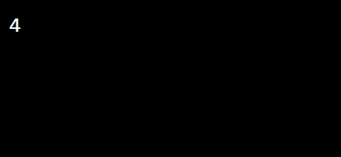
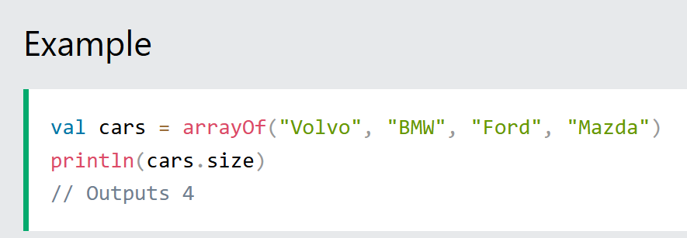
Kotlin – Variables - Arrays
Array Length / Size
To find out how many elements an array have, use the size property:
Try the code

Slide 18
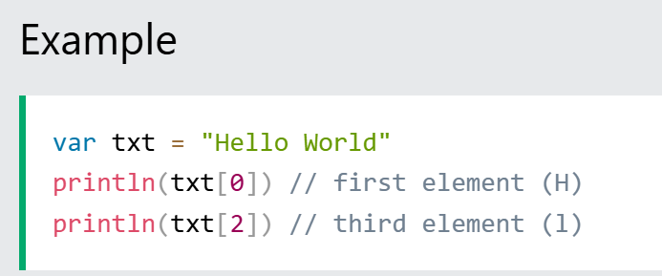
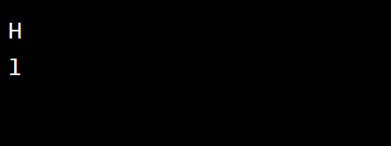
Kotlin – Variables - Strings
Access a String
To access the characters (elements) of a string, you must refer to the index number inside square brackets.
Try the code

Slide 19
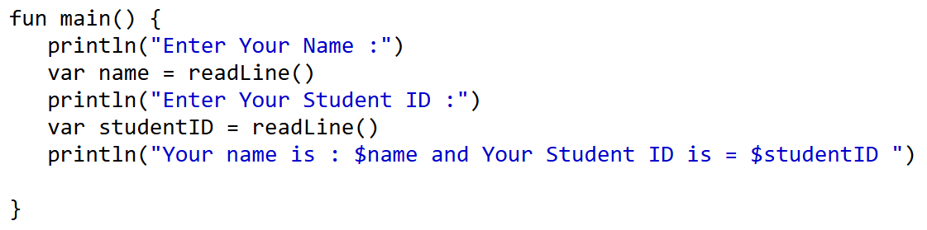
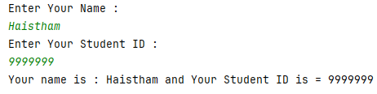
Kotlin – Variables
readLine() function allows the program user to enter string values or intercept keyboard input from the console as shown in following example:

Slide 20
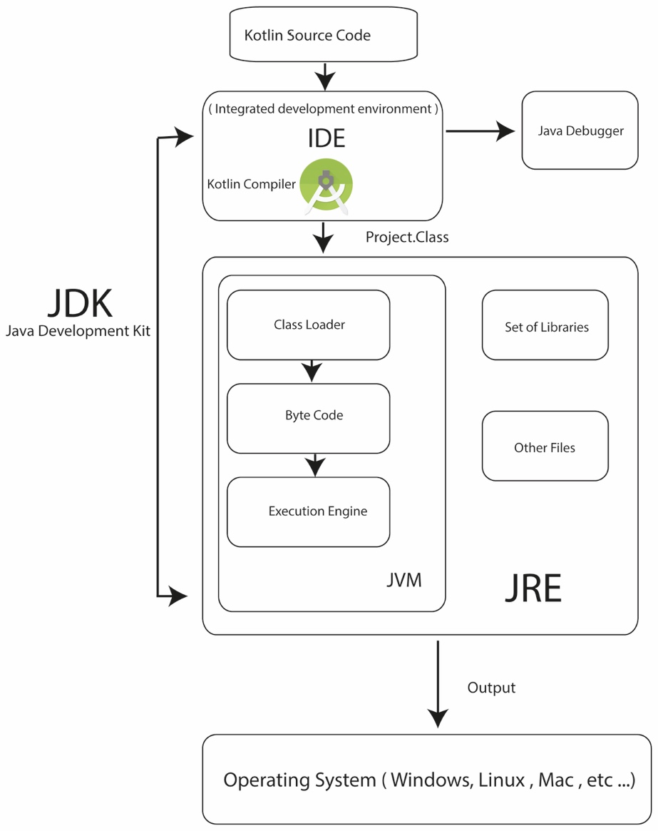
How Kotlin Programs Work?

Slide 21
Android Framework and Android Studio

Slide 22
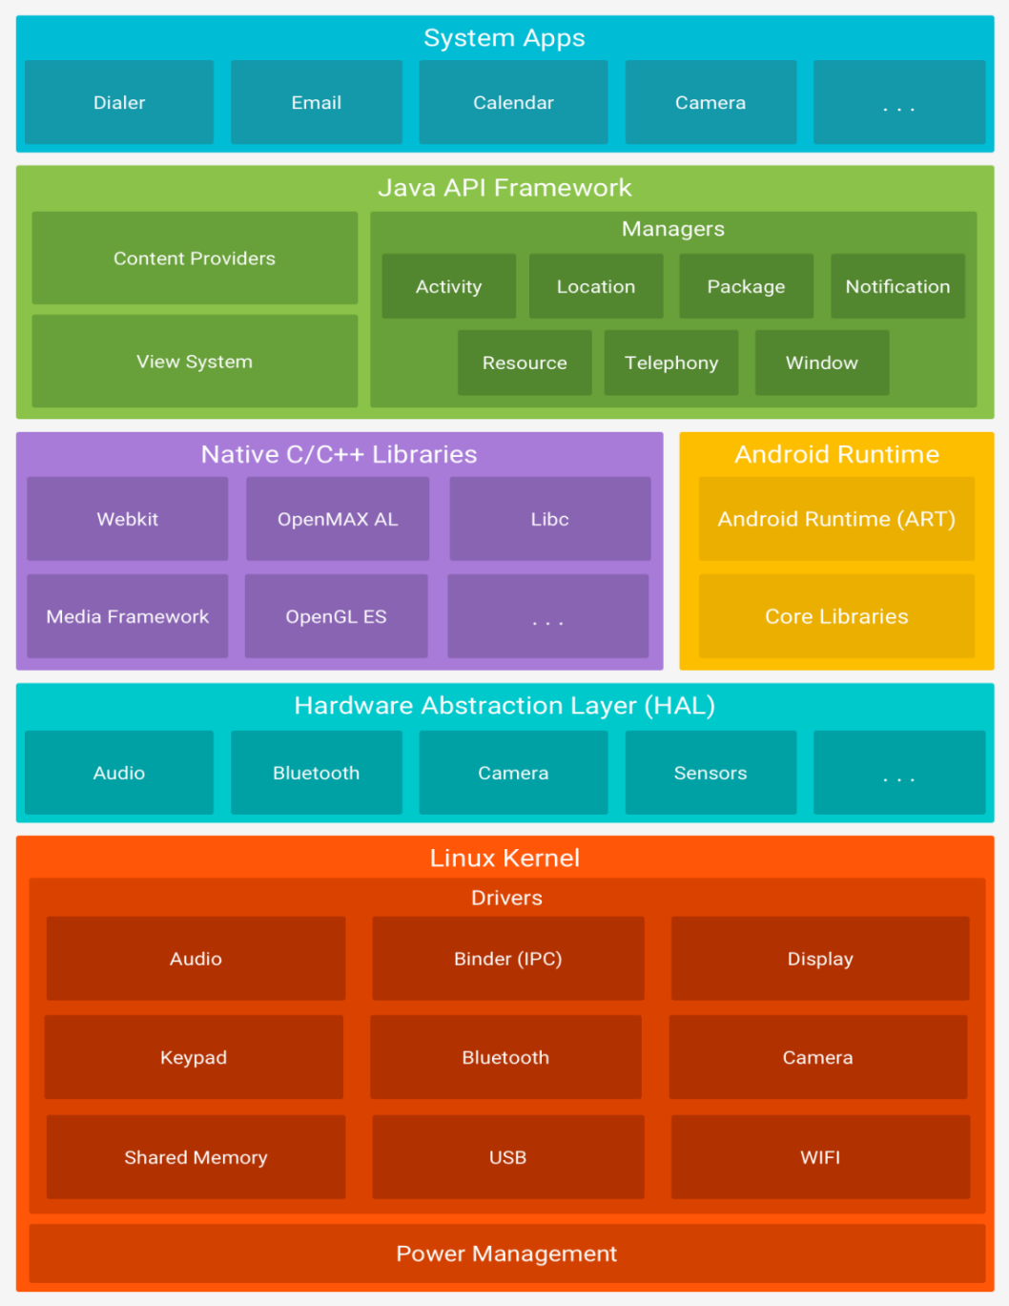
Android Platform Architecture
Android is an open source operating system, Linux-based software stack.
This diagram shows the main components of the Android platform.

Slide 23
Android Platform Architecture
Linux Kernel
The Linux kernel is the foundation of Android platform.
It helps Android in core system services and maintaining functionalities such as threading, low-level memory management, security, process management, networking, and hardware drivers.
The Linux Kernel also acts as an abstraction layer between the hardware and the software stack of the platform.
Hardware Abstraction Layer (HAL)
The Hardware Abstraction Layer (HAL) exposes hardware capabilities of devices to high level Kotlin API framework through standard interfaces.
For each hardware component such as the camera or the Bluetooth, HAL has a library module that implements an interface for that component.
Android Runtime (ART)
Each application runs in its own process and with its own instance of Android runtime on devices.
It was designed based on Java Virtual Machine and specifically for Android running in limited environment, where the limited battery, CPU, memory and data storage are the main concerns.
It reads .dex files whereas JVM (Java Virtual Machine) reads .class files.

Slide 24
Android Platform Architecture
Native C/C++ Libraries
Are used to build core Android system components and services like ART and HAL.
The functionalities of these native libraries are exposed to apps by Java framework APIs provided by Android.
They are used in drawing and manipulating 2D, 3D graphics, media framework processing, supporting fonts, data storage and web browsers.
Java API Framework
The entire feature-set of Android is accessible through APIs written in Java language.
System Apps
Android comes with many core pre-installed apps for emails, messaging, calendars, etc...
These system apps can be invoked from your own apps. For example, if you want to provide the messaging functionality to an application, you do not need to build that functionality yourself. You can invoke the system app for messaging from within your app to send messages

Slide 25
Components of Android Applications
Following are some of the components you will use often in any Android applications development. You will learn more about them with practical examples later in this subject.
Activities
Activity is the application’s user interface. Every screen in an application extends the activity class. The user interface for each activity is made up of several Views.
Services
A service is the invisible part of the application that runs in the background. Service doesn’t have any user interface of its own. Services are used to perform continuous processing in the background even when activities are not visible or active.
Content Providers Content providers are used to manage and share application databases. They are the preferred way of sharing data between applications. You may also write your content provider to share your application’s data with other apps.
For example, Android exposes some databases such as contacts and call logs using content providers.

Slide 26
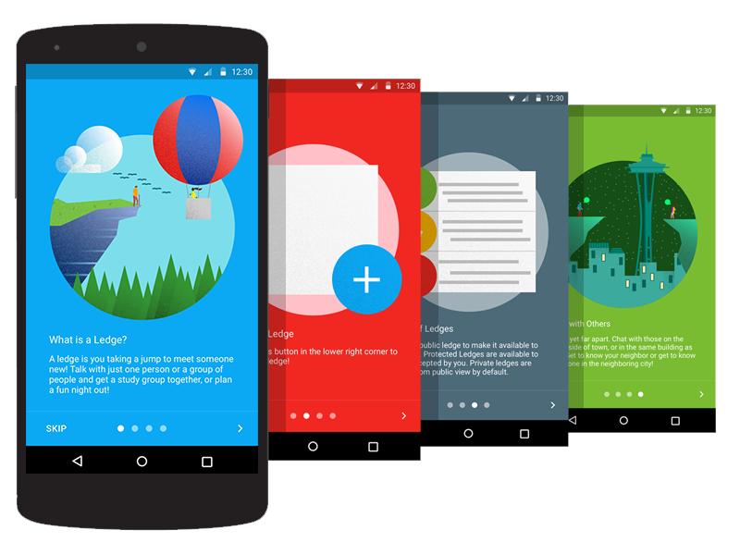
Components of Android Applications
Broadcast Receivers
Broadcast Receivers are used to receive messages broadcasted by Intents. When a broadcast receiver is added to your application for any specific Intent, then whenever that Intent occurs, your application will receive a message which has data from that Intent.
Views
Views are objects that are drawn on the screen.
A view is the parent class of all activity user interface components. Each activity is made up of a set of views grouped together within a layout.

Slide 27
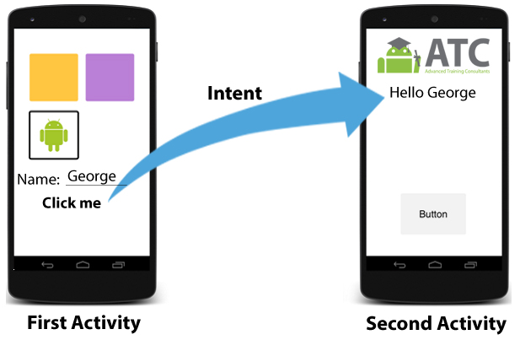
Components of Android Applications
Intents
Intents are objects used to send messages across the whole Android system. They are used to broadcast messages, start an activity, or start a service, including an intention to have an action performed. It’s the system’s duty to interpret the message and determine the target(s) that will perform the actions required.

Slide 28
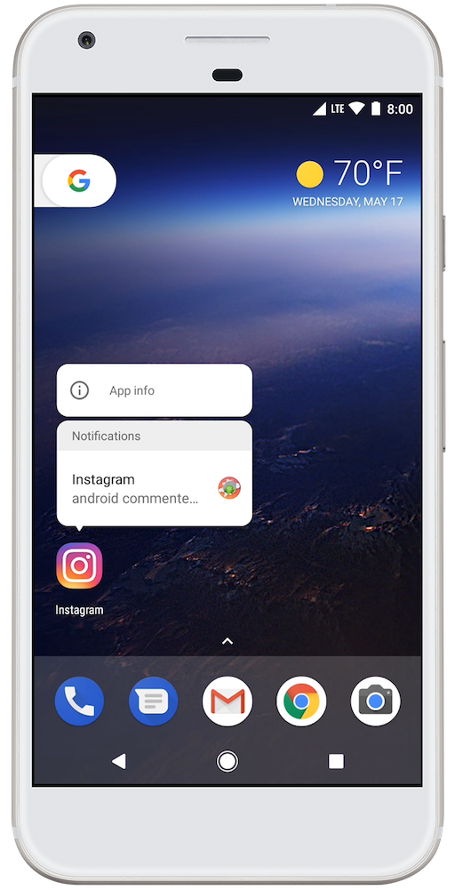
Components of Android Applications
Notifications
Notifications are used to alert the user of an event without stealing the focus or interrupting the user’s ongoing interaction or activity.
That's why they appear on the status bar at the top of the screen.
They are popup style messages from other applications such as Instagram or Facebook.
Examples of notifications can be notifications of received SMS, missed calls or notifications from any other application installed on the device.

Slide 29
Android Application Development
Android SDK platform
Android SDK platform is a set of libraries and APIs that provide necessary classes, methods and interfaces to develop Android applications and allow you to compile your code.
Integrated Development Environment (IDE)
This is the official IDE for developing Android applications. You will use Android Studio throughout this course.
Android SDK Tools: A software component that includes a complete set of development and debugging tools for Android SDK.
Android SDK build tools: This is the software component that is required to build an Android application code after a developer finishes building the application. The built tools are continuously running during development to facilitate the testing process for the developer.

Slide 30
Android Application Development
In the first tutorial you will learn how to install Android Studio

Slide 31
References
Kotlin Tutorial https://www.w3schools.com/KOTLIN/index.php . Last Accessed 31 December 2024.
Android ATC Team. (2021). Android application development (12th ed.). Android ATC.
Guo, L. (2022). The First Line of Code: Android Programming with Kotlin. Springer Nature.

Slide 32
THANK YOU

